Slide 1
Roots of Equations
inverting functions

Slide 2
The problem
You have some function y of x, y = f(x).
At what value of x is f(x) some value of interest a?
reduces to
At what value of x is f(x) – a = 0?

Slide 3
The solution
If you can solve analytically for x as a function of y, do that.
y = f(x) x = g(y)
Then you get your solution by plug-and-chug in one step.
Otherwise, you have to iterate.

Slide 4
Considerations
Does a solution exist?
Do you know how many?
Do you know about where the solution(s) are? (brackets?)
Can you easily calculate the derivative?
Is the function continuous?
How precise do you need the answer?

Slide 5
Bisection
0

Slide 6
Bisection algorithm
Start with two x values, a and b, such that f(a) and f(b) have opposite signs.
Until satisfied:
Bisect the interval: c = (a+b)/2
Replace the bracket whose f(x) has the same sign as f(c) with c.

Slide 7
Bisection advantages
Rock solid, cannot fail (unless f(x) call fails)
Converges even if f(x) is not continuous over the interval
It’s cheap
Doesn’t require many calls to f(x)
Doesn’t need a derivative

Slide 8
Bisection disadvantages
It’s slow compared to other procedures
Interval must be bracketed

Slide 9
Newton’s method
0

Slide 10
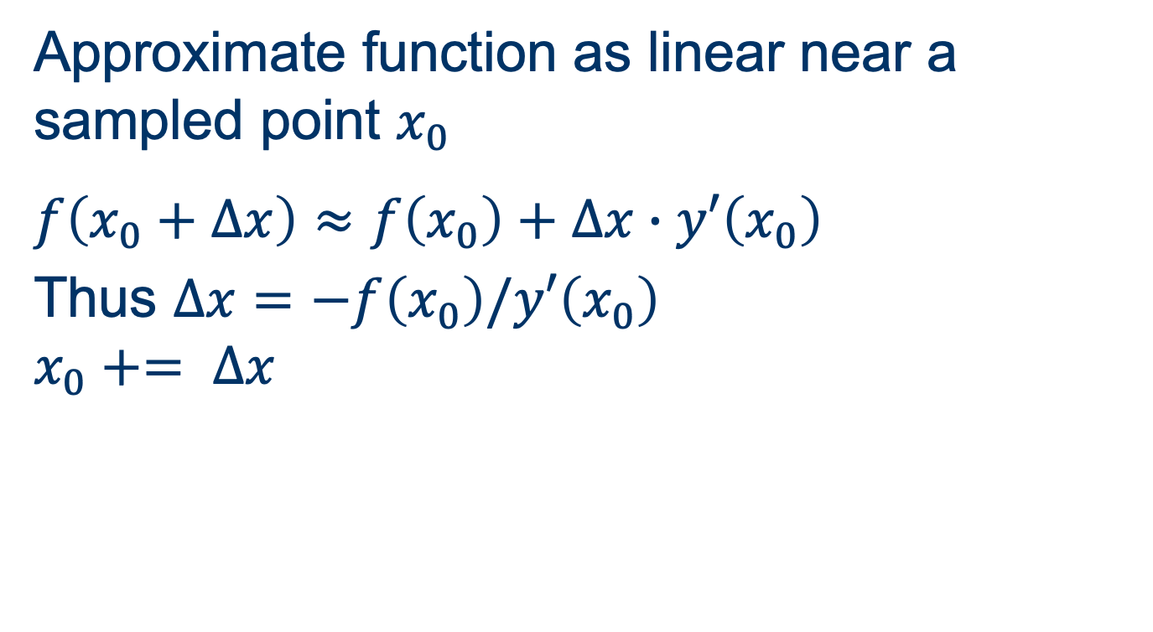
Newton’s method algorithm
Approximate function as linear near a sampled point $x_{0}$
$$f\left(x_{0}+∆x\right)≈f\left(x_{0}\right)+∆x∙y′\left(x_{0}\right)$$
Thus $∆x=−f\left(x_{0}\right)/y′\left(x_{0}\right)$
$$x_{0}+= ∆x$$

Slide 11
Newton’s method advantages
Extremely fast convergence near root
Gives very precise results in a few steps

Slide 12
Newton’s method disadvantages
Requires derivative as well as function evaluation
Not guaranteed to converge
Prone to failure if derivative changes between sampled point and the root

Slide 13
False position
0

Slide 14
False position advantages
Won’t escape brackets
Converges even if f(x) is not continuous
Generally faster than bisection
Does not require derivative
Simple to code

Slide 15
False position disadvantages
Can get stuck with a flat derivative

Slide 16
Secant
0

Slide 17
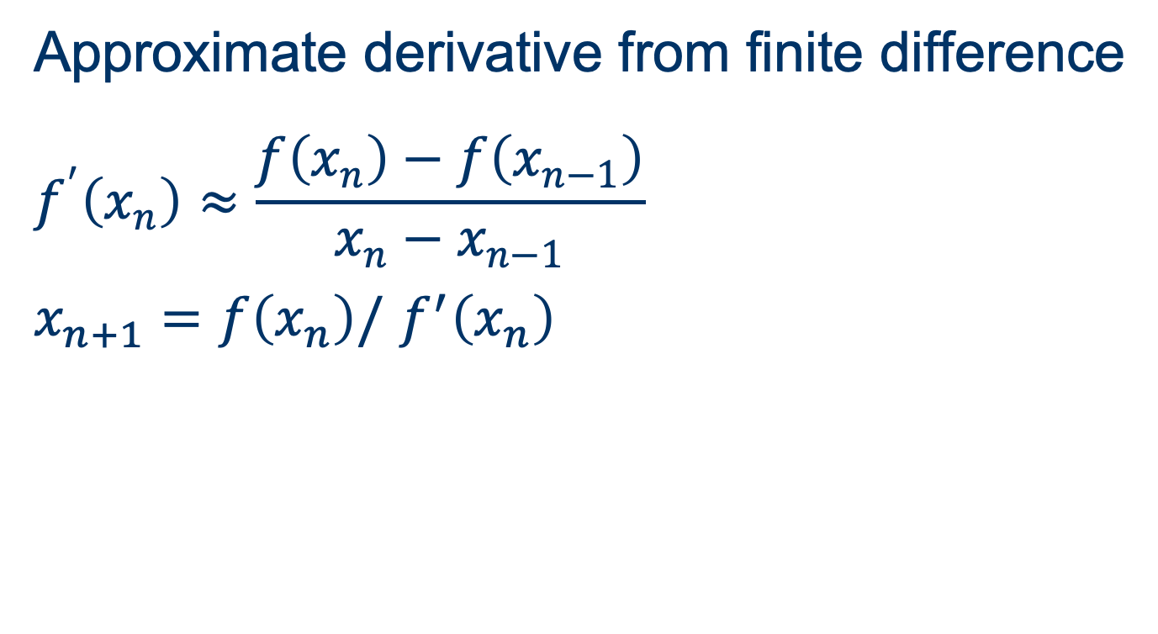
Secant algorithm
Approximate derivative from finite difference
$$f^{′}\left(x_{n}\right)≈\frac{f\left(x_{n}\right)−f\left(x_{n−1}\right)}{x_{n}−x_{n−1}}$$
$x_{n+1}=f\left(x_{n}\right)/$ $f^{′}\left(x_{n}\right)$

Slide 18
Secant method advantages
Does not require bracketing
Fast convergence
Does not require a derivative

Slide 19
Secant method disadvantages
Convergence not guaranteed

Slide 20
Brent’s method
The real workhorse
Used in most “package” root finders

Slide 21
Brent’s method
Begins with root bracketed
Evaluates 3 x values
Estimates root
by inverse quadratic interpolation
or by secant method
or by bisection

Slide 22
Brent’s method advantages
Robust and fast
Does not require derivative
Available in libraries

Slide 23
Brent’s method disadvantages
Under optimal conditions, Newton’s method is faster
More difficult to code

Slide 24
Solvers in Libraries
Library | Methods
scipy.optimize. | brentq, bisect, newton
numpy | roots (for roots of polynomials)

