Slide 1
Ampére’s law
Magnetic fields

Slide 2
B field Origin
Magnetic fields are created by currents
Field winds around the current
Expected correlations:
More current ⇒ greater field
Farther away ⇒ weaker field
Around a current ⇒ along the field

Slide 3
Ampére’s law
Follow a closed path s around a current
Add up overlap between path and field
“Circulation”
B·ds
I
s
s
s

Slide 4
Ampére’s law
∮B·ds = μ₀ I_{encl}
Path integral: around a closed path
I_{encl} = current passing through the loop
μ₀ = magnetic permeability of free space
= 4π ×10^{–7} Wb/(A·m)

Slide 5
Use Ampere’s law
∮B·ds = μ₀ I_{encl}
Find the magnetic field produced:
Infinite straight current
Solenoid
Toroid
Inside a wire of radius R, current density J

Slide 6
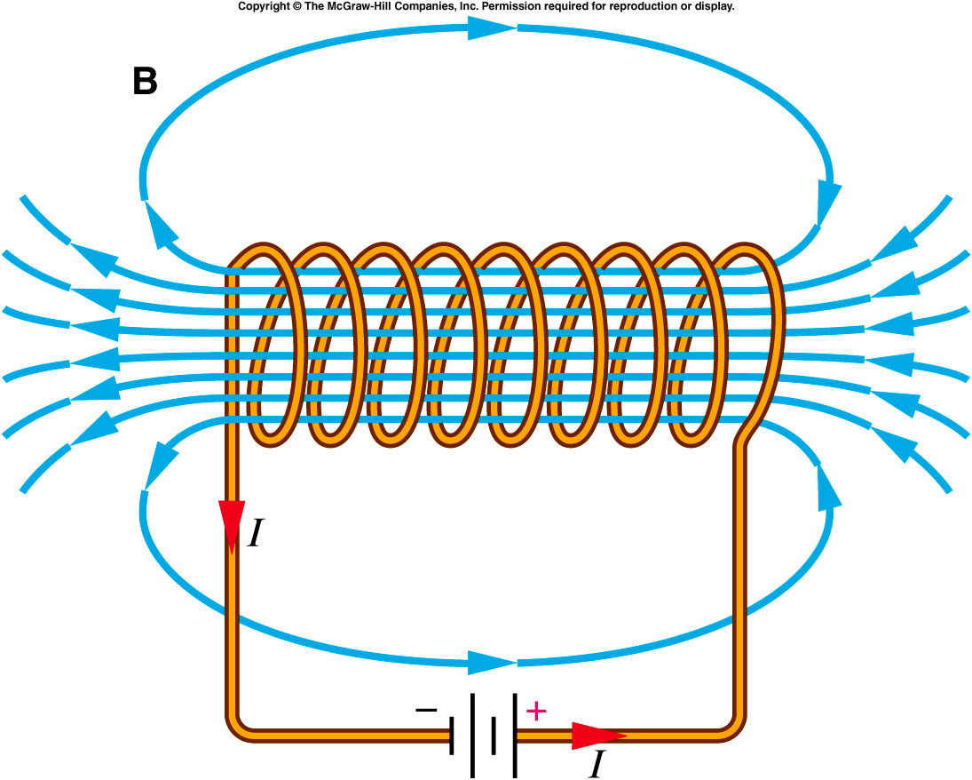
Solenoid
Source: Griffith, The Physics of Everyday Phenomena

Slide 7
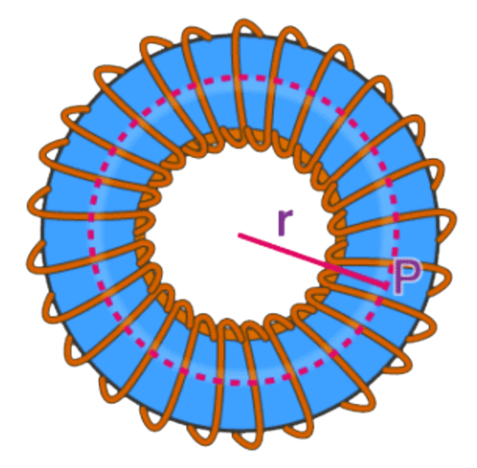
Toroid
Wire wound around a toroidal core
Image: Byju’s

