Slide 1
Voltage
Absolute potential is seldom important
Potential difference is what matters
Voltage ≡ potential difference

Slide 2
Capacitors
A device storing electrical energy

Slide 3
Capacitor
Device storing electric potential energy
Positive charge accumulates in one place, Negative charge accumulates in another
Voltage is proportional to charge separated
V=Q/C

Slide 4
Capacitor
A voltage between connected plates causes charge migration until equilibrium
Charge stored Q = CV
C = capacitance
(property of the device)
Unit = C/V = farad= F
ΔV
– –
– –
– –
–
+ +
+ +
+ +
+
–Q
+Q

Slide 5
Parallel Plate Capacitance
Plate area A, separation d
A
d
Capacitance = Aε₀/d
C²
ε₀ = 8.85×10^{–12}
N m²

Slide 6
Field Around Infinite Plate
With uniform charge density σ = Q/A
σA
1
σ
Φ_{E} =
= E(2A)
, so E =
ε₀
2
ε₀

Slide 7
Infinite ||-Plate capacitor
Individually
Together
–σ
+σ
σ/ε₀
−σ
1/2 σ/ε₀
0
0
+σ
1/2 σ/ε₀

Slide 8
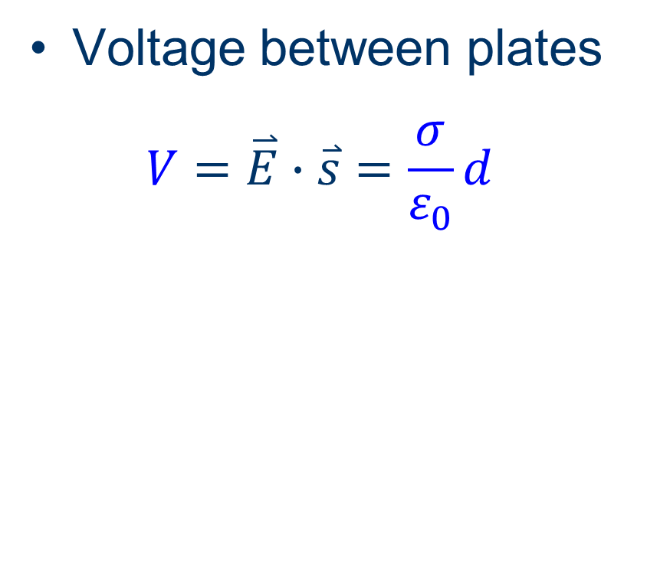
Infinite ||-Plate capacitor
Voltage between plates
$$V=\overset{⃑}{E}∙\overset{⃑}{s}=\frac{σ}{ε_{0}}d$$
+σ
σ/ε₀
−σ
0
0
d

Slide 9
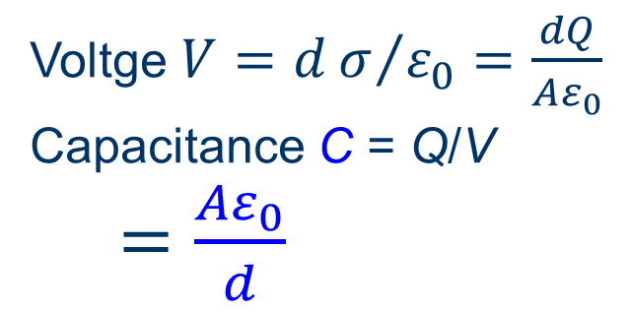
Finite ||-Plate Capacitor
Parallel plates of charge Q, area A, spacing d
Charge density σ = Q/A
+Q
–Q
Fields cancel outside
Fields cancel outside
σ/ε₀
Voltge $V=dσ/{ε_{0}}=\frac{dQ}{Aε_{0}}$
Capacitance C = Q/V
$=\frac{Aε_{0}}{d}$
d
constant!

Slide 10
Parallel Plate Capacitance
Plate area A, plate separation d
σ
Q
Field E =
=
ε₀
Aε₀
Qd
Potential ΔV = Ed =
Aε₀
Q Aε₀
Aε₀
Capacitance Q/ΔV =
=
Qd
d

Slide 11
Circuit Element Symbols
Potential Source
+ –
ΔV
Conductor
Capacitor
or
Resistor

Slide 12
At Equilibrium
Capacitor charges to potential V
Capacitor charge Q = CV
V
+ –
C
+ –
ΔV

Slide 13
Energy in a Capacitor
C = Q/V so V = Q/C
Work to push charge Q dW = VdQ = (Q/C)dQ
V
dQ
slope = 1/C
area = dW
Q

Slide 14
Energy in a Capacitor
Work to charge to Q is area of triangle W = 1/2 Q(Q/C) = 1/2 Q²/C
Work to charge to V W = 1/2 V (CV) = 1/2 C(V)²
V
Q/C
Q
CΔV

Slide 15
Combining Capacitors
Parallel
and
Series

Slide 16
Parallel Components
All have the same potential difference
Capacitances add
(conceptually add A’s)

Slide 17
Series Capacitors
All have the same charge separation
Reciprocals of C are additive
(conceptually add d’s)

Slide 18
Capacitor with a Dielectric
If capacitance without dielectric is C, capacitance with dielectric is κC.
κ = dielectric constant
κ

Slide 19
Dielectric
Insulator
Polarizes in field
Effectively reduces plate separation d
Reduces field between plates
Dielectric constant = relative permittivity ε = κε₀
Capacitance C = Aε/d

Slide 20
Dielectric breakdown
Strong field can separate charges
Ejects electrons from their orbitals
Dielectric becomes a conductor
Damage usually permanent
Limits practical thinness of dielectric layer

Slide 21
Some Dielectrics
Material | κ | Strength (kV/mm)
Air | 1.0006 | 3
Paper | 3.85 | 16
Teflon | 2.1 | 19.7
Mica | 3–6 | 118
TiO₂ | 86–173 | 4
Silica | 4 | 470–670

