Slide 1
Electric Field
Force fields are real
§ 21.4

Slide 2
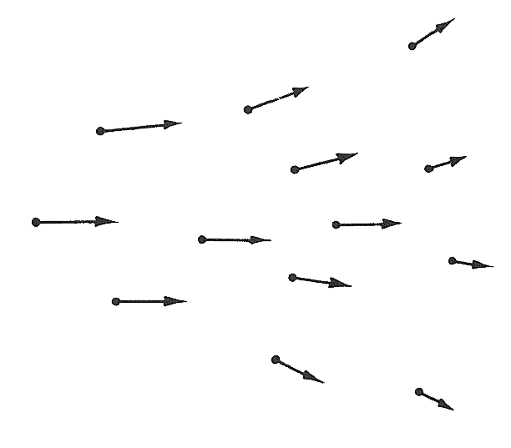
Vector Fields

Slide 3
Outline
What fields are
Formulas for some fields
Visualizing using field lines

Slide 4
Gravitational Field
Permeates space
Created by a mass
Acts on other massive objects: F = mg
Force per unit mass: g = F/m
Unit = N/kg = m/s²

Slide 5
Electric Field
Permeates space
Created by an electric charge
Acts on other charged objects: F = qE
Force per unit charge: E = F/q
Unit = N/C

Slide 6
Fields affect other objects
A charged particle is not affected by its own electric field.
A massive particle is not affected by its own gravitational field.

Slide 7
Electric field
Direction is the direction of the force exerted on a positive charge
Vector arrows point away from positive charges and toward negative charges
Magnitude is the force in N on a +1 C charge

Slide 8
Coulomb’s Law
q₀
r
q
1
qq₀
F =
r
4πε₀
r²
F = force on particle 0 from source
r = vector from source to “test” particle 0
r = unit vector in direction of r

Slide 9
Field at point P
P
r
q
1
q
E =
r
4πε₀
r²

Slide 10
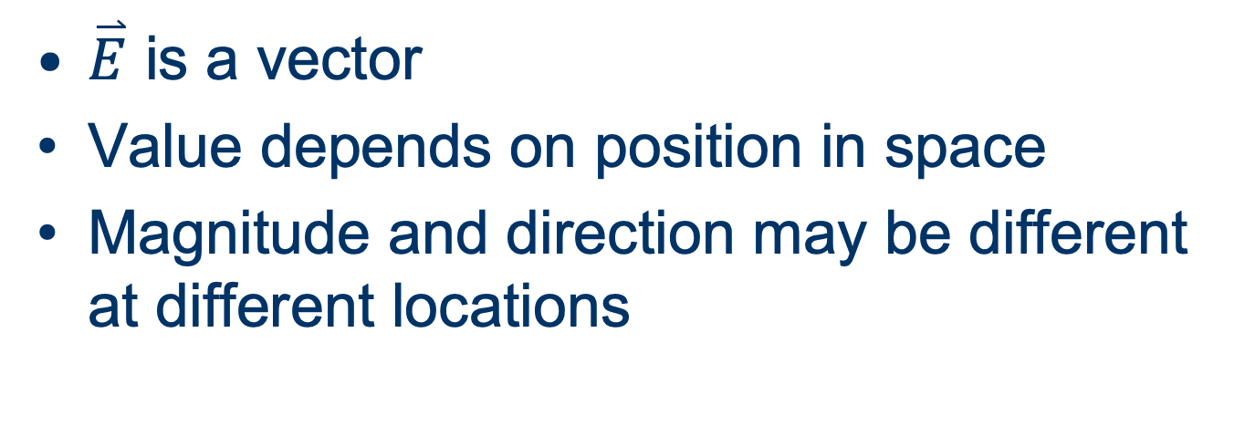
Vector field
$\overset{⃑}{E}$ is a vector
Value depends on position in space
Magnitude and direction may be different at different locations

Slide 11
Field in a conductor
Static field inside a conductor (where charges can move freely) is always zero
Why?

Slide 12
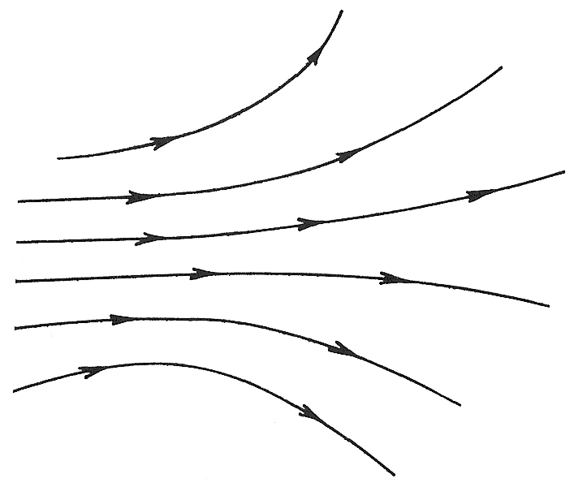
Field Lines

Slide 13
Field lines
Imaginary lines describing a field
“Lines of force”
Show the field throughout space
Directed (explicit or implicit)
Lines do not cross
Start at + charge and end at − charge

Slide 14
Visualizing a Field
Magnitude of the force on a charge is greater where field lines are close together
Direction of the force is tangent to field lines
Force on a positive charge is along field lines
Force on a negative charge is opposite field lines

Slide 15
Question
Particles A–D have the same charge. Which experiences the greatest force from the field? (Green arrows are field lines.)
C
A
B
D

Slide 16
Superposition
Combined field from many point charges is just the (vector) sum of the fields from charges individually

Slide 17
Example
Draw field lines for the electric field about these two particles with opposite charges.
+
–

Slide 18
Group Work
Draw field lines for the electric field about these two particles with equal charges.
+
+

Slide 19
Field Line Examples
(Qualitative)
Point charge
Uniform infinite wire
Uniform infinite plane
Uniform opposite infinite parallel planes

Slide 20
Charge distributions
Often it is useful to approximate many discrete charged particles as a continuous distribution of charges (why?)
λ linear charge density (C/m)
σ surface charge density (C/m²)
ρ volume charge density (C/m³)

Slide 21
Field Examples
(Quantitative)
Point charge
Uniform infinite wire
Uniform infinite plane
Uniform opposite infinite parallel planes

Slide 22
Infinite Uniform Line of Charge
y
x

Slide 23
Infinite Uniform Plane of Charge

Slide 24
Two Opposite Parallel Planes

