Slide 1
Describing Motion
in 3-D
§3.1–3.2
(and 2-D)

Slide 2
Vectors
Position is a vector
Velocity is a vector
Acceleration is a vector

Slide 3


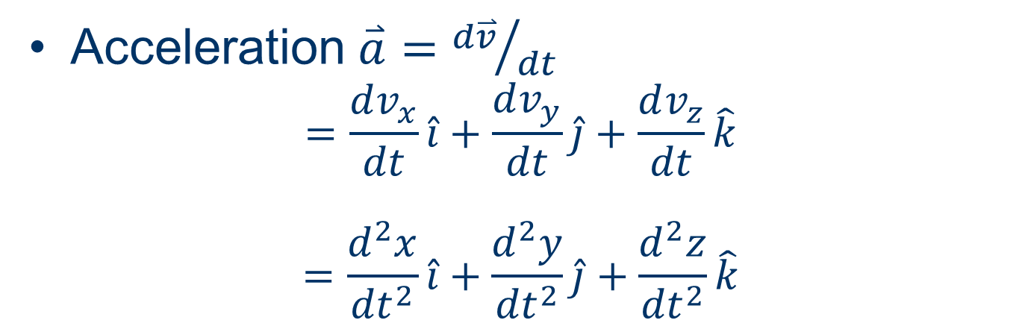
Describing 3-Vectors
Position $\overset{⃑}{r}=x\hat{i}+y\hat{j}+z\hat{k}$
Velocity $\overset{⃑}{v}={d\overset{⃑}{r}}/{dt}=\frac{dx}{dt}\hat{i}+\frac{dy}{dt}\hat{j}+\frac{dz}{dt}\hat{k}$
$$=v_{x}\hat{i}+v_{y}\hat{j}+v_{z}\hat{k}$$
Acceleration $\overset{⃑}{a}={d\overset{⃑}{v}}/{dt}$
$$=\frac{dv_{x}}{dt}\hat{i}+\frac{dv_{y}}{dt}\hat{j}+\frac{dv_{z}}{dt}\hat{k}$$
$$=\frac{d^{2}x}{{dt}^{2}}\hat{i}+\frac{d^{2}y}{{dt}^{2}}\hat{j}+\frac{d^{2}z}{{dt}^{2}}\hat{k}$$

Slide 4
Magnitudes of 3-Vectors
Distance from origin
r = | r | = x² + y² + z²
Speed v = | v | = v_{x}² + v_{y}² + v_{z}²
Magnitude of acceleration
a = | a | = a_{x}² + a_{y}² + a_{z}²

Slide 5
Vectors
Position and velocity may be in different directions
Velocity and acceleration may be in different directions

Slide 6
Familiar Situations
Ballistic trajectories
Circular motion
If a || v, path is straight.
If a || v, path is curved.

Slide 7
Question
If an object’s distance from the origin r does not change, its velocity must be zero.
True.
False.

Slide 8
Question
If an object’s speed v does not change, its acceleration must be zero.
True.
False.

Slide 9
Acceleration and Velocity
The component of a parallel to v causes the speed to change.
The component of a perpendicular to v causes the direction to change.
If either component is nonzero, the acceleration is nonzero.

Slide 10
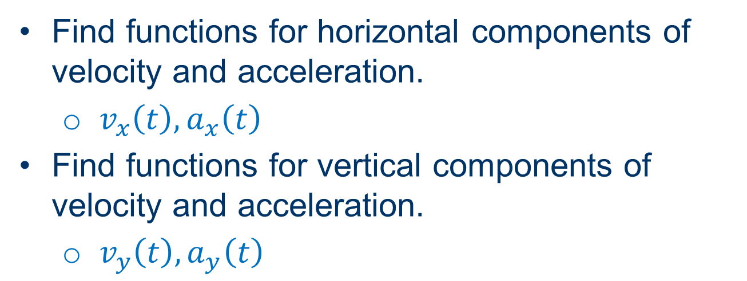
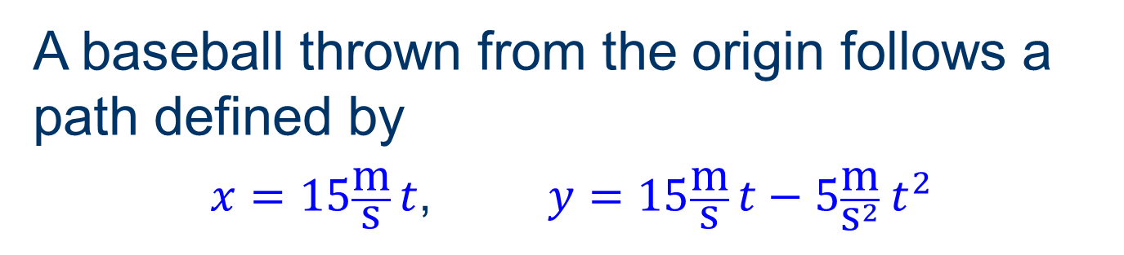
Group Work
A baseball thrown from the origin follows a path defined by
$x=15\frac{\text{m}}{\text{s}} t$, $y=15\frac{\text{m}}{\text{s}} t−5\frac{\text{m}}{{\text{s}}^{2}}{ t}^{2}$
Find functions for horizontal components of velocity and acceleration.
  $v_{x}\left(t\right),a_{x}\left(t\right)$
Find functions for vertical components of velocity and acceleration.
  $v_{y}\left(t\right),a_{y}\left(t\right)$

Slide 11
Group Work
A baseball thrown from the origin follows a path defined by
$x=15\frac{\text{m}}{\text{s}} t$, $y=15\frac{\text{m}}{\text{s}} t−5\frac{\text{m}}{{\text{s}}^{2}}{ t}^{2}$
Sketch its horizontal position, velocity, and acceleration vs. time.
  x-t, v_{x}-t, a_{x}-t
Sketch its vertical position, velocity and acceleration vs. time.
  y-t, v_{y}-t, a_{y}-t

Slide 12
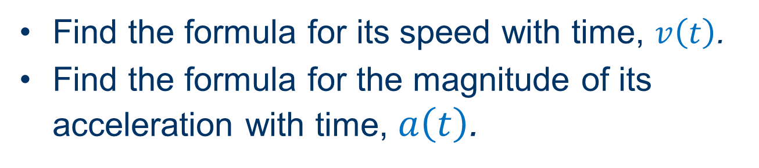
Group Work
A baseball thrown from the origin follows a path defined by
$x=15\frac{\text{m}}{\text{s}} t$, $y=15\frac{\text{m}}{\text{s}} t−5\frac{\text{m}}{{\text{s}}^{2}}{ t}^{2}$
Find the formula for its speed with time, $v\left(t\right)$.
Find the formula for the magnitude of its acceleration with time, $a\left(t\right)$.

Slide 13
Question
The rate of change of an object’s speed d|v|/dt is the same as the magnitude of its acceleration |dv/dt|.
Always.
Sometimes.
Never.

Slide 14

Group Work
A baseball thrown from the origin follows a path defined by
$x=15\frac{\text{m}}{\text{s}} t$, $y=15\frac{\text{m}}{\text{s}} t−5\frac{\text{m}}{{\text{s}}^{2}}{ t}^{2}$
Find the formula for its rate of change of speed with time, $\frac{dv}{dt}\left(t\right)$.

Slide 15
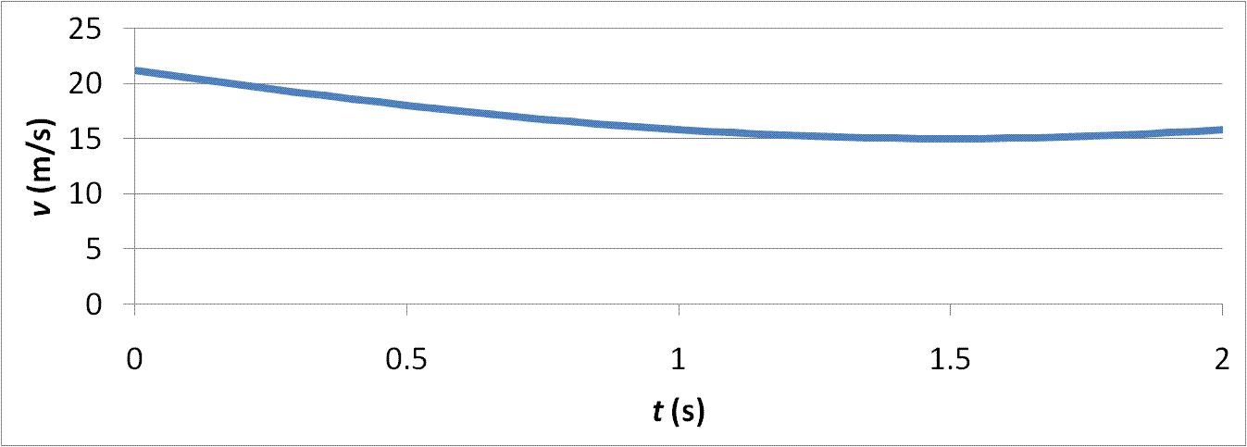
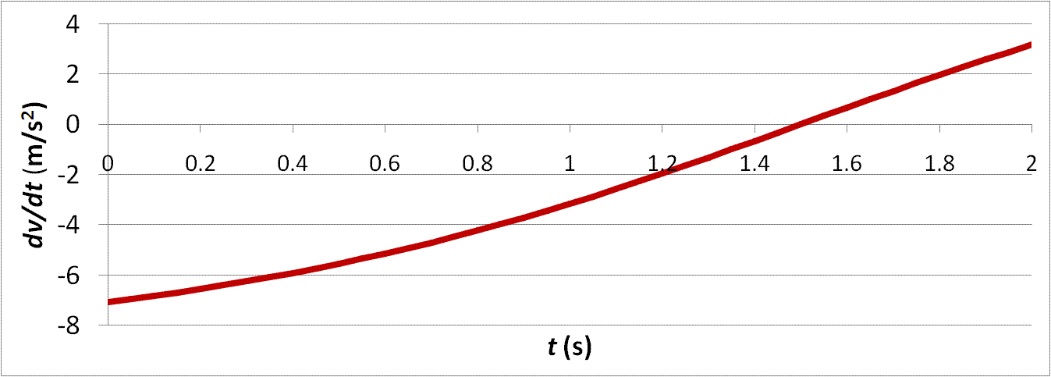
Speed and Its Rate of Change

