Slide 1
Vectors
Quantities with direction

Slide 2
Vectors and Scalars
Vector: quantity needing a direction to fully specify (direction + magnitude)
Scalar: directionless quantity

Slide 3
Represent as Arrows
direction: obvious
magnitude: length
location is irrelevant
these are identical

Slide 4
Represent as Components
Components: extent in x and y (maybe z) directions
A = (4, 3)
y
x
B
A
B = (0, –2)
Represent as ordered pairs or triples (one component for each dimension)

Slide 5
Represent as Polar Coordinates
r
φ
x
r = magnitude
φ = trigonometric direction

Slide 6

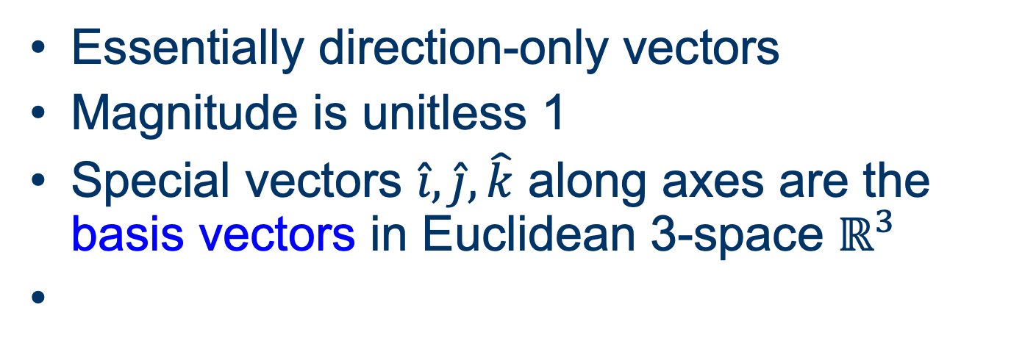


Unit Vectors
Essentially direction-only vectors
Magnitude is unitless 1
Special vectors $\hat{ı}, \hat{j}, \hat{k}$ along axes are the basis vectors in Euclidean 3-space $ℝ^{3}$
basis vector $\hat{i}$ : +x-direction
(1, 0, 0)
basis vector $\hat{j}$: +y-direction
(0, 1, 0)
basis vector $\hat{k}$: +z-direction
(0, 0, 1)

Slide 7
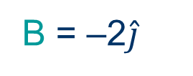
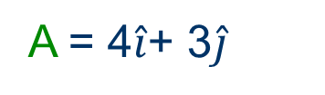
Represent as Basis Combinations
A = 4$\hat{i}$+ 3$\hat{j}$
B
A
B = –2$\hat{j}$

Slide 8
Cartesian to Polar
Magnitude r of a vector: use theorem of Pythagoras r² = x² + y² + z²
r² = 4² + 3²
r
r =
4² + 3²
=
16 + 9
=
25 = 5

Slide 9
Cartesian to Polar
Direction φ of a vector: use tan (φ) = y/x
A = (4, 3)
tan φ = 3/4
A
φ = arctan(3/4)
φ
φ = 36.87°

Slide 10
Cartesian to Polar
Direction φ of a vector: If x < 0, add 180° to arctan(y/x)
A = (–4, –3)
tan φ = 3/4
A
φ = 180° + arctan(3/4)
φ
φ = 180° + 36.87° = 216.87°

Slide 11
Polar to Cartesian
Components x and y of a vector: use sine and cosine
x = r cos φ
y = r sin φ
r
φ

Slide 12
Vector Operations
addition and subtraction

Slide 13
Add Vectors Graphically
Head-to-tail
A
A
C
B
B
A + B = C

Slide 14
How to Add Vectors Graphicaly
Head-to-Tail
Place following vector’s tail at preceding vector’s head
Resultant starts where the first vector starts and ends where the last vector ends

Slide 15
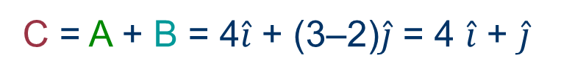
Add as Components
Add components for each direction separately
A = (4, 3)
B
B = (0, –2)
A
C = A + B = (4+0, 3–2) = (4, 1)
C
C = A + B = 4$\hat{i}$ + (3–2)$\hat{j}$ = 4 $\hat{i}$ + $\hat{j}$

Slide 16
Subtract Vectors
Add the negative of the vector being subtracted.
A
D
–B
A
B
A – B = A + (–B) = D
–B
D + B = A

Slide 17
Scalar Multiplication
Product of (scalar)(vector) is a vector
The scalar multiplies the magnitude of the vector; direction does not change
Direction reverses if scalar is negative
A
2 A
–2 A
1/2 A

Slide 18
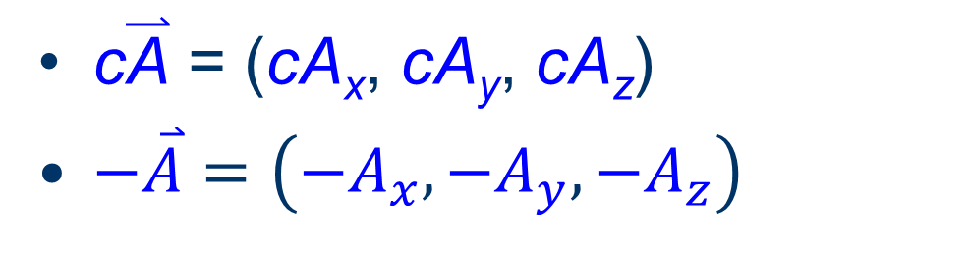
Scalar Multiplication
By components: multiply each component by the scalar
c$\overset{⃑}{\text{A}}$ = (cA_{x}, cA_{y}, cA_{z})
$−\overset{⃑}{A}=\left(−A_{x},−A_{y},−A_{z}\right)$
A
2 A
–2 A
1/2 A

Slide 19
Dot Product of Vectors
a
a·b = ab cos φ
a
φ
b
Commutative
b

Slide 20
Dot Product Geometrically
Product of the projection of one vector onto another with the other
“Overlap”
b cos φ
a
φ
ab cos φ
b
a cos φ

Slide 21
Dot Product by Components
A·B = (A_{x}B_{x} + A_{y}B_{y} + A_{z}B_{z})

Slide 22
Cross Product of Vectors
Operation symbol ×
Another way to multiply two vectors
Product is a vector!
Direction of A×B is perpendicular to both A and B

Slide 23
Cross Product Magnitude
A
⏐A × B⏐ = AB sin θ
A
θ
Maximum at θ = 90°
Zero at θ = 0°, 180°
B
B

Slide 24
Magnitude Geometrically
A
A
θ
B
B
⏐A×B⏐ = area of parallelogram
= AB sinθ

Slide 25
Cross Product Direction
Right Hand rule
Curl right-hand fingers in direction of θ
Right-hand thumb points in direction of cross-product
Not commutative
A
A
θ
B
B
A×B = –(B×A)

Slide 26
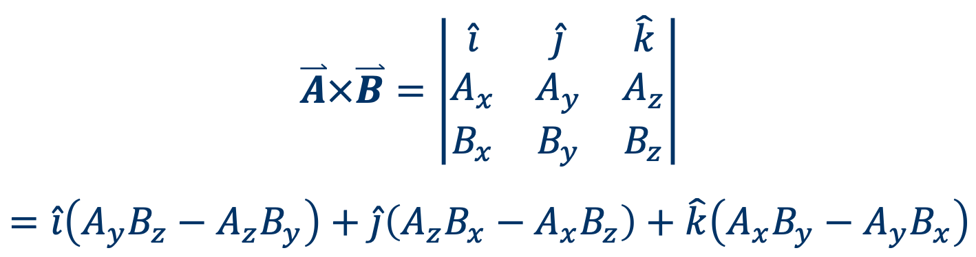
Cross Product by Components
Determinant method
$$\overset{⃑}{A}×\overset{⃑}{B}=\left|\begin{matrix}\hat{i} & \hat{j} & \hat{k} \\ A_{x} & A_{y} & A_{z} \\ B_{x} & B_{y} & B_{z}\end{matrix}\right|$$
$$=\hat{i}\left(A_{y}B_{z}−A_{z}B_{y}\right)+\hat{j}\left(A_{z}B_{x}−A_{x}B_{z}\right)+\hat{k}\left(A_{x}B_{y}−A_{y}B_{x}\right)$$

