Slide 1
Combining Waves
interference
§ 13.10–13.11
Notes:
Demonstration equipment: clamped coil spring, singing tubes, boomwhackers. Water waves would be nice, but tough in a lecture hall.
Check internet links before trying.
1

Slide 2
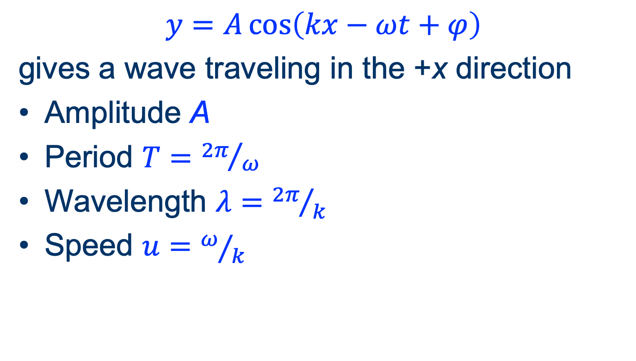
Mathematical Wave Description
$$y=A\cos\left(kx−ωt+φ\right)$$
gives a wave traveling in the +x direction
Amplitude A
Period $T={2π}/ω$
Wavelength $λ={2π}/k$
Speed $u=ω/k$

Slide 3
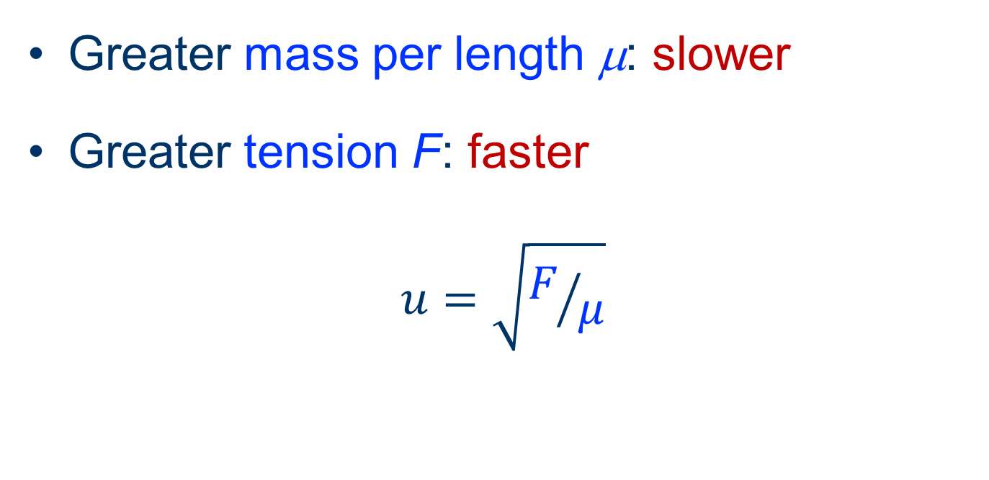
Speed of a String Wave
Greater mass per length μ: slower
Greater tension F: faster
$$u=\sqrt{F/μ}$$

Slide 4
Energy in a wave
Generally proportional to amplitude squared

Slide 5
Principle of Superposition
Where waves meet, the displacement is the sum of the displacements from the individual waves.
3
result
0
–3
Notes:
Run at: W1 = 0.2; k1 = 0.2; ampl = 15
integral multiples (half, third, quarter) of lambda: multiply W1, k1 by 2, 3, 4
add same-lambda wave with negative amplitude
Beats: slightly vary w2 and k2 together from wave 1 values
Standing waves (use phase velocity of 0.5: k = 2*w)

Slide 6
Interference
Constructive: Sum of waves has increased amplitude
Destructive: Sum of waves has decreased amplitude
Two-wave simulation

Slide 7
Beats
Waves of different frequency alternate times of constructive and destructive interference
Beat frequency is the difference in frequency of the combining tones
Simulator
  (select “Example: beats”)

Slide 8
Standing Waves
waves that don’t actually travel
§ 14.8–14.10
Notes:
8

Slide 9
Standing Waves
Sum of waves of equal amplitude and wavelength traveling in opposite directions
Half-wavelength divides exactly into the available space
Wave pattern has locations of minimum and maximum variation (nodes and antinodes)
(standing longitudinal waves)
Notes:
9
Run at: w1 = 0.2; k1 = 0.2; ampl = 15
integral multiples (half, third, quarter) of lambda: multiply w1, k1 by 2, 3, 4
add same-lambda wave with negative amplitude
Beats: slightly vary w2 and k2 together from wave 1 values (0.22 and 0.22; 0.21 and 0.21, etc.)
Standing waves (use w of about 0.2; try w = 0.2, k = 0.1)

Slide 10
Normal modes
standing waves generalized
Notes:
10

Slide 11
Resonance
Objects have characteristic frequencies at which standing waves are sustained
Lowest frequency = fundamental
Higher frequencies = overtones
Sustained motion is a combination of normal modes
Notes:
11

Slide 12
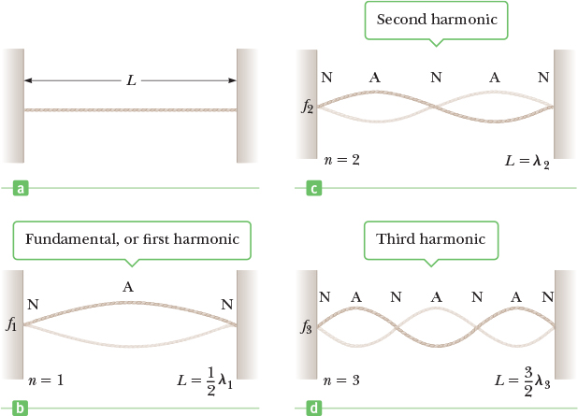
Vibrational Modes: Clamped String
Source: Serway & Vuille, College Physics, Figure 14.19
Notes:
12

Slide 13
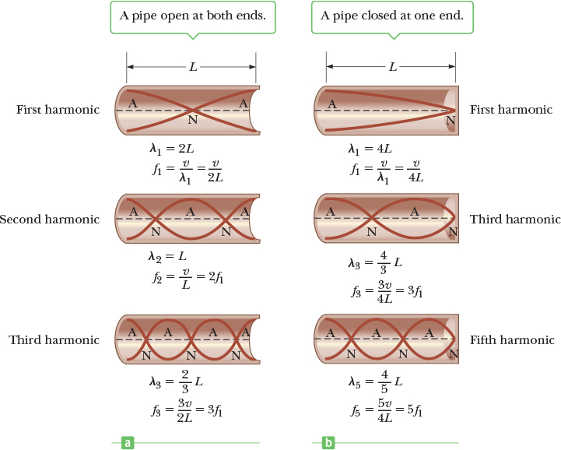
Vibrational Modes: Air Tubes
Source: Serway & Vuille, College Physics, Figure 14.24
Notes:
13

Slide 14
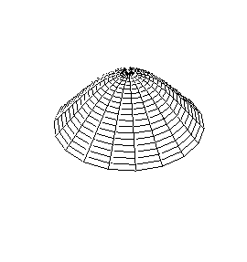
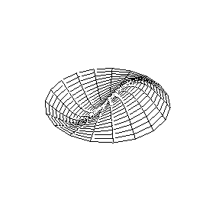
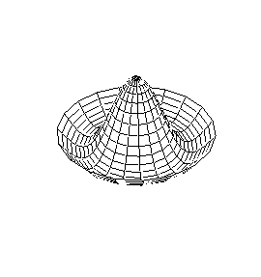
2-D Standing Waves
Nodes are lines or curves
Circular membrane standing waves
edge node only
diameter node
circular node
Source: Dan Russel’s page
Higher frequency ⇒ more nodes

Slide 15
Resonance
You’ve seen this before
Notes:
15

Slide 16
Resonance
Boundary conditions determine nodal positions
For uniform media, resonant wavelengths and frequencies have simple relationships
  Clamped strings
  https://blog.soton.ac.uk/soundwaves/standing-waves/2-string-modes/
  Air cylinders
  https://www.walter-fendt.de/html5/phen/standinglongitudinalwaves_en.htm
More complex media are more interesting
  https://www.acs.psu.edu/drussell/demos.html
Notes:
16

Slide 17
Exit Ticket
Muddiest point

