Slide 1
Rigid-Body Rotation
rotating and revolving
Ch. 7

Slide 2
Angular Velocity
What is the direction of angular velocity?
Right-hand rule:
Curl right-hand fingers in the direction of rotation.
Extended right thumb points in the direction of ω.
Rotation Axis || ω.

Slide 3
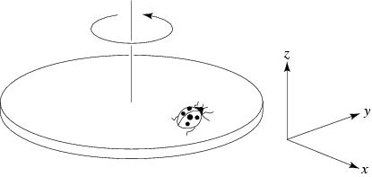
Question
A ladybug sits at the outer edge of a merry-go-round that is turning and slowing down. At the instant shown, the vector expressing its angular velocity is
in the +x direction
in the –x direction
in the +z direction
in the –z direction
in the +y direction
in the –y direction

Slide 4

Question
A ladybug sits at the outer edge of a merry-go-round that is turning and slowing down. At the instant shown, the vector expressing her angular acceleration is
same as $\overset{⃑}{ω}$
opposite $\overset{⃑}{ω}$

Slide 5
Question
A ladybug sits at the outer edge of a merry-go-round that is turning and slowing down. At the instant shown, the vector expressing her angular acceleration is
in the +x direction
in the –x direction
in the +z direction
in the –z direction
in the +y direction
in the –y direction

Slide 6
Question
A ladybug sits at the outer edge of a merry-go-round that is turning and slowing down. At the instant shown, its centripetal acceleration is
in the +x direction
in the –x direction
in the +z direction
in the –z direction
in the +y direction
in the –y direction

Slide 7
Question
A ladybug sits at the outer edge of a merry-go-round that is turning and slowing down. At the instant shown, her acceleration is
in the –x and –y direction

Slide 8
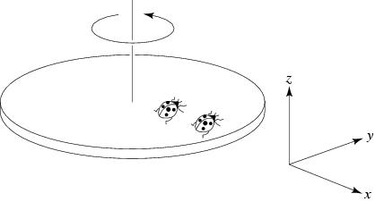
Question
A ladybug sits at the outer edge of a merry-go-round, and a lordbug sits halfway between her and the axis of rotation. The merry-go-round makes a complete revolution once each second. The lordbug's angular velocity is
half the ladybug's
the same as the ladybug's
twice the ladybug's

Slide 9
Question
A ladybug sits at the outer edge of a merry-go-round, and a lordbug sits halfway between her and the axis of rotation. The merry-go-round makes a complete revolution once each second. The lordbug's tangential velocity is
half the ladybug's
the same as the ladybug's
twice the ladybug's

Slide 10
Angular Kinematic Formulas
For constant α, α || ω
ω = ω₀ + αt
θ = θ₀ + ω₀t + 1/2 αt²
ω² = ω₀² + 2α(θ – θ₀)
Note the similarity to the linear kinematic formulas.

Slide 11
Rigid-Body Motion
rotation + translation

Slide 12
Rolling without slipping
Center-of-mass displacement
Δx = rθ

Slide 13
Rolling without slipping
Center-of-mass speed
v = rω

Slide 14
Rolling without slipping
Center-of-mass acceleration
a = rα

Slide 15
Rolling without slipping
Center-of-mass acceleration
a|| = rα

Slide 16
Rolling without slipping
Rim centripetal acceleration
a⊥ = v²/r = ω²r

