Slide 1
Rigid-Body Rotation
rotating and revolving
Ch. 7

Slide 2
Radians
the best math for angles

Slide 3
Radians
A dimensionless angle measure
arc length
distance from axis
length
= dimensionless!
length

Slide 4

Radian Measurements
Complete cycle = $2πr$
r
Complete cycle = 2π radians
1 radian ≈ 57.3°

Slide 5
Questions
What is the equivalent of ½ cycle in radians?
What is the equivalent of 1/8 cycle in radians?

Slide 6
Angular Position
2
s
r
1
θ
Radius r
Arc length s
s
Angle θ =
r

Slide 7





Angular Speed
Rate of change of angular position
Angular speed ω, radians/s
$$∆θ$$
Δ
s
1
$$∆s$$
v_{T}
ω =
=
=
=
$$∆t$$
$$∆t$$
r
r
$$∆t$$
r
v_{T} = tangential speed, m/s

Slide 8
Angular Acceleration
Rate of change of angular velocity
Δω
a||
α =
=
Δt
r
a|| = tangential acceleration
Valid for a fixed axis of rotation
(acceleration about the ω axis)

Slide 9
Periodic Processes
You will often encounter radians and angular speed for repeating processes
  1 cycle = 2π
Not restricted to rotation or circular motion

Slide 10
Angular Velocity
What is the direction of angular velocity?
Right-hand rule:
Curl right-hand fingers in the direction of rotation.
Extended right thumb points in the direction of ω.
Rotation Axis || ω.

Slide 11
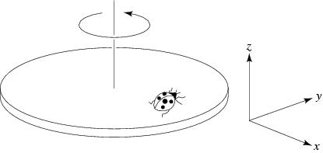
Question
A ladybug sits at the outer edge of a merry-go-round that is turning and slowing down. At the instant shown, the vector expressing its angular velocity is
in the +x direction
in the –x direction
in the +z direction
in the –z direction
in the +y direction
in the –y direction

Slide 12

Question
A ladybug sits at the outer edge of a merry-go-round that is turning and slowing down. At the instant shown, the vector expressing her angular acceleration is
same as $\overset{⃑}{ω}$
opposite $\overset{⃑}{ω}$

Slide 13
Question
A ladybug sits at the outer edge of a merry-go-round that is turning and slowing down. At the instant shown, the vector expressing her angular acceleration is
in the +x direction
in the –x direction
in the +z direction
in the –z direction
in the +y direction
in the –y direction

Slide 14
Question
A ladybug sits at the outer edge of a merry-go-round that is turning and slowing down. At the instant shown, its centripetal acceleration is
in the +x direction
in the –x direction
in the +z direction
in the –z direction
in the +y direction
in the –y direction

Slide 15
Question
A ladybug sits at the outer edge of a merry-go-round that is turning and slowing down. At the instant shown, her acceleration is
in the –x and –y direction

Slide 16
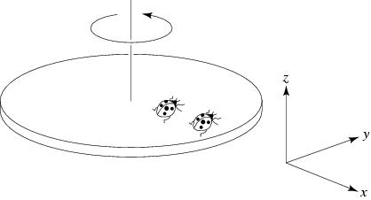
Question
A ladybug sits at the outer edge of a merry-go-round, and a lordbug sits halfway between her and the axis of rotation. The merry-go-round makes a complete revolution once each second. The lordbug's angular velocity is
half the ladybug's
the same as the ladybug's
twice the ladybug's

Slide 17
Question
A ladybug sits at the outer edge of a merry-go-round, and a lordbug sits halfway between her and the axis of rotation. The merry-go-round makes a complete revolution once each second. The lordbug's tangential velocity is
half the ladybug's
the same as the ladybug's
twice the ladybug's

Slide 18
Angular Kinematic Formulas
For constant α, α || ω
ω = ω₀ + αt
θ = θ₀ + ω₀t + 1/2 αt²
ω² = ω₀² + 2α(θ – θ₀)
Note the similarity to the linear kinematic formulas.

Slide 19
Rigid-Body Motion
rotation + translation

Slide 20
Rolling without slipping
Center-of-mass displacement
Δx = rθ

Slide 21
Rolling without slipping
Center-of-mass speed
v = rω

Slide 22
Rolling without slipping
Center-of-mass acceleration
a = rα

Slide 23
Rolling without slipping
Center-of-mass acceleration
a|| = rα

Slide 24
Rolling without slipping
Rim centripetal acceleration
a⊥ = v²/r = ω²r

