Slide 1
Momentum
the quantity of motion
§ 7.1

Slide 2
Objectives
Define momentum.
Define impulse and describe its relationship to momentum.

Slide 3
What’s the point?
Nature keeps careful account of momentum.

Slide 4
Think Question
Which process requires more time?
Pulling as hard as you can to accelerate a little red wagon from rest to a speed of 1 m/s.
Pulling as hard as you can to accelerate a horse trailer from rest to a speed of 1 m/s.
The two take the same amount of time.

Slide 5
Think Question
Which process requires more force?
Accelerating a little red wagon from rest to a speed of 1 m/s in ten seconds.
Accelerating a horse trailer from rest to a speed of 1 m/s in ten seconds.
The two take the same force.

Slide 6
Example Problem
Show that when a constant net force F is applied to an object of mass m for a time Δt, its change in velocity is
FΔt
Δv =
m
Strategy: We can find acceleration using Newton’s second law a = F/m. Then we can find Δv using the definition a = Δv/Δt.

Slide 7
Group Work
From mass m, net force F, and duration Δt, find acceleration a and velocity change Δv.
m
F
Δt
a
Δv
1 kg
10 N
1 s
1 kg
10 N
10 s
1 kg
1 N
10 s
10 kg
10 N
10 s

Slide 8
Impulse
Impulse J = FΔt
where
F Is net force
Δt is duration
Impulse is a vector.
The accumulation of force applied for some time.

Slide 9
Question
Two objects of different masses move at the same speed. Which one is harder to stop?
The lighter object.
The more massive object.

Slide 10
Question
Two objects with the same mass move at different speeds. Which one is harder to stop?
The faster object.
The slower object.

Slide 11
Momentum
Formula
p = mv
momentum is a vector.
The quantity of motion.

Slide 12
Question
Two spaceships have the same velocity, with one’s mass twice the other’s. The heavy one’s momentum is:
more than twice the light one’s momentum.
twice the light one’s momentum.
the same as the light one’s momentum.
half the light one’s momentum.
less than half the light one’s momentum.

Slide 13
Question
Two spaceships have the same mass, but one’s speed is twice the other’s. The faster one’s momentum is:
more than twice the slower one’s momentum.
twice the slower one’s momentum.
the same as the slower one’s momentum.
half the slower one’s momentum.
less than half the slower one’s momentum.

Slide 14
Group Work
What are the units of
impulse?
momentum?

Slide 15
Group Work
From m, F, Δt, Δv, find impulse J and momentum change Δp.
m
F
Δt
J
Δp
1 kg
10 N
1 s
1 kg
10 N
10 s
1 kg
1 N
10 s
10 kg
10 N
10 s

Slide 16
Group Work
Show that when a net force F is applied to an object of mass m for a time Δt, its change in momentum is
Δp = FΔt
Hint: You can find its momentum change from its mass and its velocity change.

Slide 17
Impulse-Momentum Theorem
Impulse = FΔt.
FΔt
= maΔt
= mΔv
= Δ(mv)
= Δp
So net impulse = change in momentum

Slide 18
Question
Which changes its momentum the most?
A moving object that stops when it hits a barrier.
A moving object that bounces back from a barrier.
Hints: How is Δp defined? Momentum is a vector. Which receives the greater impulse?

Slide 19
Rebound and Momentum
final p – initial p
initial p
final p
Δp
final p – initial p
initial p
final p = 0
Δp

Slide 20
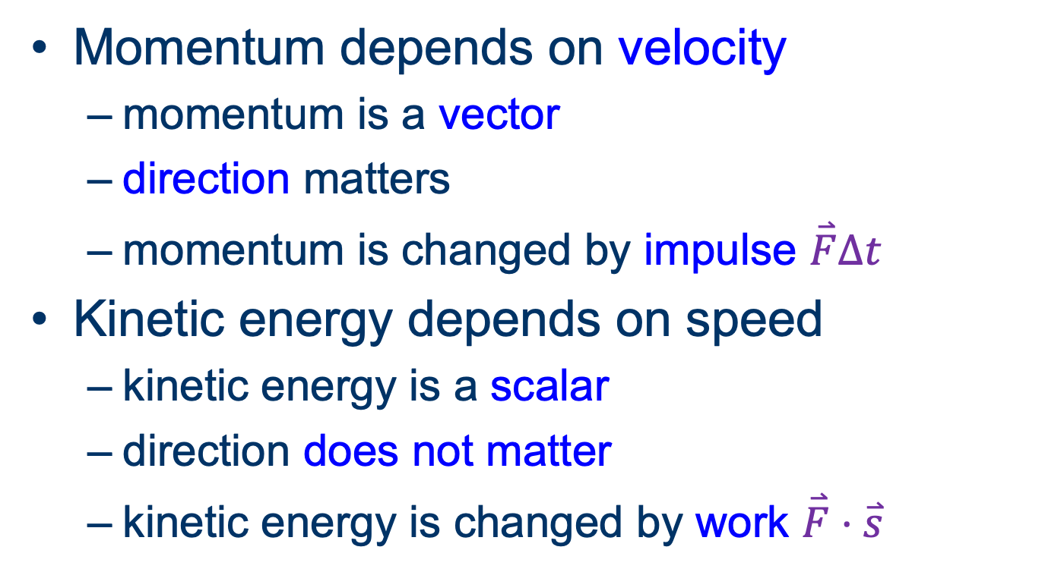
Momentum and Kinetic Energy
Momentum depends on velocity
momentum is a vector
direction matters
momentum is changed by impulse $\overset{⃑}{F}∆t$
Kinetic energy depends on speed
kinetic energy is a scalar
direction does not matter
kinetic energy is changed by work $\overset{⃑}{F}⋅\overset{⃑}{s}$

Slide 21
Poll question
You can change an object’s momentum without changing its kinetic energy.
True
False

Slide 22
Poll question
You can change an object’s kinetic energy without changing its momentum.
True
False

Slide 23
Conservation of Momentum
fundamental And Foundational (fundamental AF)
§ 7.2

Slide 24
Question
If a 0.25-g insect collides with a 1250-kg compact car, which experiences the greatest (magnitude of) impulse in the collision?
The insect.
The car.
It’s a tie.
Insufficient information to answer.

Slide 25
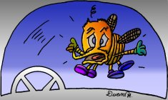
Question
When a bug hits a car windshield, whose momentum changes the most? (Assume there are no external forces.)
The bug’s.
The car’s.
It’s a tie.
Need more information to know.

Slide 26
Consequence
When two otherwise isolated objects interact, their total change in momentum is zero.
Δp₁ + Δp₂ = 0
because
Δp₁ = –Δp₂

Slide 27
Conservation of Momentum
The total momentum of an isolated system never changes.

