Slide 1
Conservation of Mechanical Energy
If the forces doing are associated with potential energies, mechanical energy does not change.
E₁ = E₂
K₁ + U₁ = K₂ + U₂
1/2 mv₁² + mgy₁ = 1/2 mv₂² + mgy₂

Slide 2
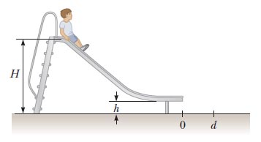
Example problem
A boy sits at rest at the top of a frictionless slide, a height H above the ground. With a negligible push, he begins sliding downward. The end of the slide is a height h above the ground, and it launches the boy off the end horizontally. What horizontal distance d does the boy travel before landing on the ground?
H = 3.20 m
h = 0.50 m
m = 28 kg

Slide 3
With non-conservative forces
Non-conservative forces change the total mechanical energy.
E₁ + W_{N} = E₂
K₁ + U₁ + W_{N} = K₂ + U₂
W_{N} = non-conservative work

Slide 4
Example problem
A boy sits at rest at the top of a frictional slide, a height H above the ground. With a negligible push, he begins sliding downward. Friction with the slide does W_{N} of work on him. What horizontal distance d does the boy travel before landing on the ground?
H = 3.20 m
h = 0.50 m
m = 28 kg
W_{N} = 200 J

Slide 5
Hooke’s law
A simple model of elasticity
§ 10.1

Slide 6
Objectives
Describe the deformation of a solid in response to a tension or compression.

Slide 7
What’s the point?
How do solids react when deformed?

Slide 8
Elasticity of Solids
Small deformations are proportional to force
small stretch
larger stretch
Hooke’s Law: ut tensio, sic vis (as the pull, so the stretch)
Robert Hooke, 1635–1703

Slide 9
Hooke’s Law Graph
slope < 0
forward
Force exerted by the spring
0
backward
0
backward
forward
Displacement from equilibrium position

Slide 10

Hooke’s Law Formula
F = force exerted by the spring
k = spring constant; units: N/m; k > 0
x = displacement from equilibrium position
negative sign: force opposes distortion
Notes:
restoring force.

Slide 11
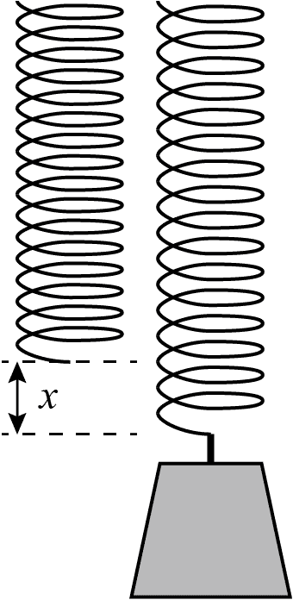
Group Work
A spring stretches 4.0 cm when a load of 12.0 N is suspended from it.
What is the spring constant of the spring?
How far will the spring stretch with a tension of 6.0 N?

Slide 12
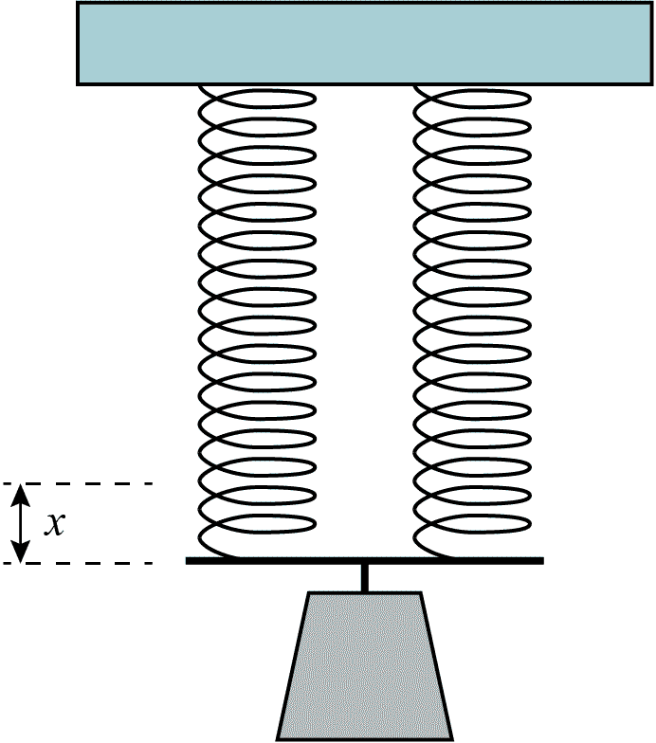
Group Work
What is the tension in each spring when a 12-N weight is suspended from them?
How far will each spring stretch?
What is the spring constant of the combined springs?

Slide 13
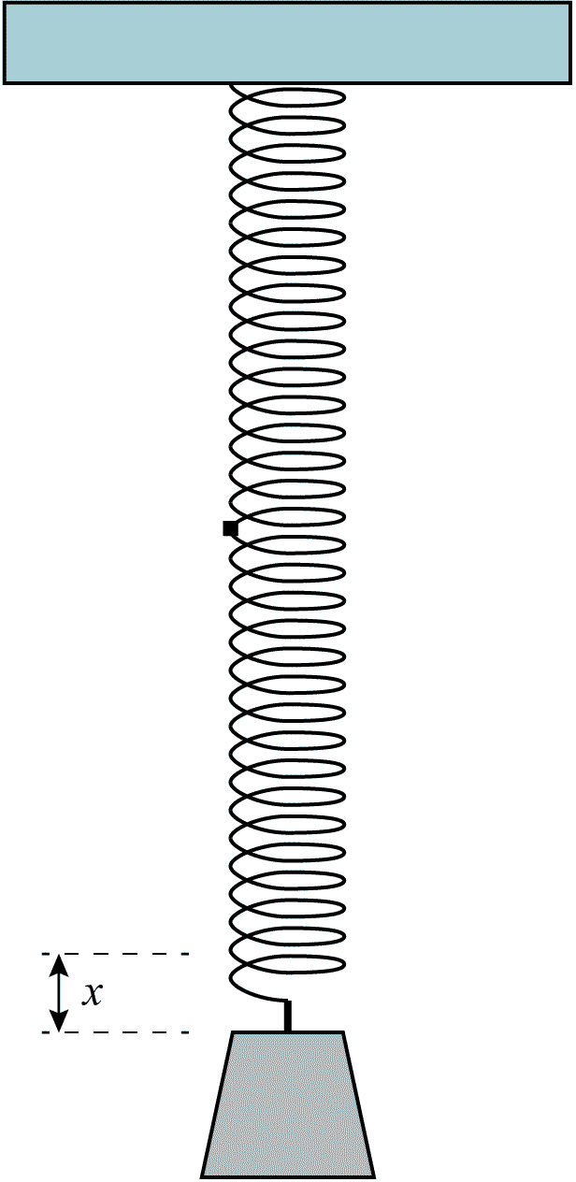
Group Work
What is the tension in each spring when a 12-N weight is suspended from them?
How far will each spring stretch?
How far do the combined springs stretch?
What is the spring constant of the combined springs?

Slide 14
Effect of Gravity
Less than you might expect:
Changes equilibrium position x = 0
Does not change k

Slide 15
Elastic Potential Energy
Hooke’s law force is conservative

Slide 16
Work to Deform a Spring
To pull a distance x from equilibrium
slope = k
kx
force
area = W
displacement
x
Work =
1
F·x ;
F = kx
2
Work =
1
=
1
2
kx·x
kx²
2

Slide 17
Potential Energy of a Spring
The potential energy of a stretched or compressed spring is equal to the work needed to stretch or compress it from its rest length.
U = 1/2 kx²
The U is positive for both positive and negative x.
Notes:
Just as the work is always positive, so is the potential energy. This follows automatically from the x² term.

Slide 18
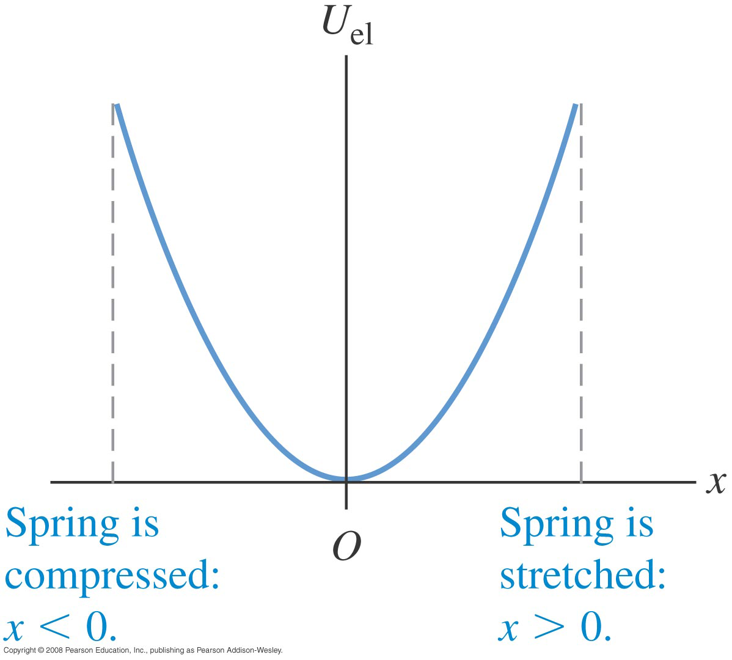
Hooke’s Law Potential
Source: Young and Freedman, Figure 7.14.

Slide 19
Group Work
A spring stretches 4.0 cm when a load of 12 N is suspended from it.
What is the potential energy of the stretched spring?

Slide 20
Group Work
The 12-N weight is suspended from two such springs in parallel.
What is the potential energy of the two stretched springs?

Slide 21
Group Work
The 12-N weight is suspended from two such springs in tandem.
What is the potential energy of the two stretched springs?

Slide 22
Notice What Happened
The tandem and parallel pairs of springs were both stretched to the same tension. Which one had the most potential energy?
The stiffer spring (parallel).
The softer spring (tandem).
Equal for both.
Notes:
The stiffer spring has twice as much work done on it. ½ kx^2with the same x and different k’s. Work will be directly proportional to k.

Slide 23
Work from Potential Energy
When a potential does >0 work on a body
(For a spring, this means moving toward the equilibrium length):
The body’s potential energy decreases
The body’s kinetic energy increases

Slide 24
Conservative force
A Hooke’s law force conserves mechanical energy.

Slide 25
Example problem
A 12.0 N weight is hung from a relaxed spring with a spring constant of 3.0 N/cm and released.
How far does the weight drop before the spring stops it?

