Slide 1
Work
force is not all that matters
§ 5.1

Slide 2
What’s the point?
Energy is critically important to Nature.

Slide 3
Objectives
Relate work to force and distance.
Calculate the kinetic energy of a moving object.

Slide 4
Work
Formula
W = work = F·s
F = force applied s = displacement

Slide 5
Units of Work
joule (J) = 1 newton along 1 meter
kg m
kg m²
J = Nm =
m =
s²
s²

Slide 6
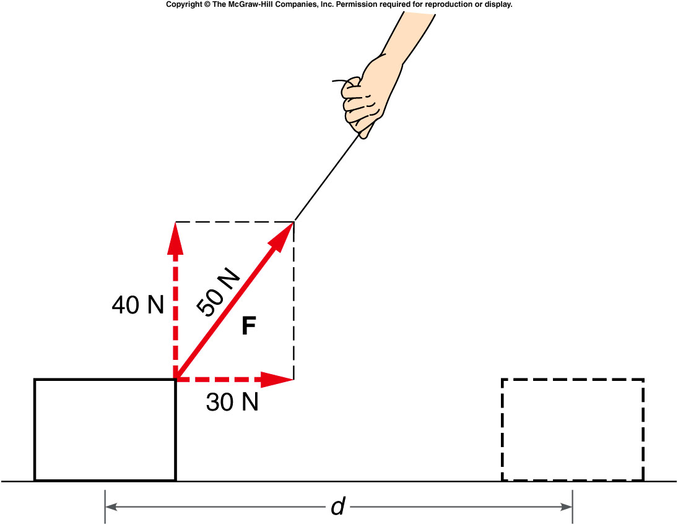
Work is a Scalar
component of force in direction of motion
Source: Griffith, The Physics of Everyday Phenomena

Slide 7

Dot Product of Vectors
a
a·b = ab cos φ
a
φ
b
Commutative
b

Slide 8
Dot Product Geometrically
Product of the projection of one vector onto the other
“Overlap”
b cos φ
a
φ
ab cos φ
b
a cos φ

Slide 9

Dot Product by Components
If
$$\overset{⃑}{A}=\left(A_{x},A_{y},A_{z}\right)$$
and
$$\overset{⃑}{B}=\left(B_{x},B_{y},B_{z}\right)$$
then
$\overset{⃑}{A}∙\overset{⃑}{B}=A_{x}B_{x}+$ $A_{y}B_{y}+$ $A_{z}B_{z}$

Slide 10
Dot Product Properties
Positive if |φ| < π/2
+
–
Negative if |φ| > π/2
Zero if vectors perpendicular (|φ| = π/2)
Maximum absolute value if parallel or anti-parallel

Slide 11
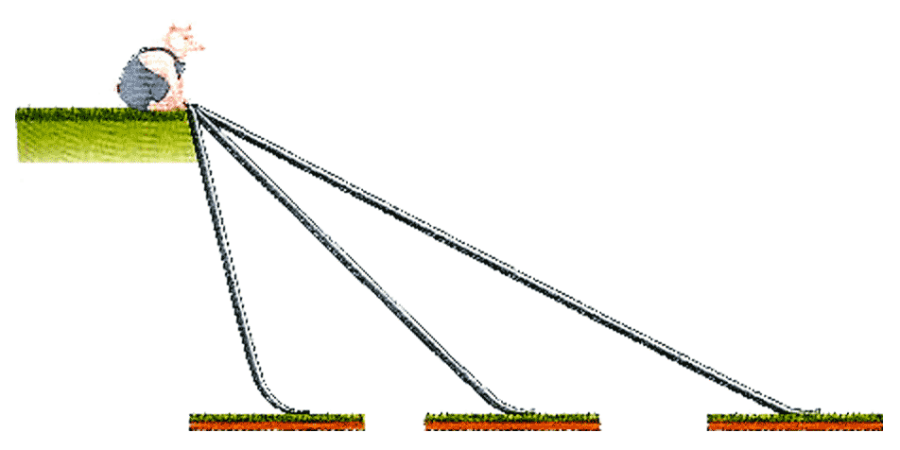
Question
The piglet has a choice of three frictionless slides to descend. Along which slide is the greatest net force exerted on the piglet?
A
B
C
The net force is the same for all.

Slide 12
Question
The piglet has a choice of three frictionless slides to descend. Along which slide would the piglet slide the longest distance?
A
B
C
The distance is the same for all.

Slide 13
Total (Net) Work
If several forces act on a moving object:
s
F₄
F₁
F₂
F₃
W = (ΣF)·s
Work by the net force
or
or
W = Σ(F·s)
Sum of work by separate forces

Slide 14
Question
The piglet has a choice of three frictionless slides to descend. Along which slide would gravity do the most work on the piglet?
A
B
C
D. Same work for all.
E. Need more information.

Slide 15
Example Problem
A luggage handler at the Laramie Airport pulls a 20-kg suitcase from rest up a ramp inclined at 25° above the horizontal with a force of 140 N parallel to the ramp. The coefficient of kinetic friction between the ramp and the box is μ_{k} = 0.30. The suitcase travels 3.80 m along the ramp. Find
the work done on the suitcase by the handler
the work done on the suitcase by gravity
the work done on the suitcase by the normal force
the work done on the suitcase by friction
the total work done on the suitcase
the final speed of the suitcase

Slide 16
Power
How long does work take?
§ 6.4

Slide 17
Power
Rate of doing work
∆E
∆W
Power =
=
∆t
∆t
∆E = change in energy ( = work)
∆t = time interval

Slide 18
Units of Power
∆E
Power =
∆t
Energy
= J/s
= W = watt
time
kg m²
kg m²
W =
=
s² s
s³

Slide 19
Power
A different but equivalent formula
∆W
F·∆s
Power =
=
= F·v
∆t
∆t
F = force
s = displacement
v = velocity

