Slide 1
Ballistic Trajectories
Simpler than reality, complicated enough for now

Slide 2
Basic Premise
Acceleration is straight down
due to gravity
All bodies accelerate the same (if no drag)
Glenn Free-fall chamber
Moon drop
At earth’s surface, g ≃ 9.8 m/s²

Slide 3
Equations of Motion
Horizontal
Vertical
a_{x} = 0
v_{x} = v_{0x}
x = x₀ + v_{0x}t
v_{0x} = v₀ cosθ
a_{y} = –g
v_{y} = v_{0y} – gt
y = y₀ + v_{0y}t – ½ gt₂
v_{0y} = v₀ sinθ

Slide 4
Bare-bones Trigonometry
sin α = A/C
cos α = B/C
tan α = A/B
C² = A² + B²
C
A
α
B

Slide 5
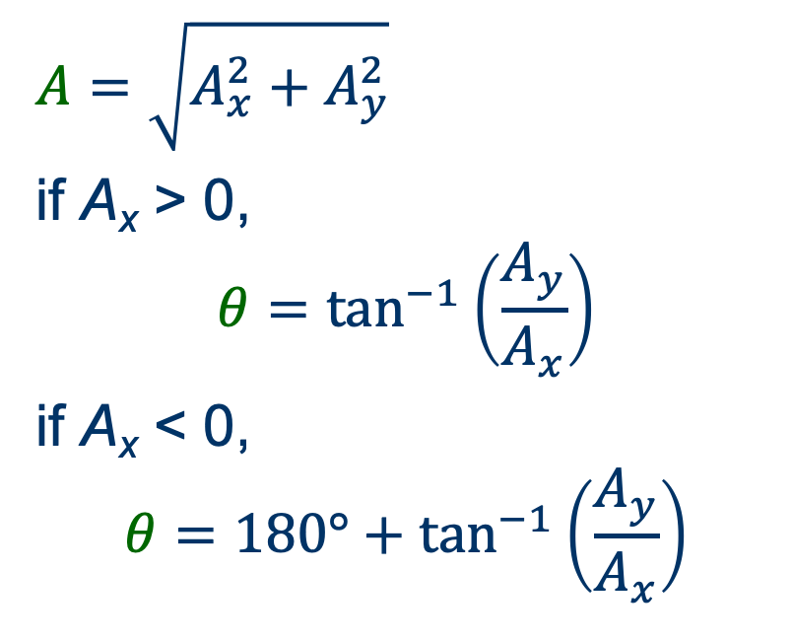
Cartesian ⇄ Polar Coordinates
to Cartesian
to Polar
A_{x} = A cos θ
A_{y} = A sin θ
$$A=\sqrt{A_{x}^{2}+A_{y}^{2}}$$
if A_{x} > 0,
$$θ=\tan^{−1}\left(\frac{A_{y}}{A_{x}}\right)$$
if A_{x} < 0,
$$θ=180°+\tan^{−1}\left(\frac{A_{y}}{A_{x}}\right)$$
A
A_{y}
θ
A_{x}

Slide 6
Example problem
Where (horizontally) does it land?
How much time until landing?
How high does it go?
v₀
θ

Slide 7
Slightly more complicated
Where (horizontally) does it land?
How much time until landing?
What is its landing velocity?
v₀
θ
h

Slide 8
Range equation
Lands at launch height
Where (horizontally) does it land?
What is the greatest possible range at a given v₀?
What launch angle gives the greatest range?
v₀
θ

