Slide 1
Announcement
No class Monday (Labor day)
Discussion sections start next week
There is a lab next week

Slide 2
Equations of Motion
Tractable cases
§2.3–2.4

Slide 3
Find Position from Velocity
Generally: velocity is slope of a position-time graph.
Conversely, position change is the area under a velocity-time graph.
When v is constant, the graph is a horizontal line.
  The area under the graph is a rectangle

Slide 4
Constant-Velocity Motion
v = Δx/Δt = constant throughout process
Δx = vΔt
x = x₀ + Δx = x₀ + vΔt
Can also use this with average v

Slide 5
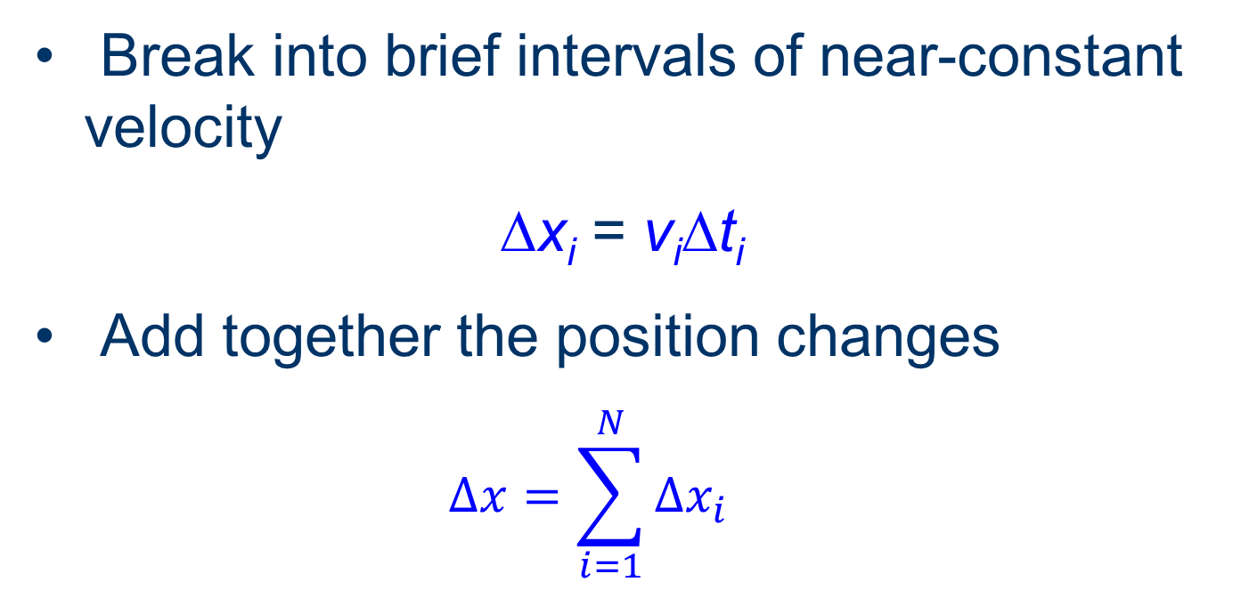
Motion with Changing Velocity
Break into brief intervals of near-constant velocity
Δx_{i} = v_{i}Δt_{i}
Add together the position changes
  $$∆x=\sum_{i=1}^{N}{∆x_{i}}$$

Slide 6
Total Distance Traveled
Sum of the nearly-constant v strips
v
Area beneath the v-t curve

Slide 7
Find Velocity from Acceleration
Generally: acceleration is slope of a velocity-time graph.
Conversely, velocity change is the area under an acceleration-time graph.
What is v when a is constant?

Slide 8
Constant-Acceleration Motion
a = Δv/Δt for any interval
Δv = a Δt
Δv = velocity change over time Δt
v = v₀ + Δv = v₀ + a Δt

Slide 9
Acceleration on an x-t Graph
Velocity is the slope of a position-time graph
Acceleration means a changing slope
  A constant slope means a straight x-t line
  A varying slope means a curved x-t line
Positive acceleration = concave up
Negative acceleration = concave down

Slide 10
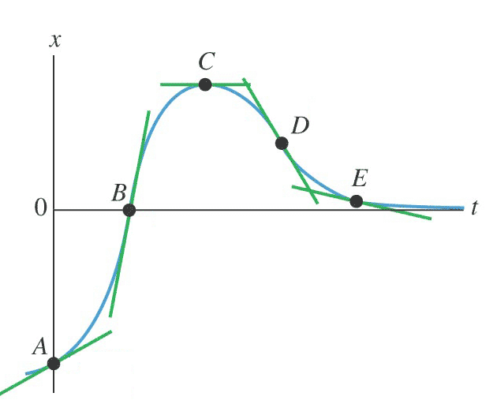
Visualize Acceleration
Group Work:
Signs of x
Signs of v
Signs of a
Young and Freedman, Fig. 2.8

Slide 11
Acceleration Scenario
Starting from a traffic light that turns green
slope = velocity
d
t
slope = acceleration
v
area = distance
t
a
area = velocity
t

Slide 12
Equations of Motion
What is position under conditions of constant acceleration?
∆v
½ ∆v∆t
= ½ a(∆t)²
velocity
v₀
v₀∆t
∆t
time

Slide 13
Position from Constant
Acceleration
Position change Δx = v₀ Δt + ½ a (Δt)²
Position x_{t} = x₀ + v₀ Δt + ½ a (Δt)²

Slide 14
Constant acceleration motion
Group work:
4a. Acceleration
4b. Velocity and position formulas
4c–f. Velocity and position values

Slide 15
Another Form (constant a)
If you don’t know Δt and want v:
x = x₀ + v₀Δt + 1/2 a (Δt)² Δt = Δv/a
x – x₀ = v₀ Δv/a + 1/2 a (Δv/a)²
2a ∆x = 2v₀ (∆v) + (∆v)²
2a ∆x = ∆v(2v₀ + v – v₀)
2a ∆x = (v – v₀)(v + v₀)
2a ∆x = v² – v₀²
v² = v₀² + 2a ∆x
Do units work?

Slide 16
Another Form (constant a)
If you don’t know a but know v, v₀, and Δt:
x = x₀ + v₀Δt + 1/2 a (Δt)²
a = Δv/Δt = (v–v₀)/Δt
x = x₀ + v₀ Δt + ½ (∆v/Δt) (Δt)²
x – x₀ = v₀ Δt + ½ v Δt – 1/2 v₀ Δt
x – x₀ = v₀ Δt – ½ v₀ Δt + 1/2 v Δt
x – x₀ = ½ (v₀ + v) Δt
Do units work?

Slide 17
Example Problem
A car 3.5 m in length traveling at 20 m/s approaches an intersection. The width of the intersection is 20 m. The light turns yellow when the front of the car is 50 m from the beginning of the intersection. If the driver steps on the brake, the car will slow at –3.8 m/s² and if the car steps on the gas the car will accelerate at 2.3 m/s². The light will be yellow for 3 s.
To avoid being in the intersection when the light turns red, should the driver use the brake or the gas?

Slide 18
Consider
What quantities could change to allow the car to stop in time?
What quantities could change to allow the car to clear the intersection in time?

Slide 19
Free fall
Constant downward acceleration
9.80 m/s² = g
Valid when air resistance can be neglected

Slide 20
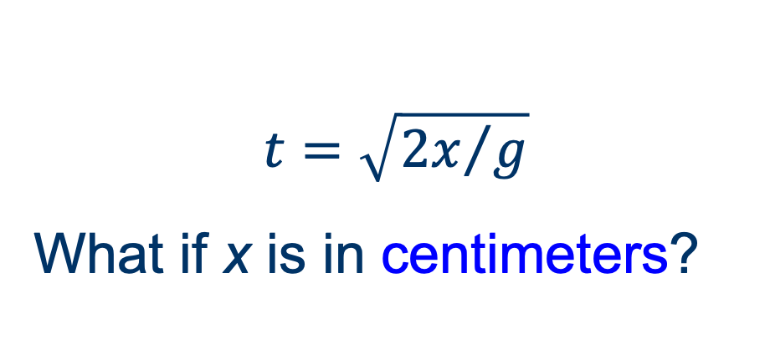
Reaction Time lab
0
0
g
x = x₀ + v₀t + ½ at²
x = ½ gt²
At what time has the ruler fallen a distance x?
t² = 2x/g
Do the units work?

Slide 21
Example Problem
A hiker drops a pebble from Thor Peak.
How long does it take to complete the 1250-m drop?
How fast is the pebble moving after dropping 1250 m?

Slide 22
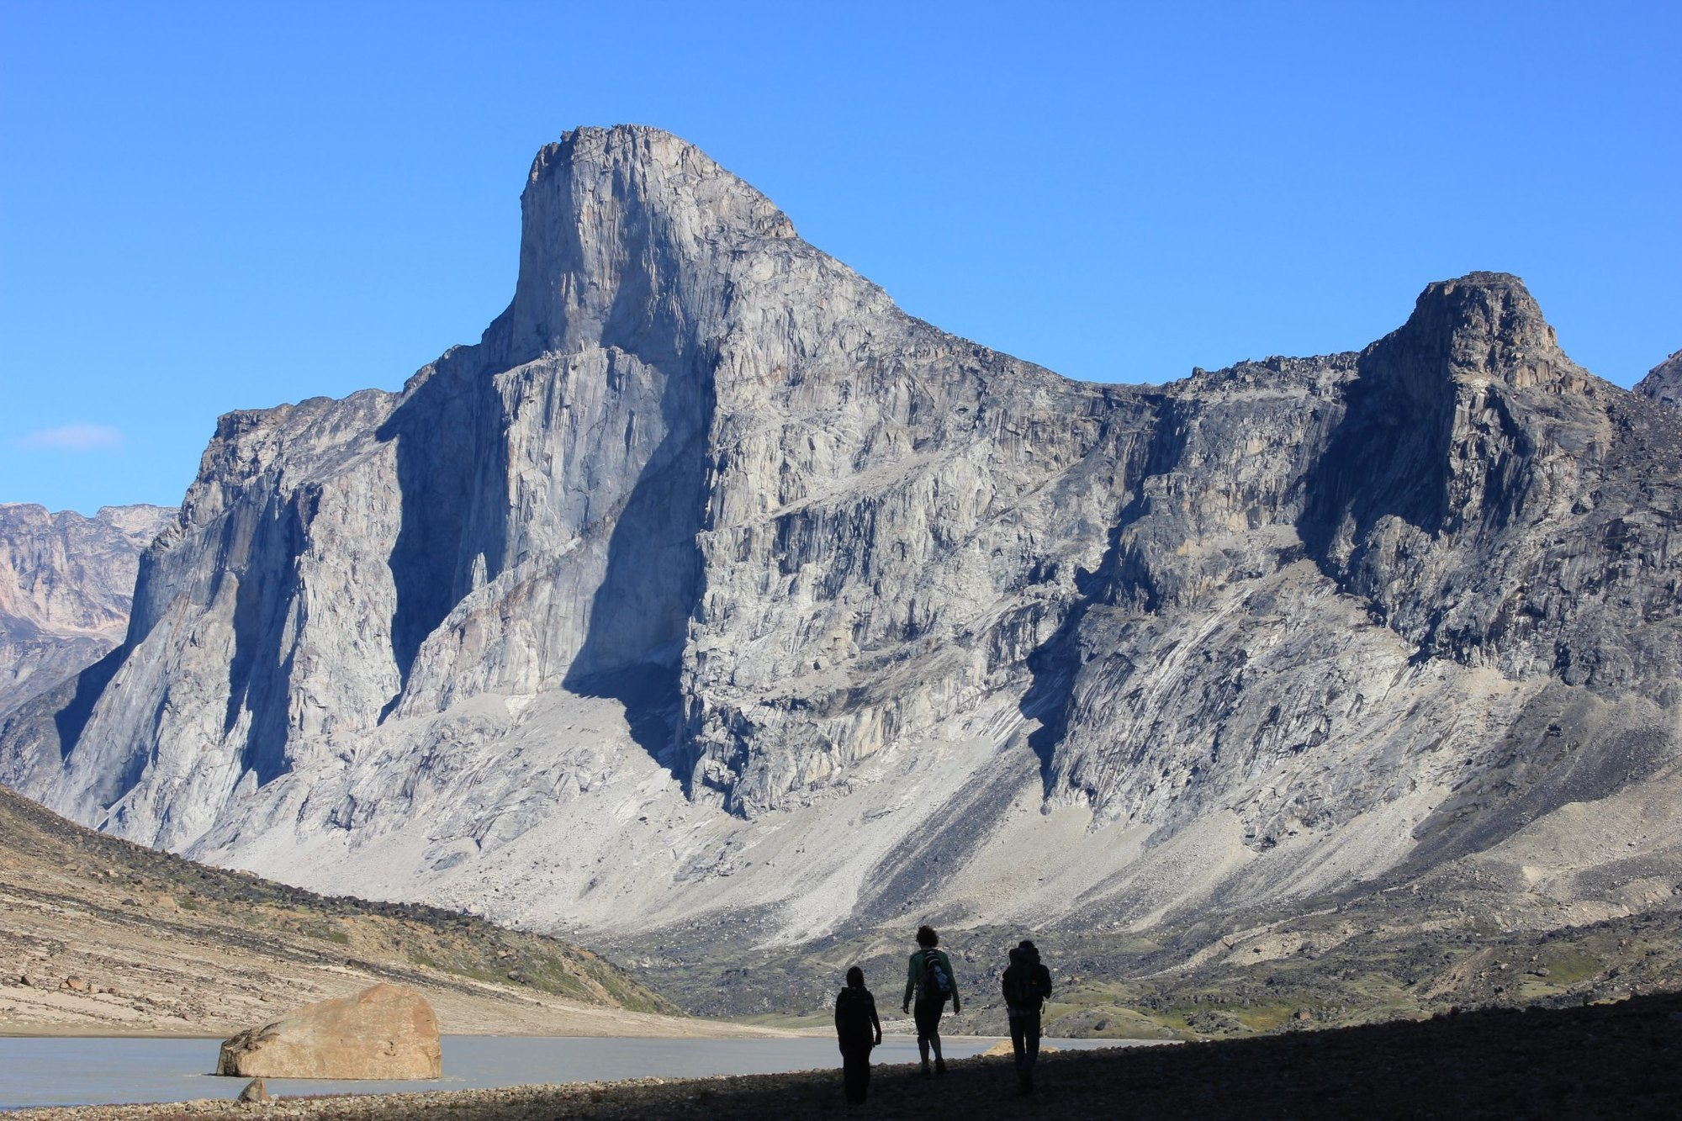
Image: Thor Mountainside

