Slide 1
Describing Motion
Position, velocity, and acceleration
§2.1–2.2

Slide 2
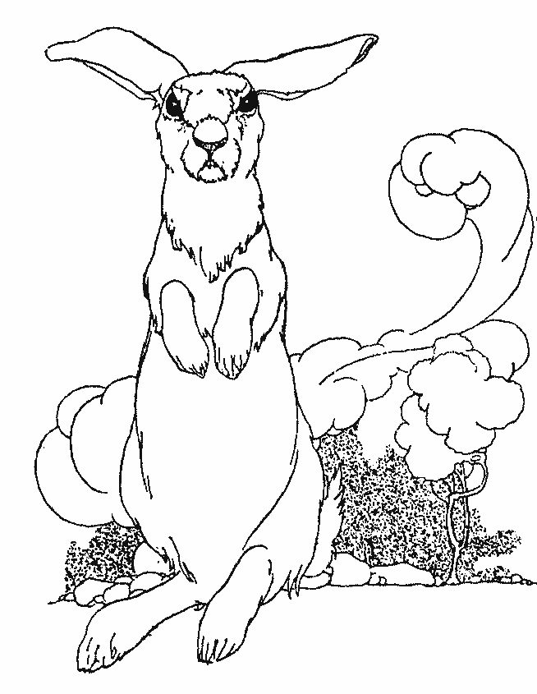
The Tortoise and the Hare
Told in words, formulas, and graphs

Slide 3
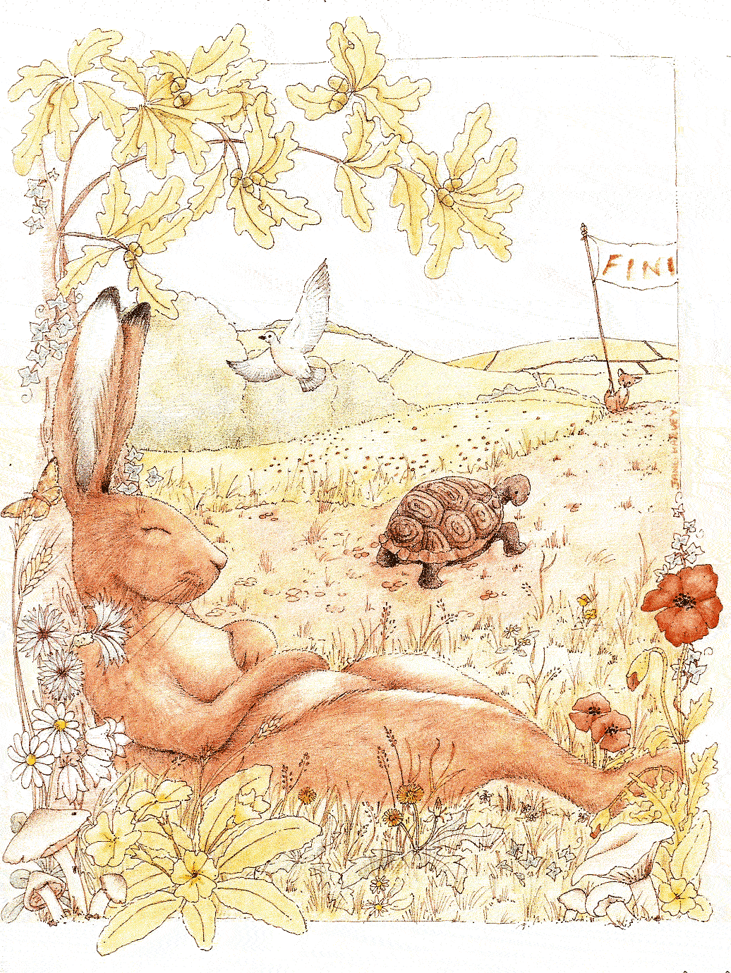

Slide 4
Group Work
Describe the Tortoise-and-hare race using a position-time graph.

Slide 5
Tortoise and hare race
finish
distance
tortoise
hare
start
t₁
t₂
t₃
hare rests
time
tortoise finishes
hare finishes

Slide 6
Question
Who was fastest?
The tortoise.
The hare.
They had the same speed.
What do you mean by faster?

Slide 7
Velocity
Rate of changing position
Δx
average velocity =
over entire interval
Δt
∆x = change in position = x – x₀
∆t = change in time = t – t₀

Slide 8
Velocity as Slope
Δ position
Velocity =
= slope of graph!
Δ time
position
Δ d
Δ t
time

Slide 9
Poll Question
Who had the greatest average velocity?
The tortoise.
The hare.
Their average speeds were the same.
Over what time interval?
What do you mean by greater?

Slide 10
Speed
path length
average Speed =
duration

Slide 11
Velocity Units
displacement
m
=
= m/s
time
s

Slide 12
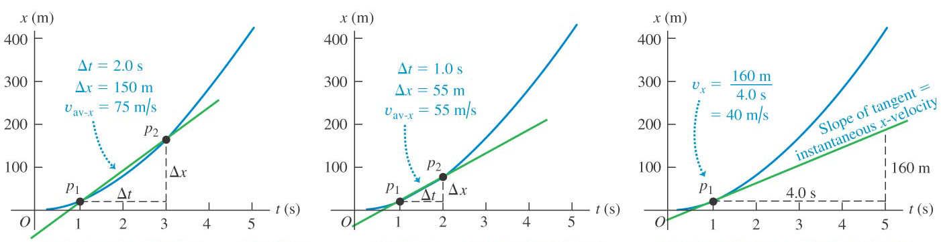
Instantaneous velocity
lim
finite Δt
smaller Δt
Δt→0
Young and Freedman, Figure 2.7

Slide 13
Displacement and path length
Displacement = position change
displacement

Slide 14
Velocity and Speed
Speed is how fast something moves through space
Velocity comprises speed and direction

Slide 15
Instantaneous quantities
Δx
instantaneous velocity = lim
at one instant
Δt
Δt
0
instantaneous speed =
magnitude of instantaneous velocity

Slide 16
Question
Who had the greatest instantaneous speed during the race?
The tortoise.
The hare.
Their instantaneous speeds were the same.
What do you mean by greatest?

Slide 17
Group Work
Describe the Tortoise-and-hare race using a velocity-time graph.

Slide 18
Rearrange the formula
v_{avg} = Δx/Δt
Δx = v_{avg}Δt
v_{avg}Δt is the area of a rectangle in a v-t graph

Slide 19
Area under a v-t graph
area = (a m/s)×(b s) = ab m
velocity (m/s)
distance units
a
b
time (s)

Slide 20
Speeds and Areas
hare
speed
area = vΔt
= Δ(distance)
tortoise
t₀
t₁
t₂
t₃
t₄
time

Slide 21
Acceleration Scenario
A car waits at a stop light for 5 seconds, smoothly accelerates to 15 m/s over 5 seconds, and then continues at 15 m/s.
Group work: Describe the car’s motion using a velocity-time graph.
(Here, you know the numbers.)

Slide 22
Acceleration
Rate of changing velocity
Δv
average acceleration =
Δt
over the entire interval
Δv
instantaneous acceleration = lim
Δt
Δt
0
at one instant

Slide 23
Poll Question
What is the SI unit for acceleration?
m.
s.
m·s.
m/s.
m²/s.
m/s².
m²/s².

Slide 24
Group Work
In the car scenario:
What is the car’s acceleration during the different segments of its motion?
0–5 s
5–10 s
after 10 s
Describe the car’s motion using an acceleration-time graph.

Slide 25
Consider
In the car scenario:
What is the car’s position during the different segments of its motion?
Qualitatively depict the car’s motion using a position-time graph.
What graph’s slope is the velocity-time graph?

