Slide 1
Questions
and concerns

Slide 2
What’s on the final?
Standards 46–51
A study guide is posted
Last year’s final is posted

Slide 3
What about retesting?
Retesting on 1–5 during final
  sort of like Exam 1
No retesting on Standards 46–51
  They’ll be partial credit

Slide 4
What’s with engines?

Slide 5
Entropy and Engines

Slide 6
Heat at constant temperature
∆S = q/T

Slide 7
Heat Engine Cycle
Heat source,Th
Qh
expand
Initial state
W
Lower T, V
Higher T, V
contract
Qc
Heat sink,Tc

Slide 8
Refrigerator Cycle
Heat sink,Th
Qh
contract
Initial state
W
expand
Lower T
Higher T
Qc
Heat source,Tc

Slide 9
Energy and Entropy
Conservation of energy
0 = Qh – Qc – W
Entropy
∆Sc = ±Qc/Tc
∆Sh = ±Qh/Th

Slide 10
Energy flow
System | Qh | Qc | W
Engine | in | out | out
Refrigerator | out | in | in

Slide 11
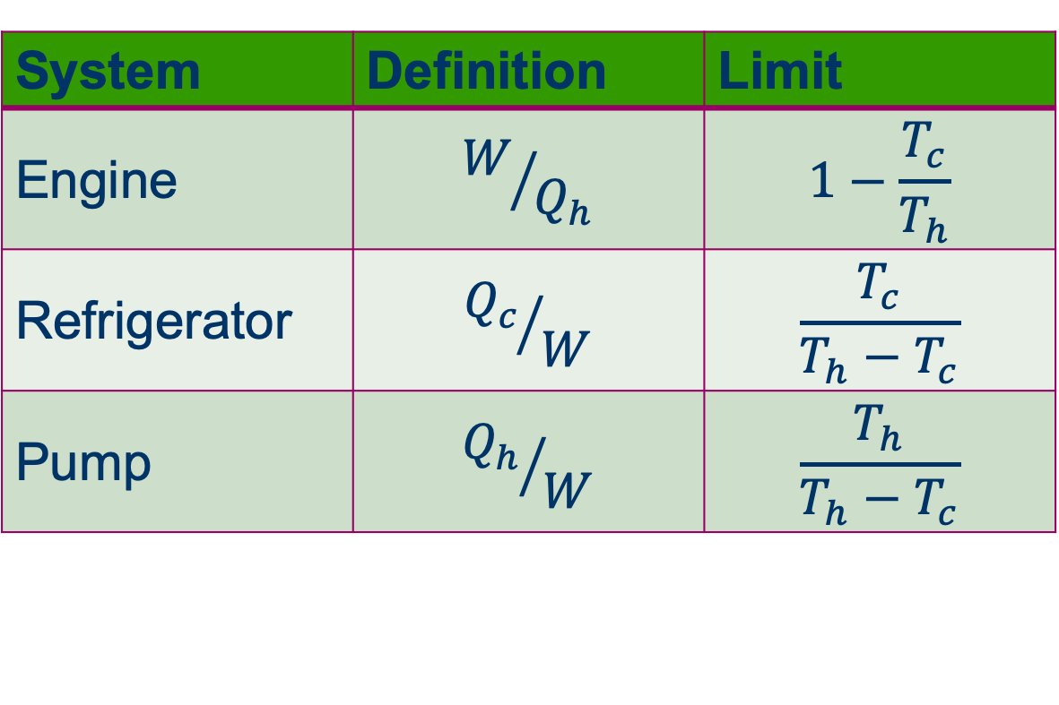
Performance
System | Definition | Limit
Engine | $$W/{Q_{h}}$$ | $$1−\frac{T_{c}}{T_{h}}$$
Refrigerator | $${Q_{c}}/W$$ | $$\frac{T_{c}}{T_{h}−T_{c}}$$
Pump | $${Q_{h}}/W$$ | $$\frac{T_{h}}{T_{h}−T_{c}}$$

Slide 12
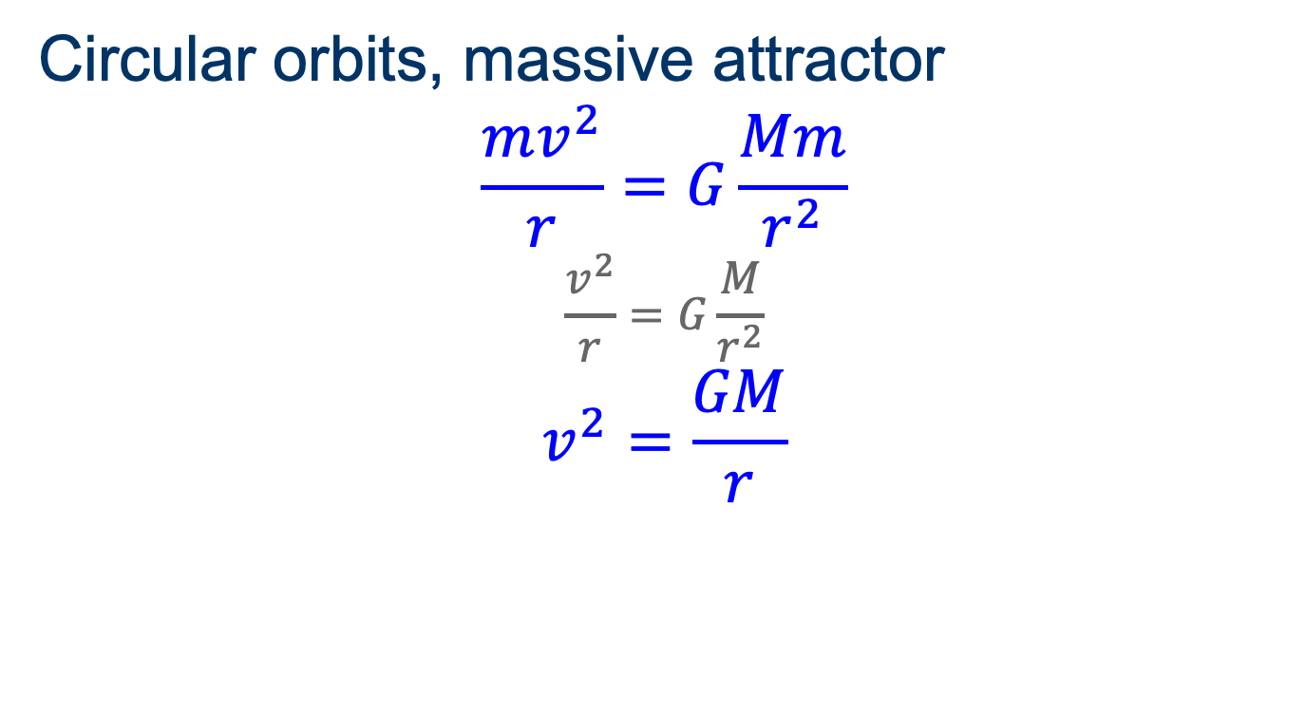
How do orbits work?
Circular orbits, massive attractor
$$\frac{mv^{2}}{r}=G\frac{Mm}{r^{2}}$$
$$\frac{v^{2}}{r}=G\frac{M}{r^{2}}$$
$$v^{2}=\frac{GM}{r}$$

Slide 13
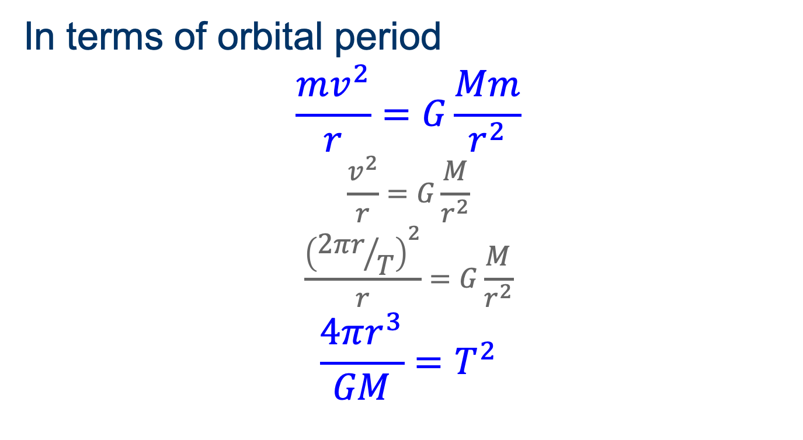
How do orbits work?
In terms of orbital period
$$\frac{mv^{2}}{r}=G\frac{Mm}{r^{2}}$$
$$\frac{v^{2}}{r}=G\frac{M}{r^{2}}$$
$$\frac{{\left({2πr}/T\right)}^{2}}{r}=G\frac{M}{r^{2}}$$
$$\frac{4πr^{3}}{GM}=T^{2}$$

Slide 14
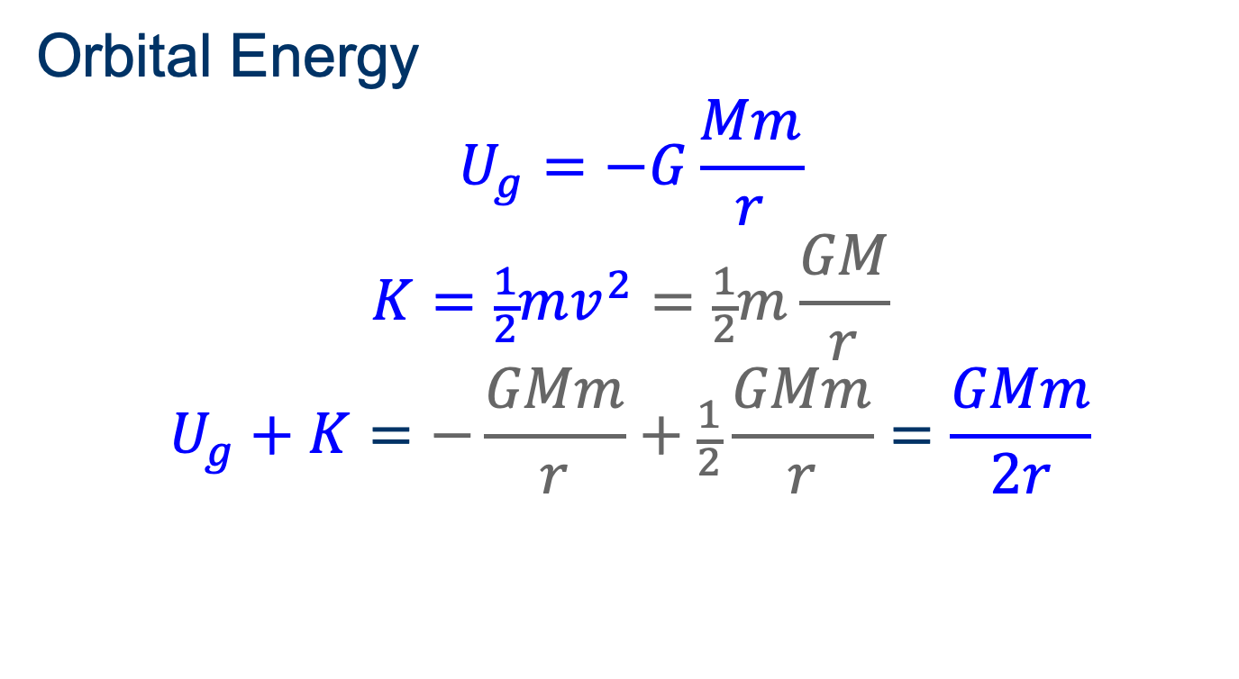
How do orbits work?
Orbital Energy
$$U_{g}=−G\frac{Mm}{r}$$
$$K=\frac{1}{2}mv^{2}=\frac{1}{2}m\frac{GM}{r}$$
$$U_{g}+K=−\frac{GMm}{r}+\frac{1}{2}\frac{GMm}{r}=\frac{GMm}{2r}$$

Slide 15

Escape
Escape Energy
$$0≤U_{g}+K$$
$$0≤\frac{1}{2}mv^{2}−\frac{GMm}{r}$$
$$v^{2}≥\frac{2GM}{r}$$

