Slide 1
Quiz 1
Next Thursday Sep 11 5:10–6 PM
CR 133
Paper-and-pencil test
Standards 1–7
You may use a calculator
You may bring an 8 ½"×11" notes sheet
Please don’t cheat

Slide 2
Your Questions

Slide 3

Does $x−x_{0}=\frac{1}{2}\left(v_{0}+v\right)t$ work if acceleration isn’t constant? It doesn’t have a in it.
No.
Imagine a car travels at 2 m/s for 20 minutes, then at 20 m/s for 2 minutes.
x – x₀ = 2400 m + 2400 m = 4800 m
not
(11 m/s)(22 min) = 14,520 m

Slide 4
How do I know which equation to use?
Does it apply to the physics of the situation?
Does it link the quantities you know to the one you want to know?

Slide 5
Does a negative acceleration mean slowing down?
Sometimes.
Negative acceleration means accelerating in the negative direction.
Slowing down means that acceleration and velocity are in opposite directions.
(Speeding up means that velocity and acceleration are in the same direction.)

Slide 6
What if you are missing more than one quantity?
You need at least one independent equation for each unknown.

Slide 7
Can you work more example problems in class?
Gaaaaah.
Discussion section is a thing.

Slide 8
What’s the difference between “instantaneous,” “average,” and “constant” quantities?
Instantaneous: At one moment
Average: One number to characterize an entire interval
Constant: Not changing during the interval
  All instantaneous values are the same
  And they equal the average as well

Slide 9
How do you convert a verbal description to a formula?
Constructing a mathematical model is the greatest challenge in solving a physics problem.

Slide 10
What unit conversions do we need to know?
Metric prefixes
For other conversions (e.g.
2.54 cm = 1 in), I’ll give you the equivalences. Your job is to use them properly.

Slide 11
Are inflection points concave up or concave down?
No.
up
down
up
down

Slide 12
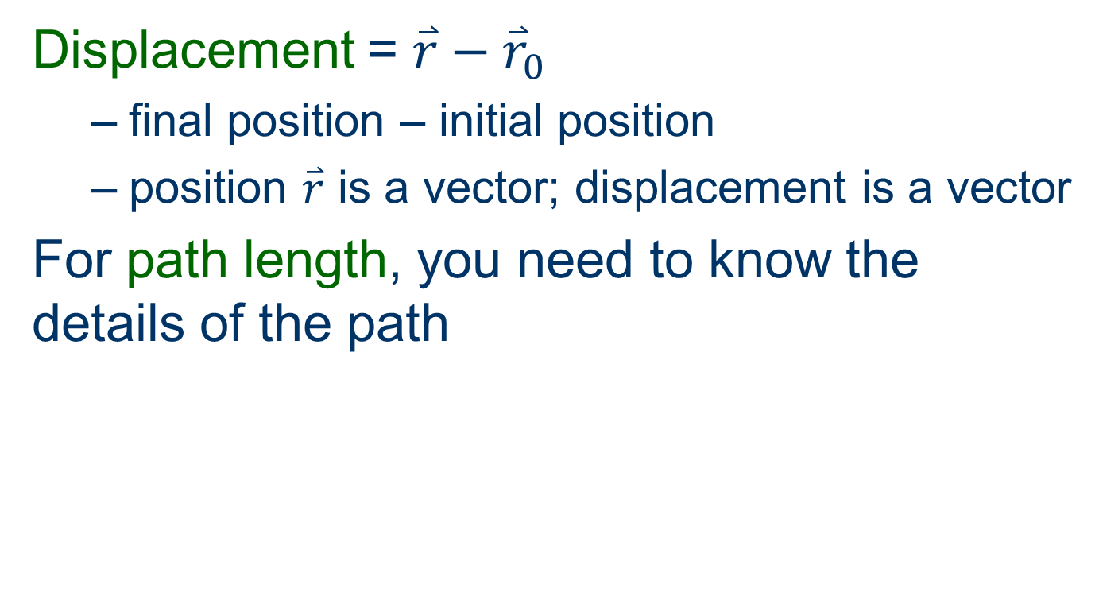
How do we distinguish displacement from path length, and how do we find each?
Displacement = $\overset{⃑}{r}−{\overset{⃑}{r}}_{0}$
  final position – initial position
  position $\overset{⃑}{r}$ is a vector; displacement is a vector
For path length, you need to know the details of the path

Slide 13
How do I know if I got the right answer?
Check the units
See if the formula makes sense
  it helps to have a formula, not just a number
Substitute your answer into the equation

