Slide 1
Galaxies
How did they get here?
§19.11

Slide 2
Galaxies
The fundamental organizational unit of the universe is the galaxy
Galaxies probably arose from slight over-densities
Pressure-density waves in e–/p⁺/γ plasma (sound waves)

Slide 3
Cosmic Microwave Background
Image: NASA/WMAP
Temperature range ±200 µK

Slide 4
What we see now
Elliptical galaxies are red and dead
Spiral galaxies contain arms with OB associations

Slide 5
When stars form
Elliptical galaxies form stars early
Spiral galaxies are slow and steady
Comins, Fig 19.18

Slide 6
Star birth inhibits disk formation
Disk before stars
Stars before disk
Comins, Fig. 19.19

Slide 7
The first galaxies
Small ellipticals
Population III stars
  metal poor
  high mass (100 M⊙)
  short lives
Coalescence of remnants birthed SMBH?

Slide 8
Reionization
Energetic population III stars ionized surrounding gas
Population III stars are a current hot topic
  How did they form?
  What mass ranges?
  How did they end?
Image: Population III star formation. Ralf Kaehler, Tom Abel.

Slide 9
Age of quasars
2.6–3.1 Gy
Galaxies so active and ISM so hot that star formation was inhibited
Quasar lull allowed star formation to resume
Peak star formation about 6 Gy
Energy output now decreases with time
  present about half of 2 Gy ago

Slide 10
Galaxies and dark matter
Appear to correlate
concentrations and voids in the same places
Dark matter overdensities probably attracted baryonic matter

Slide 11
What happens next?
fate of the universe
§19.12–19.15

Slide 12
Basic Options
Expansion continues forever
  Universe thins and cools
Expansion halts and reverses
  Big crunch

Slide 13
Perlmutter et al. study
Question: Is there enough matter in the Universe to halt expansion?
Used Type 1a SNs to study the rate at which gravity slowed cosmic expansion
Found that expansion is accelerating
2011 Physics Nobel prize
Some mysterious form of energy must be operating

Slide 14
Possible spacetime geometries
Positive
Flat
Negative
Comins, Fig. 19.21

Slide 15
Geometry
Observations indicate spacetime is flat
More evidence for inflation

Slide 16
CMB reveals energy
Model of CMB fluctuation depends on densities of
  baryonic matter
  dark matter
  dark energy
Scales of sound wave interactions depend on interplay of pressure and gravity
  affect heights of even and odd peaks

Slide 17
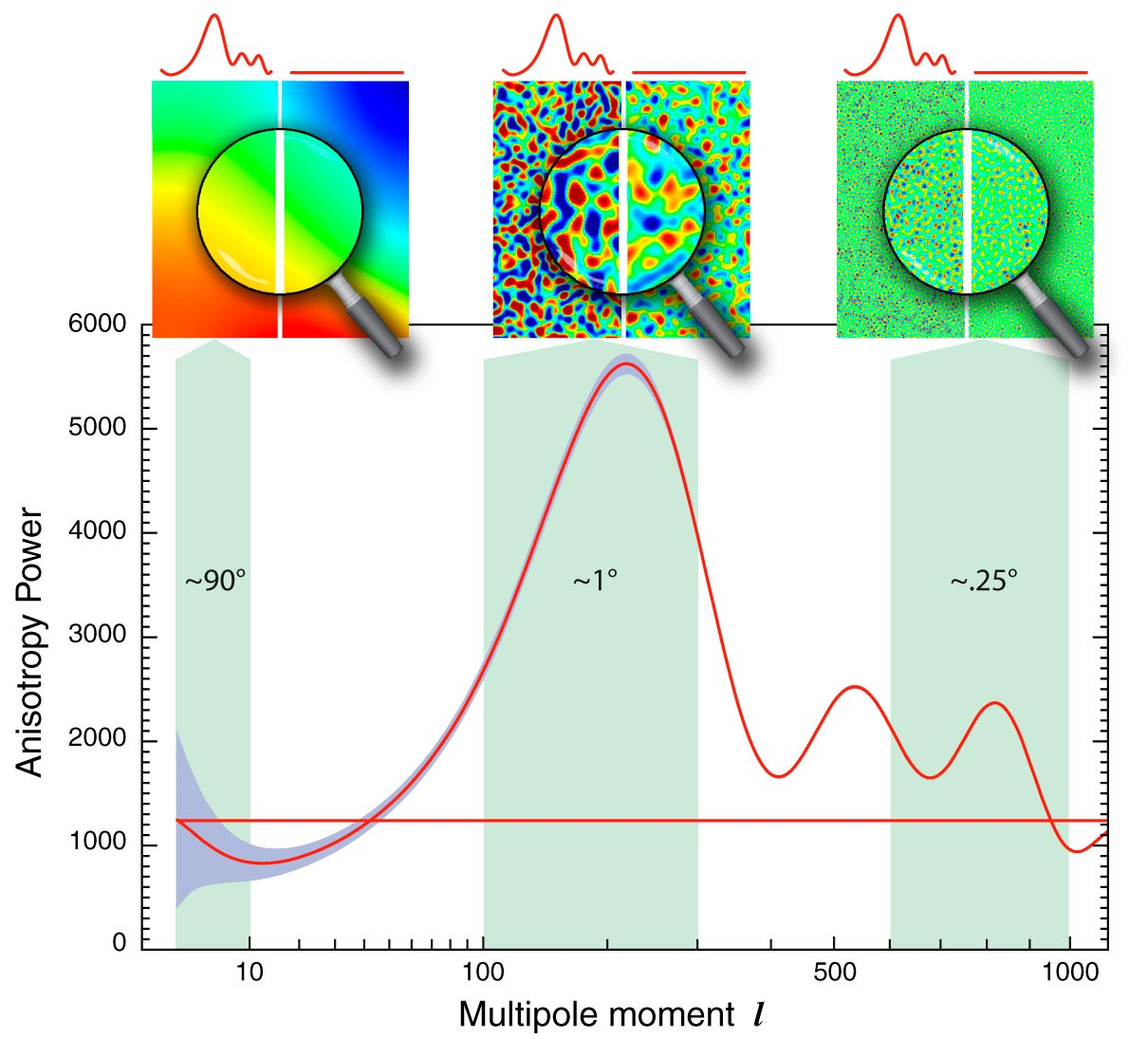
Angular fluctuation spectrum
Image: NASA

Slide 18
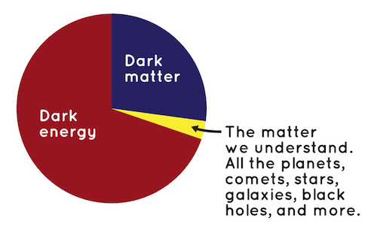
Interpretation
Universe is flat (first peak)
Baryonic matter is about 5%
Dark matter is about 24%
Dark energy is 71%

Slide 19
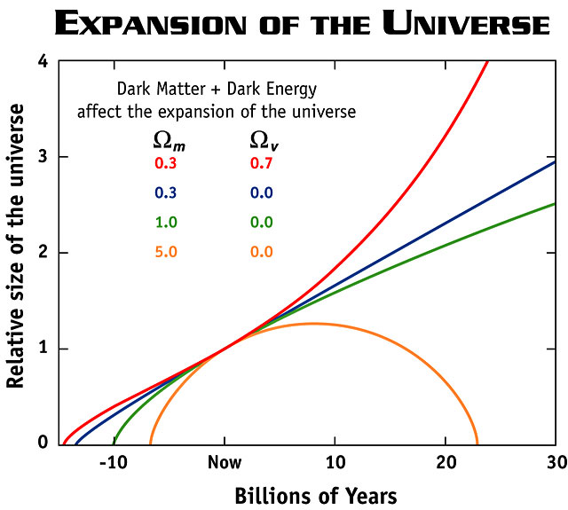
Ω_{m} = mass density
Ω_{v} = energy density
Image: NASA

Slide 20
Time line of the universe
Big Bang to the Dark Era web page

Slide 21
The prediction, so far
Expansion will continue forever
Space will cool
Probably will not have a “big rip”

