Slide 1
Galaxy Clusters
Many galaxies are in close-packed clusters
Most cluster galaxies are elliptical
Most galaxies outside clusters are spiral
ISM in clusters often emits X rays
Bound clusters often shouldn’t be by velocity and observable mass
Dark matter must be present

Slide 2
Types of Galaxy Clusters
Rich and poor
  Rich > 1000 galaxies
Regular and irregular
  Regular are spherical, centrally concentrated
Closest rich cluster: Virgo cluster
Closest regular cluster: Coma Cluster
Clusters are all redshifted

Slide 3
Virgo Cluster
Image: Abdullah Alharbi, via APOD

Slide 4
Coma Cluster
Image: Joe Hua, via APOD

Slide 5
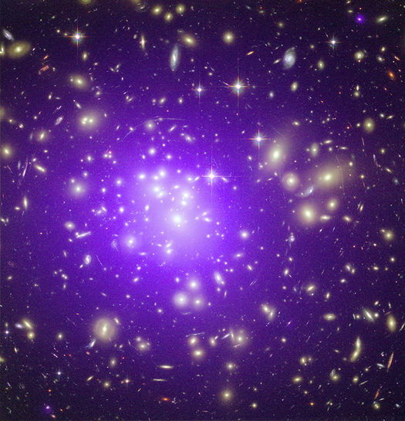
Abell 1689
X ray source
Gravita-tional lens
Image: Chandra/HST Composite

Slide 6
Galaxy Groups
Smaller than clusters
A few large galaxies and more satellites
Our group is the local group
  Milky Way, Andromeda. Triangulum, many dwarfs

Slide 7
Local Group
Comins, Fig. 17.20

Slide 8
Stephan’s Quintet
Image: Hubble

Slide 9
Galaxy Superclusters
Not gravitationally bound

Slide 10
Hubble-Lemaitre law
Comins, Fig. 17.345

Slide 11
The Universe is Expanding
Everywhere
Space itself is stretching

