Slide 1
Hubble Classification
Comins, Fig. 17.15

Slide 2
Three Primary Categories
Elliptical
Spiral
Irregular

Slide 3
Spiral Galaxies
Spiral Galaxy M81
Image: NASA/ESA, Hubble

Slide 4
Spiral Galaxies
Contain disk, bulge, halo
  Halo stars Population II
Spiral arms in disk
  Spiral arm stars Population I
Winding of spiral arms correlates to bulge size
10⁹–10¹³ M⊙
  Milky Way ~1.5×10¹² M⊙

Slide 5
Spiral Arms
If lines of stars, arms would wind tightly
  they don’t
Instead, spiral density waves initiate star formation
Waves travel more slowly than the galactic matter
  Animation
Mechanism maintaining waves TBD

Slide 6
Spiral Galaxy Classification
Sa: Large bulge, tight spiral
Sb: Moderate bulge, moderate spiral
Sc: Small bulge, loose spiral
SB’s: same, but with central bars

Slide 7
Andromeda Galaxy
Closest large spiral
About as large as Milky Way
UV Tour (Swift)
No bar, no ring, moderate winding SA(s)b

Slide 8
NGC 891, Sb
Image: Adam Block, Mt. Lemmon Sky Center

Slide 9
Flocculent Spirals
Self propagating star formation

Slide 10
Flocculent Spiral NGC 4414
Poorly-defined spiral arms
Image: NASA/ESA/ Hubble

Slide 11
Barred Spiral Galaxies
Bar contains stars in highly elliptical orbits
Bars increasing in frequency
  70% of nearby spirals are barred
  20% of distant spirals are barred

Slide 12
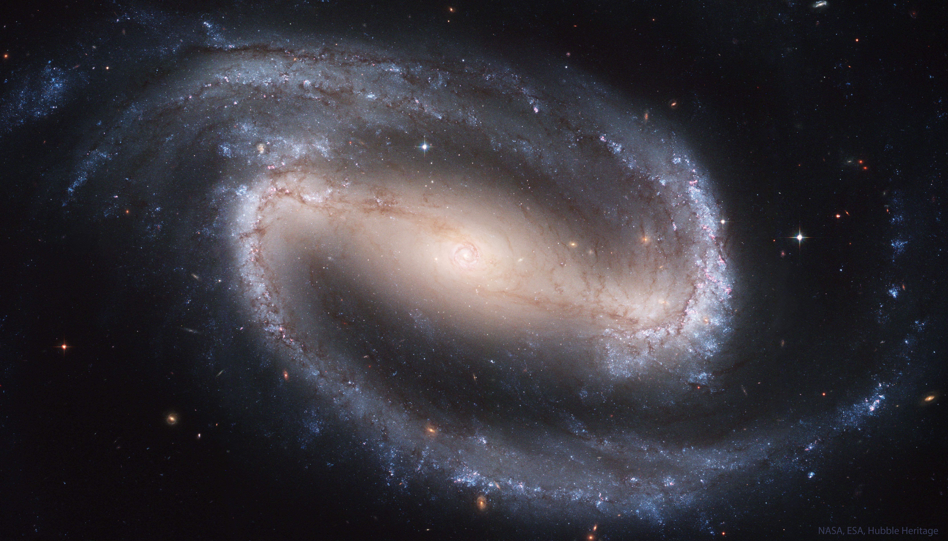
Barred Spiral NGC 1300
Image: Hubble

Slide 13
Grand Design Spiral NGC 1232
Image: European Southern Observatory

Slide 14
Grand Design Spirals
Multiple symmetrical arms
Often accompanied by a nearby satellite

Slide 15
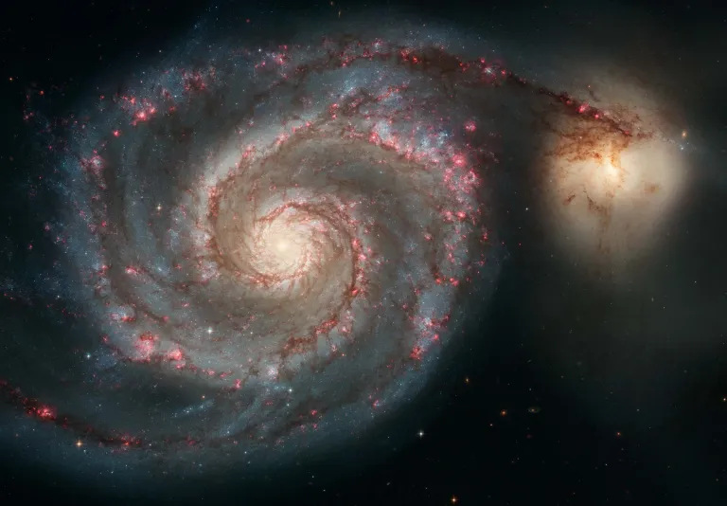
Whirlpool Galaxy
Image: Hubble

Slide 16
Lenticulars
Disk galaxies without spiral arms
Usually lacking in gas and dust
May be barred

Slide 17
Lenticular Galaxy NGC 5866

Slide 18
Spiral Galaxy Rotation Curves
Mass distribution not all visible
Dark matter must be present

Slide 19
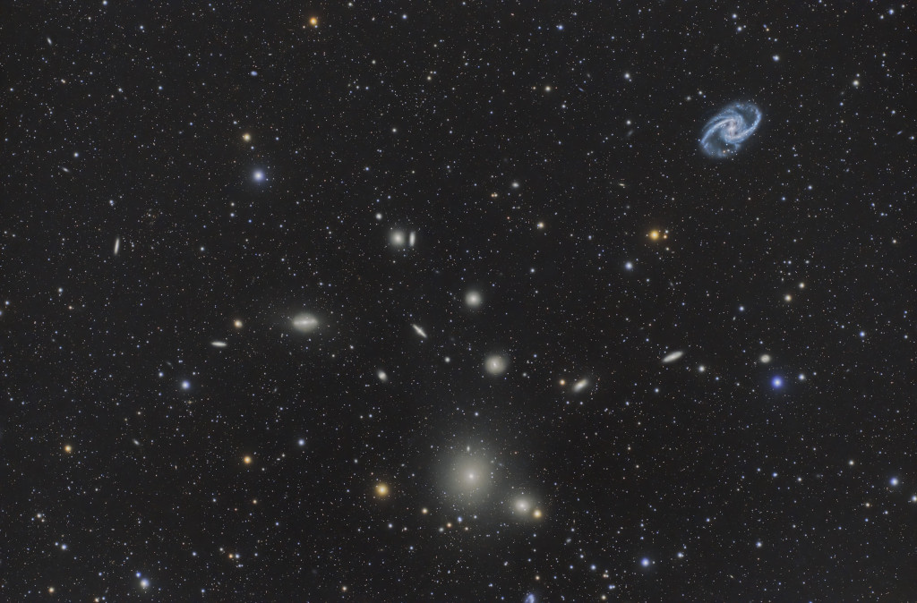
Elliptical Galaxies
Fornax Cluster. Marcelo Rivera, via APOD

Slide 20
Elliptical Galaxies
Smallest and largest of the galaxies
Range from dwarf to giant
May form from collisions of galaxies
Computed MW + And video
Tend to contain Population Il stars

Slide 21
Irregular Galaxies
No clear symmetry or organized structure
Often small, or interacting galaxies
Irr-I contain dust and young Pop I stars
  O,B
Irr-II contain Pop II stars
SMC and LMC are Irr-I

Slide 22
Irregular Galaxy M55
Image: Martin Pugh

Slide 23
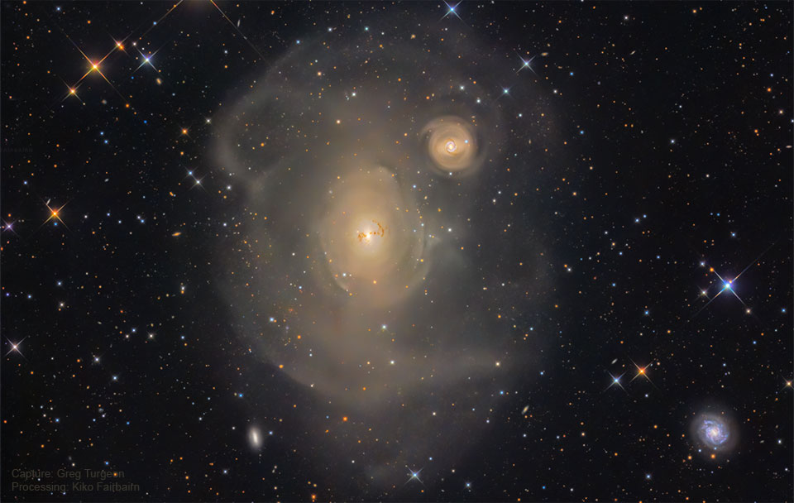
Galactic Cannibalism
Image: Greg Turgeon, via APOD

Slide 24
ARP 142: two views

Slide 25
NGC 6240
Contains two supermassive black holes
Image: Hubble

Slide 26
Antenna Galaxies
Image: Kent E. Biggs, via APOD

Slide 27
Mice Galaxies
Image: Hubble

Slide 28
Will We Collide with M31?
Simulation

Slide 29
Hoag’s Object
Image: NASA/ESA/Hubble

Slide 30
Galaxy Clusters
Many galaxies are in close-packed clusters
Most cluster galaxies are elliptical
Most galaxies outside clusters are spiral
ISM in clusters often emits X rays
Bound clusters often shouldn’t be by velocity and observable mass
Dark matter must be present

Slide 31
Types of Galaxy Clusters
Rich and poor
  Rich > 1000 galaxies
Regular and irregular
  Regular are spherical, centrally concentrated
Closest rich cluster: Virgo cluster
Closest regular cluster: Coma Cluster
Clusters are all redshifted

Slide 32
Virgo Cluster
Image: Abdullah Alharbi, via APOD

Slide 33
Coma Cluster
Image: Joe Hua, via APOD

Slide 34
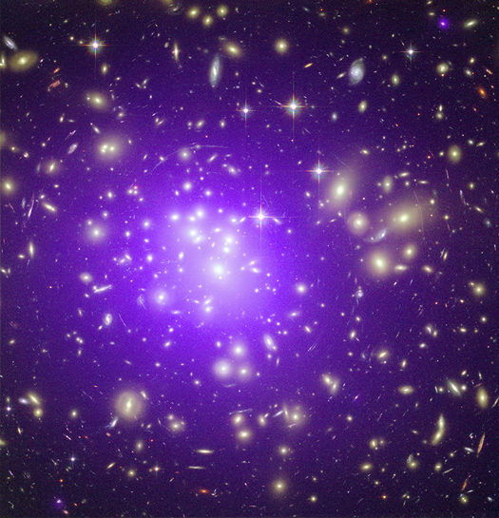
Abell 1689
X ray source
Gravita-tional lens
Image: Chandra/HST Composite

Slide 35
Galaxy Groups
Smaller than clusters
A few large galaxies and more satellites
Our group is the local group
  Milky Way, Andromeda. Triangulum, many dwarfs

Slide 36
Local Group
Comins, Fig. 17.20

Slide 37
Stephan’s Quintet
Image: Hubble

Slide 38
Galaxy Superclusters
Not gravitationally bound

Slide 39
Hubble-Lemaitre law
Comins, Fig. 17.345

Slide 40
The Universe is Expanding
Everywhere
Space itself is stretching

