Slide 1
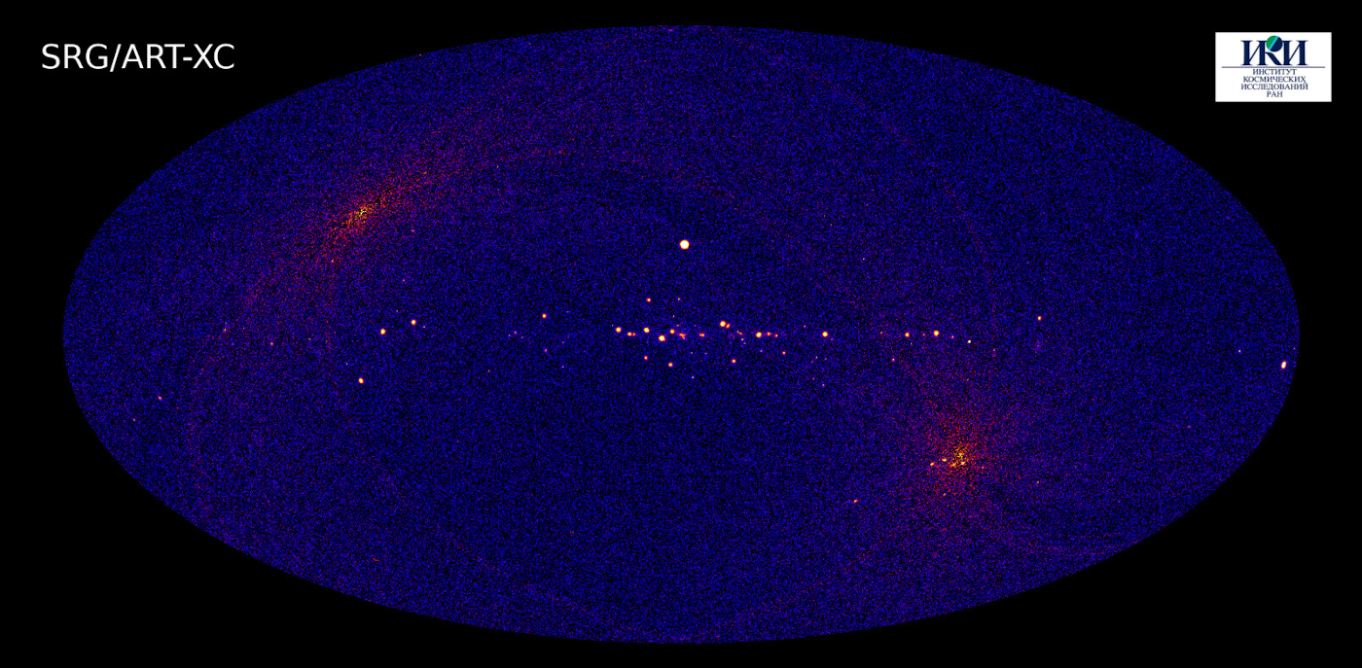
Observing Black Holes
Image: SRG, 4–12 keV band

Slide 2
Observing a Black Hole
How?
They don’t emit light
They don’t emit anything
Options:
Gravitational lensing
Accretion
Hawking radiation

Slide 3
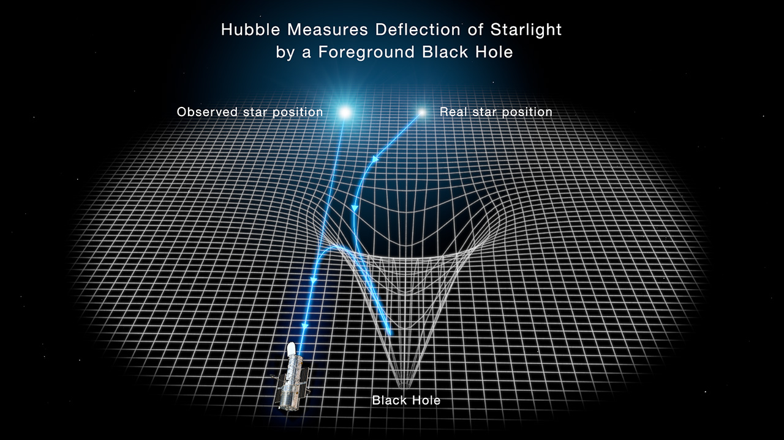
Hubble Hunt: Lensing
Image: Joseph Olmstead, NASA

Slide 4
Cygnus X-1
Image: Visible wavelengths, NASA?ESA

Slide 5
Cygnus X-1
Brightest X-ray source in the sky
Bunary companion to blue supergiant HDE226868 (30 M⊙)
Compact object 9–20 M⊙
Orbit ~0.2 AU; T ~ 5.6 days

Slide 7
X-Ray Source
X-rays emitted by accretion disk
Infalling material heated to fantastic temperatures
Emit X-rays
Variability suggests small object
Spin may be very fast
“Stellar mass black hole”

Slide 8
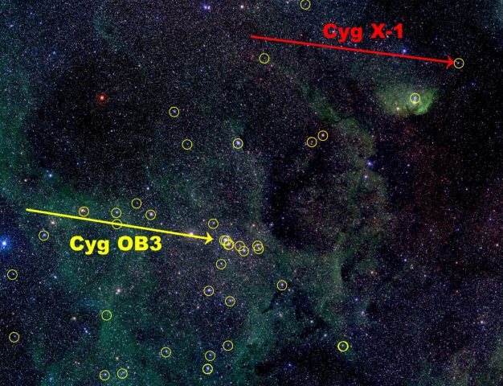
Cygnus OB Association
Image: IAFE, via APOD

Slide 9
Progenitor Star
Probably > 60 M⊙
Collapsed without explosion

Slide 10
M87
jet
Image: Mt Lemmon Sky Center

Slide 11
M87
Large elliptical galaxy in Virgo cluster
Supermassive galaxy
Lacks substantial gas or dust
Bright radio source
enigmatic jet near nucleus

Slide 12
M87 Jet
Image: NASA/Hubble

Slide 13
M87 Jet
Ions accelerated along axis of accretion disk
NASA video

Slide 14
M87 Nucleus
Image: Event Horizon Telescope

Slide 15
M87’S supermassive black hole
~6.5 billion M⊙
R_{S} ~ 120 AU

Slide 16
Milky Way Galaxy
Center in Sagittarius, near Scorpius
Star video
Strong radio and X-ray source

Slide 17
Sgr A*
Main image: IR,/VIS, HST; inset x-ray, Chandra

Slide 18
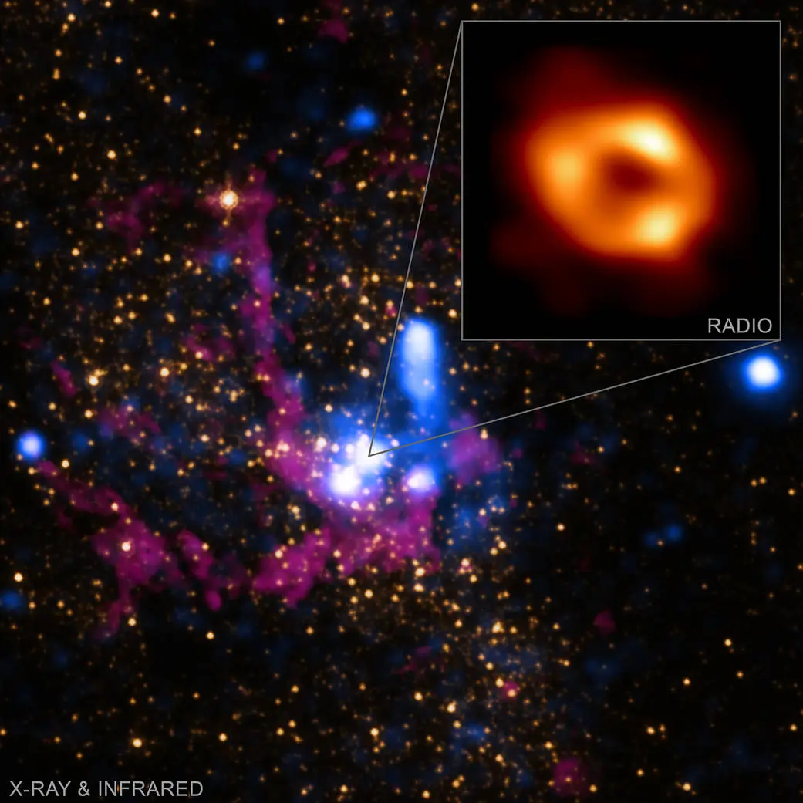
Insert: EHT
Multiple wavelength image

Slide 19
Milky Way’s black hole
4.31 million M⊙
R_{S} ~ 0.08 AU

Slide 20
Intermediate-mass black holes?
They probably exist
  Centers of globular clusters
  Ultra-luminous x-ray sources
  Candidate near Sgr A*

Slide 21
Hawking Radiation
Virtual particle pairs can be created just outside event horizon
One returns, one escapes
Black hole loses mass over time
Process gets faster as black hole becomes lighter

