Slide 1
How Stars Die
Some with a bang
some with a whimper
SN1987A remnant, false color Near IR, Webb telescope

Slide 2
Stars’ Ends
< 0.4 M⊙: fade away
0.4–8 M⊙: white dwarf
> 8 M⊙: core collapse

Slide 3
0.4–8 M⊙ Stars
Giant phase
  Shell H fusion
Core He fusion
  flash or no flash
  Horizontal branch

Slide 4
Beyond the Horizontal Branch
Core exhausts He, contracts
He shell fusion initiates
H shell fusion outside He layer
Star expands and cools
Asymptotic Giant Branch

Slide 5
Asymptotic Giant Branch
Comins, Fig. 14-2

Slide 6
Mass Loss
Sheds ~30% first time as a giant
Sheds ~50% as AGB

Slide 7
Low-Mass AGB Stars
Core and shell degenerate
Shell can He flash several times
Envelope expands and cools, cooling core
Shell plasma recombines, radiates
Temperature jump expels envelope
Planetary nebula expands from star

Slide 8
Helix Nebula
Image: Patrick Winkler, via APOD

Slide 9
HFG1 and Abell 6
Image: Julian Cadena, via APOD

Slide 10
Little Ghost Nebula
Image: Hubble Heritage, via APOD

Slide 11
M2-9
Image: B. Balick, via APOD

Slide 12
NGC 2392
Image: NASA/Hubble

Slide 13
Planetary Nebulae
Named for disk appearance
Complex shapes not fully understood
Account for 85% of material expelled by stars
Material source for Population I stars

Slide 14
The Core
Becomes a Wolf-Rayet-type star [WR]
  High surface temperature 20–200 kK
  spectral lines of ionized He, C, N
  weak or absent H lines
Cools to a white dwarf
  6 kK in about 5 billion years
Eventually becomes black dwarf
  many billions of years

Slide 15
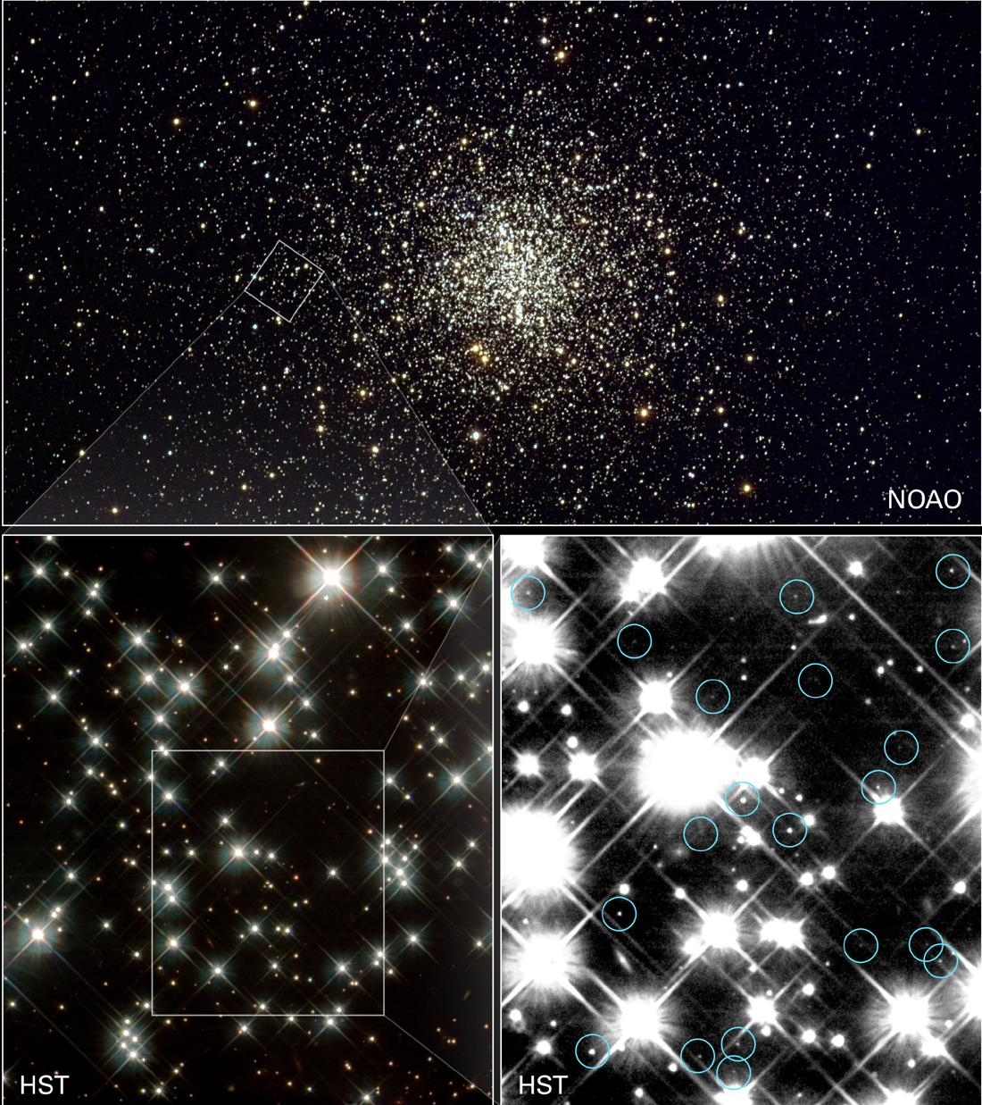
Cluster M4
Circled objects are white dwarfs
Images:
upper: Kitt Peak
Lower: HST

Slide 16
Stars over 8 M⊙
Core He fusion to C, O
C fusion to Ne, Mg
O fusion to S, Si, P
Si fusion to Fe
Each step takes less time

Slide 17
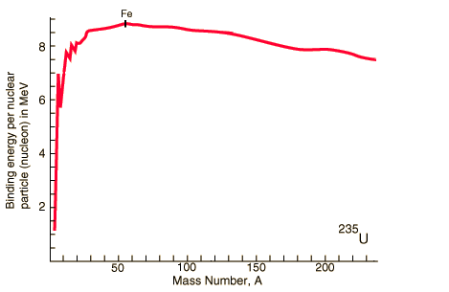
Binding Energy
fission
fusion
Source: Georgia State U., Hyperphysics
http://hyperphysics.phy-astr.gsu.edu/hbase/nucene/nucbin.html

Slide 18
End-stage Supergiant
Comins, Fig. 14.10

Slide 19
Then what?
Iron does not yield energy by fusion
Cannot maintain hydrostatic pressure
Core collapses

Slide 20
Core Collapse
Rising temperature causes photodisintegration
p⁺ + e– → n + ν_{e}
Core reaches nuclear density, bounces
Envelope falls in at ~0.15c
Core and ν collide with envelope
Type II Supernova
r-process nucleosynthesis

Slide 21
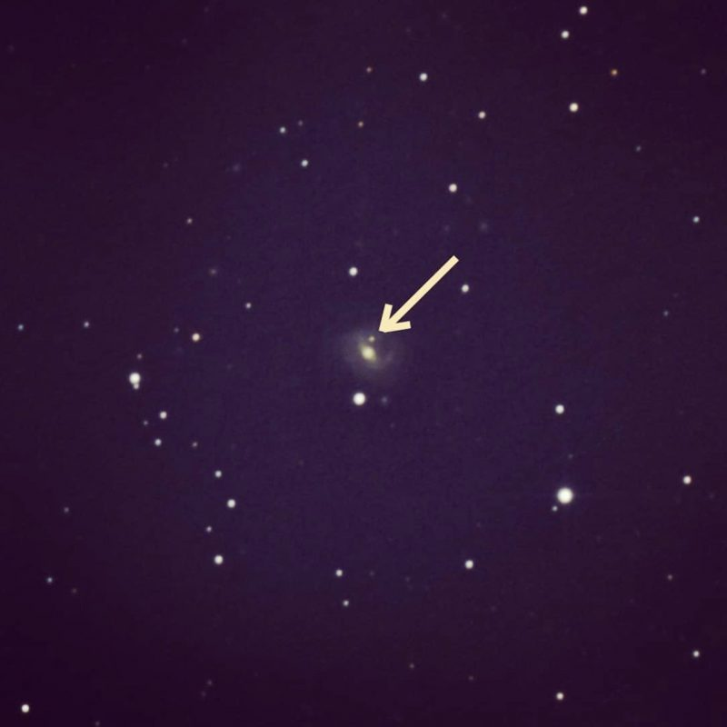
Extragalactic Supernova
SN2018iq
Image: Brian Ottum, via earthsky

Slide 22
Supernova frequency
Estimated ~ 1 per 100y in a galaxy
We haven’t seen one in the Milky Way since 1604
  Kepler’s Supernova
Why so long ago?

Slide 23
Supernova 1987A
In Large Magellanic Cloud
Feb 24, 1987
peak m = 2.9
progenitor star B supergiant
13-second neutrino burst
  12 events at Kamiokande II
  5 at Baksan
  8 at IMB

