Slide 1
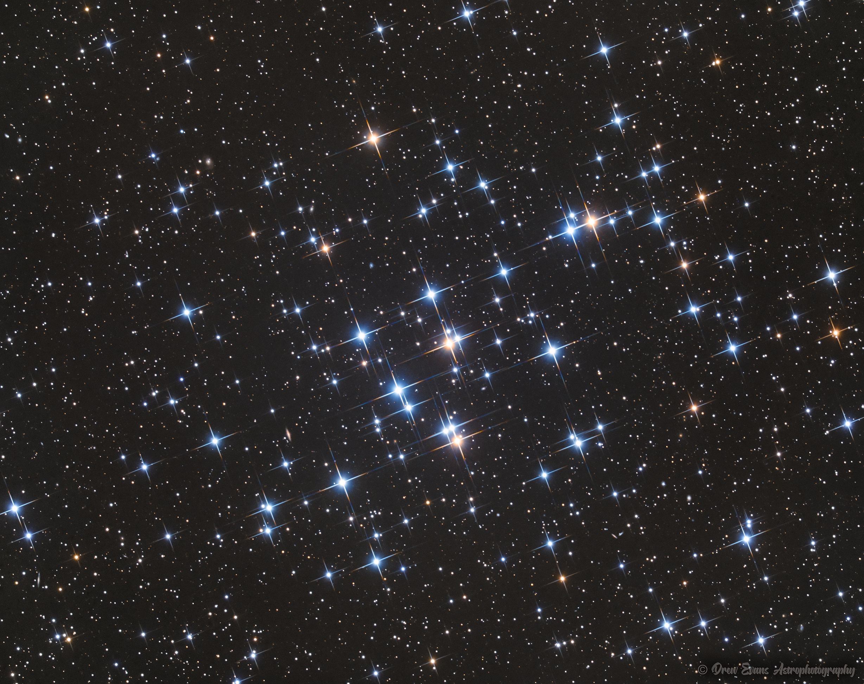
Joining the Main Sequence
Beehive Cluster in Cancer
How stars form
Image: Drew Evans

Slide 2
Star Clusters
Associations of stars visually close together
If actually associated, probably born from the same stellar nebula
Same age
Same distance from Earth

Slide 3
Open Clusters
Irregular cluster of stars
Typically young, metal-rich
Loosely connected
  Stars escape
  Each escape weakens the bonds between the rest
Mostly found in the Galaxy’s spiral arms

Slide 4
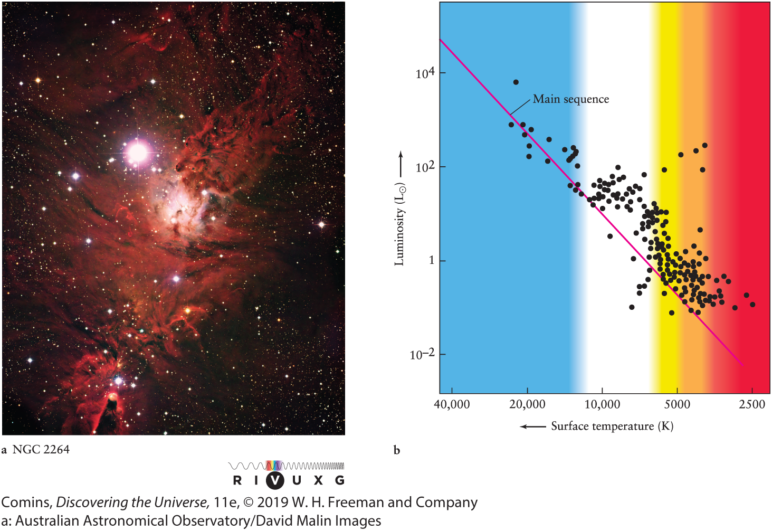
Very Young Cluster NGC 2264
Light Proto-stars have not reached Main Sequence
Estimated 2 My
Comins, Fig. 13-19

Slide 5
Main Sequence
Core H fusion
Hydrostatic equilibrium

Slide 6
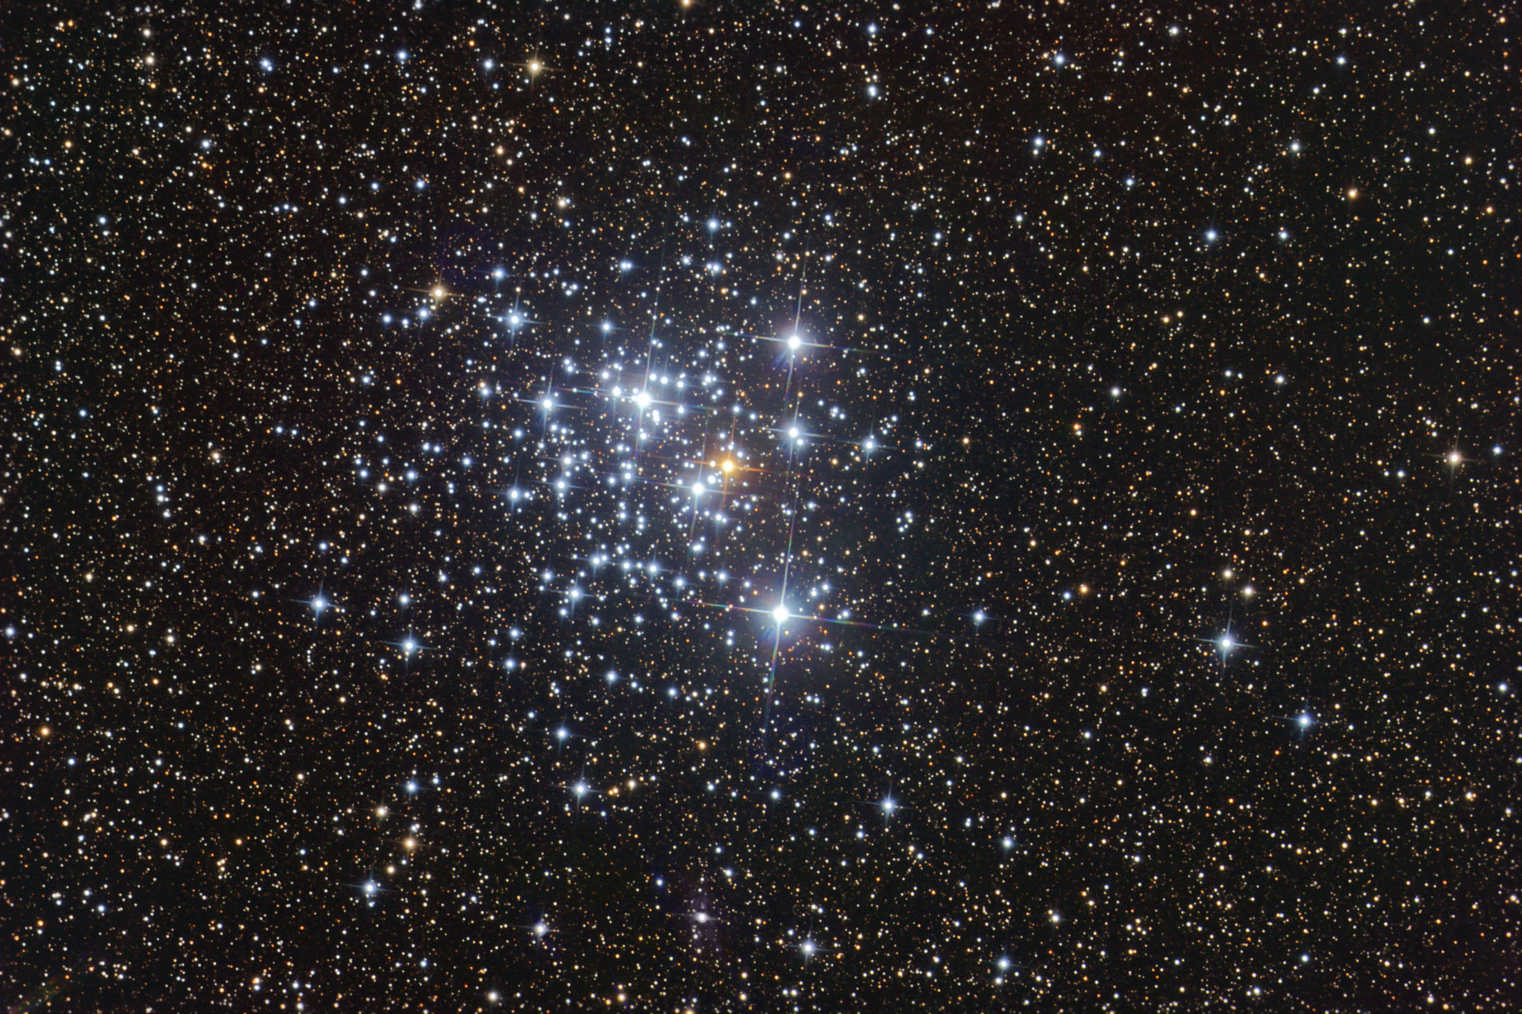
“Jewel box” cluster, NGC 4755 (Kappa Crucis)
Image: Dieter Willasch, via Astronomy Picture of the Day

Slide 7
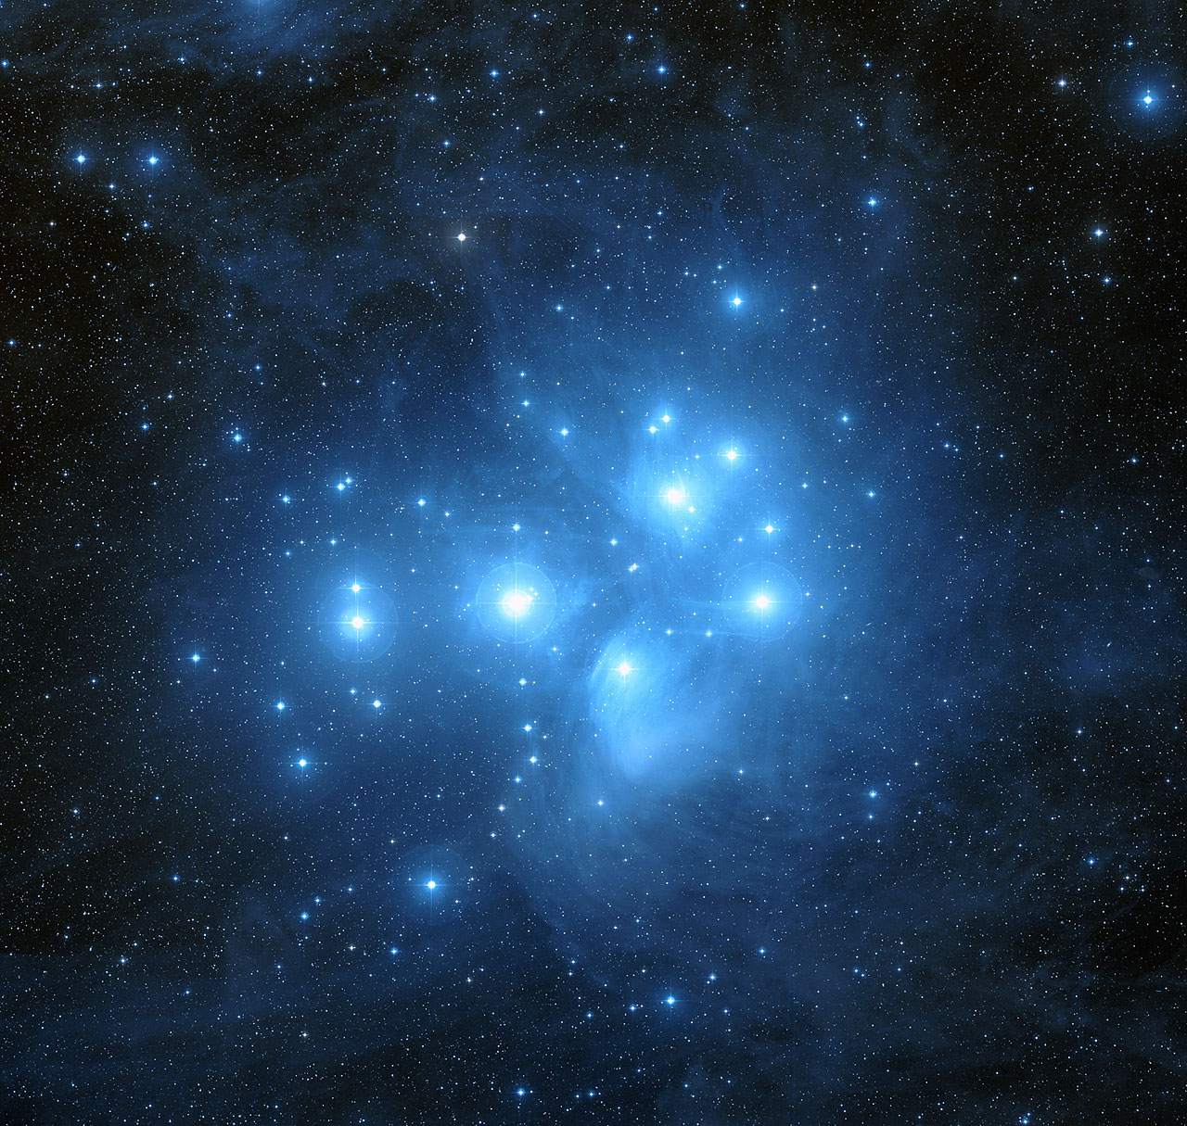
Pleiades Cluster in Taurus
Image: Hubble data, processed by Davide De Martin

Slide 8
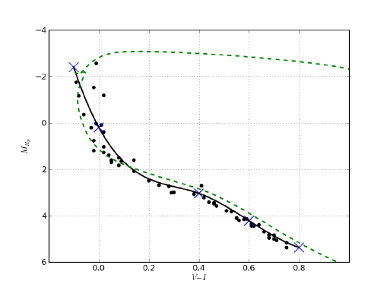
Pleiades
Image: Frédéric Arenou, via ResearchGate

Slide 9
HII Regions
O and B stars ionize enclosing molecular cloud
Observe in Ha at 656 nm
O at 501
  more visible to eye

Slide 10
Leaving the Main Sequence
How stars age

Slide 11
Star Lifetimes
Massive stars live fast and die young
Fusion rate increases with mass faster than direct proportion

Slide 12
Star Lifetimes
Mass (M_{ʘ}) | Surface temperature (K) | Luminosity (L_{ʘ}) | Time on main sequence (10⁶ years) | Spectral class
25 | 35,000 | 80,000 | 3 | O
15 | 30,000 | 10,000 | 15 | B
3 | 11,000 | 60 | 500 | A
1.5 | 7000 | 5 | 3000 | F
1.0 (Sun) | 6000 | 1 | 10,000 | G
0.75 | 5000 | 0.5 | 15,000 | K
0.50 | 4000 | 0.03 | 200,000 | M
Comins, Table 13.2
Older than age of universe

Slide 13
Dwarf Stars 0.08–0.4 M⊙
Keep fusing H until it runs out
Fully convective: complete mixing
Will end as cooling balls of He
(Far in the future)

Slide 14
Above 0.4 M⊙
Stars not convective near core
  radiative zone
When core H diminishes, core is crushed
H shell fusion initiates around core
Outer layers expand, cool
“Red Giant” star phase
Cooler, larger, more luminous than MS

Slide 15
Giant Star stage
Comins, Fig 13-22

Slide 16
H Shell Fusion
Creates He
He settles to core
Core becomes hot and dense enough to fuse He
  100 million K

Slide 17
Helium Fusion
“Triple alpha process”
⁴He + ⁴He → ⁸Be
¹²C + γ
⁴He
Then
¹²C + ⁴He → ¹⁶O + γ

Slide 18
0.4–2 M⊙: Helium Flash
Core compression halted by electron degeneracy pressure
Volume does not increase with temperature
He fusion rapidly ignites
Comins, Fig. 13-25a

Slide 19
0.4–2 M⊙: Helium Flash
Temperature rises to 3.5 MK in a few hours
Degeneracy breaks, core expands and cools
H-fusing layer expands and cools
Star shrinks
Comins, Fig. 13-25a

Slide 20
Above 2 M⊙: He fusion, no flash
Cores do not become degenerate
Feedback between p, T, V, and fusion rate
Some cycling in size and luminosity, not as abrupt as with He flash

Slide 21
Giants and He fusion
Luminosity changes less dramatically for heavier giants
Comins, Fig. 13-25b

Slide 22
Instability Strip
Some stars have He in the photosphere near ionization temperature
Opaque ionized, transparent recombined
Comins, Fig. 13-26

Slide 23
Cepheid Variables
Absorbs light and expands when ionized
Expands, increasing irradiance
Cools, recombines, becomes transparent
Cools and contracts

Slide 24
Cepheid Variables
Direct proportion between period and luminosity
Standard Candle for distance
Comins, Fig. 13.28

Slide 25
Globular Clusters
Spherical (“globular”) cluster of stars
Typically very old, metal-poor
Gravitationally bound
  stars seldom escape
Spherically distributed about the Galactic center

Slide 26
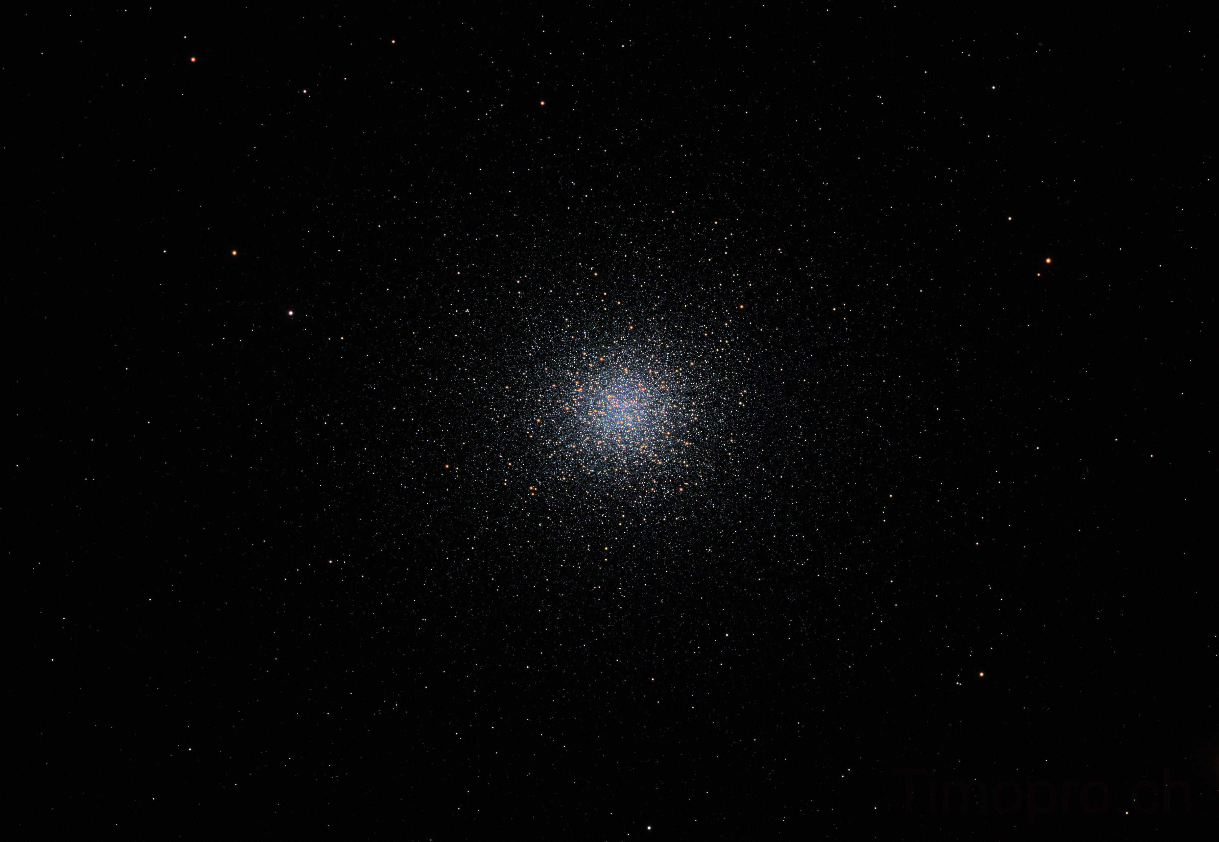
Messier 13
Image: Timothy Prospero

Slide 27
Image: Robert Vanderbei

Slide 28
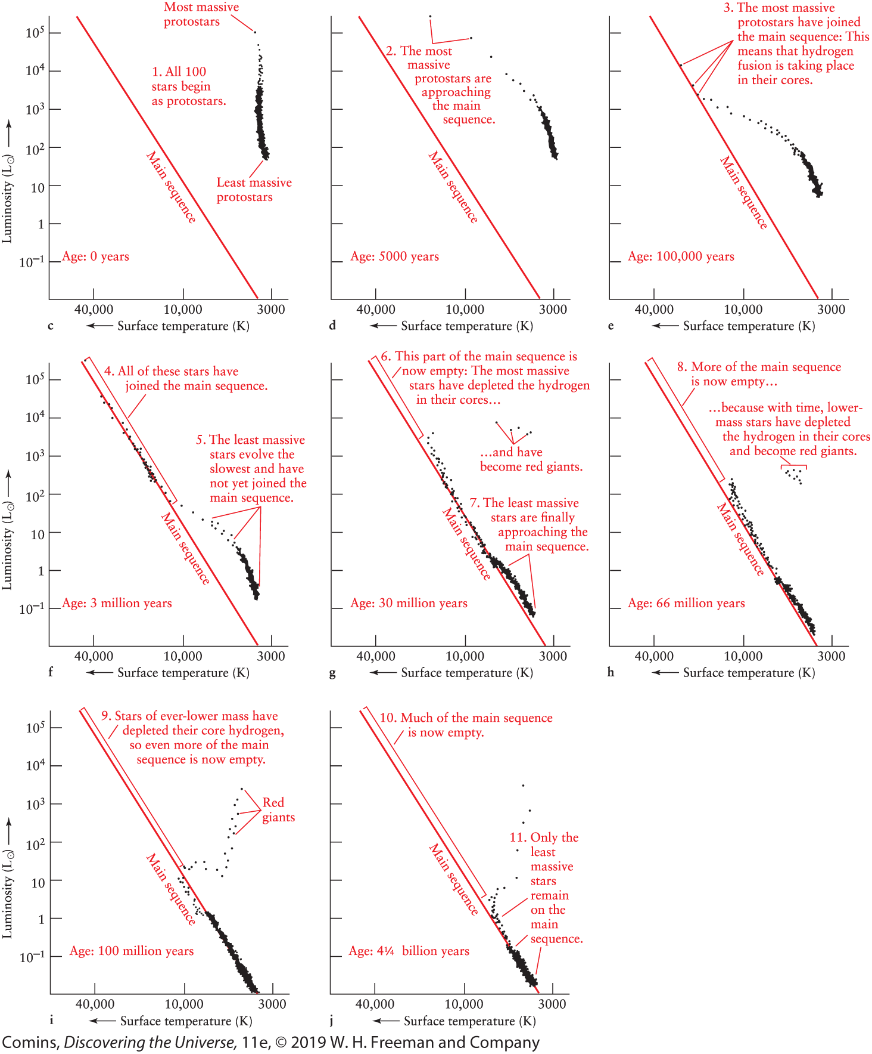
Comins, Fig 13.31
Star Cluster Evolution
Points deleted after giant phase

Slide 29
Populations I and II
Population I
  Younger stars
  Higher metallicity
  Found in spiral arms of the Galaxy
Population II
  Old stars
  Low metallicity
  Found in Galactic hub and halo

