Slide 1
A Star is Born
Image: NASA/HST

Slide 2
Stars change over time
Temperature
Size
Luminosity
Composition
Structure
Even mass!

Slide 3
Stellar nurseries
Stars begin in clouds of gas and dust

Slide 4
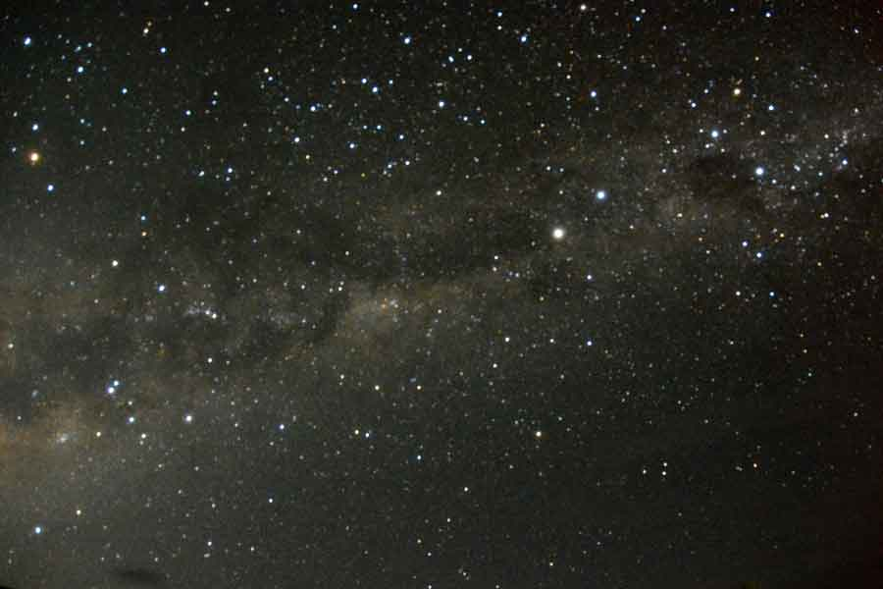

Slide 5
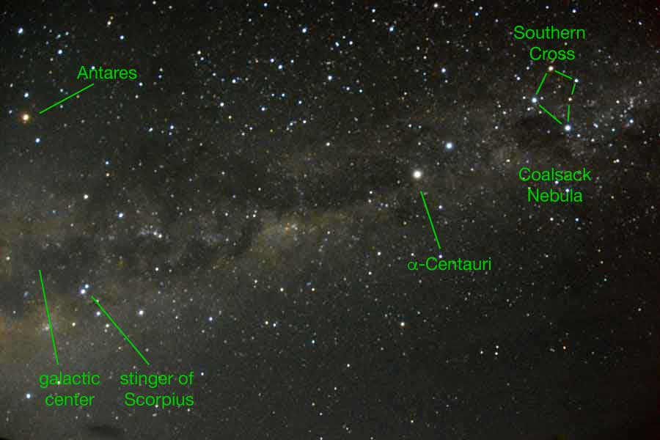

Slide 6
Interstellar Medium
≥ 10% of galactic mass
Low T, visible in IR wavelengths
Composition 74% H₂, 25% He, 1% metals
  by mass
Dust contains C, Si, O, PAH

Slide 7
Observing dust
Dust blocks starlight by interstellar extinction
Dust scatters short-wavelength light in interstellar reddening
  red and IR wavelengths are transmitted
Comins, Fig. 13.5

Slide 8
Molecular Clouds
Composed mostly of H₂
Detected by CO
Evidence that H₂/CO ≈ 10,000
Density 10²–10⁵/cm³
  dense compared to space
  sparse compared to atmosphere
Chamaleon I Molecular Cloud Complex
Image: ESA/Herschel/Planck; J. D. Soler, MPIA

Slide 9
Jeans Instability
How are they triggered?
“Young stars” mean O and B
Energetic radiation ionizes H and He
  “H2” (ionized H) region
  clears the area

Slide 10
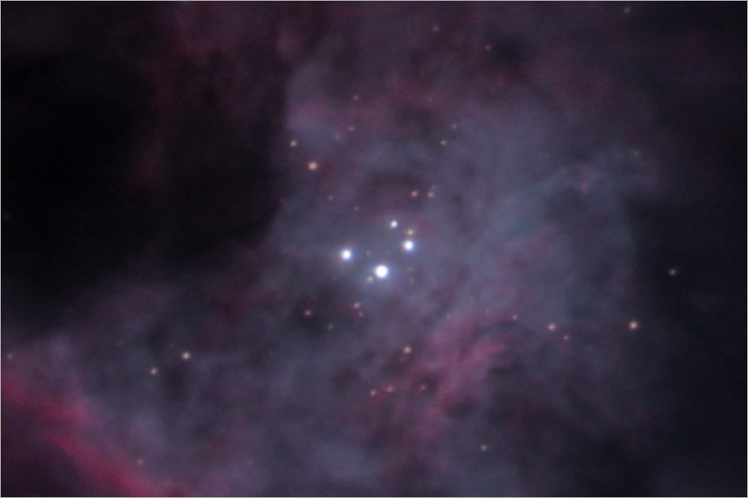
O and B Stars of the Trapezium
Image: Jerry Lodriguss, Astropix

Slide 11
Steps of Star Formation
Jeans unstable cloud contracts
Dark overdense regions ≡ Bok globules
  IR shows dense cores
Spin determines if one large or several smaller stars form
Protostars are large (5 AU), bright in IR
Pre-MS when it stops accreting

Slide 12
Main Sequence
H fuses in the core
Fusion ignites at sufficient core temperature and density
Luminosity is greater at higher mass
  why?
High temperature ⇔ high mass
More massive stars ignite sooner

Slide 13
Path Depends on Mass
Comins, Fig. 13.13

Slide 14
Minimum Mass
≥ 0.08 M⊙ required (95 Jupiters)
Brown dwarf
At > 13 Jupiters, D can fuse
At > 60 Jupiters, Li can fuse
Not of great consequence

Slide 15
Maximum Mass
To be determined
Evidence exists of stars up to 300 M⊙

