Slide 1
The Stars
How big and bright?
§12.1–12.6

Slide 2
Brightness
The more light a star emits, the brighter it appears.
The more distant a star is, the dimmer it appears.

Slide 3
Quantify Brightness
Energy per time per incident area
Decreases with the square of distance
  incident area is proportional to the square of distance
Comins, Fig 12.3

Slide 4
Motivation
We want to know
How intrinsically bright a star is
How large a star is
  Mass would be nice to know, too
How distant a star is
These are difficult to find!

Slide 5
Black body formula
A star’s color tells its temperature
Temperature tells its luminosity per area
If we know its temperature and total luminosity, we can calculate its surface area
Then we know its size

Slide 6
Distance
How far is a star?
We can accurately measure positions on the celestial sphere
  two angles, no distance
How can we measure distances?
  direct comparison
  travel time
  triangulation

Slide 7
Parallax
Comins, Fig. 12.1
Nearby star
Even closer star
The smaller the parallax angle, the more distant the object.

Slide 8
Annual Parallax
If θ = 1”, d = 206265 AU
206265 AU = 1 parsec
Distance in parsecs = 1/(parallax in arcseconds)
AU
θ
d

Slide 9
Distances by Parallax
An arcsecond is a very small angle
A parsec is a very long distance
  1 parsec = 3.26 light·years
No stars are within 1 parsec of the Sun
  closest is 1.3 pc
Very best measurements go out to 10 kpc

Slide 10
Brightness
The magnitude scale

Slide 11
Qualitative scale
In 129 B.C., Hipparchus catalogued stars by brightness
  brightest were first magnitude
  second, third, etc. progressively dimmer
Naked-eye visible stars range about a factor of 100 in visual brightness

Slide 12
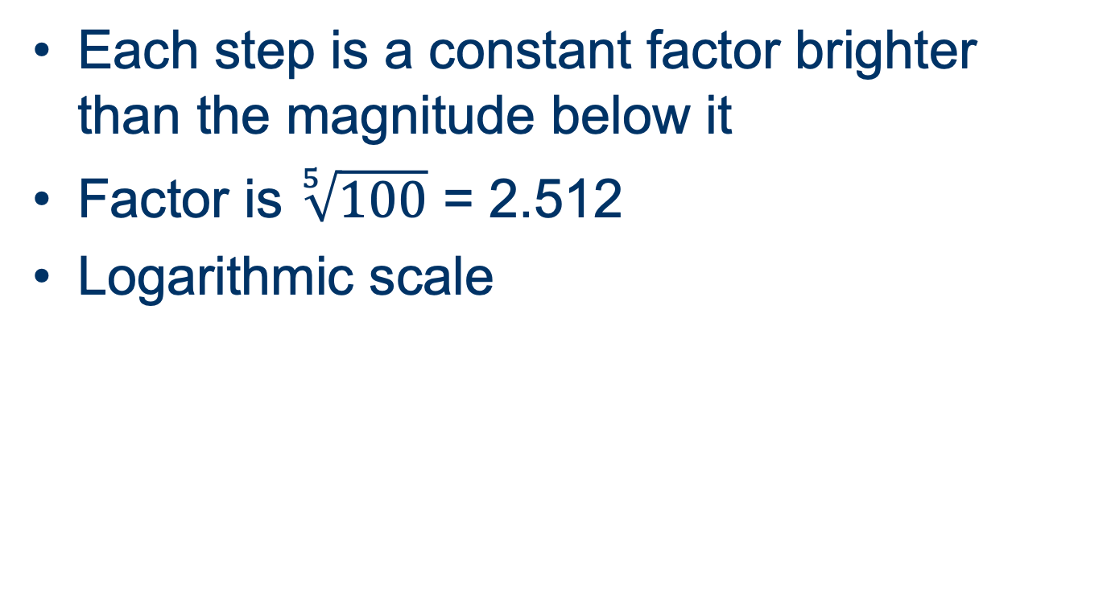
Quantitative scale
Each step is a constant factor brighter than the magnitude below it
Factor is $\sqrt[5]{100}$ = 2.512
Logarithmic scale

Slide 13
Logarithmic scales
decibels
even-tempered scale
pH
stellar magnitudes

Slide 14
Apparent Magnitudes
Sun –26.74
Sirius –1.46
Vega +0.03
Polaris +1.97
Betelgeuse 0.6
Rigil Kentaurus –0.27
Deneb 1.25
Arcturus –0.04

Slide 15
Absolute magnitude
How bright a star would appear from a distance of 10 pc
Can calculate from apparent magnitude and distance
M = m – 5 log₁₀(d/10 pc)
M = absolute magnitude
m = apparent magnitude
d = distance

Slide 16
Absolute Magnitudes
Sun +4.83
Sirius +1.43
Vega +0.582
Polaris –3.64
Betelgeuse –6
Rigil Kentaurus +4.34
Deneb –8.73
Arcturus +0.2
A1050_L20_Exoplanets.pptx

Slide 17
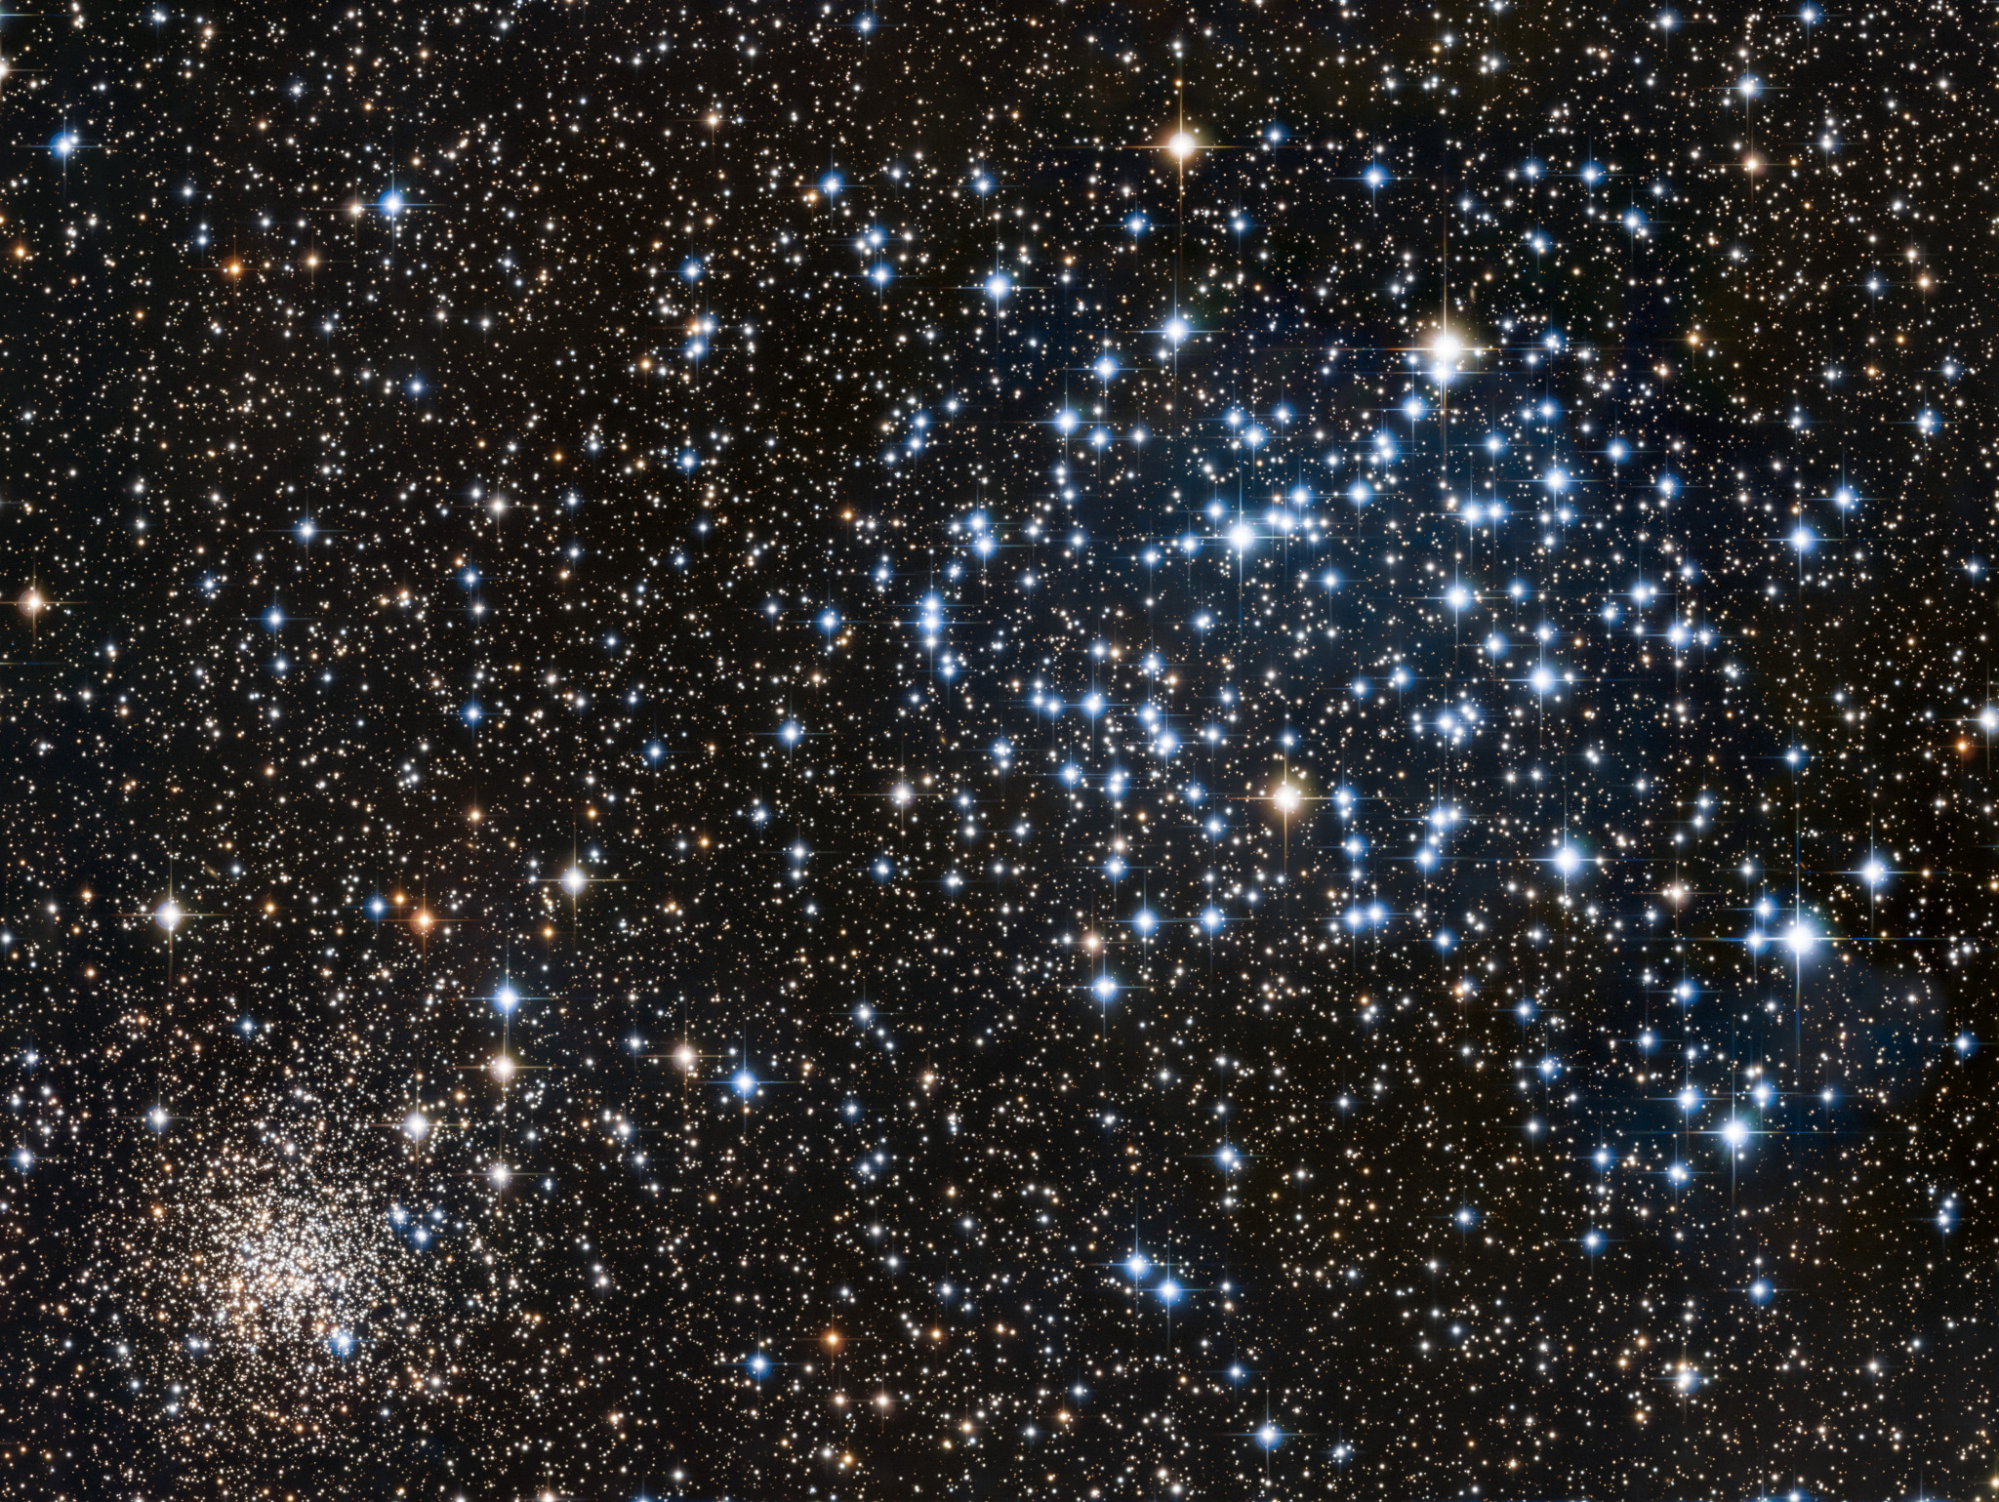
Types of Stars
distinctions and commonalities
Image: Evan Tsasi, LATTE, via APOD

Slide 18
Learning about Stars
What features are critical?
What can we learn?
Are there categories?

Slide 19
Temperature
Stars are close to black body emitters
Spectrum depends on temperature

Slide 20
Color Temperature
Measure starlight through different color filters
  conventionally blue (B, 441 nm) and yellow (V, 551 nm)
Color index is the difference in relative intensity B – V
Plot B–V directly or match to B–V of theoretical black body

Slide 21
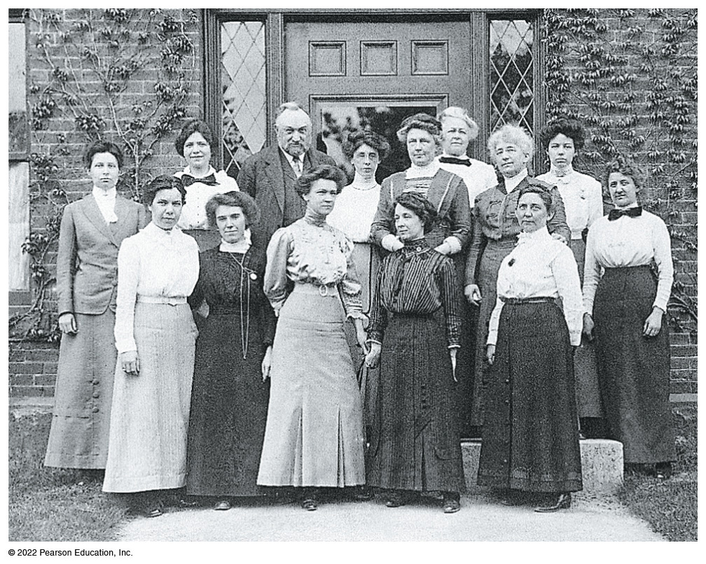
Spectral Class
“Computers” at Harvard College Observatory continued the Henry Draper catalogue of stars to m = 9
Bennett Fig. 12.5

Slide 22
Spectral Class
Williamina Fleming classified stars by the strength of their Balmer absorption lines
  classes A–P in descending intensity
Annie Jump Cannon found the correct order was OBAFGKM
Cecelia Payne-Gaposchkin discovered that classes correlate with temperature
  descending

Slide 23
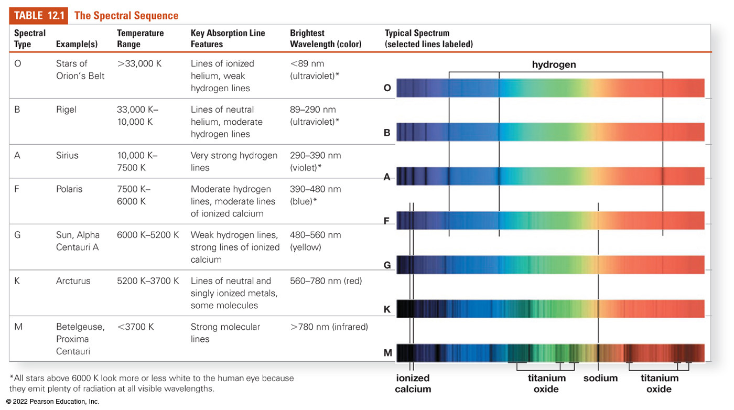
Spectral Classes

Slide 24
Subclasses
Large temperature variations between classes
Divided further into subclasses 0–9
  0 is hottest, 9 is coolest
  So an A9 is close in temperature to a F0
The Sun is a G2 star

Slide 25
Temperature and Luminosity
Separate of correlated?

Slide 26
Hertzsprung-Russell Diagram
Plot absolute luminosity (M) vs temperature
Bright
Luminosity
Dim
Hot
Cool
Temperature

Slide 27
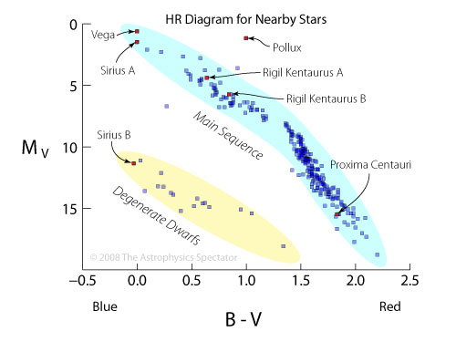
Stars within 10 pc
Image: The Astrophysics Spectator

Slide 28
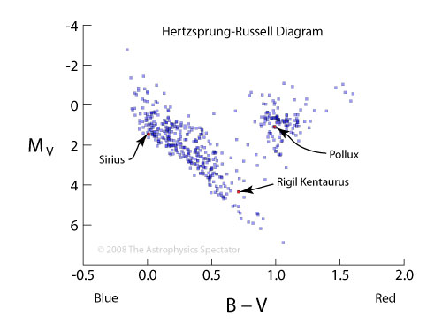
Visible Stars within 50 pc
Image: The Astrophysics Spectator

Slide 29
H-R Groupings
Most stars are main sequence
  top left–bottom right diagonal
Some are bright giants and supergiants
  large for their temperature
Some are very hot and dim “white dwarfs”
  must be very small

Slide 30
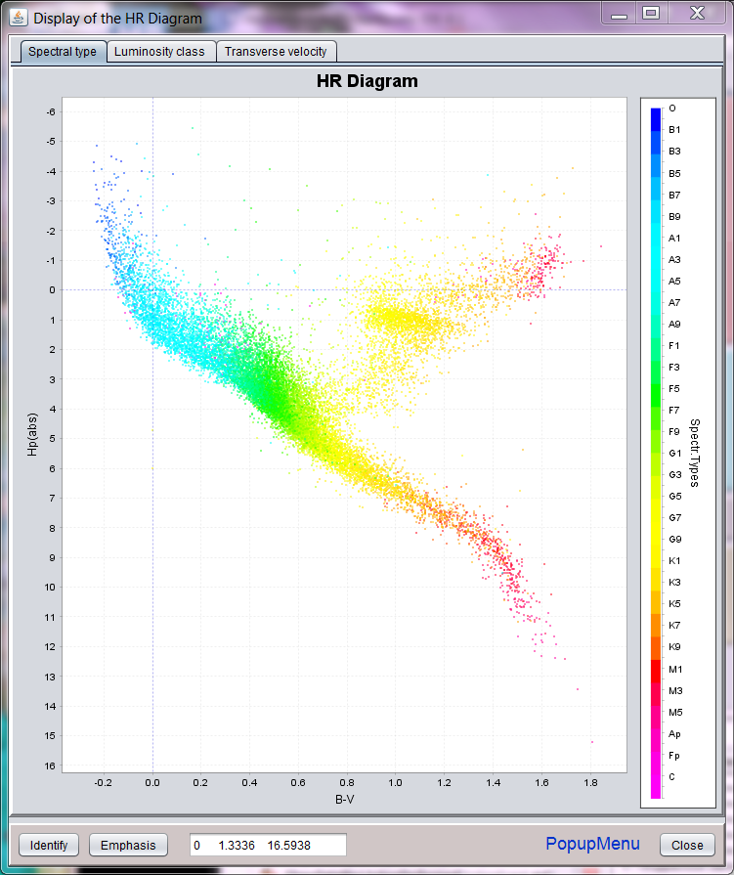
More stars
Image: HipparcosInteractive

Slide 31
Luminosity Classes
Some stars are much brighter than others at the same temperature
  they must have much more surface area
A larger star will have a less dense atmosphere
Can measure pressure broadening of spectra
Sharper spectra from larger stars

Slide 32
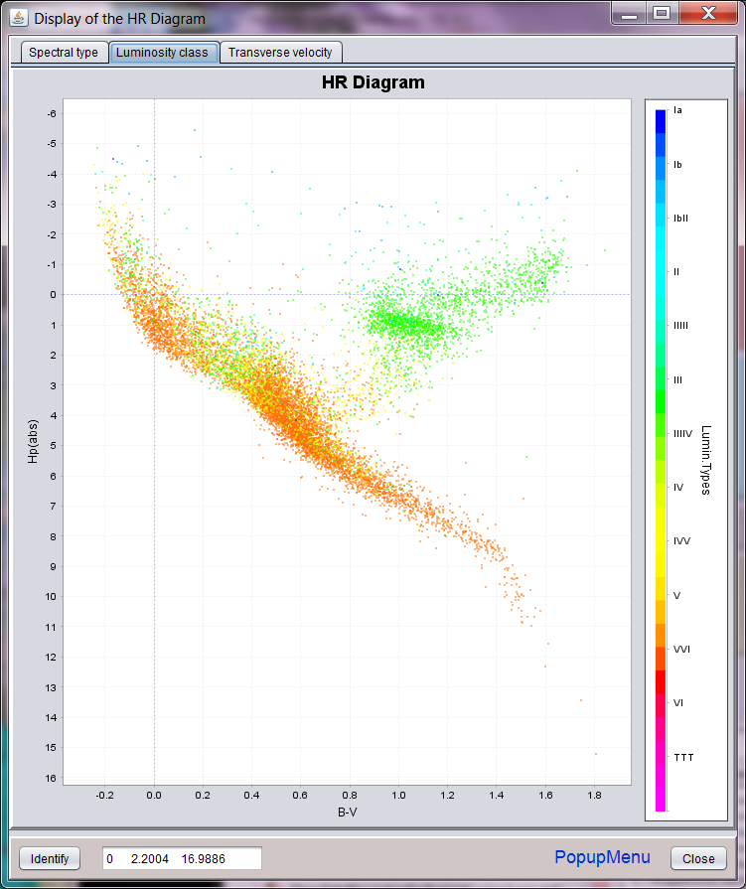
Coded by Luminosity Class
Image: HipparcosInteractive

Slide 33
Luminosity Classes
Classes I–V
Sun is a G2V star

Slide 34
Distance from Spectrum
If we know a star’s spectral class and luminosity class, we can estimate its absolute magnitude
(Approximately)
We can find its distance from its apparent magnitude
(Approximately)
This is called “spectroscopic parallax”

