Slide 1
Inside the Sun
The source of it all
§11.8–11.11

Slide 2
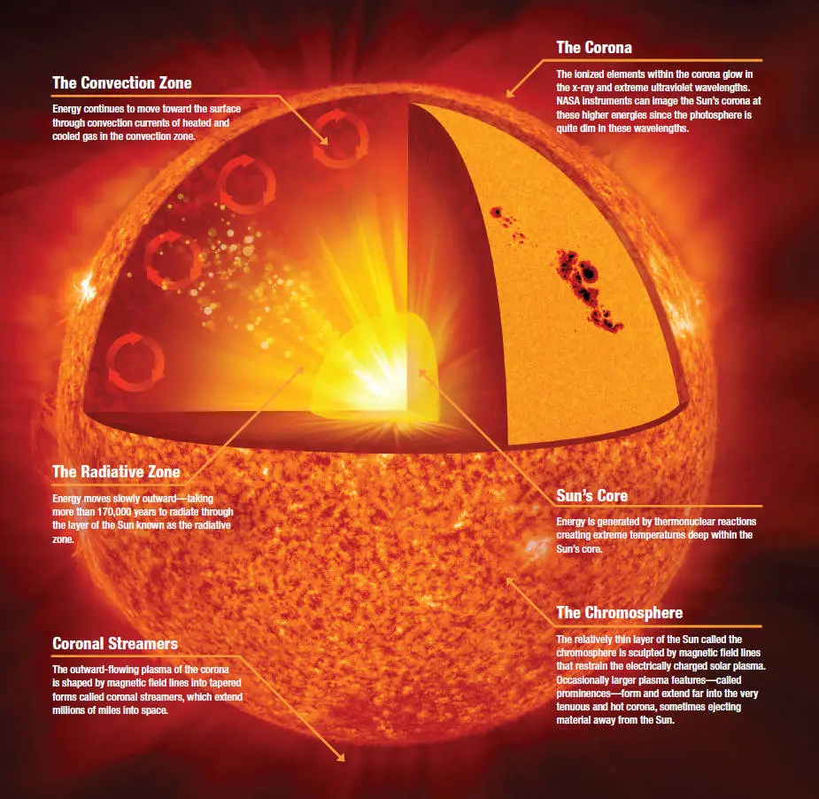
Image: NASA/Jenny Mottar

Slide 3
Why does the Sun shine?
Gravitational collapse causes temperature increase
  Collapse converts gravitational potential energy to kinetic energy
  Temperature is proportional to average molecular kinetic energy
  Hot things glow

Slide 4
Hydrostatic equilibrium
Pressure = weight per area
Pressure increases with density and temperature
Comins, Fig. 11.22

Slide 5
Can it last?
Release of radiant energy lowers temperature
Further collapse raises pressure and temperature
Eventually shrinks and snuffs out

Slide 6
Why does it still shine?
An energy source maintains its size and luminosity

Slide 7
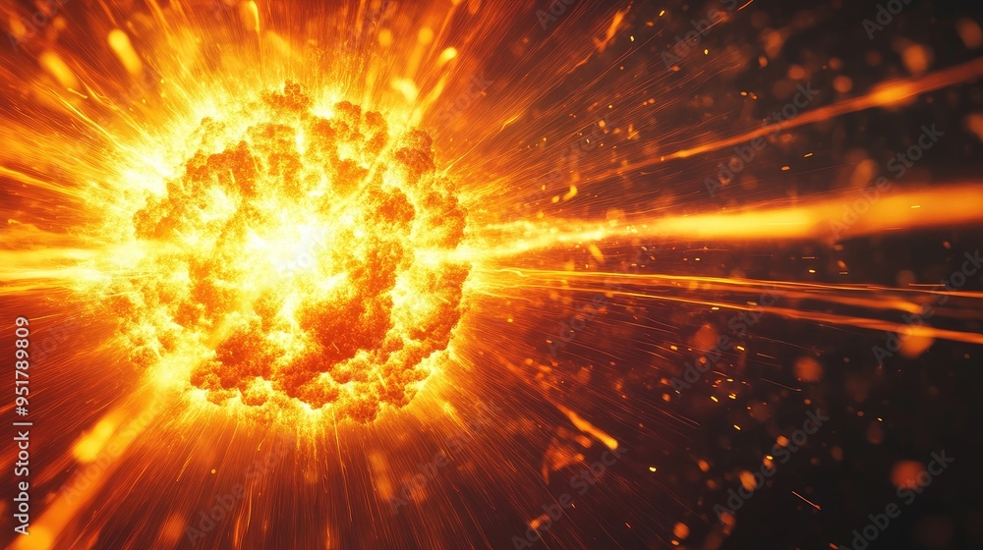
Nuclear Fusion
Image: Adobe Stock/ Generated with AI

Slide 8
Solar Fusion
Comins, p. 383

Slide 9
Solar Model
Computational model of energy flow within the Sun
Accounts for nuclear reactions, fluid dynamics, radiation, thermal physics
Comins, Fig. 11.23b

