Slide 1
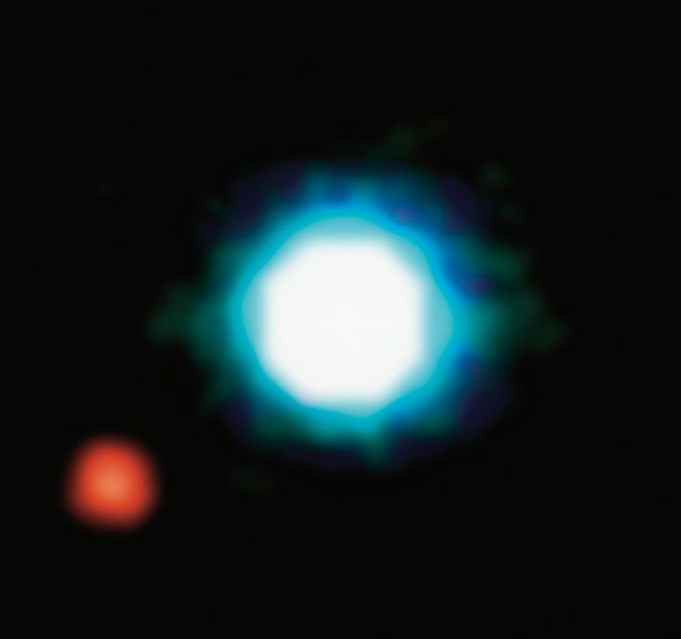
Exoplanets
Worlds beyond the Sun
Image: ESO
2M1207 b
Notes:
2M1207 b is a Jupiter-like planet, 5 times more massive than Jupiter. It orbits the brown dwarf at a distance of 55 AU.

Slide 2
Challenge
A Sun-like star is about a billion times brighter than the light reflected from its planets.
Planets are close to their stars, relative to the distance from us to the star.
  This is like being in San Francisco and trying to see a pinhead 15 meters from a grapefruit in Washington, D.C

Slide 3
Detecting planets
Direct: pictures or spectra of the planets themselves
Indirect: measurements of stellar properties revealing the effects of orbiting planets

Slide 4
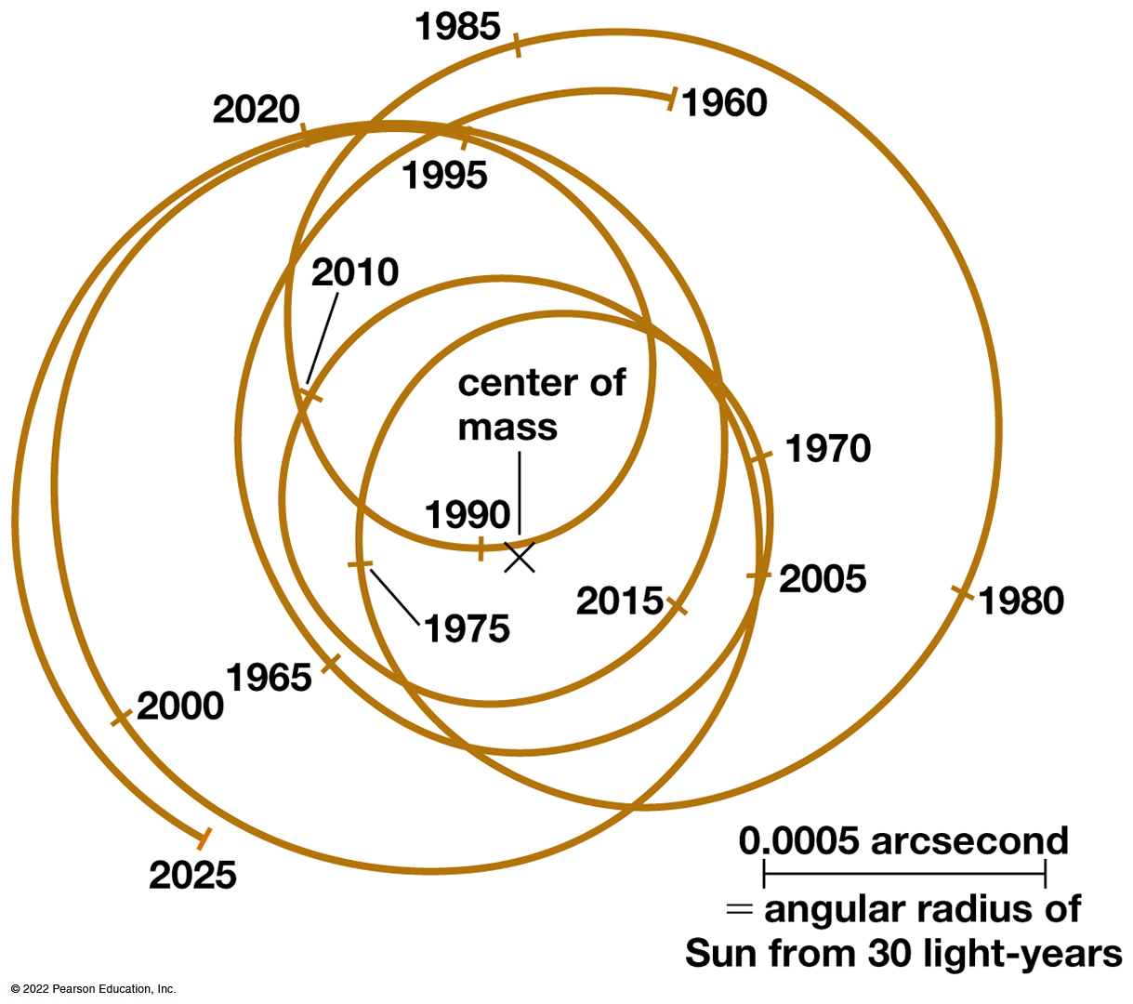
Astrometric Technique
We can detect planets by measuring the change in a star's position on the sky.
These tiny motions are very difficult to measure (~0.001")
Bennett, Fig 10.2

Slide 5
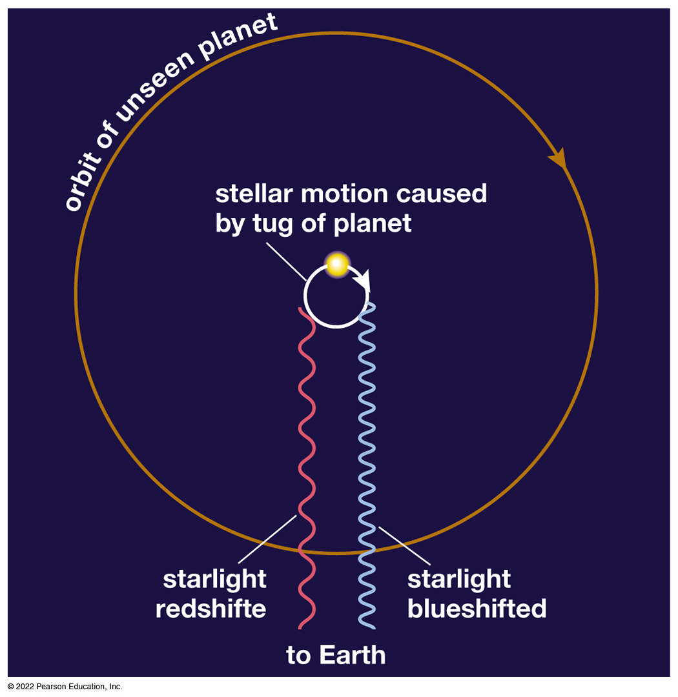
Doppler Technique
Measuring a star's Doppler shift can tell us its motion toward and away from us.
Current techniques can measure motions as small as 1 m/s (walking speed!).
Bennett, Fig 10.3

Slide 6
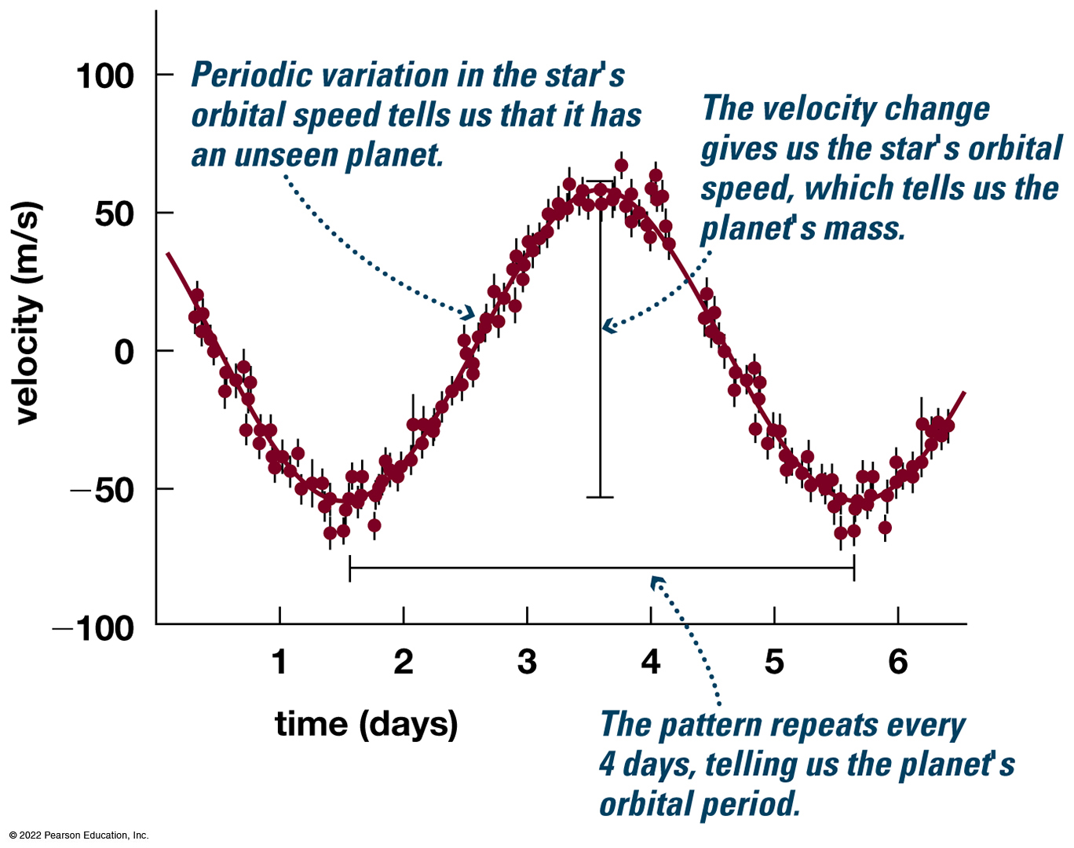
First Detection (1995)
51 Pegasi b
“Hot Jupiter”
  Mass 0.46 M_{J}
  Orbital period 4.2 days
  0.05227 AU
Bennett, Fig 10.4

Slide 7
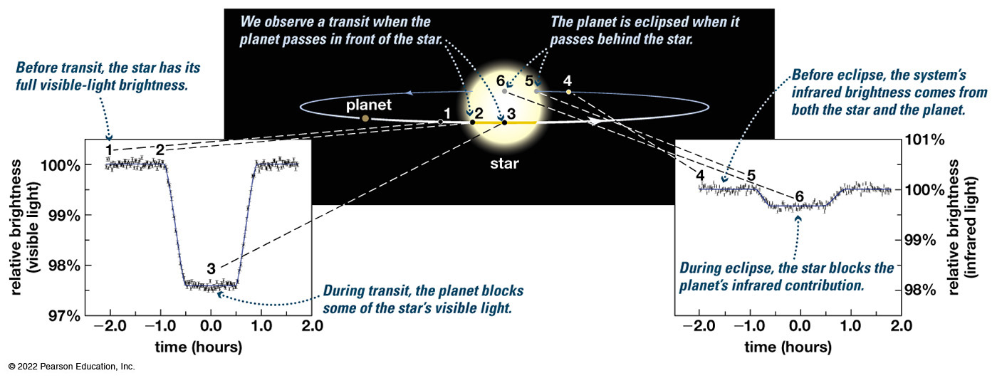
Transits and Eclipses
Bennett, Fig 10.5
Transit: Planet in front of star
Eclipse: planet behind star

Slide 8
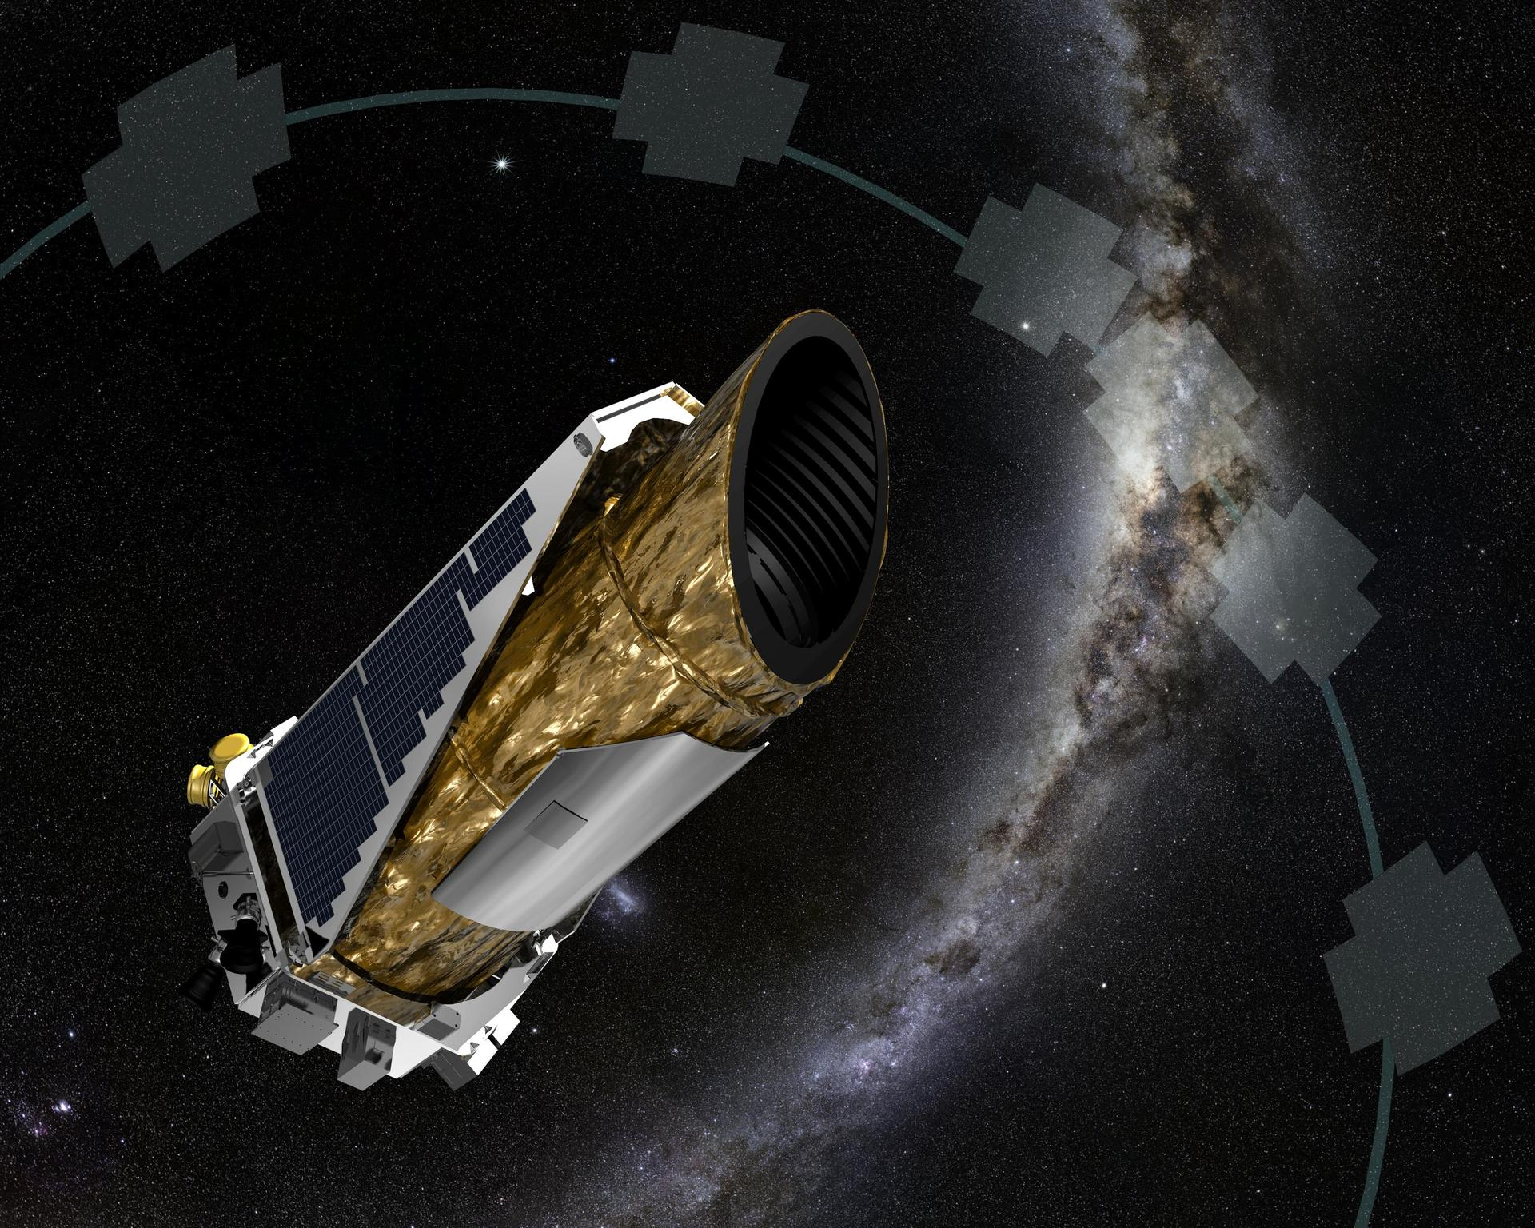
Kepler Mission
NASA
Searched for transits 2009–2013.
Surveyed 500,000 stars
Image: NASA

Slide 9
Kepler findings
Most stars have planets
Planets most frequently detected are “small Neptunes”

Slide 10
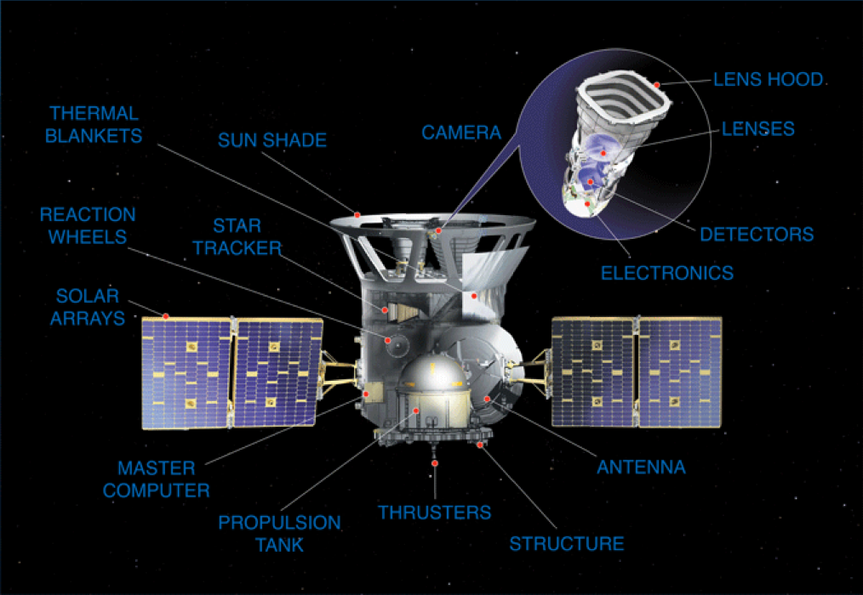
TESS Mission
Transiting Exoplanet Survey Satellite
Detects transitory phenomena

Slide 11
Measurable Properties
Orbital period, distance, and shape
Planet mass, size, and density
Atmospheric properties

Slide 12
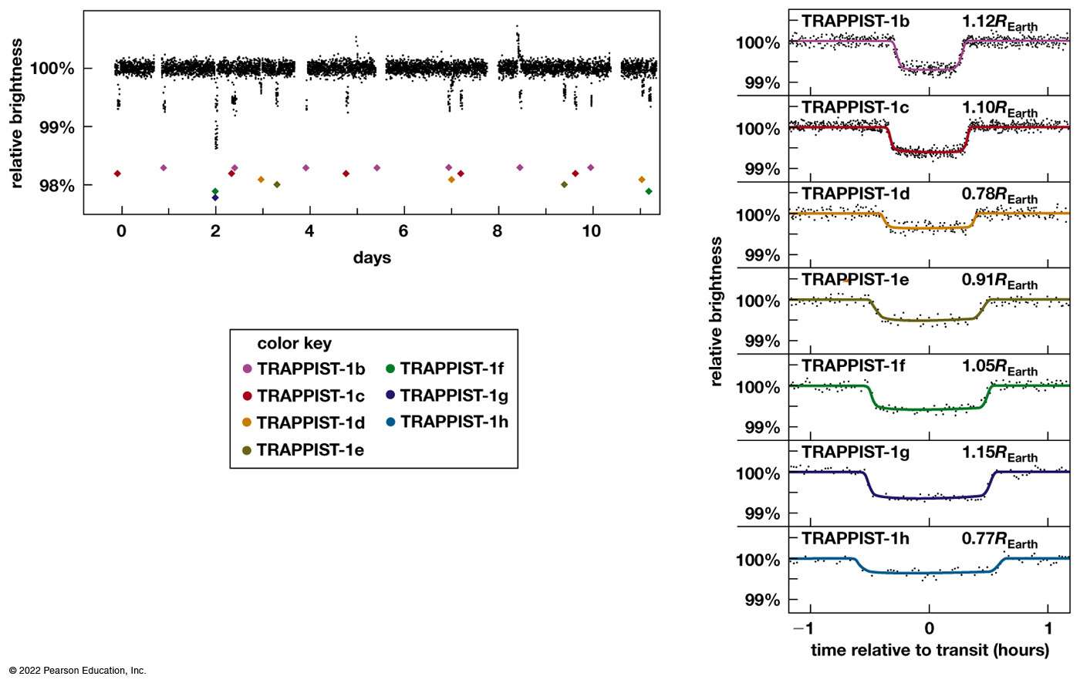
The Trappist-1 System
Bennett, Fig 10.7

Slide 13
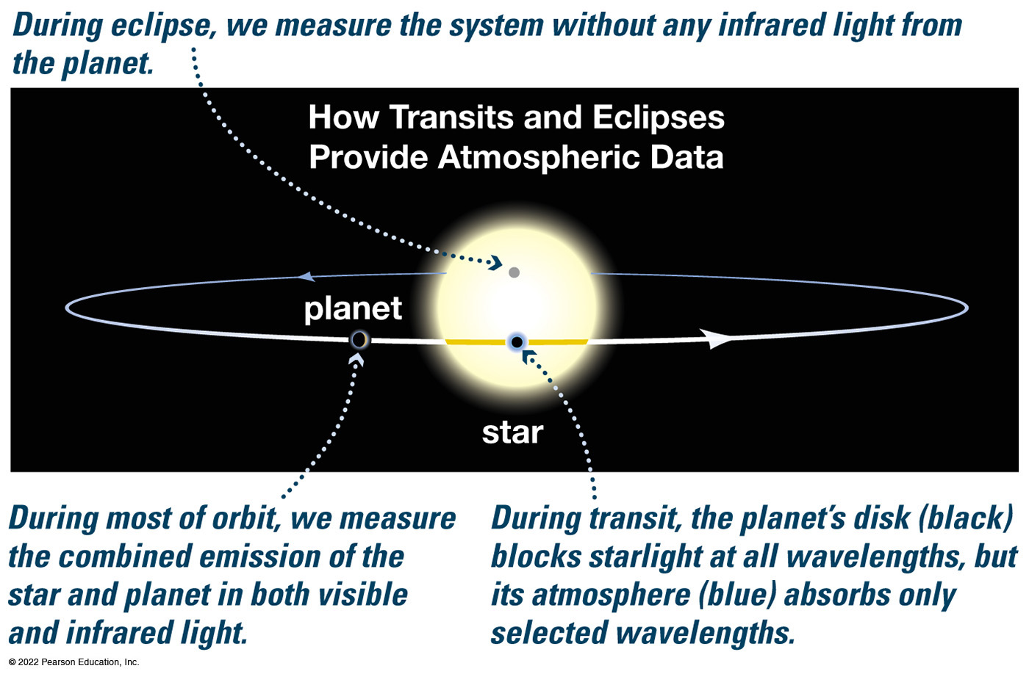
Atmospheric Data
Bennett, Fig 10.9

Slide 14
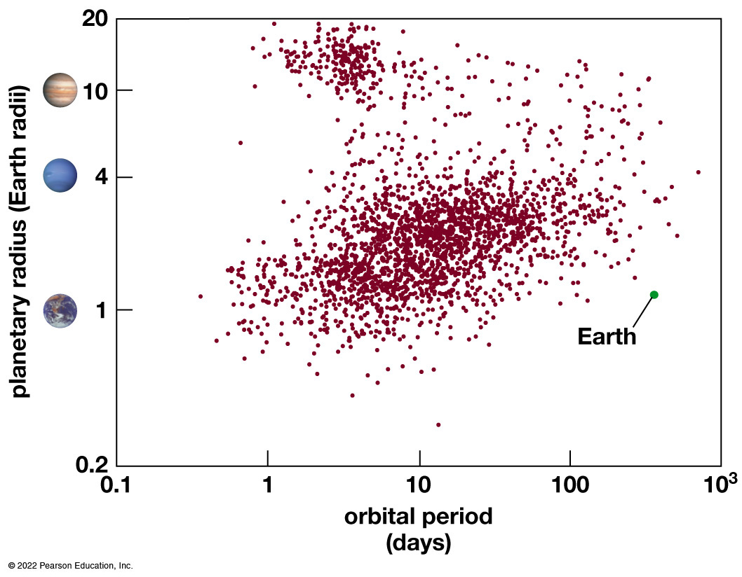
What we’ve found

Slide 15
Forming Exoplanetary Systems
How do “Hot Jupiters” get close to their stars?
Nebular theory expects Jupiter-size planets to form beyond the frost line
A young planet may be pulled inward by waves in a closer dust disk

Slide 16
Question
What happens in a gravitational encounter that allows a planet's orbit to move inward?
The planet transfers energy and angular momentum to another object.
The other object moves inward as well.
It speeds up the star’s rotation.

Slide 17
Are We Normal?
Systems like our Solar system are difficult to detect and verify
Transiting systems depend on chance alignment

