Slide 1
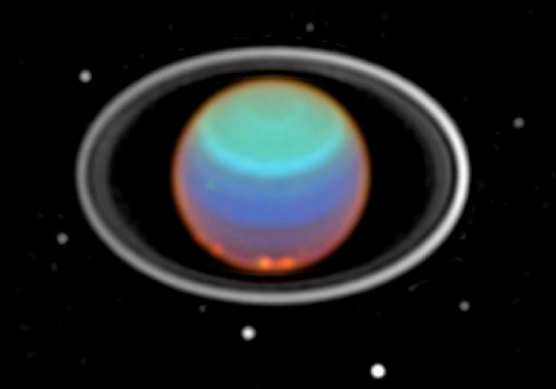
Uranus
Say that again?
Image: Hubble, Near IR mosaic
§9.14–9.15

Slide 2
Uranus
Mass 8.68 × 10²⁵ kg = 14.5 m_{E}
Rotational period –17.24 h
Diameters
  equatorial 4.01 Earth diameters
  polar 3.93 Earth diameters
Density 1270 kg/m³ (second least dense)
Albedo 0.48
28 known satellites

Slide 3
Uranus’s Orbit
Semimajor axis 19.16 AU
Orbital eccentricity 0.0469
Orbital inclination to ecliptic 0.77°
Orbital period 84.01 y
Axial obliquity 97.77°(sideways)

Slide 4
Uranus’s Atmosphere
82.5% Hydrogen
15.2% Helium
2.3% Methane (bluish)
Temperature 76K at 1 bar
Aerosols
  ethane, ammonia, water, ammonium hydrosulfide

Slide 5
Uranus’s Weather
Cloud cover and activity change over time
Possibly seasonal
Near-IR shows latitudinal bands
  retrograde winds at equator

Slide 6
Uranus’s Rings
Very low albedo, 0.015
Change visibility throughout orbit
Thickness 100–300 m

Slide 7
Internal structure (hypothesized)
Rocky core
mantle of hot “ices:” H₂O, CH₄, NH₃
H₂, He atmosphere

Slide 8
Uranus’s Magnetic Field
Mostly dipolar
Tilt 58.6°to rotation axis
Offset from center by 1/3 R_{U}
At surface about twice Earth’s
Attributed to “hot ice” layer

Slide 9
Neptune
a lot like Uranus
§9.16–9.17
Image: NASA/JPL, Voyager 2

Slide 10
Enhanced View
NASA/JPL; Comins Fig. 9-43a

Slide 11
Neptune
Mass 1.02 × 10²⁶ kg = 17.2 m_{E}
Rotational period 16.11 h
Diameters
  equatorial 3.88 Earth diameters
  polar 3.83 Earth diameters
Density 1638 kg/m³ (second least dense)
Albedo 0.44
16 known satellites

Slide 12
Neptune’s Orbit
Semimajor axis 30.18 AU
Orbital eccentricity 0.097
Orbital inclination to ecliptic 1.77°
Orbital period 164.8 y
Axial obliquity 28.3°

Slide 13
Neptune’s Atmosphere
80.0% Hydrogen
19.0% Helium
1.5% Methane (bluish)
Temperature 72K at 1 bar
Aerosols
  ethane, ammonia, water, ammonium hydrosulfide

Slide 14
Neptune’s Magnetic Field
Mostly dipolar
Tilt 46.9°to rotation axis
Offset from center by 0.49 R_{U}
At surface about twice Earth’s
Attributed to “hot ice” layer

Slide 15
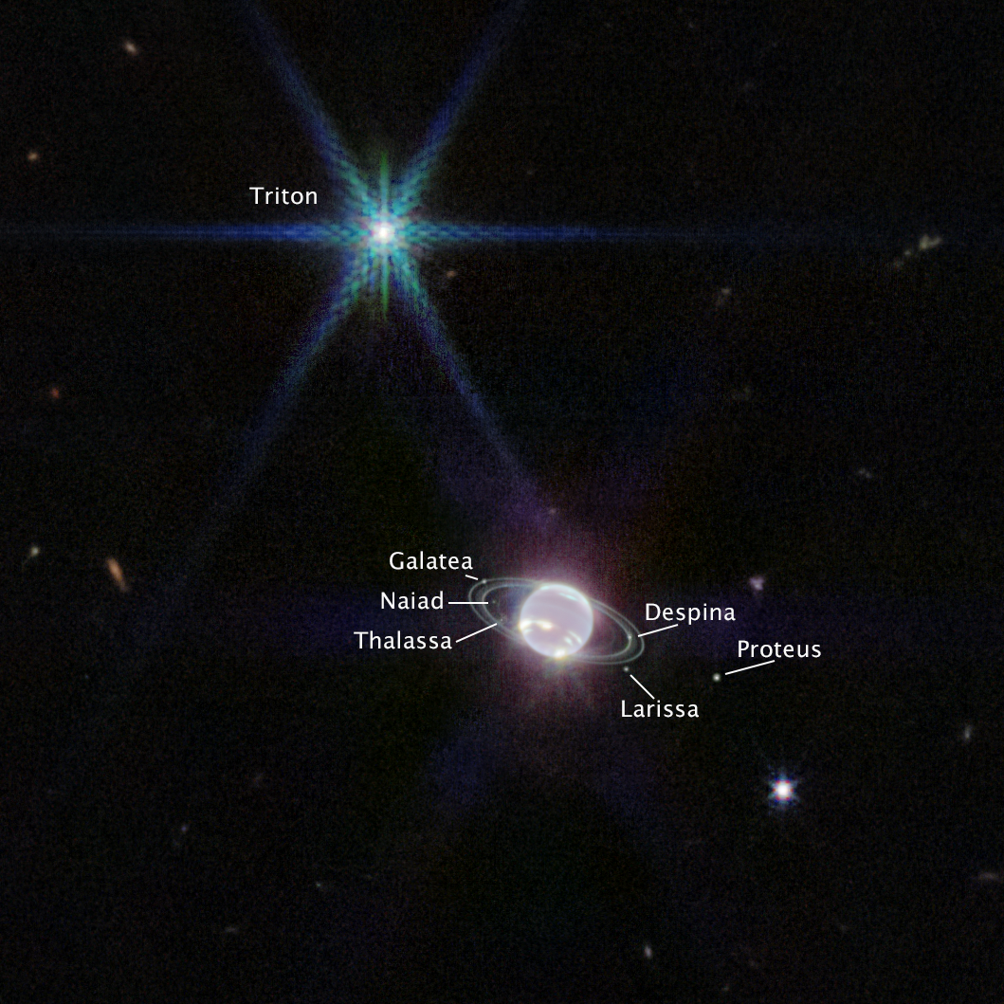
Neptune’s Rings
Image: NASA, ESA, CSA, STScI, Webb Telescope

Slide 16
Jupiter’s Moons
Four large and many small

Slide 17
Io
Innermost of the Galilean moons
Orbital period 1.8 days
Semi-major axis 421,800 km
Eccentricity 0.004
Phase locked
Density 3530 kg/m³
Diameter 5% bigger than Moon
Roll the ball

Slide 18
Io
Driest known object in the Solar system
Densest natural satellite in the Solar system
Strongest surface gravity of any natural satellite
Most geologically active object in Solar system

Slide 19
Io
Surface colored with sulfur
Lava composition: basaltic
Heat source: tidal flexing
Ejecta produce plasma torus around Jupiter
Image: Juno, NASA/JPL

Slide 20
Europa
Slightly smaller than the Moon (90% diameter)
Orbital period 3.6 days (resonance with Io)
Semi-major axis 671,000 km
Eccentricity 0.009
Density 3010 kg/m³
Phase locked
Roll the ball

Slide 21
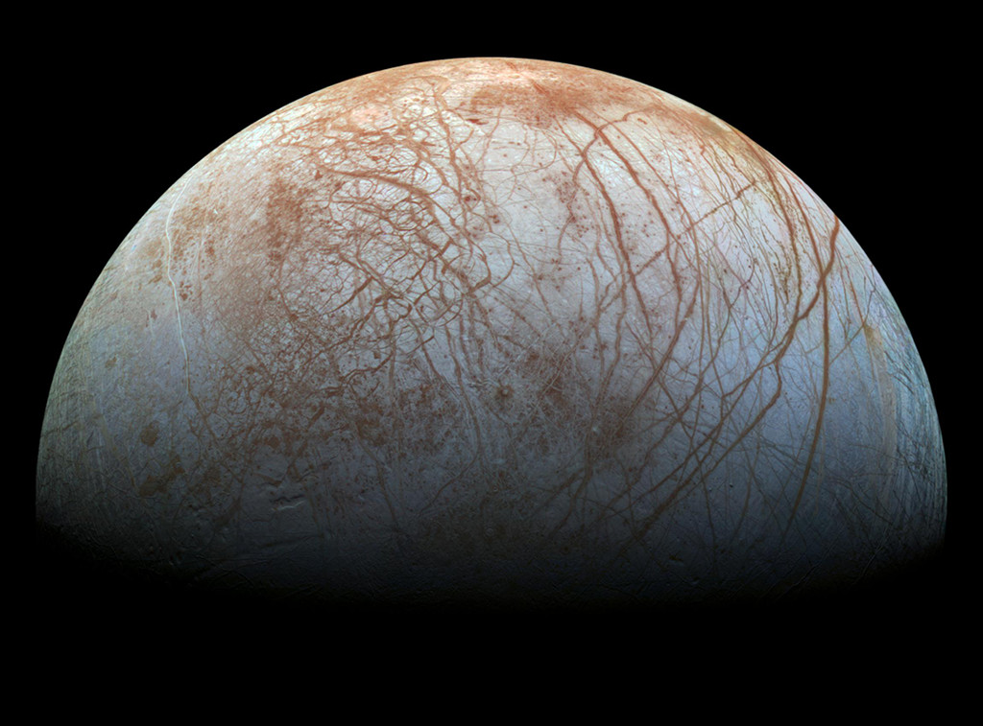
Europa
Image: NASA/JPL

Slide 22
Europa
Icy crust
Probable liquid subsurface ocean
Water geysers strongly suspected
Europa Clipper mission
  launched 10/14/24, reaches Jupiter 4/30
  Search for evidence of liquid subsurface water

Slide 23
Ganymede
Largest moon in the Solar system
  larger than Mercury (but lighter)
Orbital period 7.2 days (resonance with Io)
Semi-major axis 1,070,000 km
Eccentricity 0.001
Density 1940 kg/m³
Phase locked
has a magnetic field

Slide 24
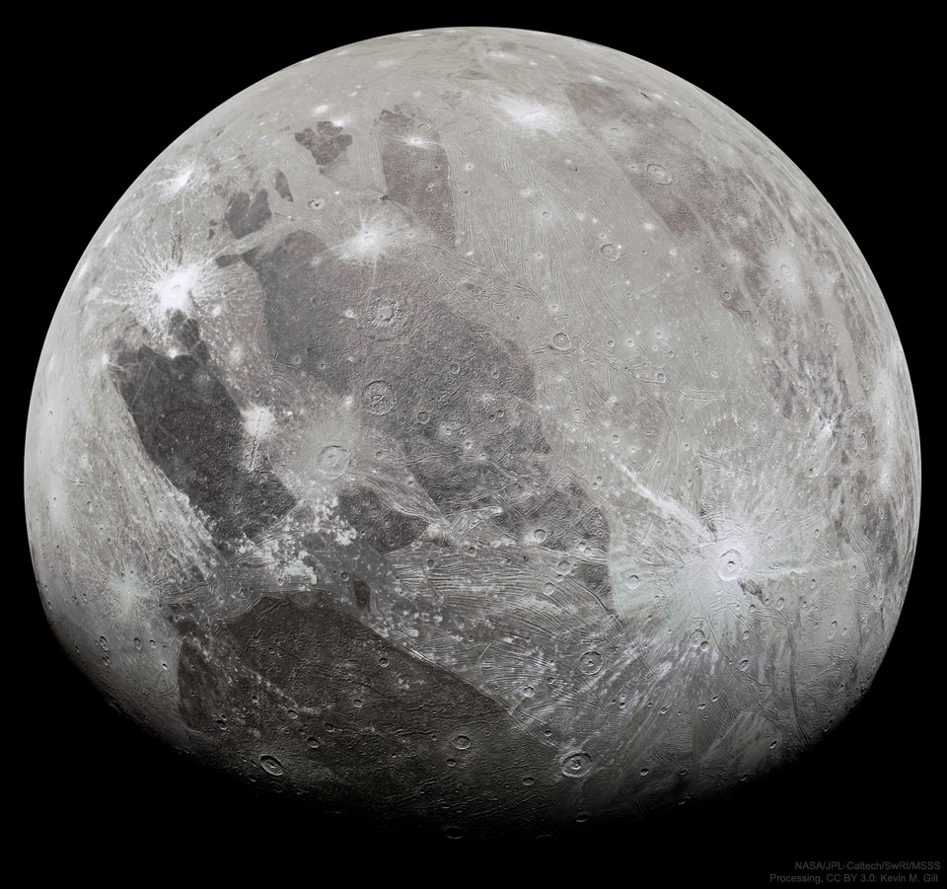
Ganymede
Image: NASA/JPL

Slide 25
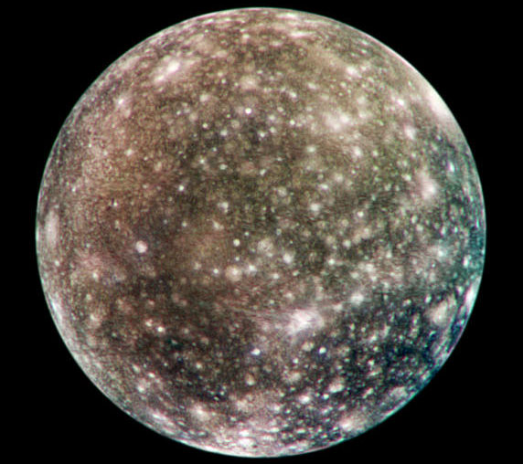
Callisto
Image: NASA/JPL

Slide 26
Callisto
Outermost of the Galilean satellites
Most heavily cratered body in the Solar system
Orbital period 16.7 days
Semi-major axis 1,883,000 km
Eccentricity 0.007
Density 1830 kg/m³
Phase locked

Slide 27
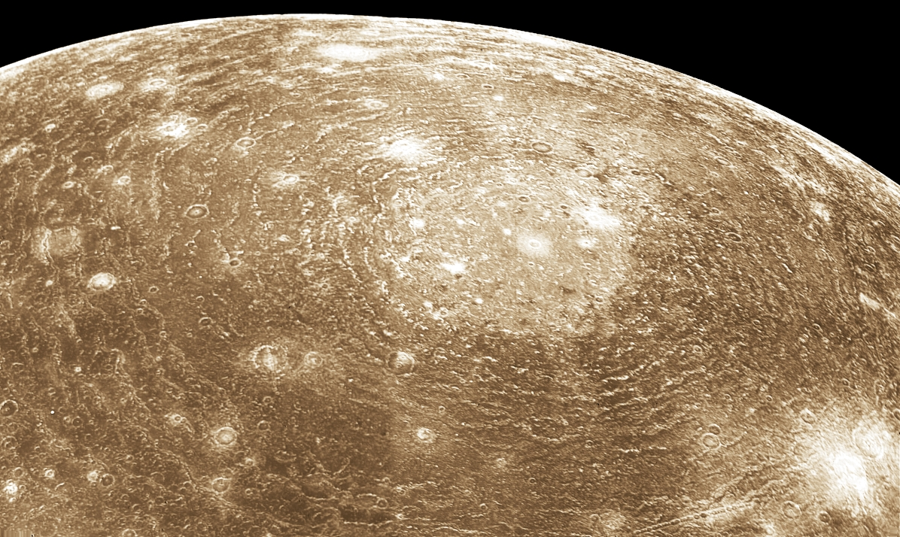
Valhalla structure
Image: NASA< Voyager 1

Slide 28
Valhalla
Largest multi-ring impact structure in the Solar system
No antipodal chaotic zone

Slide 29
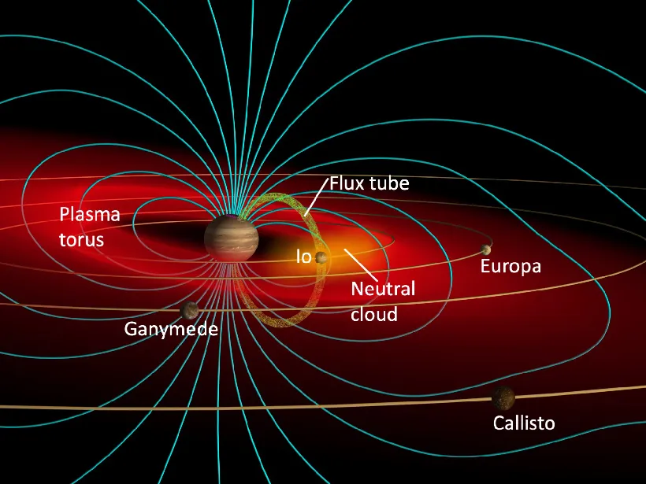
Gas/Plasma Torus
Gases ejected by Io and Europa
Interact with Jupiter’s magnetosphere
Image: John Spencer

Slide 30
Ring System
Within orbit of Io
Debris from small moons Metis, Adrastea, Amalthea, Thebe

Slide 31
Smaller Moons
Four within Io’s orbit
Remainder beyond Callisto’s orbit
Many outer moons orbit retrograde

Slide 32
How did this happen?
Jupiter’s Rocky core formed beyond snow line
  accreted ices
  then massive enough to H₂ and He
Moons too light to bind H₂ and He
Io probably lost ices through volcanism

Slide 33
Saturn’s Moons
One very big
and many many more

Slide 34
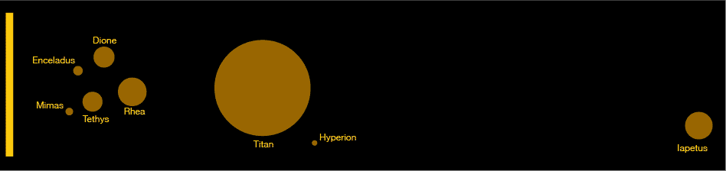
Moons
Sizes and Distances (different scales)

Slide 35
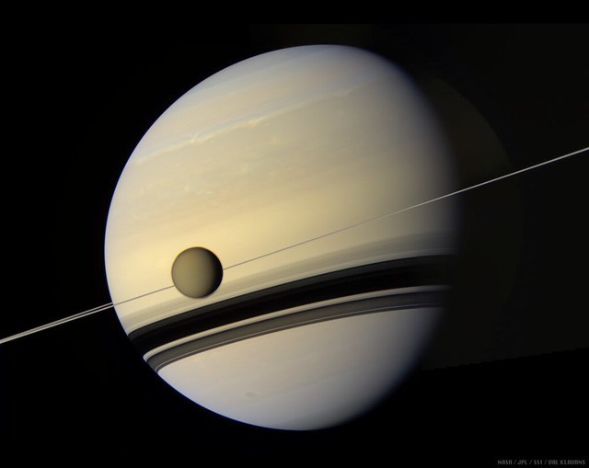
Titan
NASA / JPL / SSI / Val Klavans

Slide 36
Titan
Largest moon after Ganymede
Orbital period 15.9 days
Semi-major axis 1,222,000 km (20 R_{S})
Eccentricity 0.0292
Density 1880 kg/m³
Synchronous rotation

Slide 37
Titan’s structure
(maybe)
Rocky core
Ice-VI
Brine
Ice
Hydrocarbon ocean
Atmosphere

Slide 38
Titan’s surface
Rivers and lakes of liquid methane
Dunes of hydrocarbon granules
Few visible impact craters

Slide 39
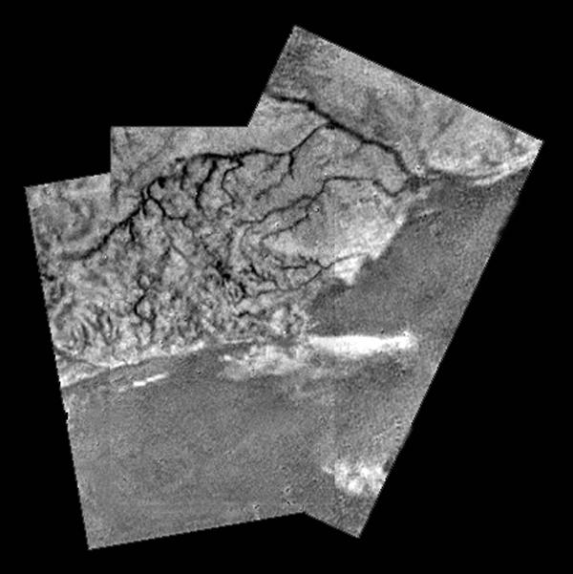
River on Titan
Image: Huygens probe

Slide 40
Landing Site
Image: Huygens probe

Slide 41
Titan’s atmosphere
Surface pressure 1.5 bar
Composition 95% N₂, 5% CH4
Photochemical smog haze
Methane rain

Slide 42
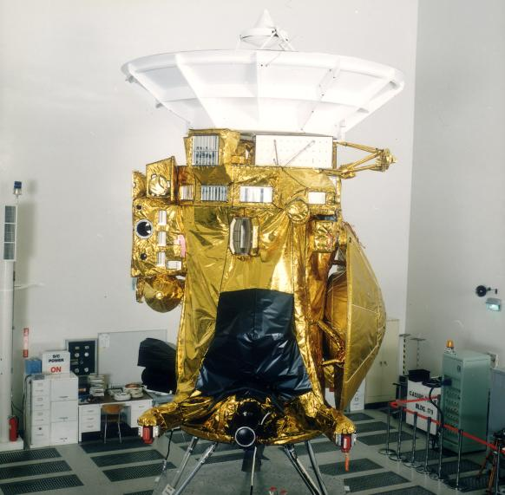
Cassini Spacecraft
Image: NASA/JPL

Slide 43
Enceladus

Slide 44
Enceladus
208 ×197 ×191 km
Orbital period 1.37 days
  (2:1 resonance with Dione)
Synchronous rotation
Semi-major axis 238,000 km (3.9 R_{S})
Eccentricity 0.0045
Density 1610 kg/m³
Albedo 1.0
Spin the ball

Slide 45
Enceladus activity
Water eruptions produce snow
Escape at “tiger stripes”
Produces Saturn’s E ring
Top spot for chance of life

Slide 46
Smaller Moons
New Saturn Moons. Scott Sheppard, Carnegie Institute

Slide 47
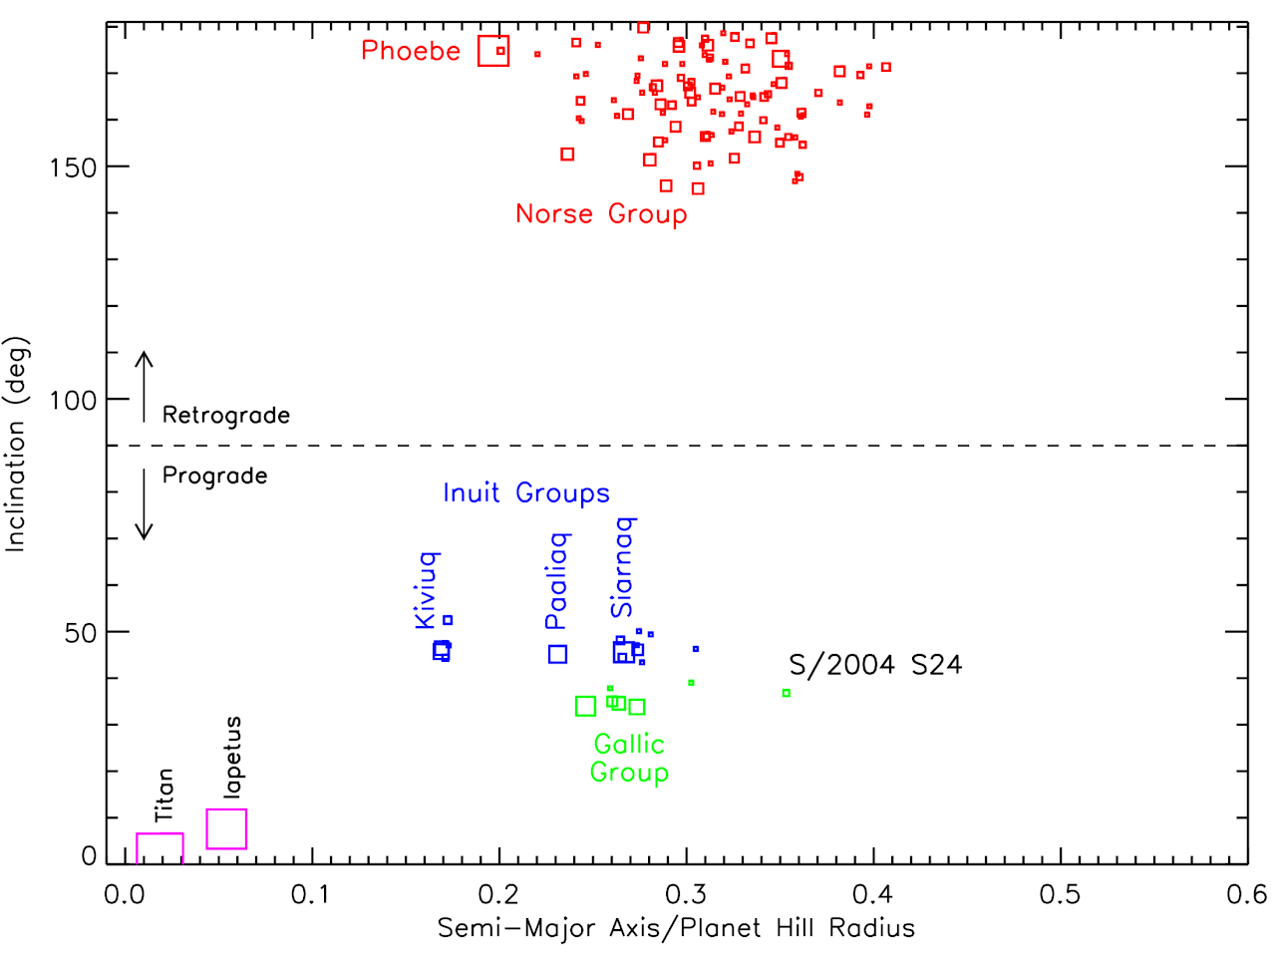
Smaller Moons
New Saturn Moons. Scott Sheppard, Carnegie Institute

Slide 48
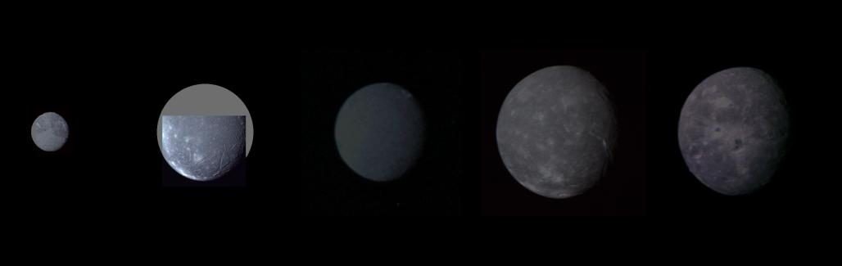
Uranus’s Major Moons
All rotate synchronously
ice-like densities
Titania
Oberon
Ariel
Umbriel
Miranda
Image: NASA, Voyager 2 (montage)

Slide 49
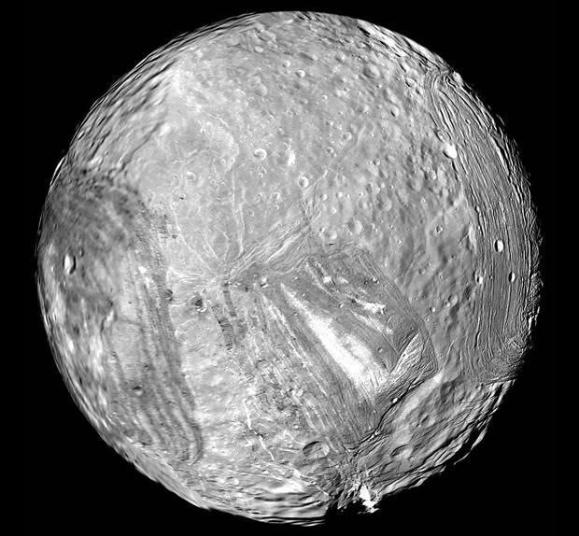
Miranda’s odd shape
Varied terrain
Regions of few impact structures
Tidal heating?
spin the ball

Slide 50
Neptune’s Rings
Image: NASA, ESA, CSA, STScI, Webb Telescope

Slide 51
Neptune’s Moons
One large moon, Triton
  about 78% Moon’s diameter
  density 2050 kg/m3
Irregular moons with eccentric orbits

Slide 52
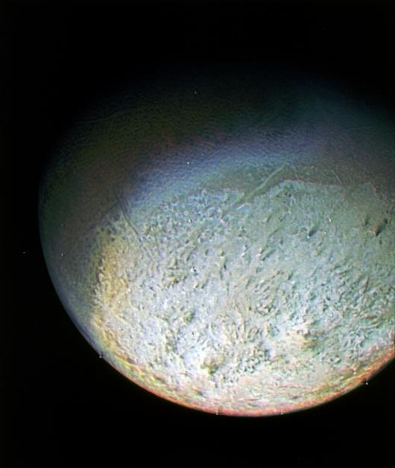
Neptune’s Moon Triton
Surface rock and ice
Contains ice-filled craters
Retrograde orbit
  radius decreasing
Captured KBO?
Image: NASA, Voyager 2

Slide 53
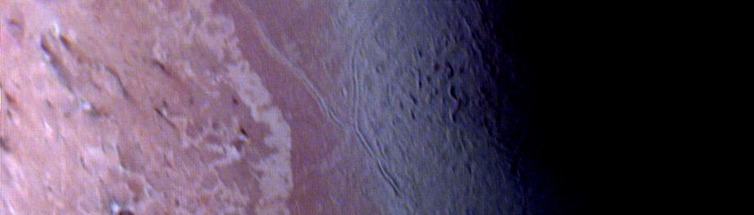
“Cantaloupe” Terrain
Image: NASA, Voyager 2

Slide 54
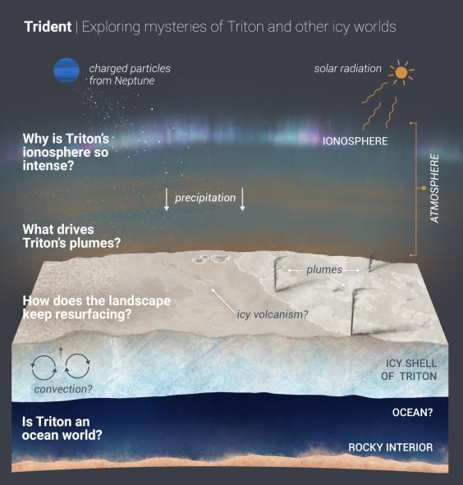
Image: NASA

Slide 55
Roche Limit
The gravitational pull of a planet or star decreases with distance form the center
This stretches an orbiting body
If the stretch is greater than the satellite’s gravitational cohesion, the satellite breaks apart
Inside this Roche limit, satellites are not stable

Slide 56
Fate of Triton
and also maybe Phobos

