Slide 1
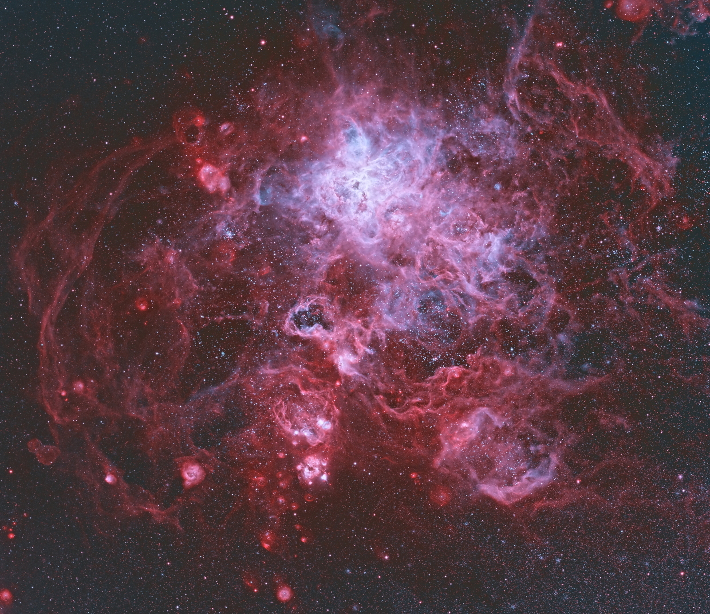
Origins of Stars and Planets
Our sort of neighborhood
Chapter 5

Slide 2
Gases and solids
Stars are H and He
Most of the universe is H and He
Many planets have heavier elements

Slide 3
Metals
To an astronomer, a metal is an element beyond He
S, As, Ar all “metals”
H and He formed in the Big Bang
Metals form in stars
  Nuclear fusion

Slide 4
Metals leave stars
Stellar winds
Planetary nebulae
Supernovae
Neutron star mergers

Slide 5
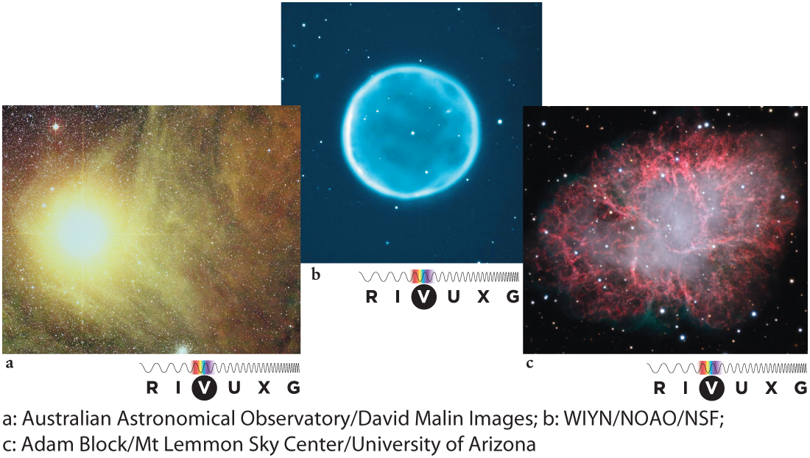
Metals leave stars

Slide 6
Star formation
Stars born inside clouds of gas and dust
Collapse after a Jeans instability
Local overdensity: gravity outweighs pressure
Material falls inward
  heats up
  collapses until pressure supports weight
Radiative energy loss facilitates collapse

Slide 7
Overdensity triggers
Wind and light pressure from new star
  Star formation chain reaction
Nearby nova or supernova
Colliding clouds

Slide 8
Collapsing cloud
Rotation intensifies as cloud contracts
Forms proto-star and protoplanetary disk
Development of star and planets is a subject of active research

Slide 9
Star ignition
Core becomes hot and dense enough to support fusion
Starlight and stellar wind disperse unconsolidated matter

Slide 10
Exoplanets
Detected by a myriad of techniques
  transits
  Doppler
  astrometry
  direct imaging

Slide 11
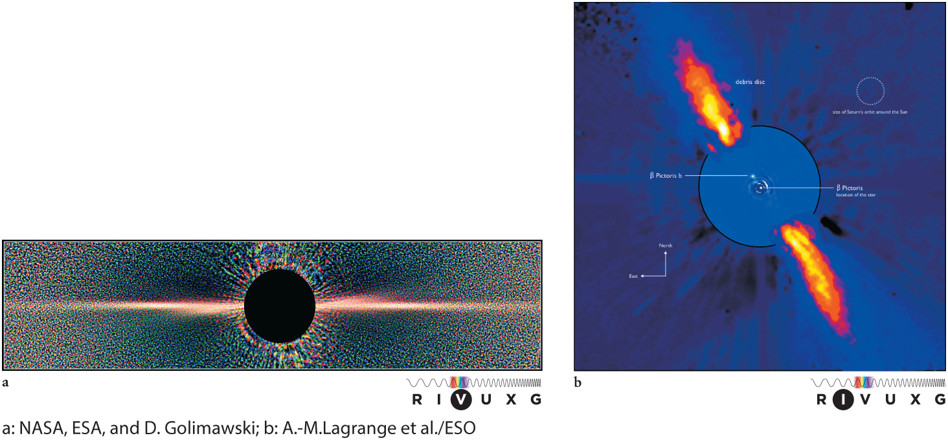
Circumstellar disks

Slide 12
Host stars are diverse
Binaries
Neutron stars
Red dwarfs
Stars in globular clusters

Slide 13
Exoplanets are diverse
Hot Jupiters
Super-Earths
Orbiting opposite stellar rotation

Slide 14
Orphan planets
Not orbiting a star
Ejected from double star system or by a massive sibling?
Estimates to be as numerous as stars

