Slide 1
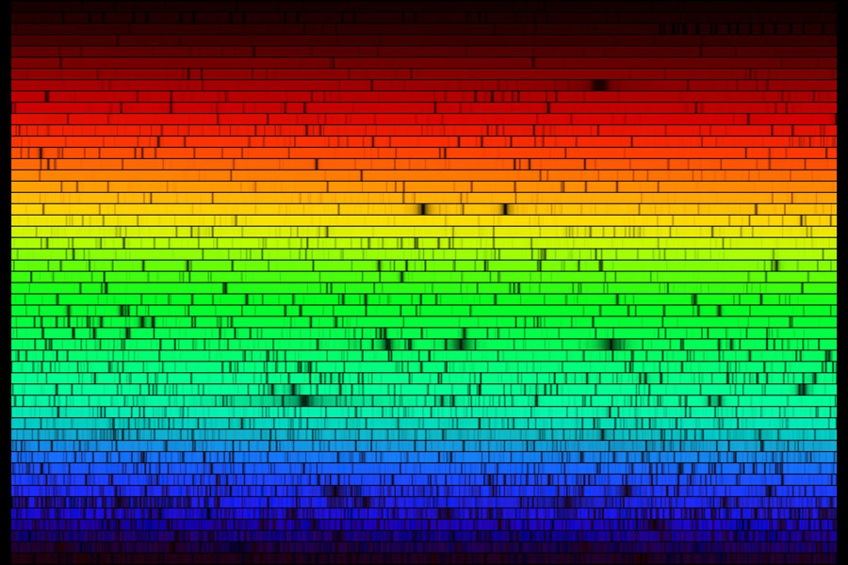
Spectra
messages from afar
Source: McMath-Pierce Solar Observatories

Slide 2
Kirchhoff’s spectroscopy laws
heated solids emit continuous spectra
Heated gases emit bright-line spectra
Illuminated gases transmit dark-line spectra

Slide 3
Emission Lines
Hydrogen
Helium
Neon
Sodium
Source: J. Strasbourg,I. Kiel after J. Tabbot. Data from NIST.

Slide 4
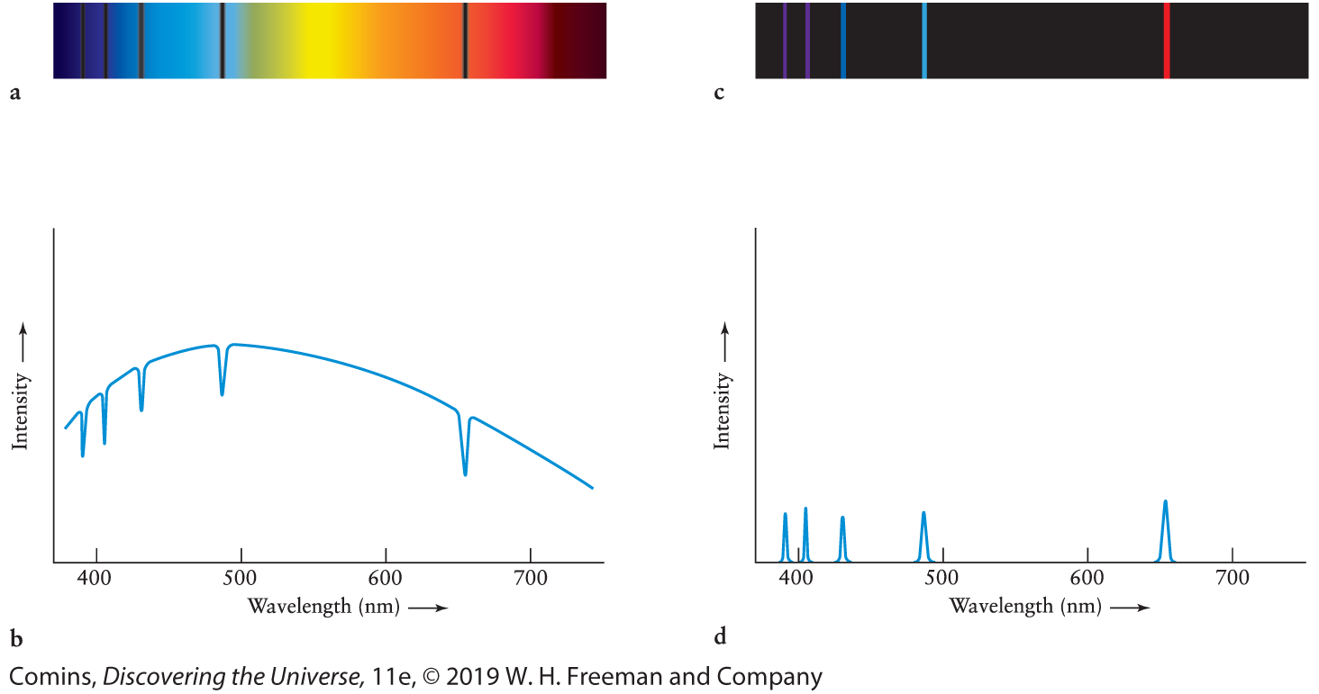
Hydrogen Line Spectra
Figure 4.8, Page 129

Slide 5
Why line spectra?
Electrons have wave properties
Atoms contain confined electrons
Allowed states are standing waves
Energy levels are the characteristic wave energies
Energy absorbed or released in transitions
Light energy = hc/λ

Slide 6
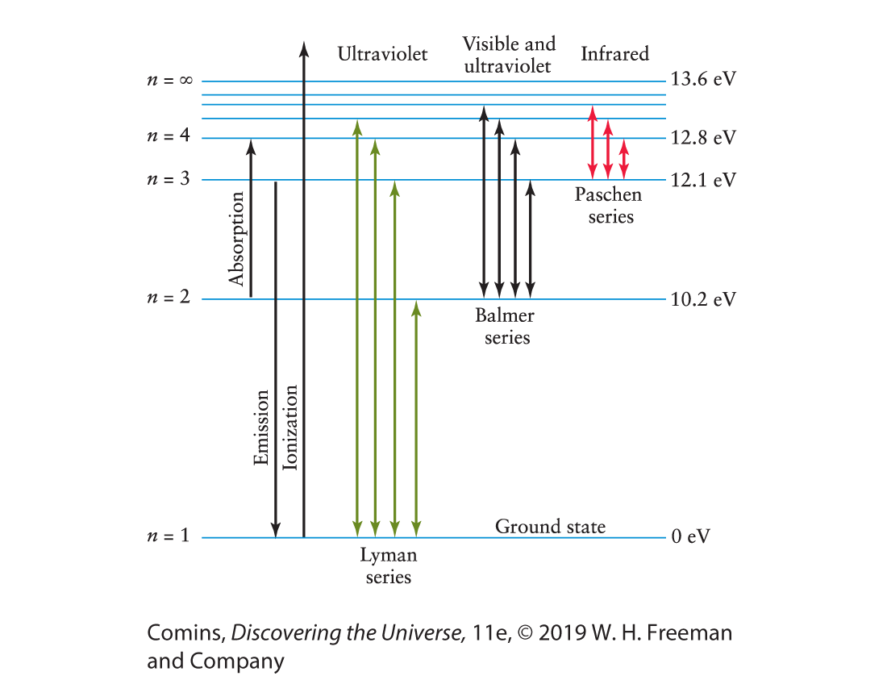
Figure 4.11, Page 133

Slide 7
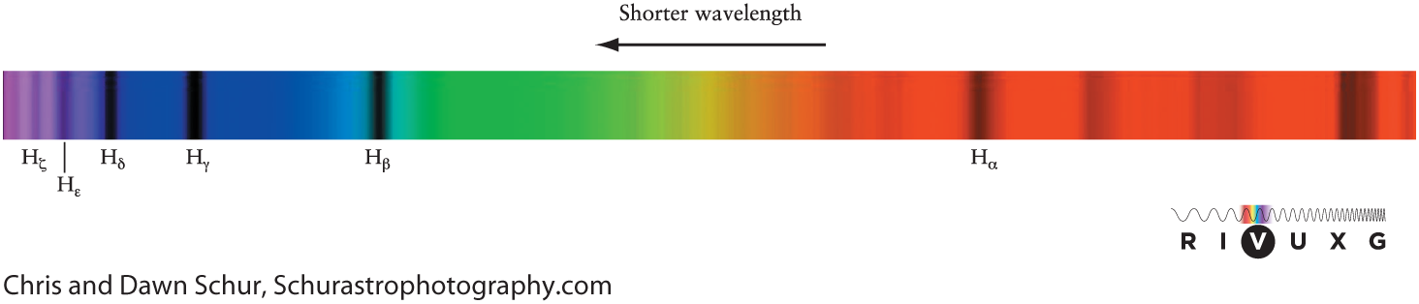
H Spectral lines
Figure 4.13, Page 134
Balmer series
Hα is n = 3 to n = 2 transition
  λ = 656.3 nm
  “Nature’s favorite color”

Slide 8
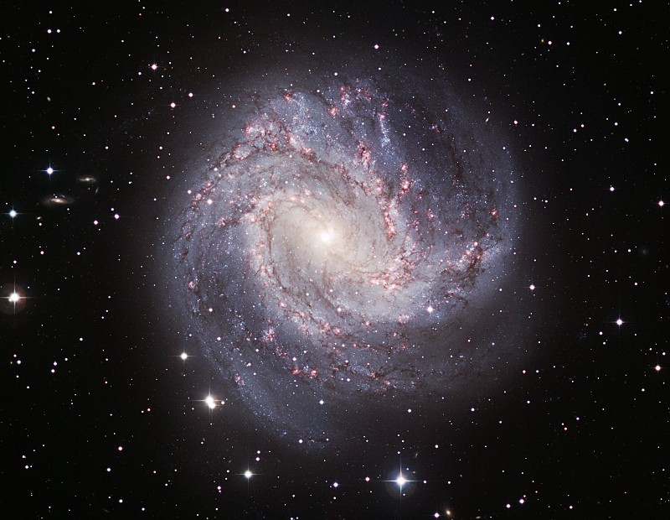
Hydrogen Emission
“Thousand Ruby Galaxy” M83
Source: European Southern Observatory

Slide 9
H atom spectrum
Must be hot enough to split H₂
Not hot enough to ionize H

Slide 10
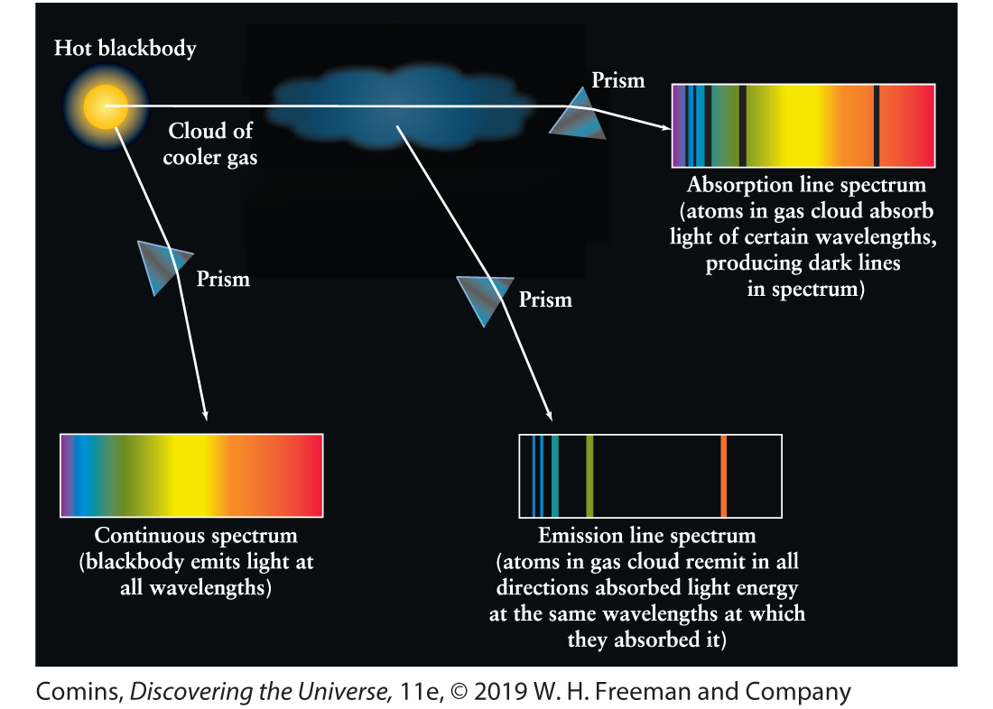
Astronomical Spectra
Figure 4.9, Page 130

Slide 11
Spectrum of the Sun
Source: McMath-Pierce Solar Observatories

