Slide 1
All the Light We Cannot See
we still want to detect

Slide 2
Near-IR and Near-UV
can use optical technology
Some problems with atmospheric absorption

Slide 3
Infrared
long-wave shows cool dust
short-wave see through dust
red-shifted distant sources

Slide 4
Radio Astronomy
Not obscured by clouds, rain, etc
Detects objects that are visually unremarkable or invisible
Sees H atoms (21 cm)
Large dishes, large arrays

Slide 5
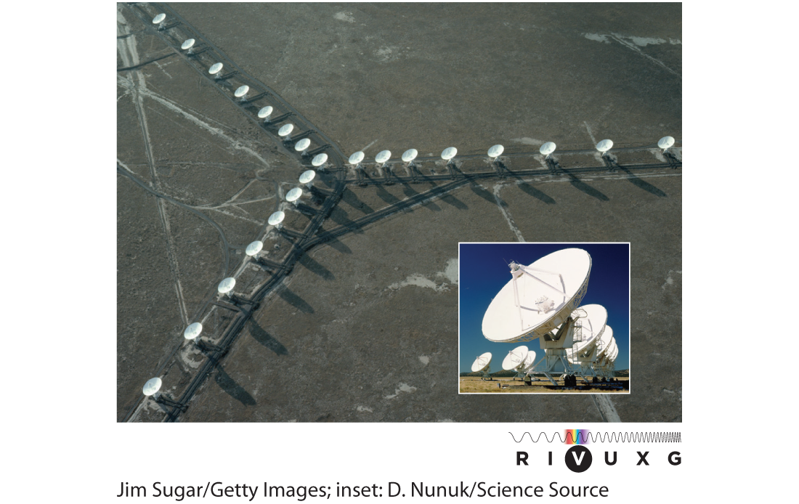

Slide 6
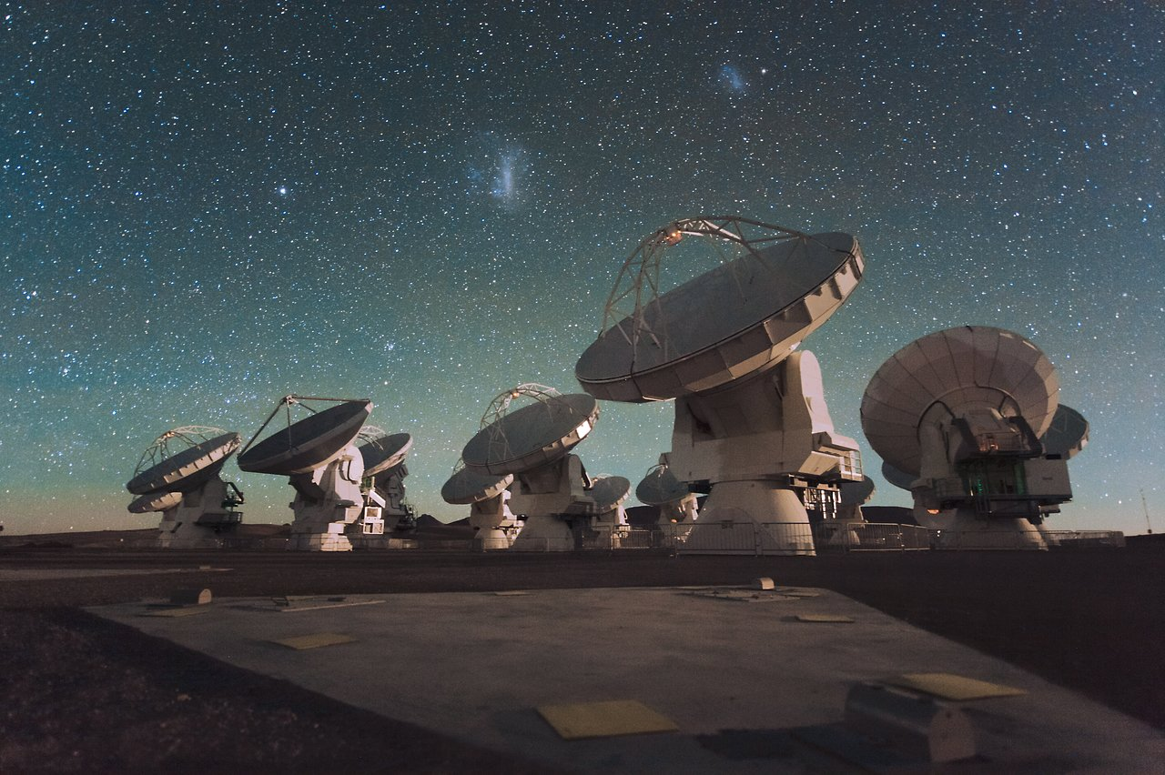

Slide 7
Microwave Astronomy
Atmospheric absorption
Important for cosmology (CMB)

Slide 8
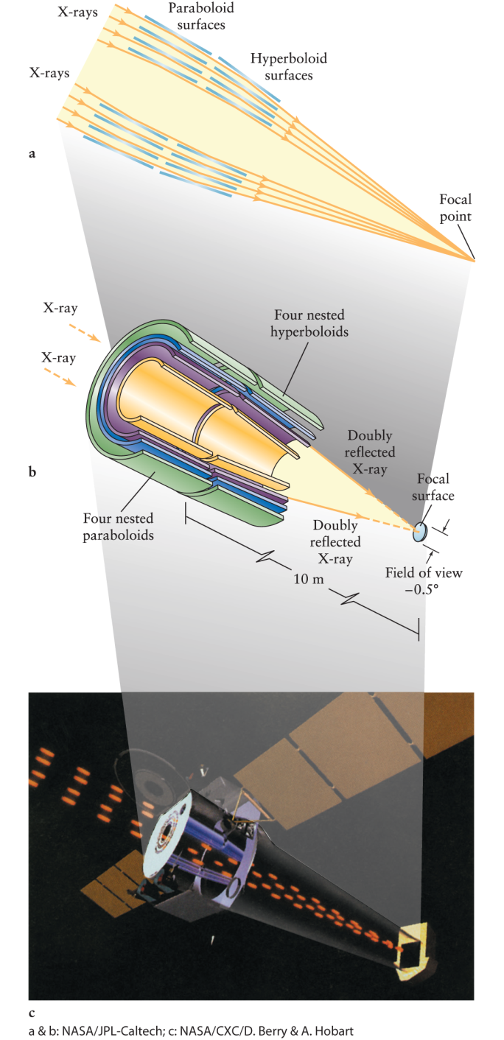
X-ray
Must be above the atmosphere
grazing incidence mirrors

Slide 9
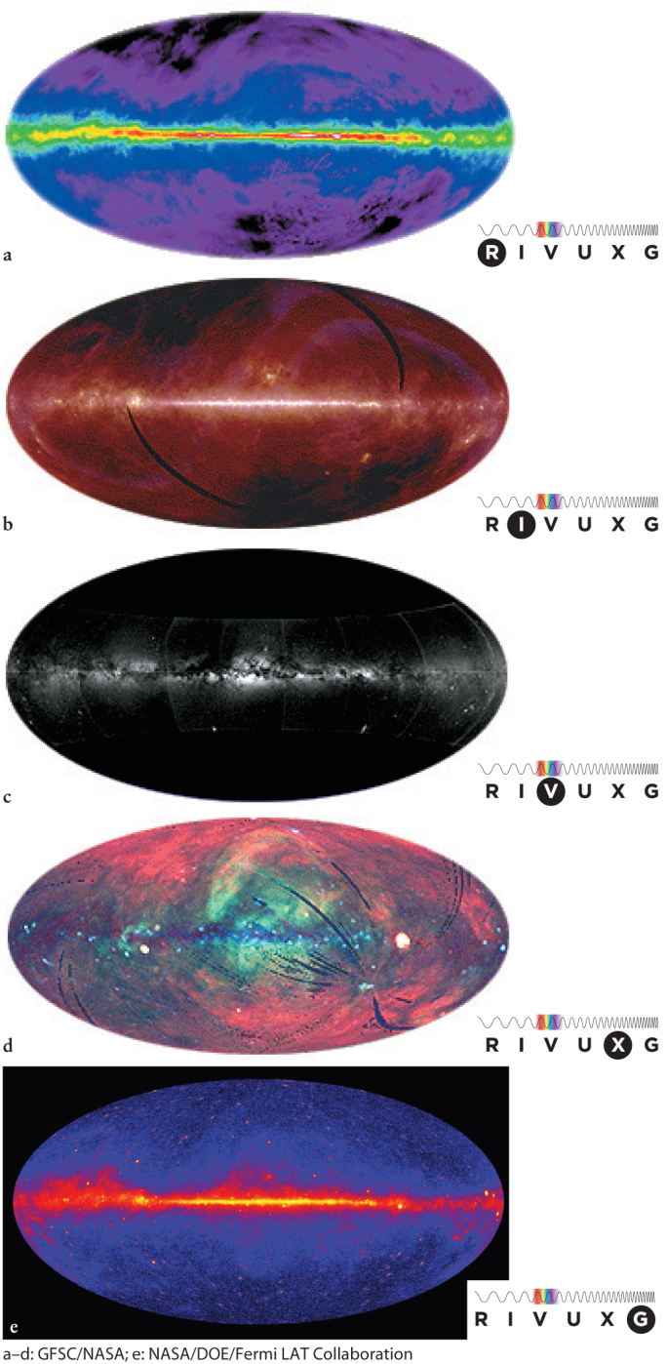
Pictures

Slide 10
Non-EM Observations
Neutrinos
  interiors of stars
Meteorites
  our Solar system
Cosmic rays
  difficult to interpret
Gravity waves
  eventually detected

Slide 11
Thermal Electromagnetic Spectra
Color and temperature

Slide 12
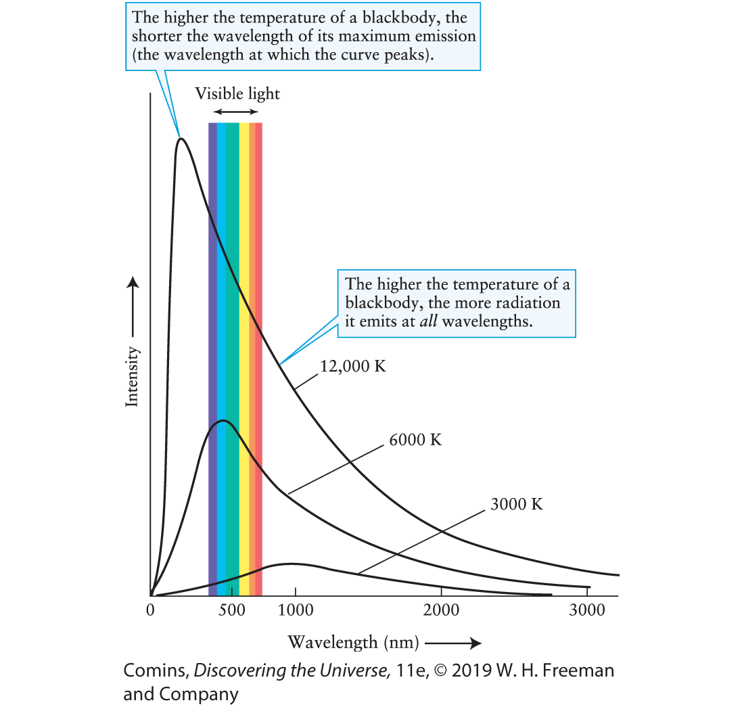
Black body
Theoretical absorber of all wavelengths
Emission depends on temperature

Slide 13
Black body
Brighter at all wavelengths at higher temperatures
Intensity =
energy/time
area

Slide 14
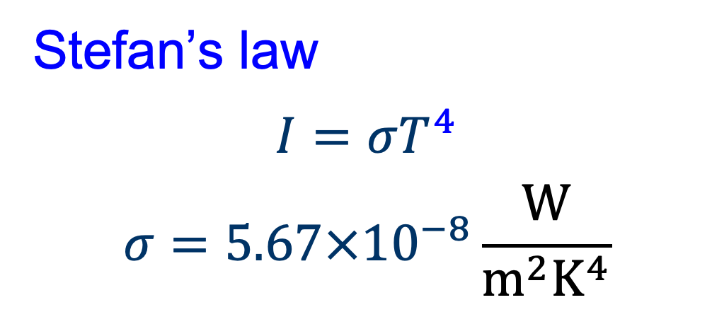
Black body
Stefan’s law
$$I=σT^{4}$$
$$σ=5.67×{10}^{−8}\frac{\text{W}}{{\text{m}}^{2}{\text{K}}^{4}}$$

Slide 15
Black body
Greatest intensity at shorter wavelengths at higher temperatures

Slide 16
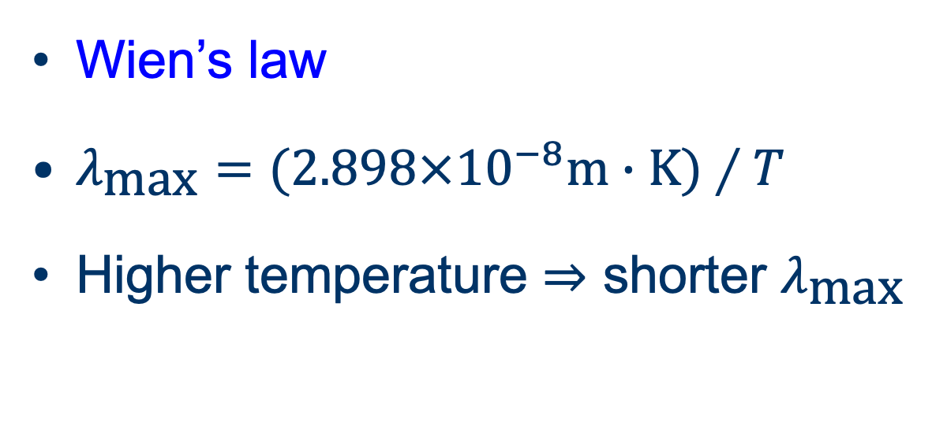
Black body
Wien’s law
$λ_{\text{max}}=(2.898×{10}^{−8}\text{m}∙\text{K)}∕T$
Higher temperature ⇒ shorter $λ_{\text{max}}$

Slide 17
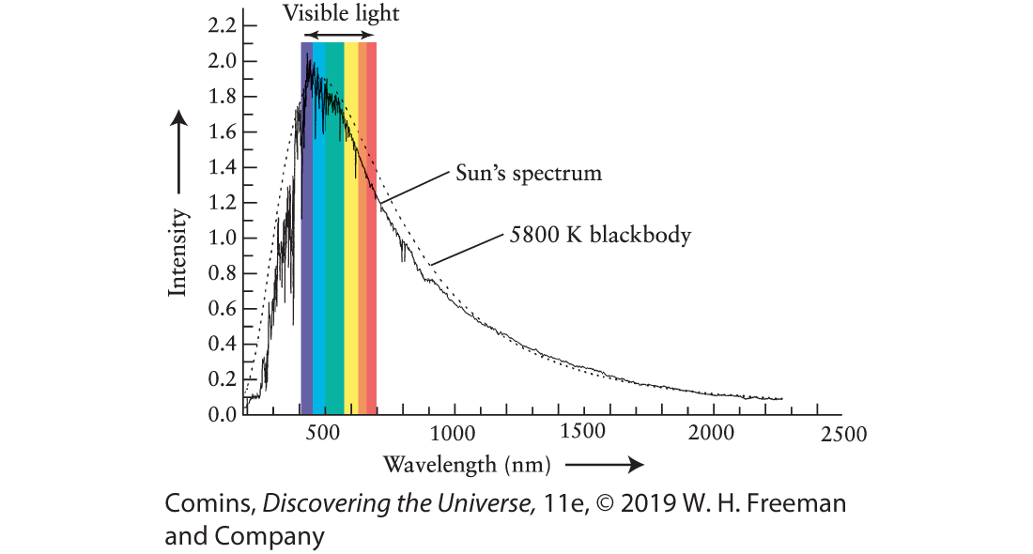
Why do we care about black bodies?

Slide 18
Figure 4.3, Page 122

Slide 19
Kirchhoff’s spectroscopy laws
heated solids emit continuous spectra
Heated gases emit bright-line spectra
Illuminated gases transmit dark-line spectra

