Slide 1
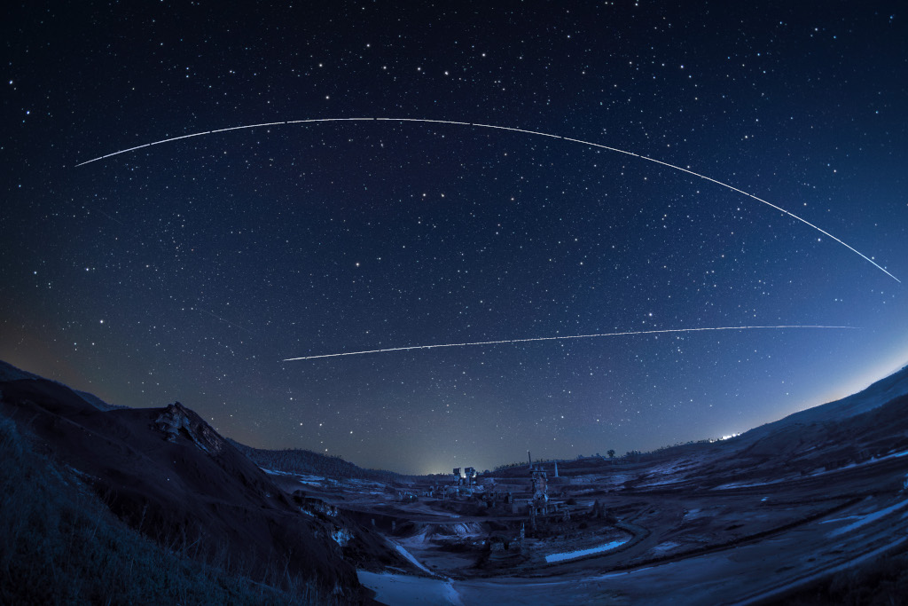
Physics of Orbits
Gravity and motion
Image: Zarcos Palma

Slide 2
Motion through the sky
the physics of quintessence?

Slide 3
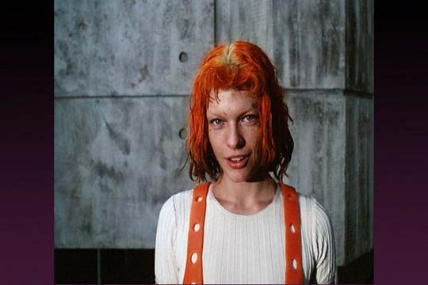
The Ancients observed
Some things fall down
  solids, liquids
Some things blow around
  air
Some things rise
  fire
Some things circle
  the fifth element?

Slide 4
Sky things move
Stars
  circle the sky once per sidereal day
Moon
  circles once per month
Sun
  circles the ecliptic annually, varying speed
Planets
  Near the ecliptic, loopy

Slide 5
Mars Retrograde
Images: Comins, Fig. 2.2

Slide 6
What’s happening?
No evidence the Earth moved
Celestial motions based on circles?
Ptolemy’s (c. 100–170) elegant epicycle model
  Deferent: circle around Earth
  Epicycle orbits along the deferent
  planet orbits along the epicycle
Accepted for over 1000 years

Slide 7
Epicyclic Planetary Motion
Images: Comins, Fig. GD2-1

Slide 8
Epicyclic Planetary Motion
Images: Comins, Fig. GD2-1

Slide 9
What went wrong?
After hundreds of years, observations did not match Ptolemy’s models’ predictions
Nicolaus Copernicus (1473–1543) revived a heliocentric model
  explained retrograde motion without epicycles
  Did not provide better predictions

Slide 10
What went wrong?
After hundreds of years, observations did not match Ptolemy’s models’ predictions
Tycho Brahe (1546–1601) made extensive observations of stellar and planetary positions
Johannes Kepler (1571–1630) strove to develop a model to calculate Brahe’s data

Slide 11
Kepler’s Laws
Completely empirical
Planets orbit the sun in elliptical paths, with the Sun at one focus
Duration (period) of the orbit T is related to the semi-major axis a of the orbit as
  T² = a³
The orbit sweeps out equal areas in equal times

Slide 12
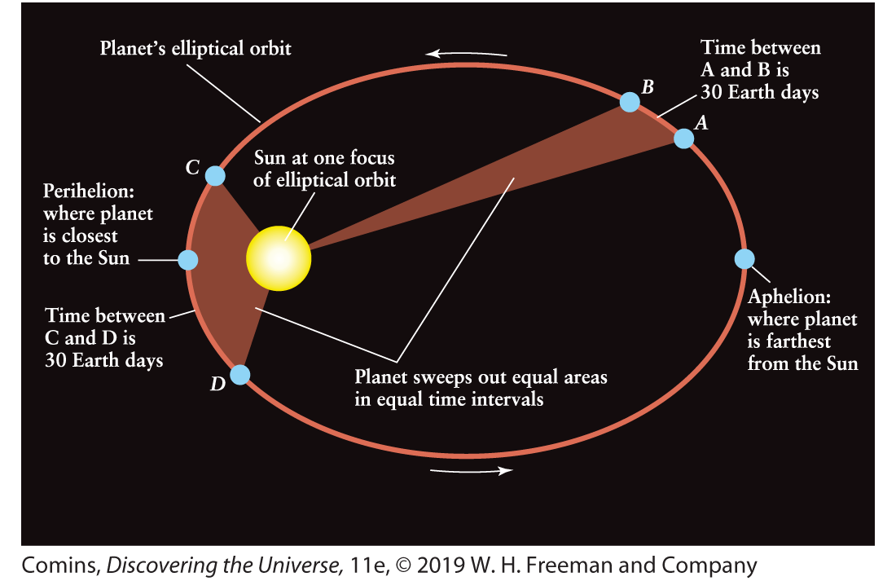
Elliptical Orbits

Slide 13
Keplerian Orbits
Planets orbit the Sun, but the orbits are not centered on the Sun
Planets move fastest at perihelion, slowest at aphelion
Planets closer to the Sun have faster speeds and shorter orbital periods

Slide 14
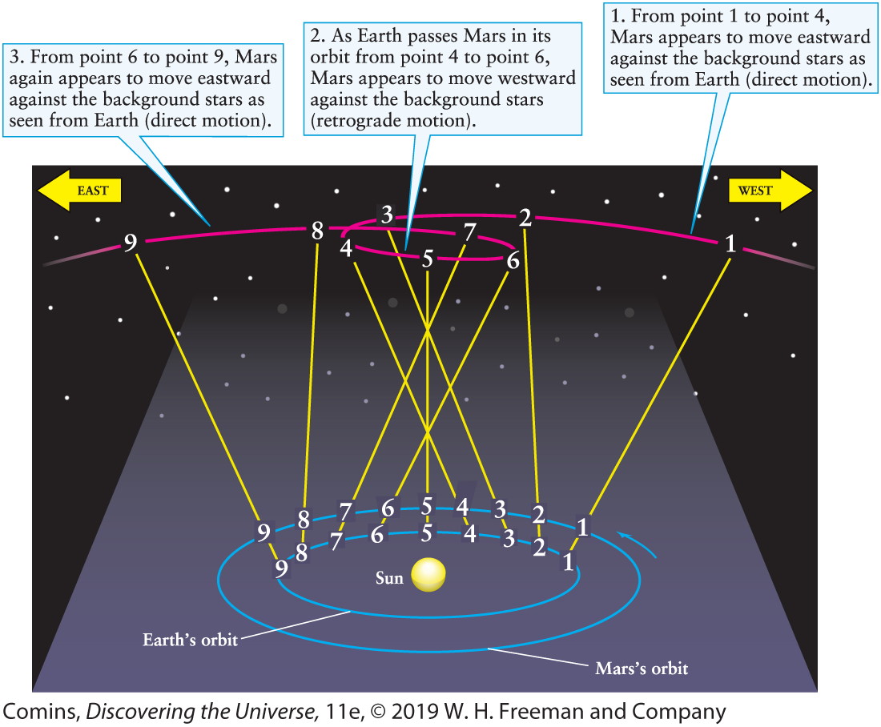
Retrograde motion explained

Slide 15
Retrograde Motion
ScienceWorld video (YouTube)
Simple animation

Slide 16
What went wrong?
Galileo Galilei (1564–1642) first observed with a telescope
  Saw sunspots on the Sun
  Saw four moons orbiting Jupiter
  Saw stars in the Milky Way
  Saw mountains on the Moon
All discoveries countered the prevailing geocentric, quintessential view

Slide 17
Kepler’s laws explained
by Newton’s theory of gravity
Isaac Newton (1643–1727) pioneered physics
  Laws of motion
  Optics
  Calculus
  Model of gravity

Slide 18
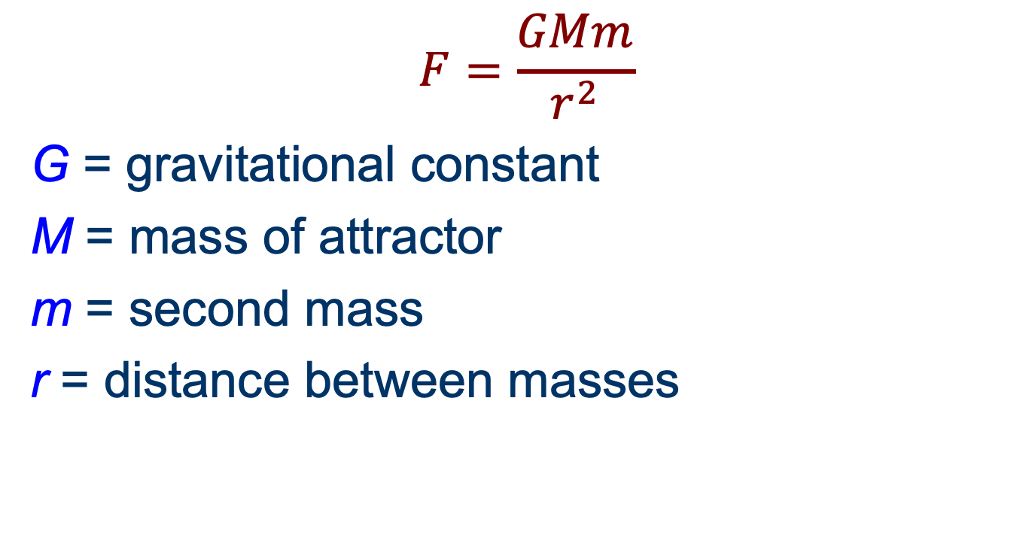
Newton’s gravity formula
$$F=\frac{GMm}{r^{2}}$$
G = gravitational constant
M = mass of attractor
m = second mass
r = distance between masses

Slide 19
Newtonian gravity
The inverse square force explained elliptical orbits
and all of Kepler’s laws

Slide 20
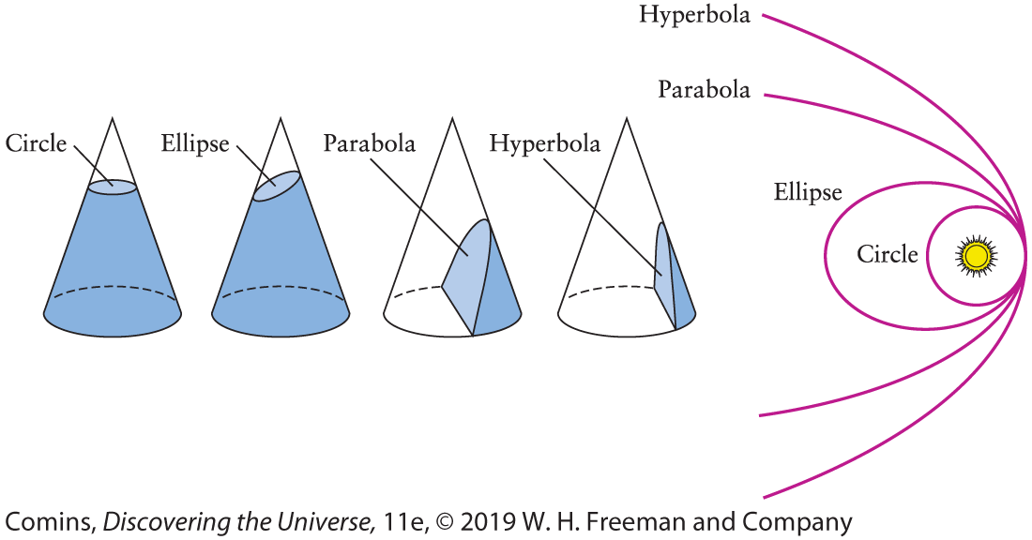
Newtonian gravity
Not only ellipses! Ellipses are the paths of bound objects.

