Slide 1
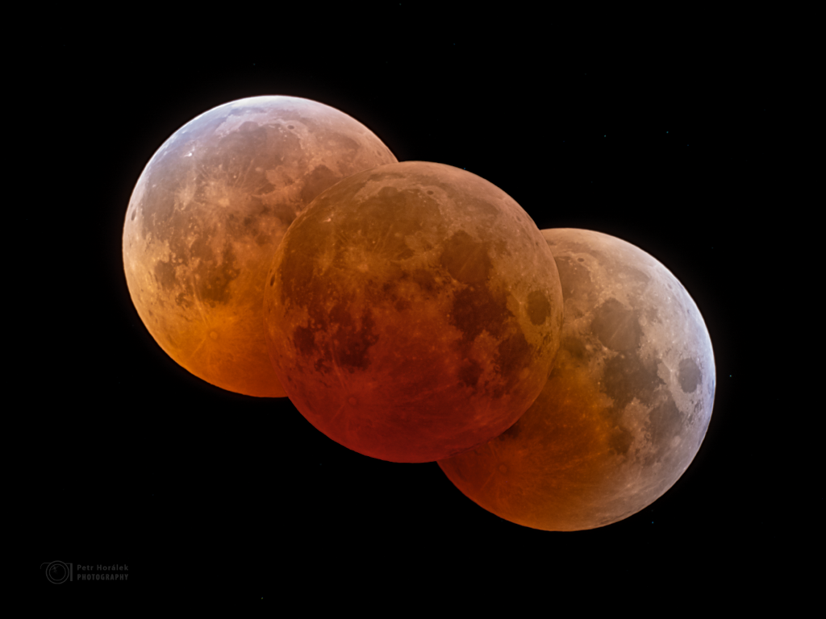
Eclipses, Transits, and Occultations
Getting in the way

Slide 2
Solar Eclipses
Moon blocks the Sun
What phase?
Why not every month?

Slide 3
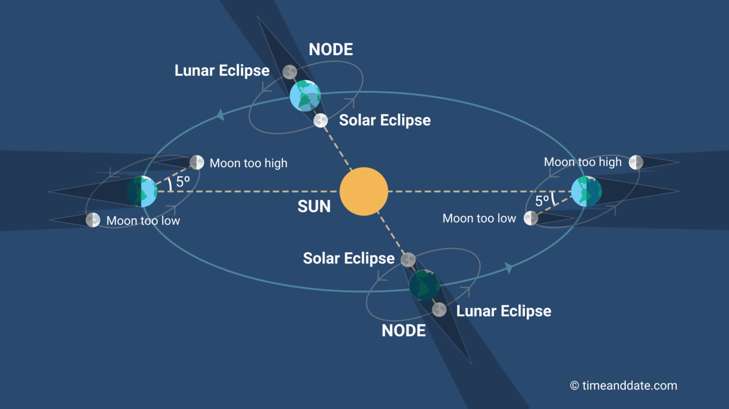
Eclipses

Slide 4
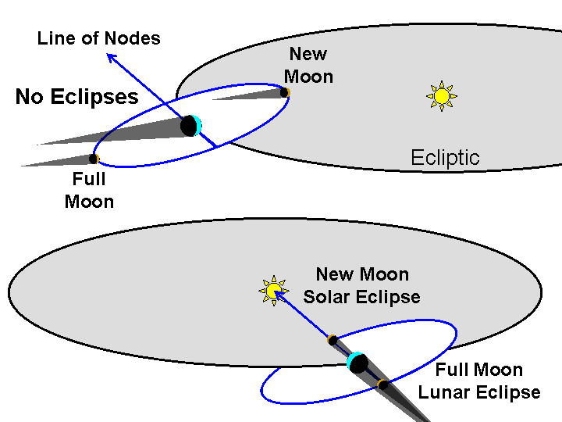
Lunar inclination
Image credit: Richard Pogge, Ohio State U

Slide 5
Line of sight
Node: where an orbit crosses the ecliptic
Nodal line: where orbital plane intersects the ecliptic

Slide 6
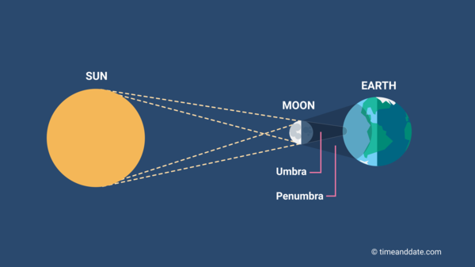
Parts of the shadow

Slide 7
Earth and Moon
Photo: NavCam 1 of the OSIRIS-REx probe, Sep 25, 2017
Approximately equidistant from Earth and Moon
Credit: NASA

Slide 8
They’re so close
Sun and Moon each subtend ½ degree
Sun is 400 times the diameter of Moon
Sun is 400 times farther than Moon

Slide 9
Disk matching
Sun: diameter 1.393 ×10⁶ km
Position | Distance (km) | Angle (ʹ)
average | 150 ×10⁶ | 32.3
perihelion | 147 ×10⁶ | 32.8
aphelion | 152 ×10⁶ | 31.7
Moon: diameter 3475 km
Position | Distance (km) | Angle (ʹ)
average | 384,399 | 31.1
perigee | 356,870 | 33.5
apogee | 406,079 | 29.4
The Sun usually looks bigger than the Moon

Slide 10
Types of Solar Eclipse
Total
  Part of Earth’s surface passes through Moon’s umbra
Partial
  Moon’s penumbra lands on Earth’s surface, but umbra misses
Annular
  Earth’s surface is beyond the Moon’s umbra

Slide 11
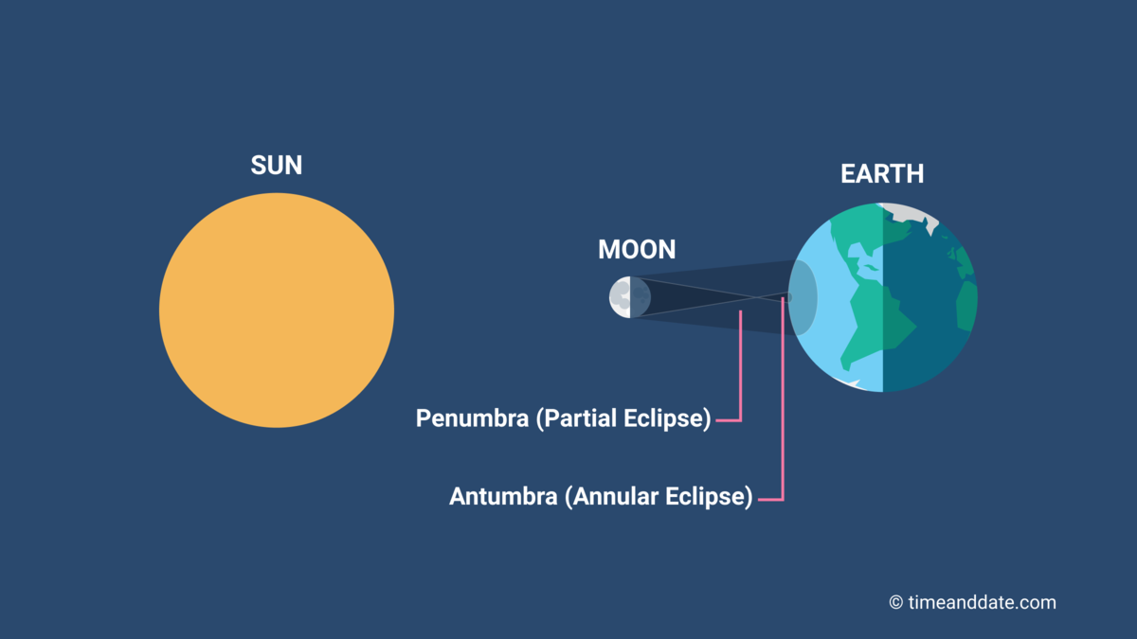
Annular eclipse

Slide 12
View a Solar Eclipse
More likely in summer
  More time facing the Sun
Totality more likely at aphelion
  Northern hemisphere summer
Narrow path of totality
Brief totality at best

Slide 13
What is an eclipse like?
GOES time lapse
Veritasium

Slide 14


Slide 15
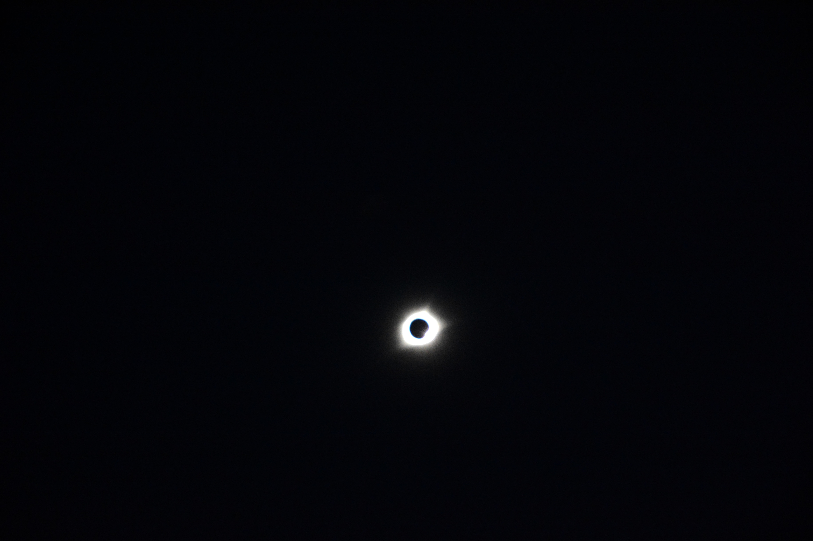

Slide 16
Upcoming Solar Eclipses
Recent total solar eclipse Aug 12
  totality in Greenland, Iceland, Spain
Annular solar eclipse 02/06/2027
  Maximum obscuration in Southern Cone
After that, total solar eclipse 8/2/2027
  totality in north Africa, Arabian peninsula
Total solar eclipse 7/22/2028 in Oceania
Laramie’s next total solar eclipse 5/3/2106

Slide 17
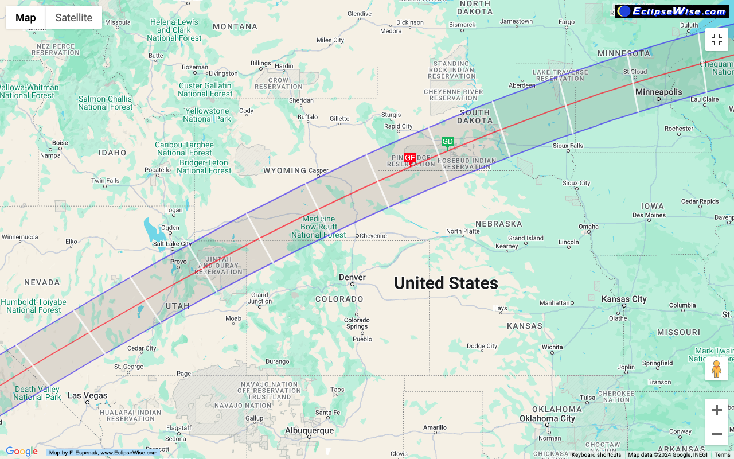

Slide 18
Lunar eclipses
Earth shades the Moon
What phase?
Why not every month?

Slide 19
Types of Lunar eclipse
Total
  Entire Moon passes into Earth’s umbra
Partial
  Some of the Moon inside Umbra, some in penumbra
Penumbral
  Moon passes into penumbra, misses umbra

Slide 20
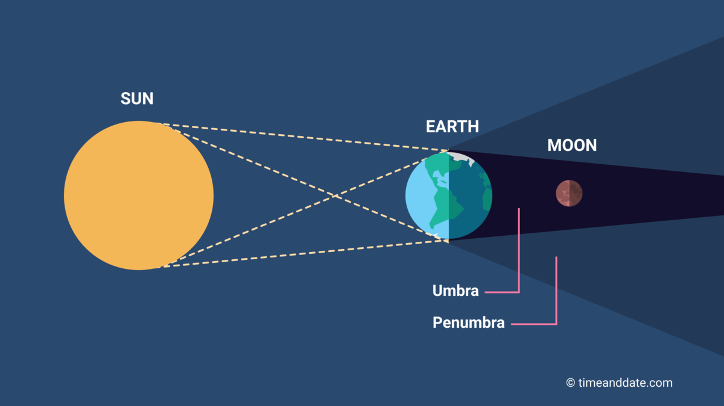
Total lunar eclipse

Slide 21
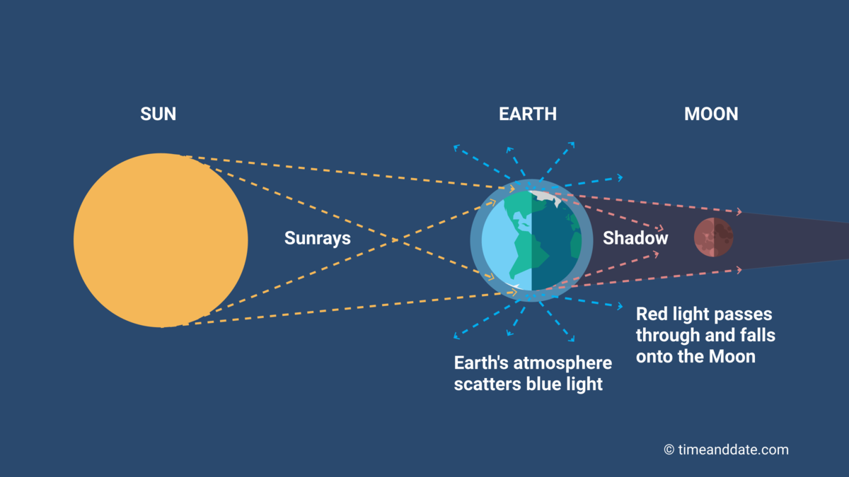
Blood Moon
Why is the umbra red?

Slide 22
View a Lunar Eclipse
Only visible at night
Visible everywhere the Moon is visible
Long period of totality

Slide 23
Earth’s umbral diameter
at distance of Moon
Position | Umbra, km | Umbra/Moon
average, average | 9177 | 2.64
aphelion, perigee | 9487 | 2.73
perihelion, apogee | 8912 | 2.56
As long as they line up, the eclipse is total.

Slide 24
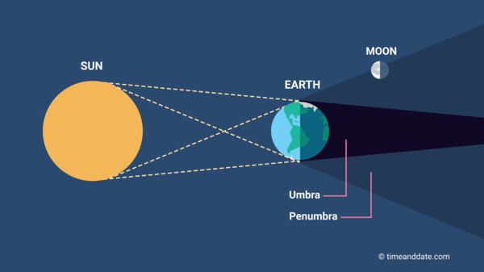
Penumbral lunar eclipse

Slide 25
Upcoming Lunar Eclipses
Recent partial (92%) Aug 27–28
No total lunar eclipses in 2027
No total lunar eclipses we’ll see in 2028
Some of total 6/26/2029 visible in Laramie
  Moonrise–10:13 PM

Slide 26
Planetary Transits
Inner planet between Sun and Earth
  Inferior conjunction
Very little obscuration
  Mercury 10"–12"
  Venus 58"
Nodal alignment required
  Mercury’s orbital inclination 7°
  Venus’s orbital inclination 3.4°

Slide 27
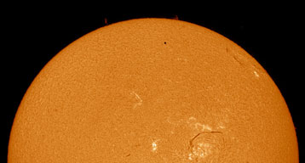
Transits are Rare
Next transits of Mercury:
  Nov 13, 2032 not visible in N. America
  Nov 7, 2039 not visible in N. America
  May 7, 2049 visible in western N. Am.
  Nov 8, 2052 visible in Americas
Image: Howard Brown-Greaves

Slide 28
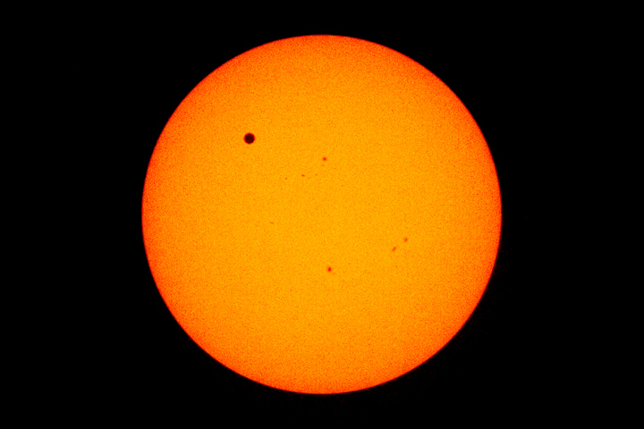
Transits are Rare
Transits of Venus:
  Jun 8, 2004
  Jun 6, 2012
  Dec 11, 2117
  Dec 18, 2125
  June 11, 2247
  June 9, 2255
Image: NASA

Slide 29
Exoplanet Transits
Sensitive way to detect exoplanets
Gives information about
  atmosphere of star
  atmosphere of planet
  diameter of planet
Low probability of alignment
Difficult to detect planets much smaller than their stars

Slide 30
Occultations
Closer object blocks a more distant object
E.g. planet, moon, or asteroid blocks a star
Gives information about
  atmosphere of blocker
  size and shape of near object
  size and shape of distant object

Slide 31
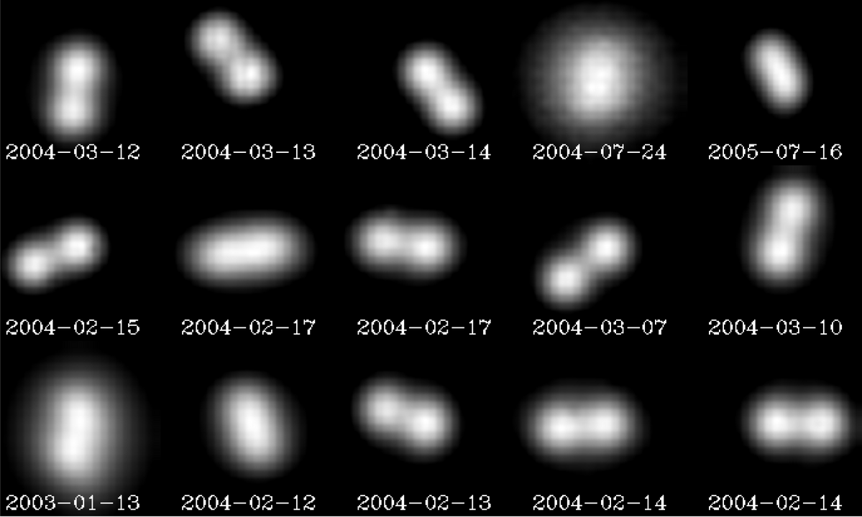
Asteroid (90) Antiope
Best telescopic view, VLT/adaptive optics
By European Southern Observatory

Slide 32
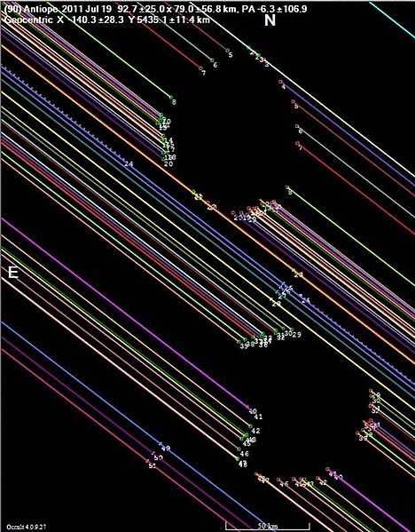
Asteroid (90) Antiope
Occultation of LQ Aquarii, 7/19/2011
Timings from multiple stations in western US
Credit: David Dunham, International Occultation Timing Association

Slide 33
Eclipse and occultation
APOD 11 Nov 2022

