Slide 1
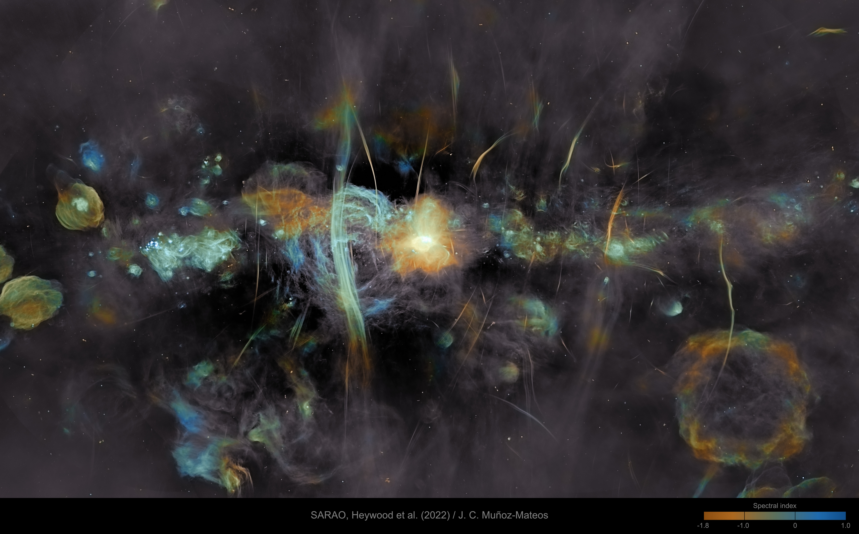
Stellar Coordinates

Slide 2
Coordinates
How should we specify where something is in the sky?

Slide 3
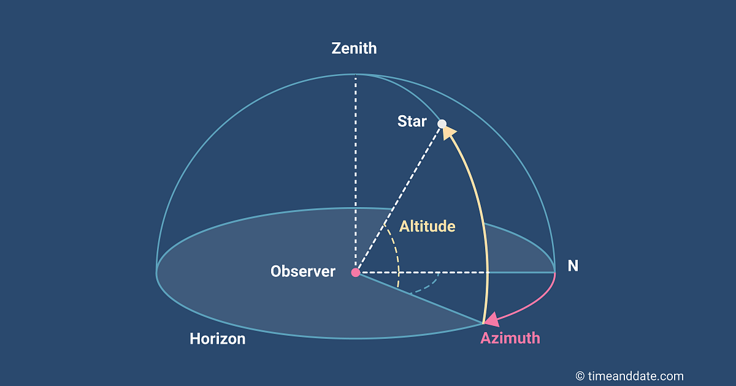
Alt-Azimiuth
Altitude: degrees above the horizon
Azimuth: degrees clockwise of north

Slide 4
Alt-Azimuth Coordinates
Advantages
  Easy to use
  Intuitive
Disadvantages
  System moves relative to the sky
  Zenith is different everywhere on Earth
  Must specify time, location to be useful

Slide 5
Equatorial Coordinates
Declination
  0° at equator
  +90°at north celestial pole
  –90° at south celestial pole

Slide 6
Equatorial Coordinates
Right ascension
  0 at first point of Aries (March equinox)
  Progresses eastward around the celestial equator to 24 h
  Reported in hh:mm:ss

Slide 7
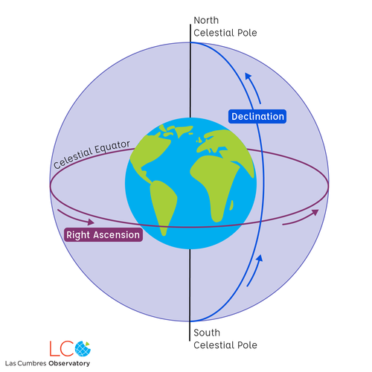
Equatorial Coordinates

Slide 8
Equatorial Coordinates
Advantages
  Referenced to the sky, not the Earth
  Tracking RA is easy using (sidereal) time
Disadvantages
  No obvious landmarks for zero
  The celestial equatorial plane moves
  The First Point of Aries moves

Slide 9
Ecliptic Coordinates
Latitude 0° at the ecliptic plane, ±90° at the ecliptic poles
Longitude 0° at the First Point of Aries, increases eastward to 360°

Slide 10
Ecliptic Coordinates
Advantages
  The ecliptic plane doesn’t move
  Uses degrees for both coordinates
Disadvantages
  The First Point of Aries does move

Slide 11
Galactic coordinates
Image: NASA/Caltech-JPL, Spitzer data

Slide 12
Galactic Coordinates
Latitude 0° is the plane containing the Sun parallel to the plane of the Milky Way galaxy
Longitude 0° in the direction to the galactic center
Longitude increases ccw looking down north galactic pole

Slide 13
Galactic Coordinates
Advantages
  Stabler than Earth Orbit parameters
Disadvantages
  Galactic plane hard to define exactly
  Galactic plane isn’t exactly planar

Slide 14
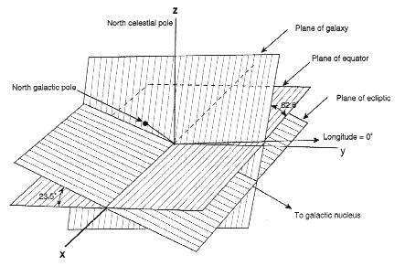
Converting between systems
Source: Green Bank Observatory

Slide 15
ICRS
International Celestial Reference System
Defined by 303 distant radio sources (mostly quasars)
Equivalent to equatorial coordinates at January 1, 2000

Slide 16
Constellation Boundaries
Celestial sphere is officially partitioned between 88 constellations
  Adopted in 1930
Boundaries between constellations are line segments of constant right ascension or declination
  B1875.0 coordinates

Slide 17
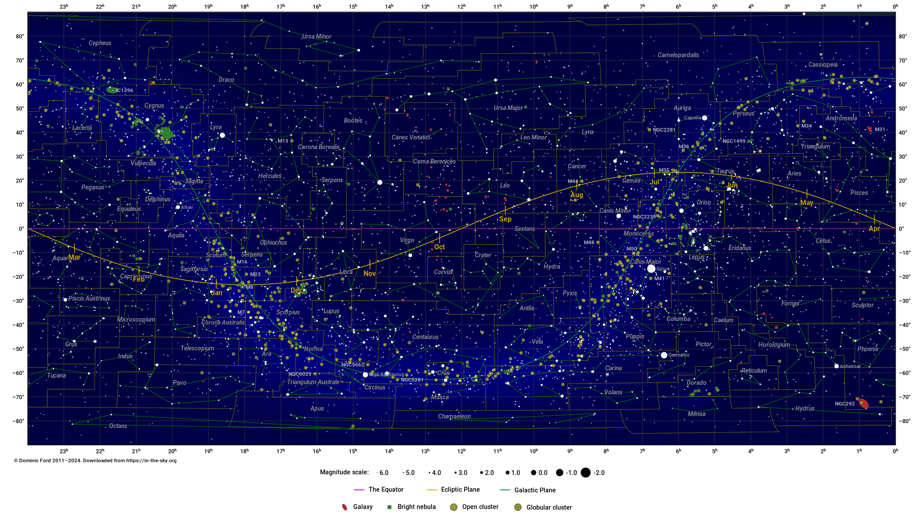
Constellations

