Slide 1
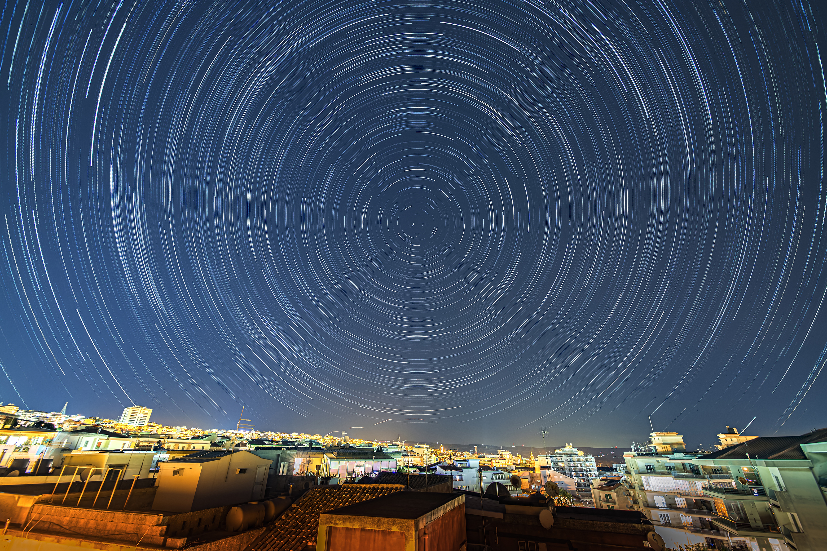
Days, Months, Years
The sky tells time
Image credit: Gianni Tumino
Notes:
A1050 L02 Sky cycles
1
08/29/26

Slide 2
What we see in the sky
In the atmosphere
  animals, dust, clouds, aircraft, meteors
Around the Earth
  satellites, the Moon
The Sun
Around the Sun
  Planets, comets
Beyond the Sun
  Stars, nebulas, galaxies

Slide 3
The Heavens move
Celestial objects move across the sky
  That’s what we see
Regularly-repeating patterns in the sky have set our concept of time

Slide 4
Daily motion
Celestial objects travel east to west
Circle around an axis
  counterclockwise around North Star in northern hemisphere
  clockwise around nothing prominent in southern hemisphere
From this we can deduce which way Earth spins

Slide 5
Daily motion
We see different objects
  at different times of the night
  at different times of the year
  from different parts of the Earth

Slide 6
Polaris
Close to North Celestial Pole
  20th brightest star
  0.75° from pole (1.5 times diameter of full Moon)

Slide 7
We can observe
Half the sky at a time
  above the horizon
  90° around our zenith
Some stars never set (circumpolar)
Some stars never rise (always below the horizon)

Slide 8
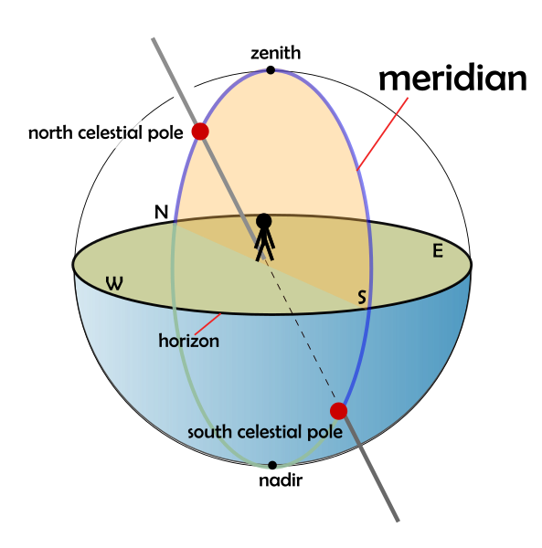
What we see
Credit: Wikimedia commons, creator AMitchell125

Slide 9
Latitude matters
The farther we are from the equator:
  the more stars are circumpolar
  the more stars are always below the horizon

Slide 10
Wanderers
The Sun travels through the fixed stars
Moves about 1° per day along the circular path of the Ecliptic
Inclined 23.5° from the Celestial Equator
Passes through Zodiac constellations
Crosses the equator at equinoxes
Farthest north and south at solstices

Slide 11
Wanderers
The Moon, Mercury, Venus, Mars, Jupiter, Saturn travel near the ecliptic in halting paths
Uranus, Neptune, and Pluto are too faint to see with the unaided eye

Slide 12
Repeating patterns
Regularly-repeating patterns in the sky have set our concept of time
Days
12- and 24-hour days and nights
  Egyptians favored base 12
  Standard hours only really caught on after mechanical clocks became commonplace
Minutes and seconds

Slide 13
Days
The Sun rises and sets day after day
  Daylight length varies annually

Slide 14
Days
Solar Day: high noon to high noon
  (when the Sun crosses the meridian)
  varies throughout the year
Mean solar day = 24 hours

Slide 15
Days
Sidereal Day: fixed star to fixed star
  One Meridian crossing to the next
  Period = 23 h 56 min 4.1 s
One year holds one more sidereal day than solar days
From this we can deduce which way Earth orbits

Slide 16
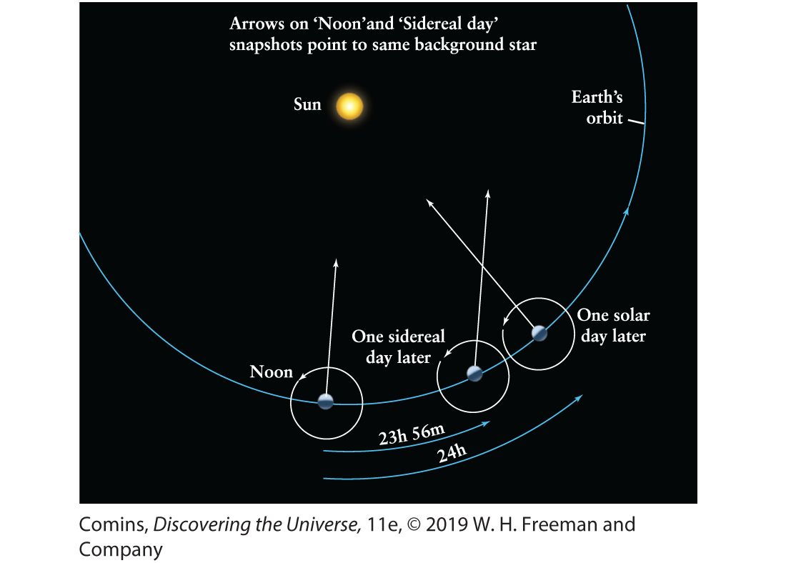
Days
Figure 1.10, Page 17

Slide 17
Weeks
Seven days of the week
Seven visible wanderers in the sky
English | French | Spanish
Sunday | dimanche | domingo
Monday | lundi | lunes
Tuesday | mardi | martes
Wednesday | mercredi | miércoles
Thursday | jeudi | jueves
Friday | vendredi | viernes
Saturday | samedi | sabado

Slide 18
Months
Cycle of the Moon (moonth)
Lunar or Synodic month: Cyclic phases of the Moon
Period 29.5 days

Slide 19
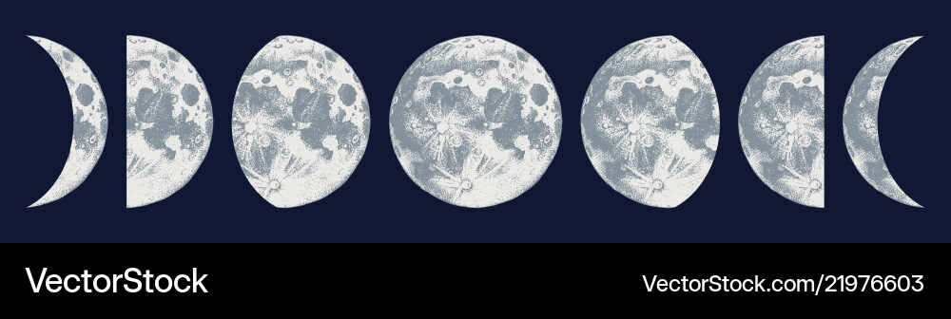
Phases of the Moon
New
Waxing crescent
First quarter
Waxing Gibbous
Full
Waning Gibbous
Last quarter
Waning crescent

Slide 20
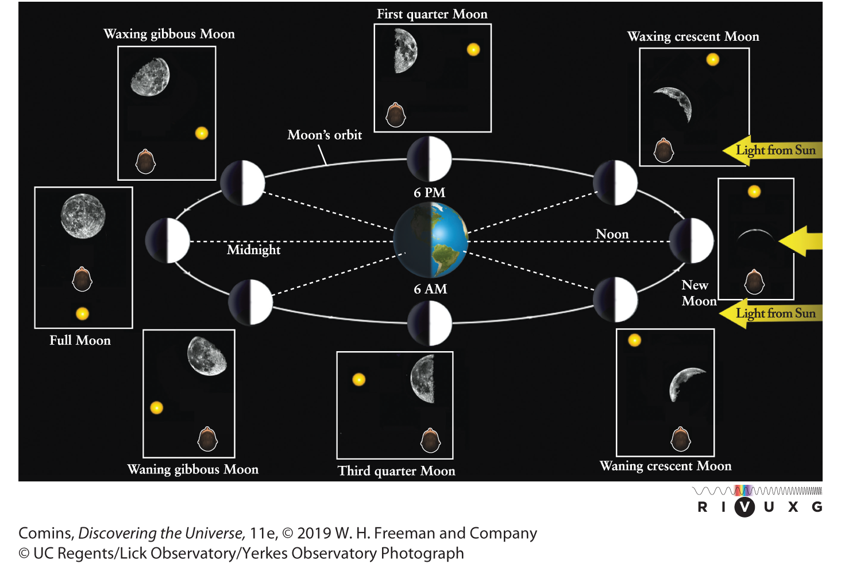
Phases of the Moon
Figure 1.23, Page 27

Slide 21
Months
Sidereal month: fixed star to fixed star
Period 27.3 days
From this we can deduce which way the Moon orbits Earth

Slide 22
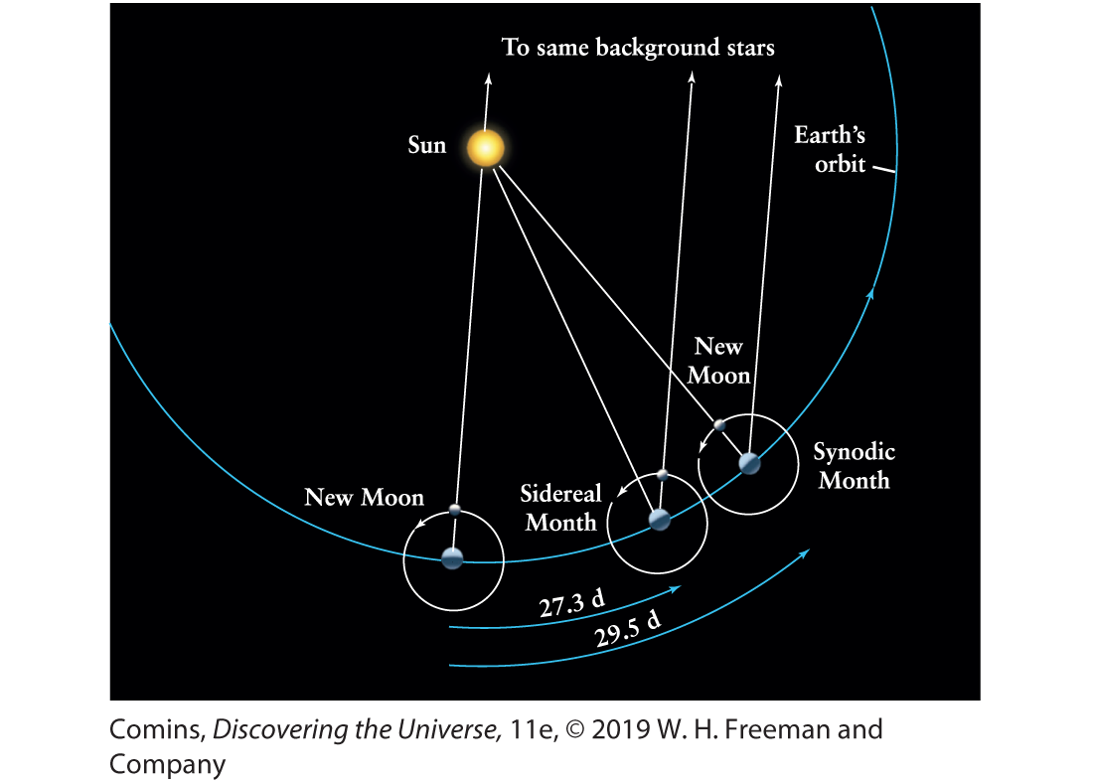
Months
Figure 1.25, Page 29

Slide 23
Years
Orbit of Earth around the Sun
  Appears the other way around
Sidereal year
  fixed star to fixed star
  Period 365.256 days
Tropical year
  equinox to equinox
  Period 365.24219 days

Slide 24
Precession
Earth’s axis slowly precesses
  about the axis of the ecliptic
Period about 26,000 years
Equinoxes precess about the ecliptic
  The Sun is in different constellations at the change of the seasons than it was in the past

Slide 25
The Seasons
Astronomically begin at equinoxes and solstices
Yearly temperature cycles result from 23.5° axial tilt
More daylight hours during Spring and Summer
Sun closer to zenith in Spring and Summer

Slide 26
The Seasons
Temperature lags solar input
  It takes time to heat up and cool down
Season beginnings vary culturally
  USA: astronomical seasons
  Europe: first of the month
  Ancient Celts: cross-quarter days
  Laramie: June is Spring, July is Summer, August is Fall

Slide 27
The Tropics
Gr. tropos, “turning”
Sun “turns around” at the tropics
  formerly in Cancer and Capricornus
Between the tropics, the Sun is directly overhead at solar noon twice per year

Slide 28
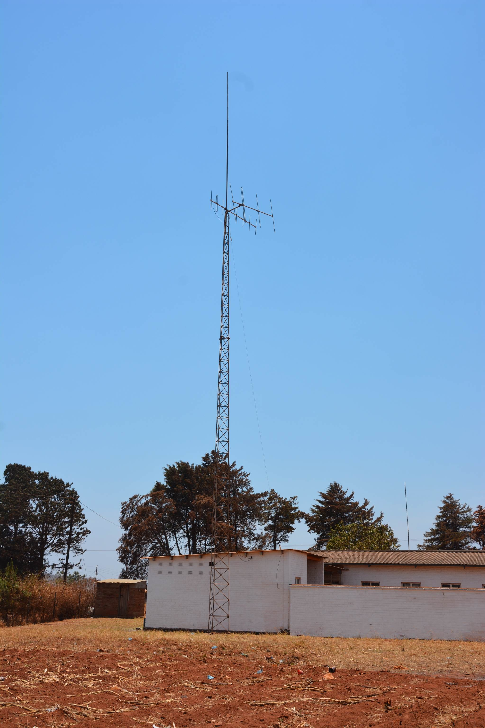

Slide 29
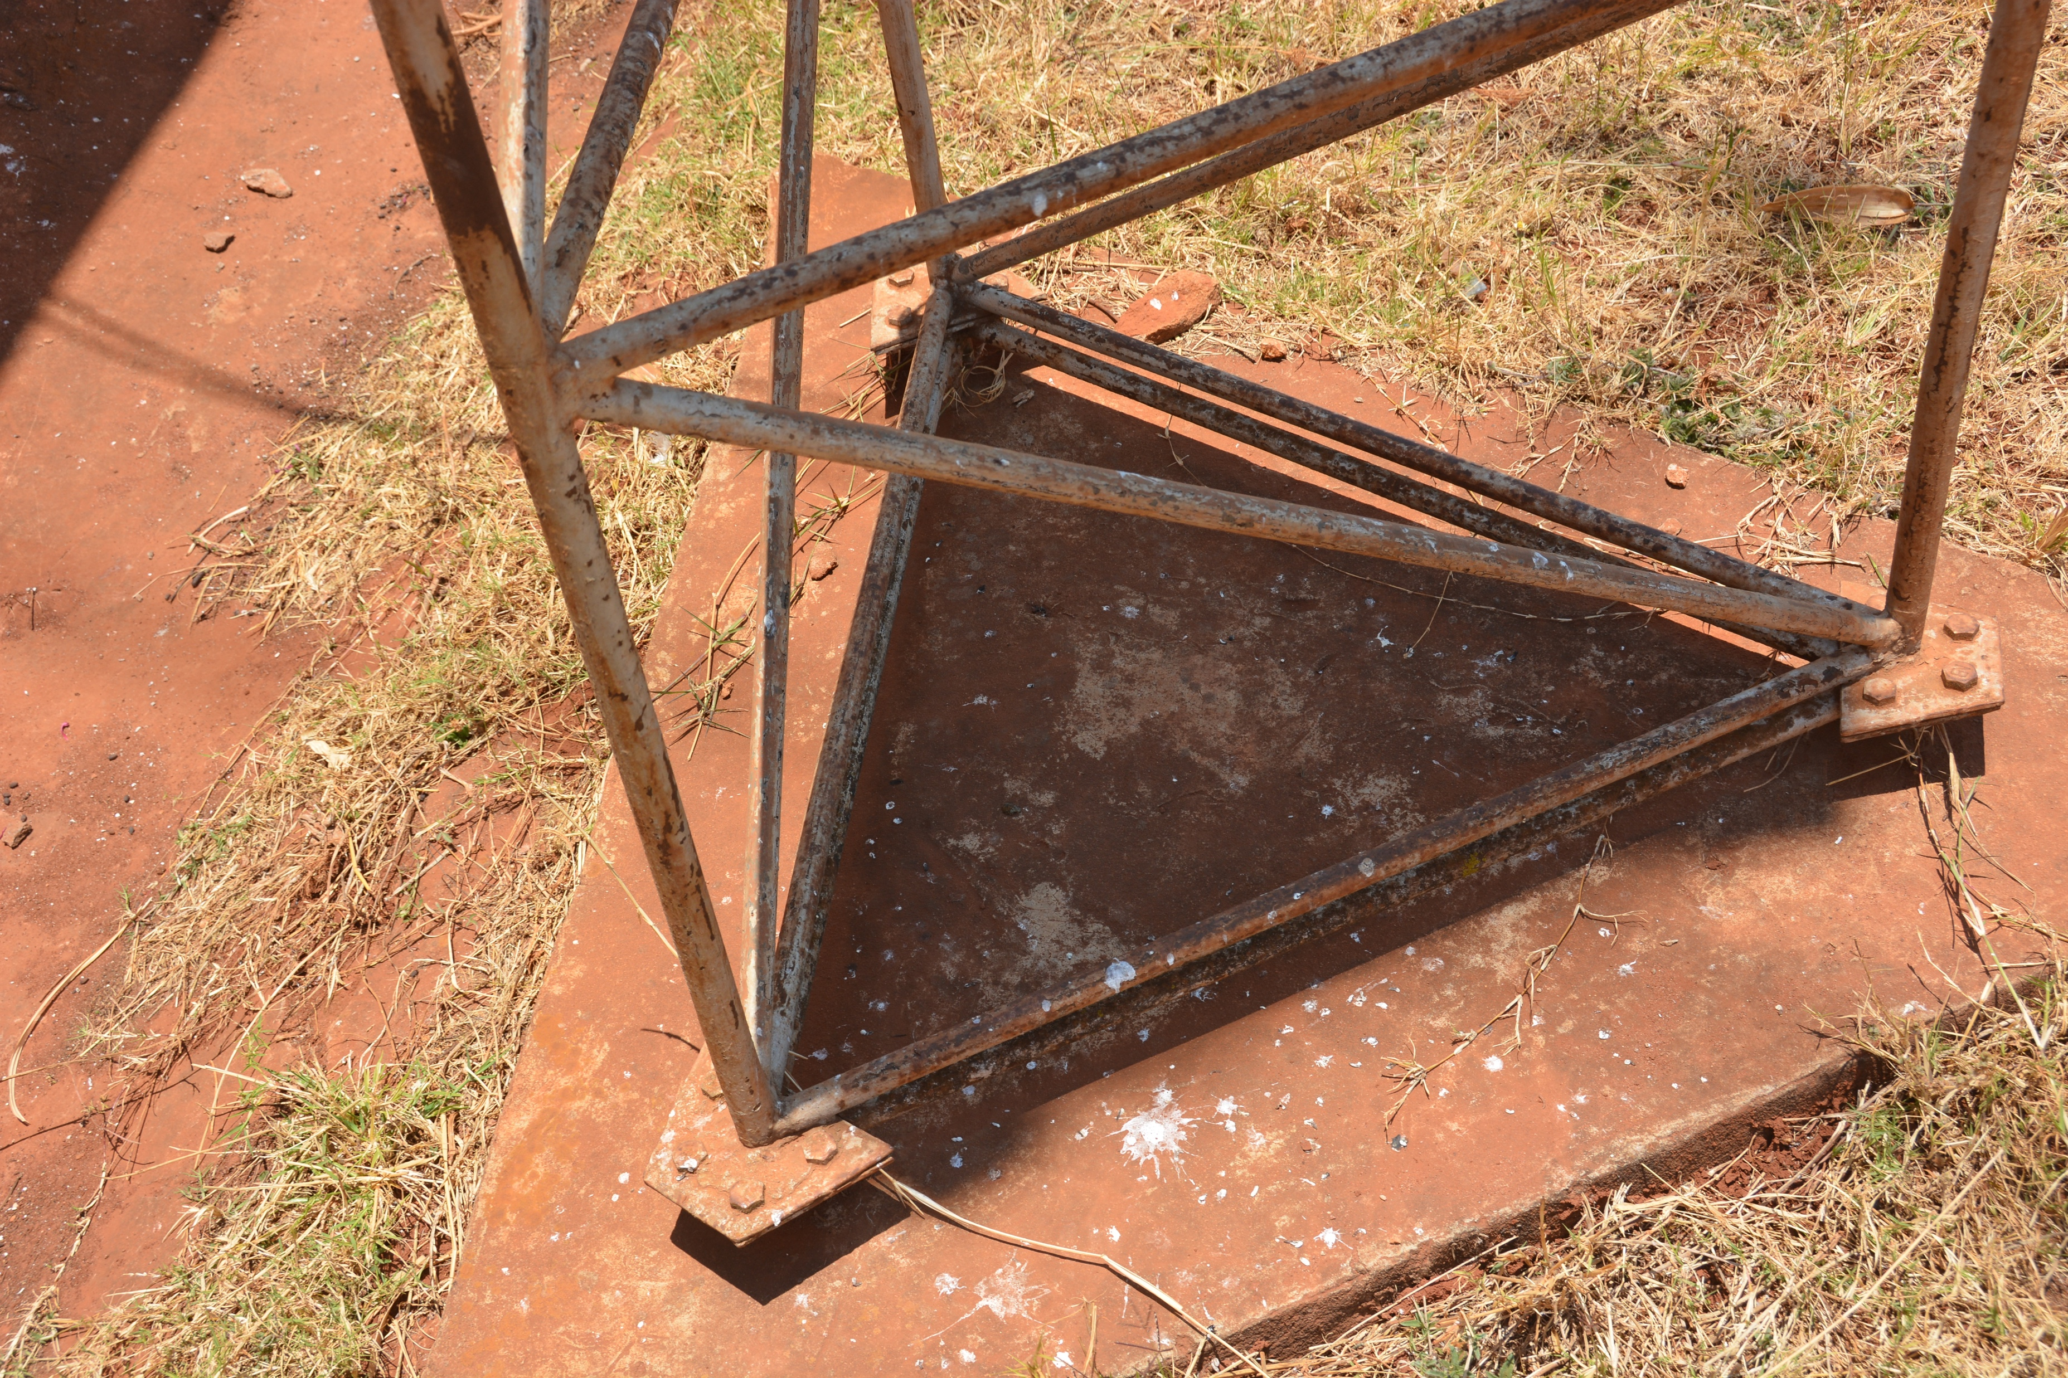

Slide 30
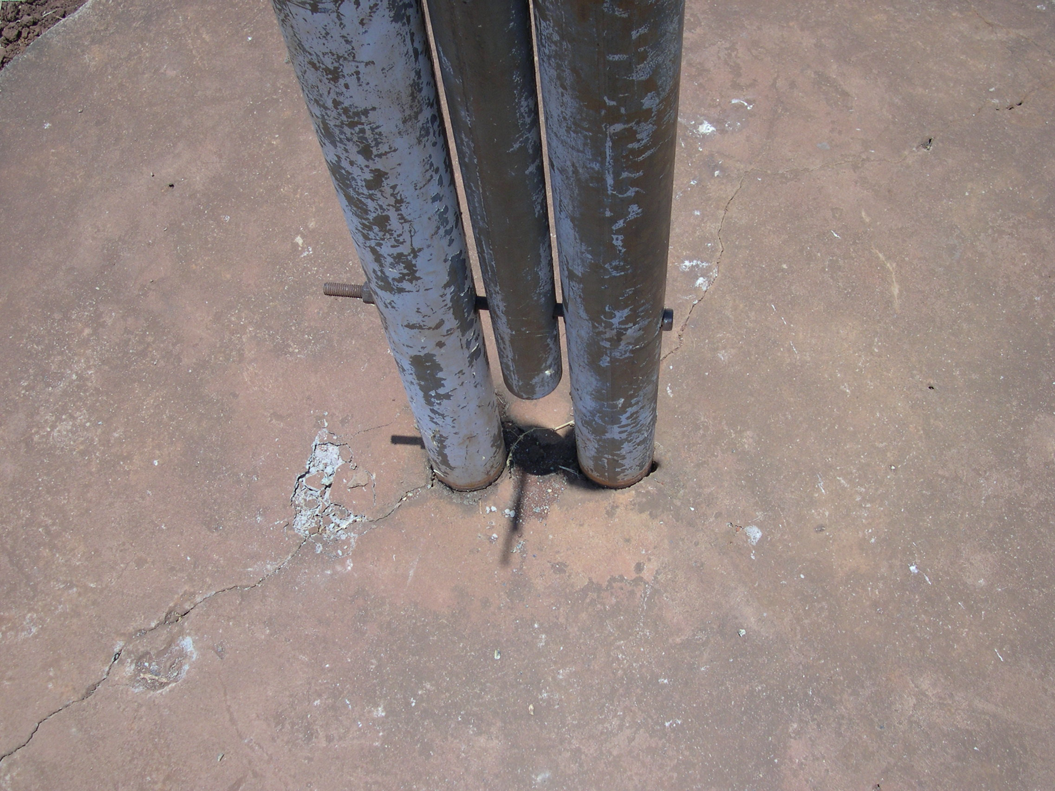

Slide 31
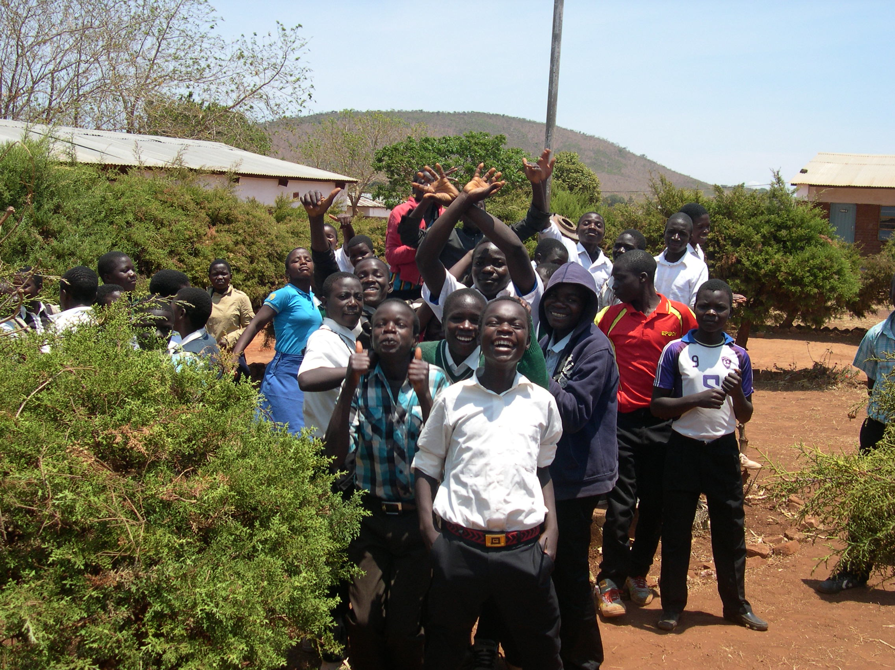

Slide 32
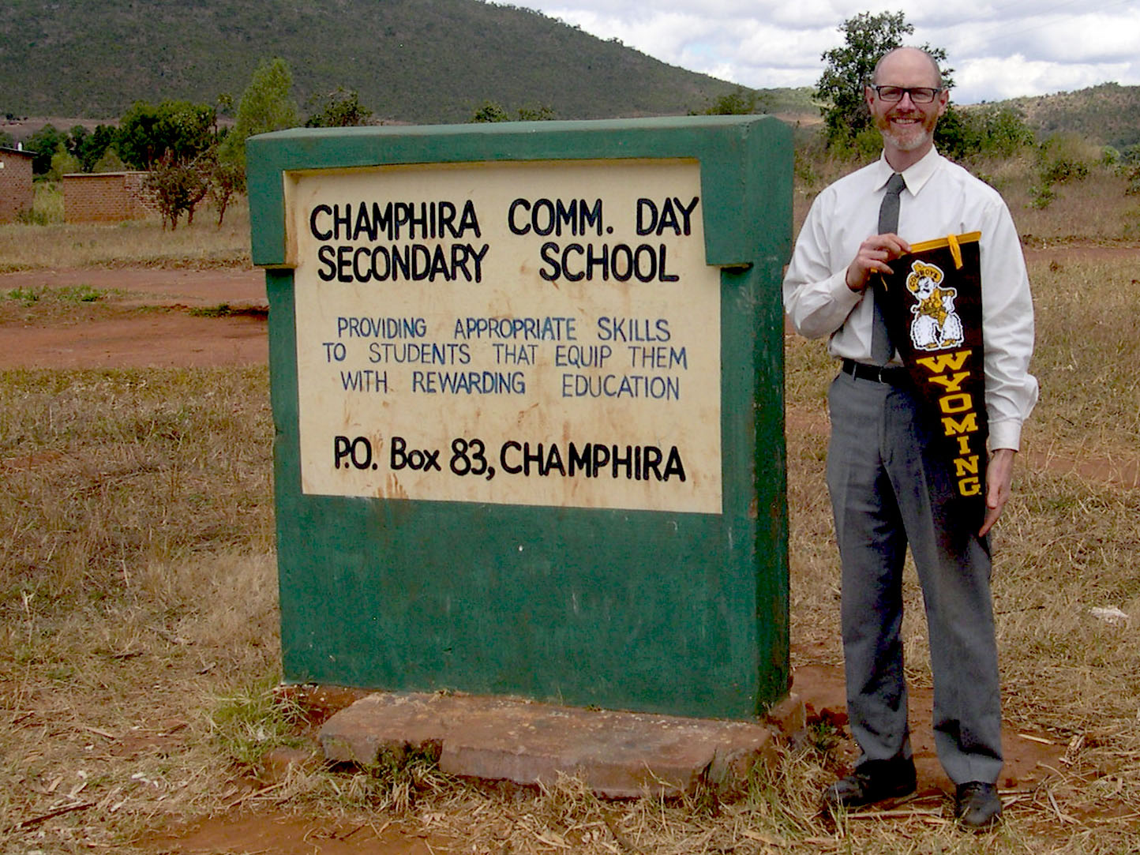

Slide 33
Perihelion and Aphelion
Currently perihelion in January, aphelion in July
More orbital time far from Sun
Orbit precesses from planetary influence and general relativity

Slide 34
Exit Ticket
Write on an index card one thing that you learned from today’s lecture
  or
One thing you’d heard about that now makes more sense
  or
One question you have about today’s topic

