Slide 1
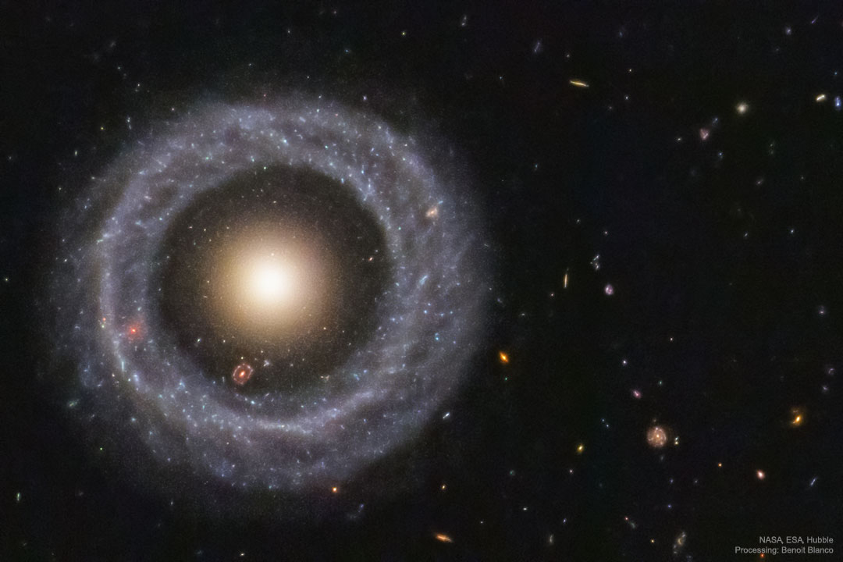
Welcome to
ASTR 1050: Survey of Astronomy

Slide 2
Subject Matter
The whole Universe

Slide 3
What’s the Point?
The universe is everything
Astronomy puts things in perspective
Understanding the universe helps us understand where we are

Slide 4
Subjects
Solar system
  How did it form?
  What does it contain?
  How do the pieces interact?

Slide 5
Subjects
The Sun
  How does it work?
  What does it do?
  What should we expect from it?

Slide 6
Subjects
Stars
  How are they alike?
  What makes them different?
  How do they behave?
  How do they change over time?

Slide 7
Subjects
Stellar remnants
  How do they form?
  How do they evolve?
  How do they interact with other bodies?

Slide 8
Subjects
Galaxies
  How do they form?
  How do they evolve?
  What is their structure?
  How do they interact with other galaxies?

Slide 9
Subjects
The Universe
  How did it form?
  What is in it?
  Why is it as it is?
  What will happen to it?
  Do we have company?

Slide 10
Who are You?
Please clearly write your first and last name
and pronouns on both sides of the tent card
Your Name
Your Name
Please display your tent card in every class
First Last

Slide 11
Group Work
Introduce yourself to your neighbors.
Tell them something boring about
  yourself
  your home town
  your family
  your name
  or anything else associated with you
Tell your group and write it down.

Slide 12
Index cards
Your name
The boring thing you told your neighbors
Anything you’d like me to know

Slide 13
Mechanics of the Course

Slide 14
Grading
40% exams, including the final
30% lab
10% homework
5% class work
15% incidental activities

Slide 15
Exams
40% of course grade
Taken in class
5 exams: 3 midterms and 2-part final
  Monday Sep 21
  Monday Oct 19
  Monday Nov 16
  Final: Wednesday Dec 16

Slide 16
Labs
30% of grade
Monday afternoons
Room STEM 180 (Enzi building, NW)
First labs this week
  That’s today!
  No labs next week (Labor Day)

Slide 17
Homework
10% of grade
Exams borrow heavily from homework

Slide 18
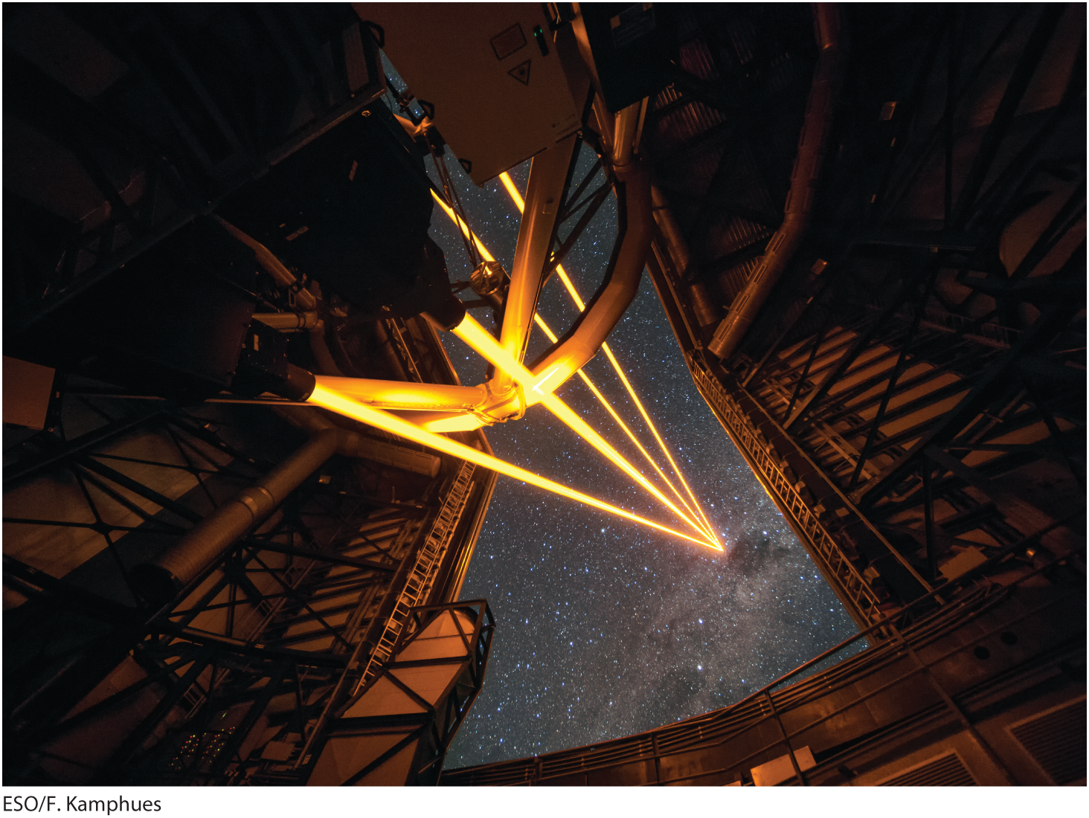
Textbook
Textbook: Comins, Discovering the Universe, 11th ed. (req.)

Slide 19
Visit Me
Physical Science building room 116
M 3:10–4:00 PM
W 11:00–11:50 AM
Physical Science building room 234
T 7:00–8:00 PM
W 7:00–8:00 PM
or by appointment

Slide 20
The Science of Astronomy
What we’re dealing with

Slide 21
Space is really big
Cosmic Voyage
  6:23–11:24

Slide 22
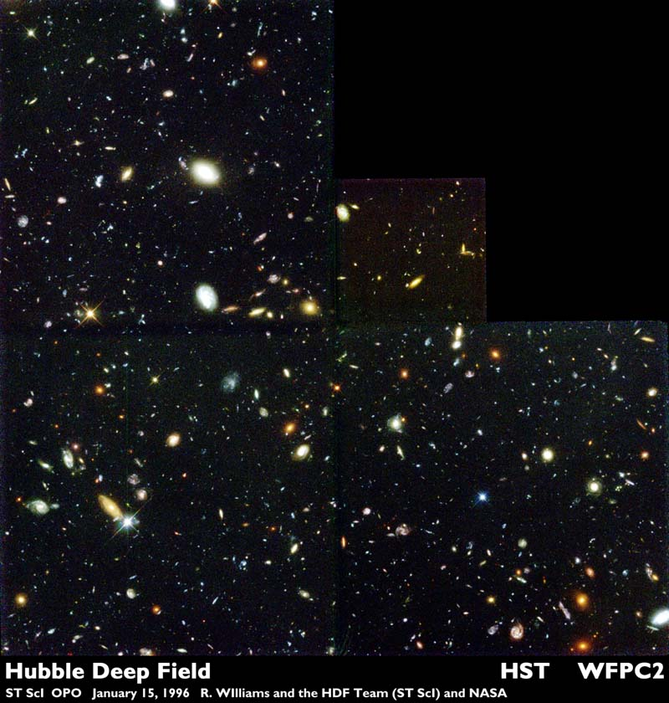
Space is really empty

Slide 23
Really big and empty
Hubble Ultra-Deep Field
  Interactive link

Slide 24
Reading for Next Time
Days, months, years: cycles of the sky
Appreciate how and why humans used astronomy to mark time

Slide 25
Right away
Find the course on WyoCourses.
Complete the Orientation Assignment.
Complete the recommended reading.

