Slide 1
Life in the universe
Do we have company?
Ch. 20
Image: Mark Garlick/Science Photo Library/Getty Images

Slide 2
What we know
There is life on Earth.
Life exists everywhere on Earth.
There has been life on Earth as long as Earth has been hospitable.
Intelligent, technological life appeared recently.
Multicellular life didn’t appear until about 600 Ma.

Slide 3
We don’t know
How life arises
How probable it is for life to arise
How probable it is for intelligent life to arise
How probable it is for technology to arise

Slide 4
What does life need?
Energy source (system out of equilibrium)
Reproduction (for persistence)
Descent with modification (for adaptability)
Probably organic compounds
Probably liquid water

Slide 5
Carbon Compounds
Only carbon facilitates large, complex molecules
Information storage (e.g. DNA)
Functionality (e.g. enzymes)
Carbon is abundant in the universe
Small organic molecules are abundant

Slide 6
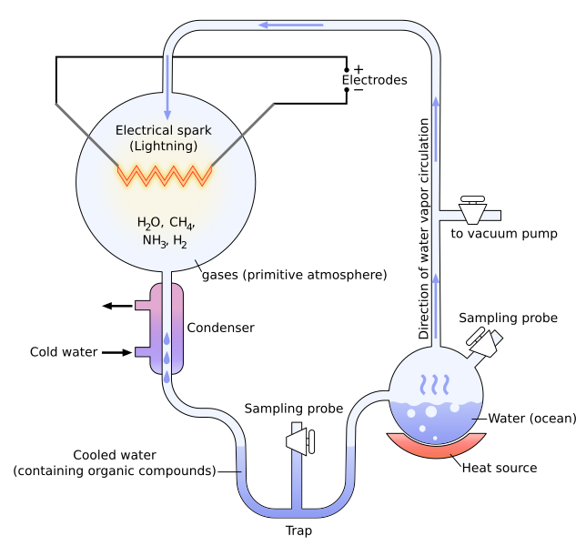
Abiogenesis
Not observed
Miller-Urey experiment created complex organics
Image: Yassine Mrabet

Slide 7
Where did life start?
Ocean?
Undersea?
Underground?
Extraterrestrial?

Slide 8
Contingent history?
Photosynthesis created O₂
Killed most life
Facilitated O₃ layer
Allowed terrestrial life?

Slide 9
Which stars can host life?
Not too hot
too short-lived?
Too much radiation?
Not too cool
close orbit induces synchronous rotation
mechanism to create reactive molecules
Best bet is spectral class F5–M0

Slide 10
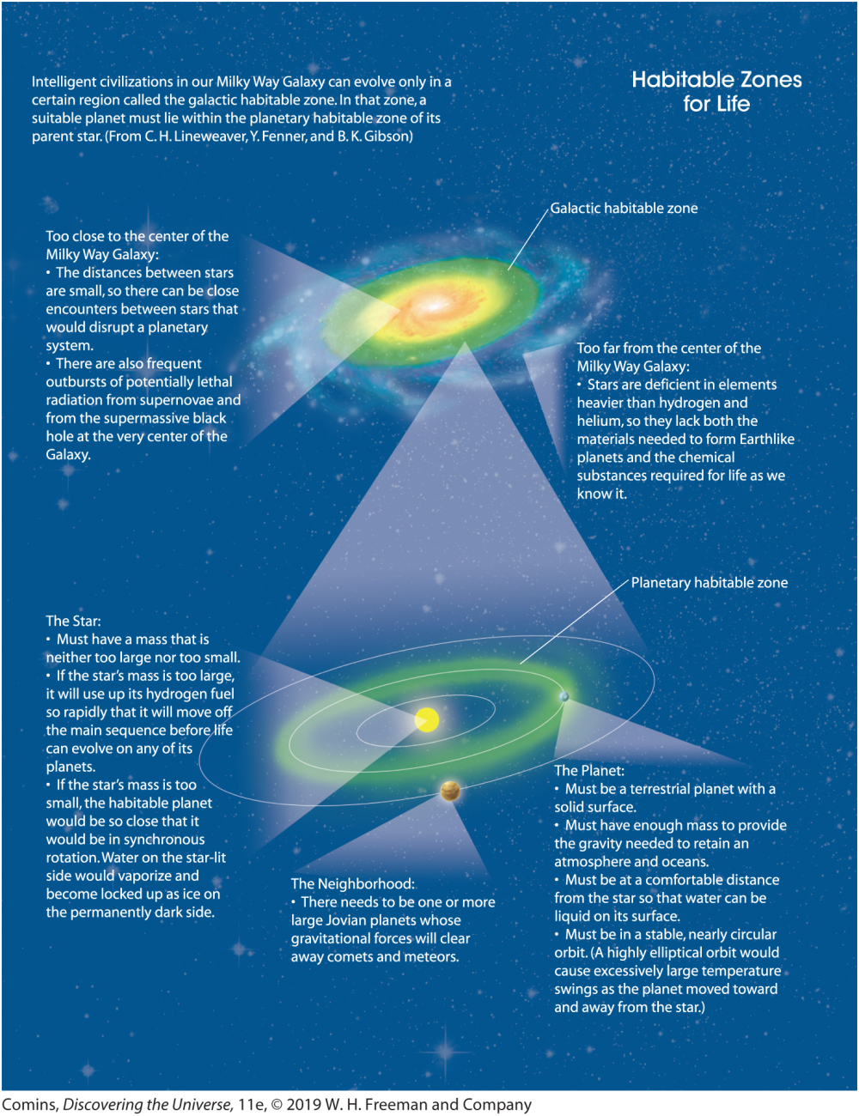

Slide 11
The search for life
No obvious signs in the Solar system
Mars
Europa
Enceladus
(Titan)
Earth is super obvious
Oxygen
Chlorophyll

Slide 12
The search for intelligent life
Can we find them?
Can they find us?
Have they found us?

Slide 13
Fermi Paradox
“Where is everybody?”
–Enrico Fermi, 1950

Slide 14
What would we find?
Radio signals
Spectroscopic signatures
Artifacts
Evidence of visitation

Slide 15
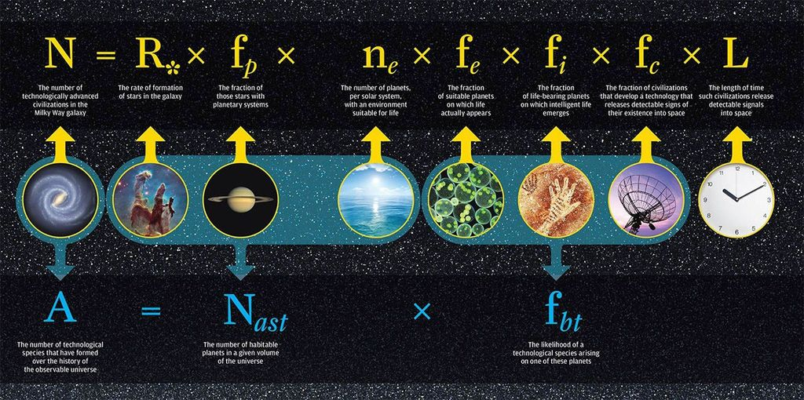
Drake Equation
Image: University of Rochester

Slide 16
Drake Equation
We now know that planets are common
Less sure about terrestrial planets in the habitable zone
We don’t know the likelihood of life
Or the likelihood of intelligence
or technology
or curiosity

Slide 17

Announcing Ourselves
Radio transmissions since 1895
Deliberate transmissions
“Aricebo message” to M13 in 1974
Four spacecraft
Pioneer 10 and 11
Voyager 1 and 2
All bearing messages

Slide 18
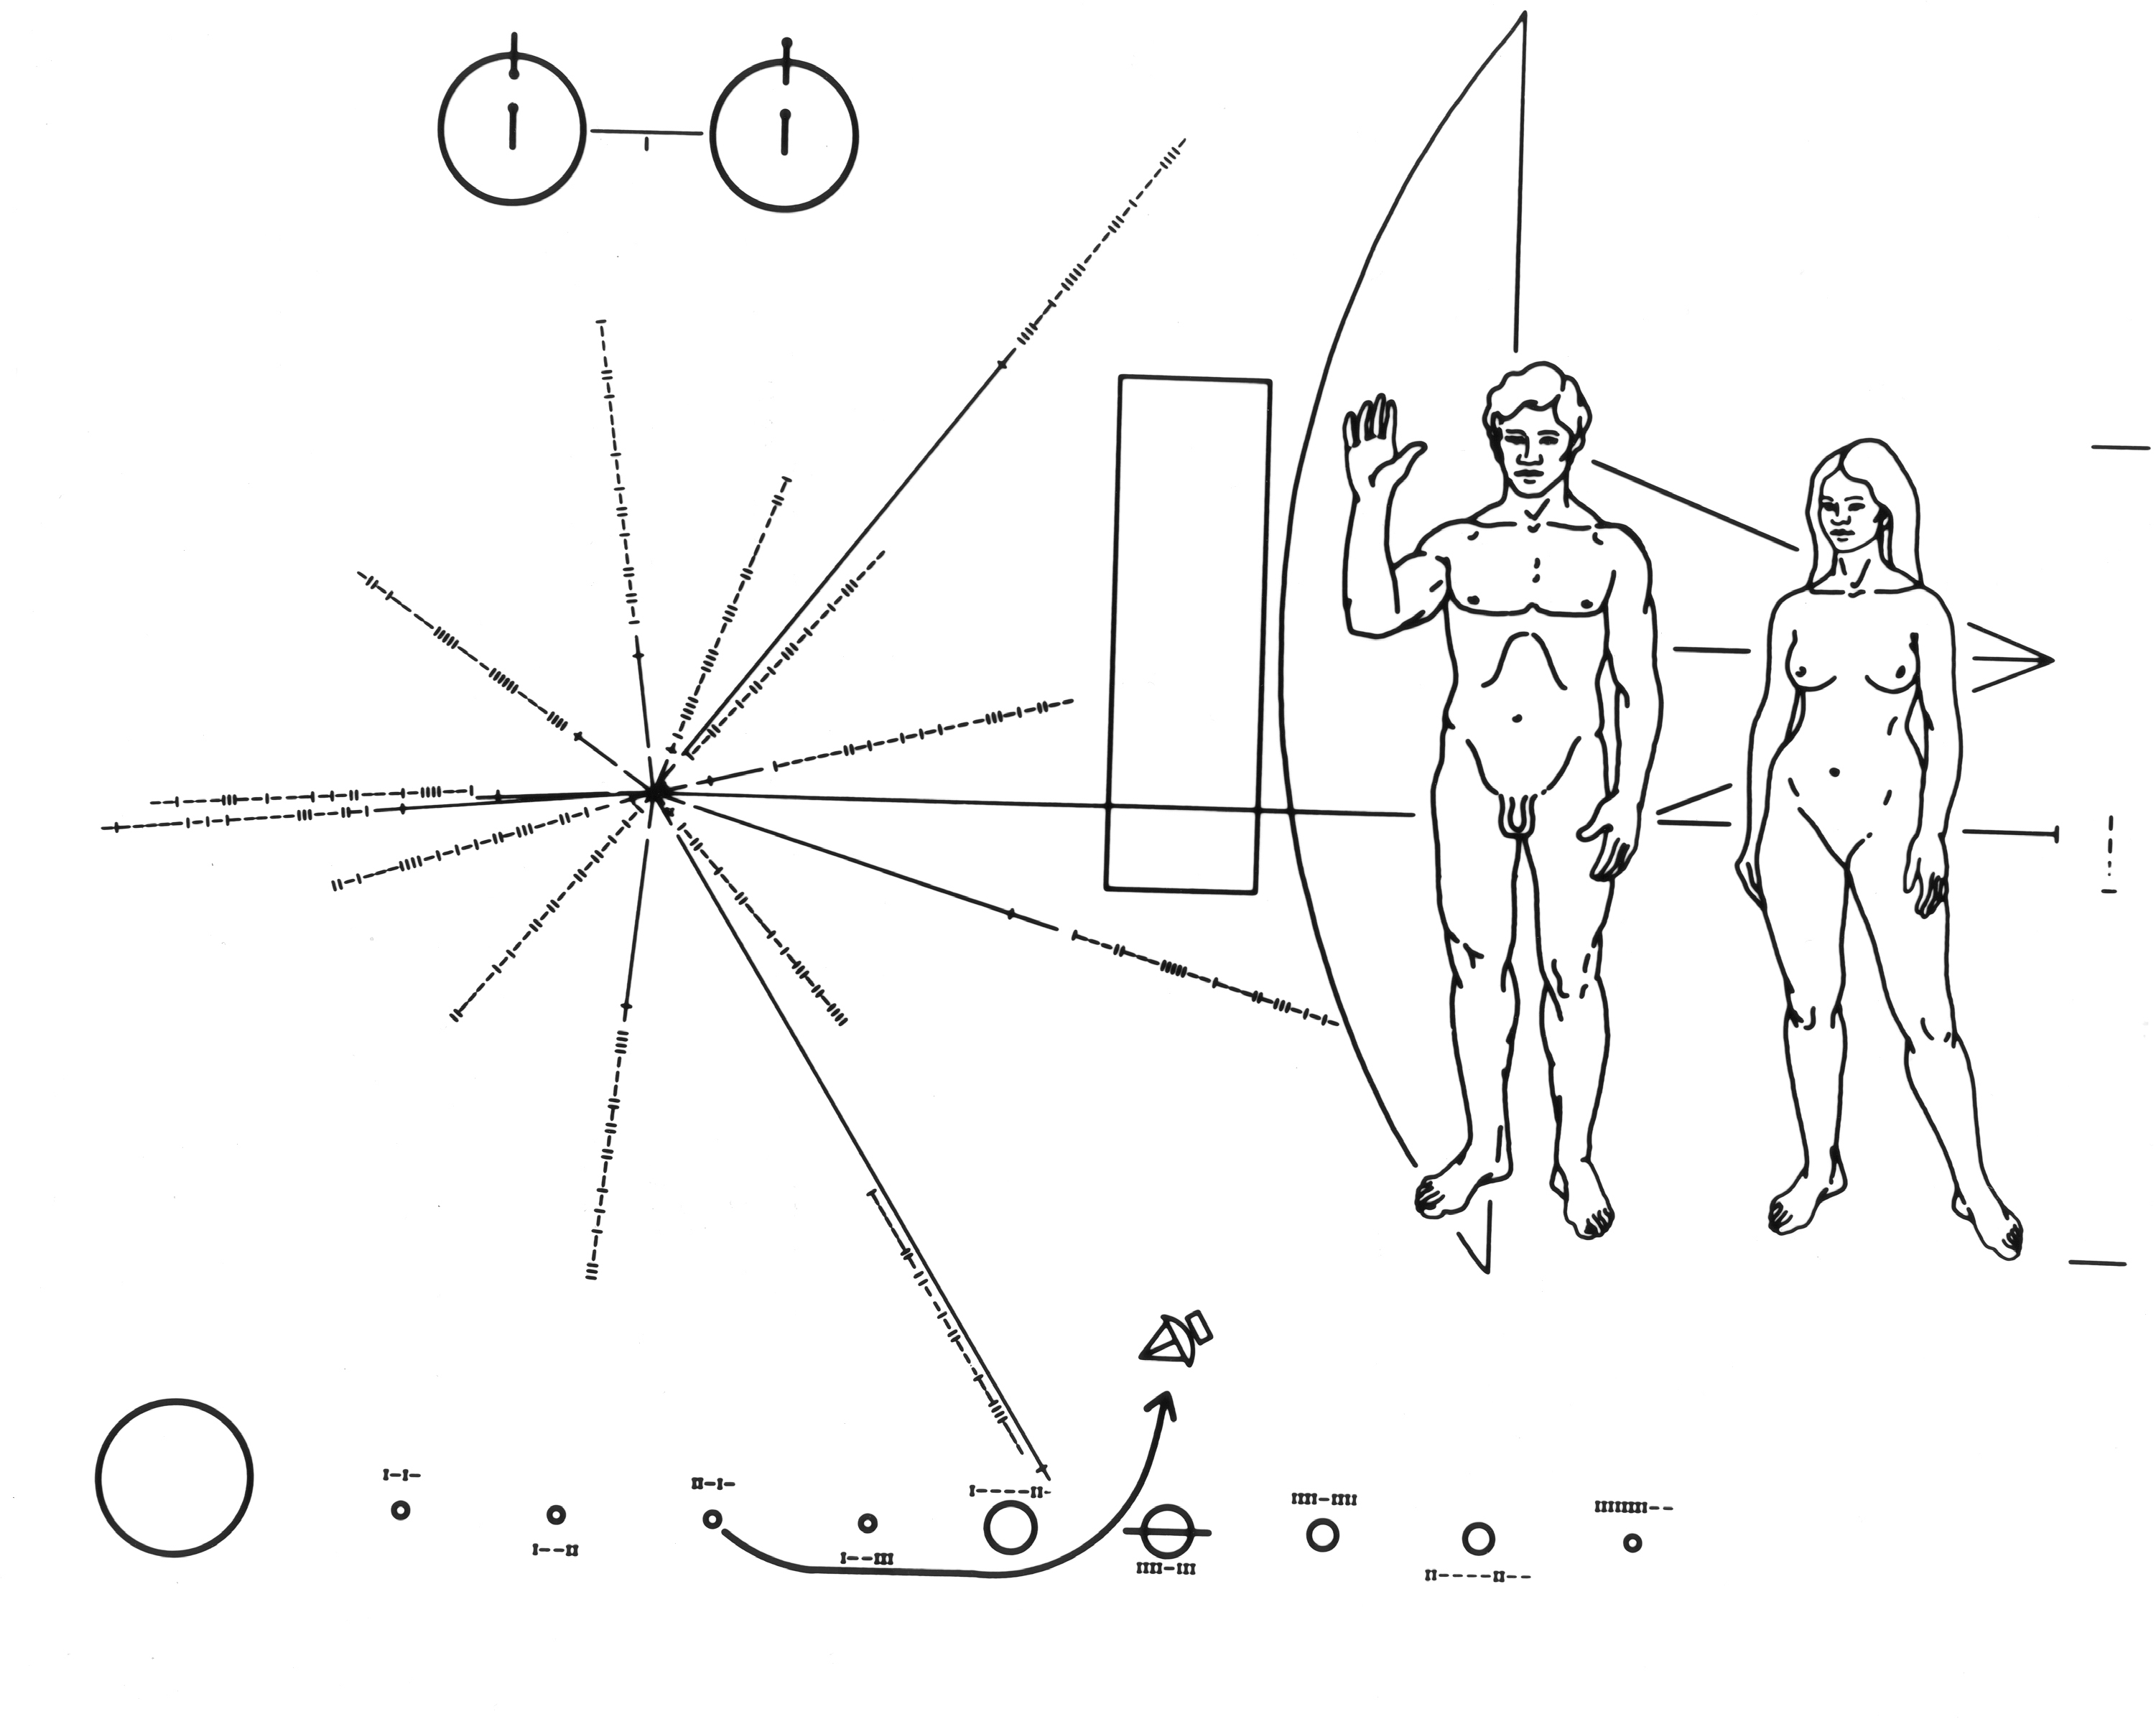
Pioneer Plaque

Slide 19
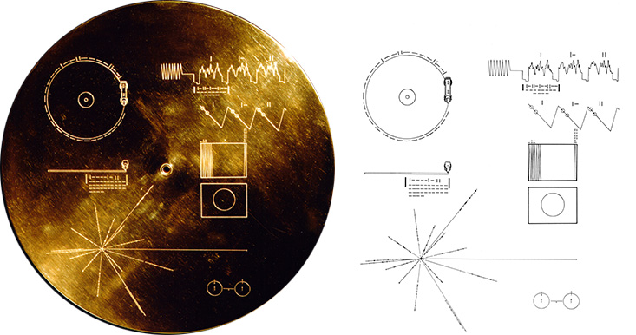
Voyager’s Golden Record

Slide 20
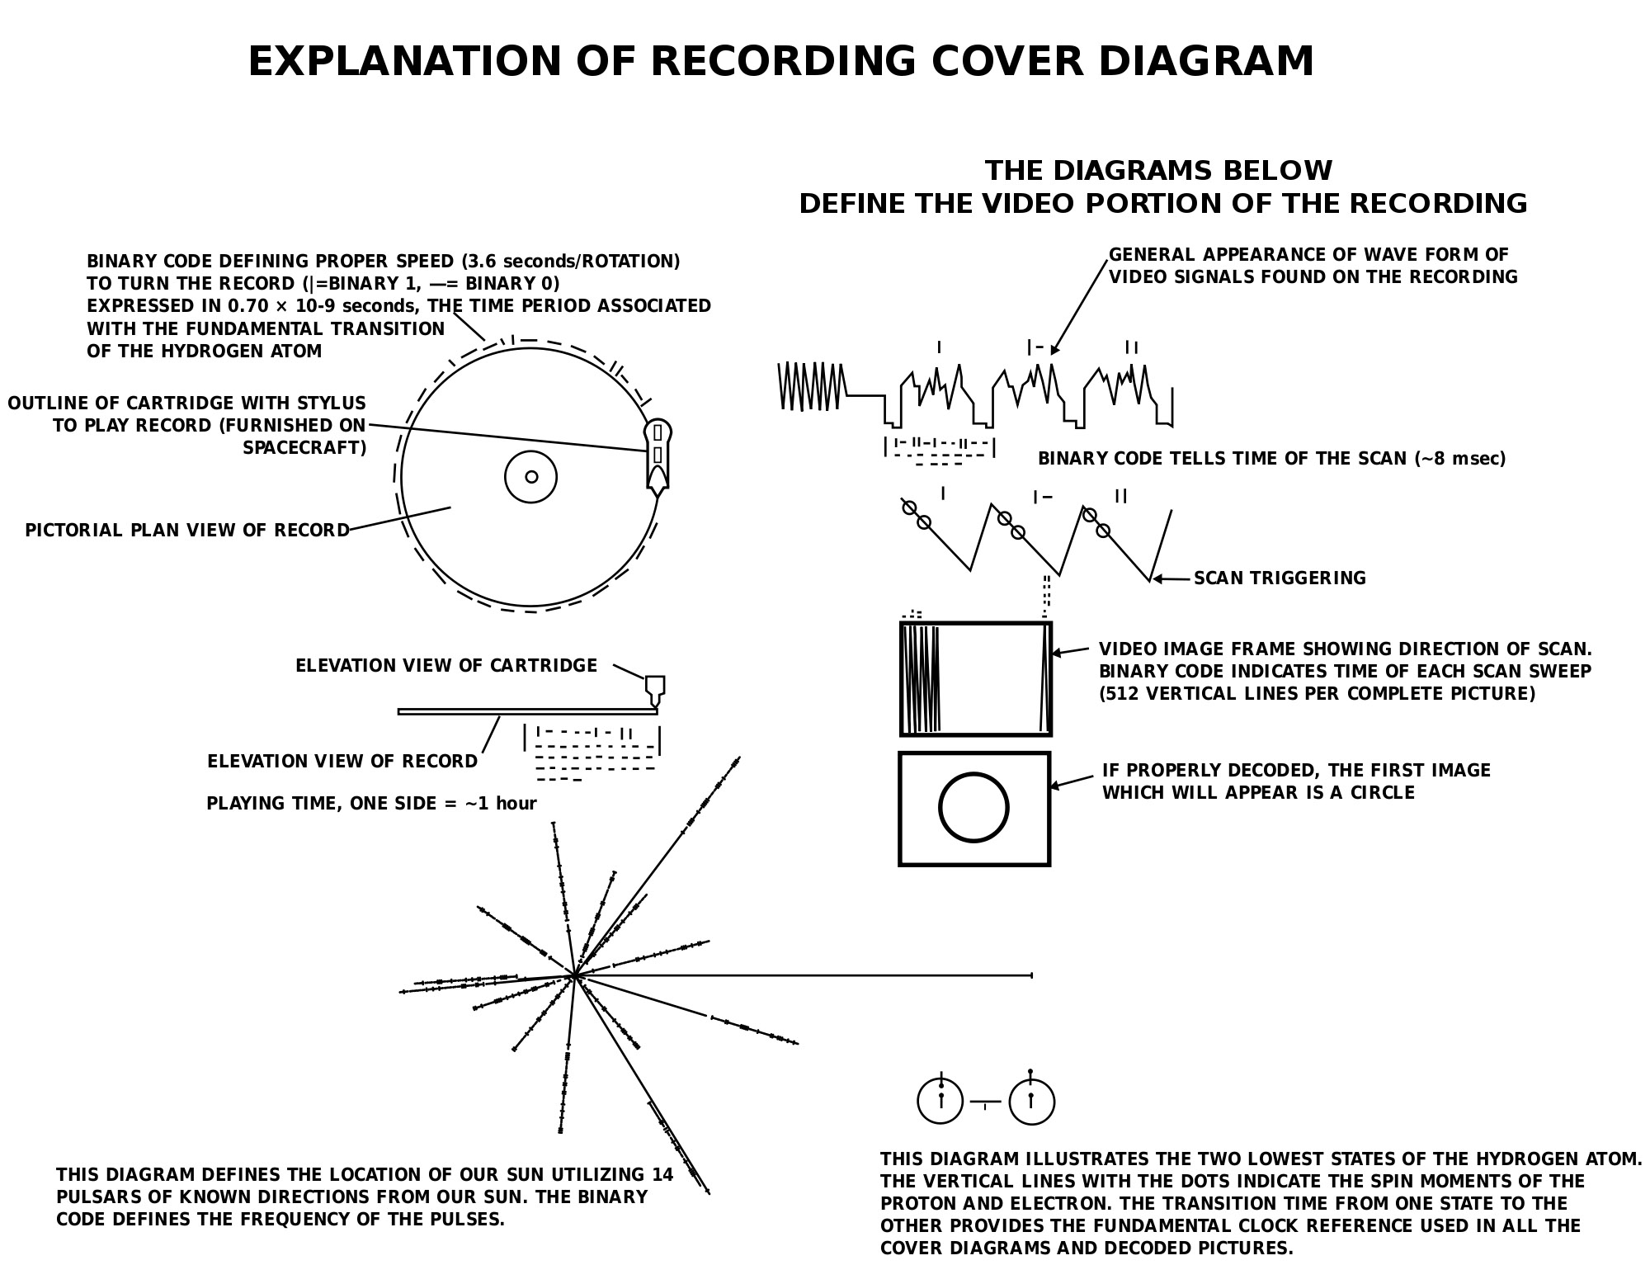

Slide 21
"We've been sitting in our tree chirping like foolish birds for over a century now, wondering why no other birds answered. The galactic skies are full of hawks, that's why.”
–Greg Bear, The Forge of God

Slide 22
Elder Race?
Somebody has to be the first
But it’s safer to imagine we’re not exceptional
“mediocrity principle”

Slide 23
Two Possibilities
There is intelligent life out there.
or
We are alone in the universe.

