Slide 1
What happens next?
fate of the universe
§19.12–19.15

Slide 2
Basic Options
Expansion continues forever
Universe thins and cools
Expansion halts and reverses
Big crunch

Slide 3
Perlmutter et al. study
Question: Is there enough matter in the Universe to halt expansion?
Used Type 1a SNs to study the rate at which gravity slowed cosmic expansion
Found that expansion is accelerating
2011 Physics Nobel prize
Some mysterious form of energy must be operating

Slide 4
Possible spacetime geometries
Positive
Flat
Negative
Comins, Fig. 19.21

Slide 5
Geometry
Observations indicate spacetime is flat
More evidence for inflation

Slide 6
CMB reveals energy
Model of CMB fluctuation depends on densities of
baryonic matter
dark matter
dark energy
Scales of sound wave interactions depend on interplay of pressure and gravity
affect heights of even and odd peaks

Slide 7
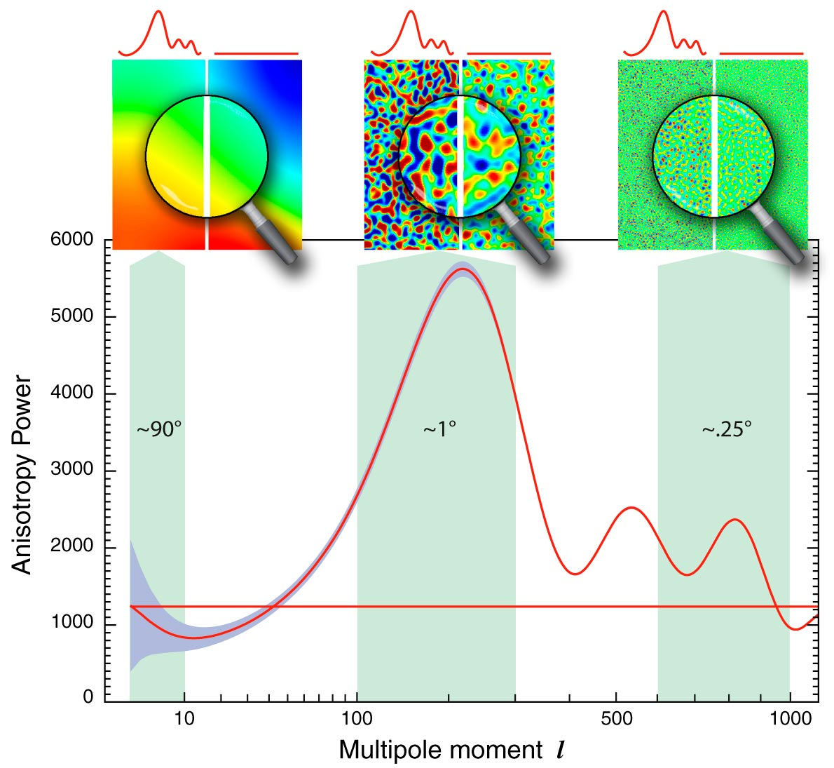
Angular fluctuation spectrum
Image: NASA

Slide 8
Interpretation
Universe is flat (first peak)
Baryonic matter is about 5%
Dark matter is about 24%
Dark energy is 71%

Slide 9
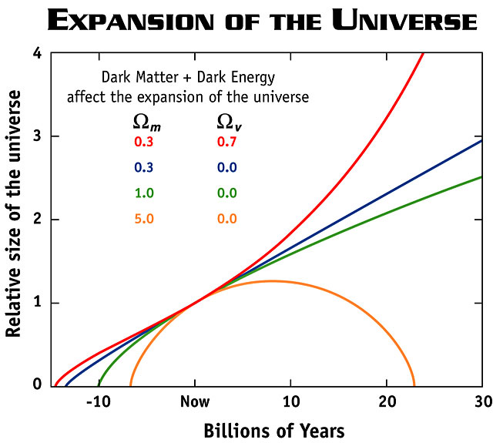
Ω_{m} = mass density
Ω_{v} = energy density
Image: NASA

Slide 10
Time line of the universe
Big Bang to the Dark Era web page

Slide 11
The prediction, so far
Expansion will continue forever
Space will cool
Probably will not have a “big rip”

