Slide 1
The Big Bang
How did we get here?
§19.1–19.10

Slide 2
Cosmology
Cosmology: The study of the origin, evolution, and fate of the universe
Universe: Everything that we can detect or that could, can, or may ever affect us

Slide 3
Olber’s paradox
Why isn’t the entire sky as bright as the surface of the Sun?
If there is a star in every direction, however distant, there should be
The universe must not be infinite in age and extent

Slide 4
Cosmological Redshift
Space itself is expanding uniformly
Light waves passing through space become stretched

Slide 5
Cosmological Redshift
Comins, Fig 19.1

Slide 6
Hubble flow
Everything distant is redshifted
Redshift appears proportional to distance
Before Hubble’s measurements, the Universe was considered static
and small
Contrary to predictions of general relativity
Einstein introduced a fudge factor cosmological constant to allow stasis

Slide 7
Hubble relationship
v = H₀d
v = recessional velocity
H₀ = Hubble constant
d = distance
If velocities have stayed constant, then vt = d
Age = t = 1/H₀
H₀ is not known precisely

Slide 8
Big Bang
Obvious interpretation: Universe is expanding from a “primordial atom”
A singularity a long time ago

Slide 9
Age of the Universe
Best estimate of H₀ is about 70 km/s per Mpc
That comes out to 0.0714 Mpc/Gy
So, to travel the full Mpc would take 1/0.0714 Gy
= 14 Gy
Approximate age of the universe

Slide 10
Is there Another Explanation?
Steady state theory:
As the Universe expands, new matter forms, keeping the density constant
No trace of a beginning, no prospect of an end

Slide 11
Which is Right?
Find testable predictions of the theories
Test them
See if they hold up

Slide 12
What does “Big bang” predict?
Universe used to be denser and hotter
too hot for H atoms to be bound
Earlier than that, too hot for nuclei to be bound

Slide 13
Recombination
(even though it was never combined before)
H⁺/e– plasma was opaque to EM radiation
Would be in equilibrium with thermal black body radiation
When the temperature dropped to ~4000K, transparent H· would form
The radiation would travel unhindered
And red-shift as the universe expands

Slide 14
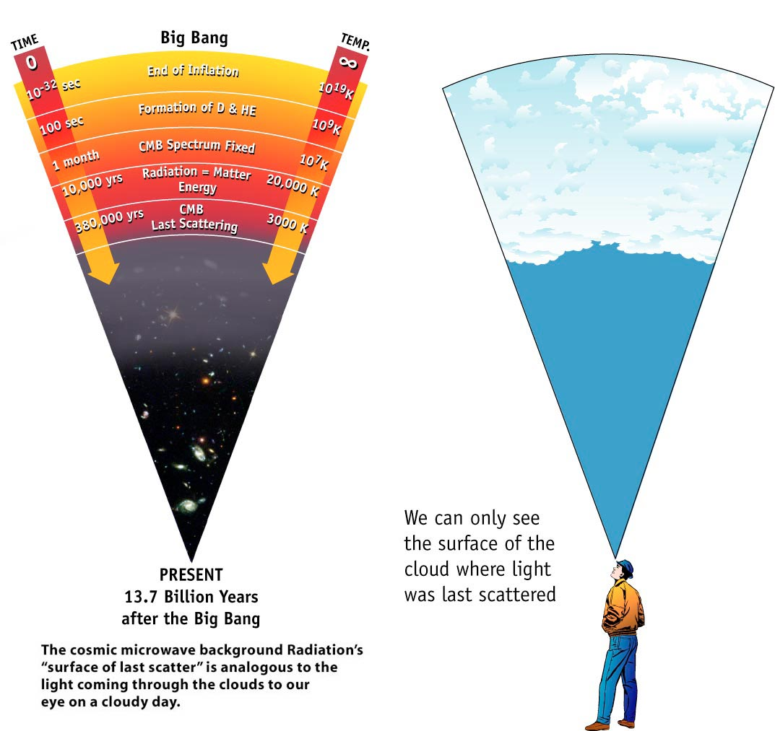
Last Scattering
Image: NASA

Slide 15
Cosmic Microwave Background
Photons from recombination should permeate all space
Detected accidentally by Penzias and Wilson in 1965
Scooping the Princeton physicists
And receiving 1978 Nobel
Comins, Fig 19.2

Slide 16
Nucleogenesis
Quark-gluon plasma at high temperature and density
Cooling forms nucleons, eventually just protons and neutrons (freeze-out)
Eventually too cool for nucleons to combine
Ultimately 75% ¹H, 25% ⁴He, traces ²H, ³He, ⁶Li

Slide 17
Results
Big bang theory correctly predicted
CMB
Distribution of elements

Slide 18
What else?
The farthest we can see back in EM radiation is the CMB
370 ky after bang
Beyond that we have accelerators and calculations

Slide 19
Studies of CMB
COBE, WMAP, BOOMERANG, Planck
Results:
CMB is an almost perfect black body at 2.73 K
We are moving at about 368 km/s relative to CMB (in direction of Leo)

Slide 20
CMB Black body
Comins, Fig 19.4
(A Doppler-shifted black body is still a black body.)

Slide 21
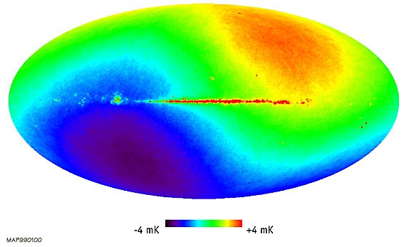
CMB Doppler shift
Image: NASA, WMAP
Dipole amplitude 3.375 mK

Slide 22
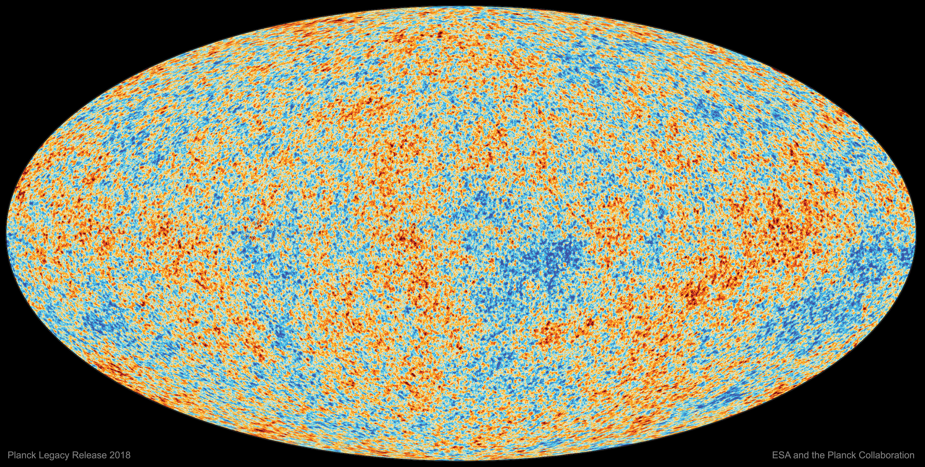
CMB Temperature Variation
Image: ESA/Planck
Temperature range ~ 0.5 mK

Slide 23
CMB is Uniform and Isotropic
Isotropy problem: Why does CMB look the same in all directions?
Ordinary expansions don’t act that way
Hard to imagine how a Jeans instability can occur
Current explanation: Inflation
universe briefly expanded superluminally
attributed to a phase change

Slide 24
Cosmic Events
Time | Era | T (K) | Characteristics
0– 10⁻⁴³ s | Big Bang | ∞ | infinitely small, infinitely dense
 |  |  | Primeval fireball
 |  |  | 1 force in nature - Supergravity
10⁻⁴³ s | Planck Time | 10³² | Earliest known time that can be described by modern physics
 |  |  | 2 forces in nature, gravity, GUT
10⁻³⁵ s | End of GUT | 10²⁷ | 3 forces in nature, gravity, strong nuclear, electroweak
 |  |  | Quarks and leptons form
 |  |  | (along with their anti-particles)

Slide 25
Cosmic Events
Time | Era | T (K) | Characteristics
10⁻³⁵ – 10⁻³³ s | Inflation | 10²⁷ K | Size of the Universe drastically increased, by factor of 10³⁰to 10⁴⁰
10⁻¹² s | End of unified forces | 10¹⁵ K | 4 forces in nature,
 |  |  | protons and neutrons start forming from quarks
10⁻⁷ s | Heavy Particle | 10¹⁴ K | proton, neutron production
 |  |  | in full swing
10⁻³⁵ to 10⁻³³ s | Inflation | 10²⁷ K | Size of the Universe drastically increased, by factor of 10³⁰– 10⁴⁰

Slide 26
Cosmic Events
Time | Era | T (K) | Characteristics
10⁻¹² s | End of unified forces | 10¹⁵ K | 4 forces in nature,
 |  |  | protons and neutrons start forming from quarks
10⁻⁷ s | Heavy Particle | 10¹⁴ K | proton, neutron production
 |  |  | in full swing
10⁻³⁵ – 10⁻³³ s | Inflation | 10²⁷ K | Size of the Universe drastically increased, by factor of 10³⁰to 10⁴⁰

Slide 27
Cosmic Events
Time | Era | T (K) | Characteristics
10⁻¹² s | End of unified forces | 10¹⁵ K | 4 forces in nature,
 |  |  | protons and neutrons start forming from quarks
10⁻⁷ s | Heavy Particle | 10¹⁴ K | proton, neutron production
 |  |  | in full swing
10⁻⁴ s | Light particle | 10¹² K | electrons and positrons form

Slide 28
Cosmic Events
Time | Era | T (K) | Characteristics
100 s | Nucleo-synthesis era | 10⁹ - 10⁷ K | helium, deuterium, and a few other elements form
380 ky | Recom-bination (Decoupling) | 3000 K | Matter and radiation separate
 |  |  | End of radiation domination, start of matter domination of the Universe

Slide 29
Cosmic time line
Image: NASA/WMAP

Slide 30
Fundamental forces
Comins, Fig 19.4

Slide 31
Comins, Fig 19.8

Slide 32
Many Open Questions
Is gravity related to the other three forces?
Why does matter dominate?
What caused inflation?

