Slide 1
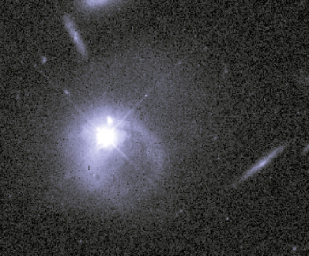
Active Galaxies
Chapter 18
Image: Hubble

Slide 2
Active Galaxies
Galaxies whose nuclei emit prodigious energy
Quasars and QSOs
Seyfert galaxies
Radio galaxies
BL Lac objects
Spoiler: We think they’re all created by material falling into SMBH

Slide 3
Quasars
Sources seen in radio surveys
Optical follow-up showed unresolved points (quasi-stellar)
Emission lines highly redshifted
not recognized initially
Started forming 2 Gy after Universe
Seem to have stopped 7 Gy ago

Slide 4
Quasar density over time
Comins, Fig, 18-6

Slide 5
Luminous Objects
Object | Luminosity (watts)
Sun | 4×10²⁶
Milky Way Galaxy | 10³⁷
Seyfert galaxies | 10³⁶−10³⁸
Radio galaxies | 10³⁶−10³⁸
Quasars | 10³⁸−10⁴²
Comins, Table 18-1

Slide 6
Quasi-Stellar Objects
Optical point sources like quasars
But not strong radio sources

Slide 7
Seyfert Galaxies
Spiral galaxies with luminous nuclei
Brightness can fluctuate on timescale of days

Slide 9
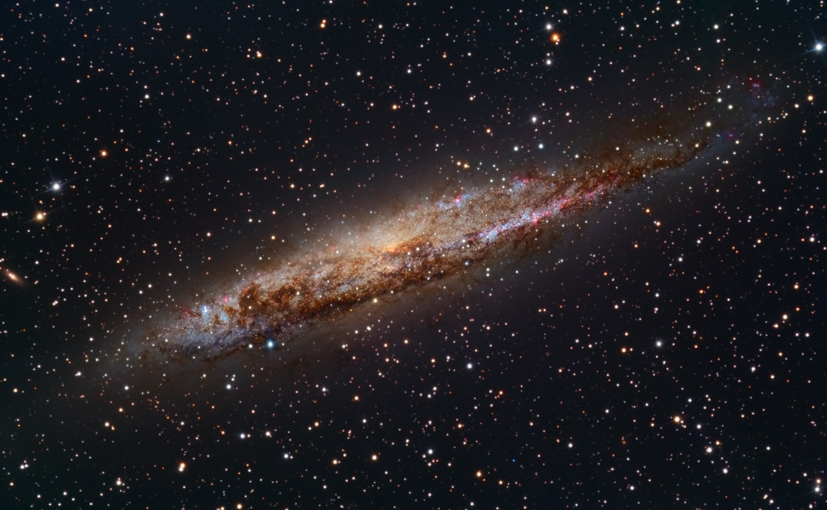
NGC 4945
Activity visible in IR

Slide 10
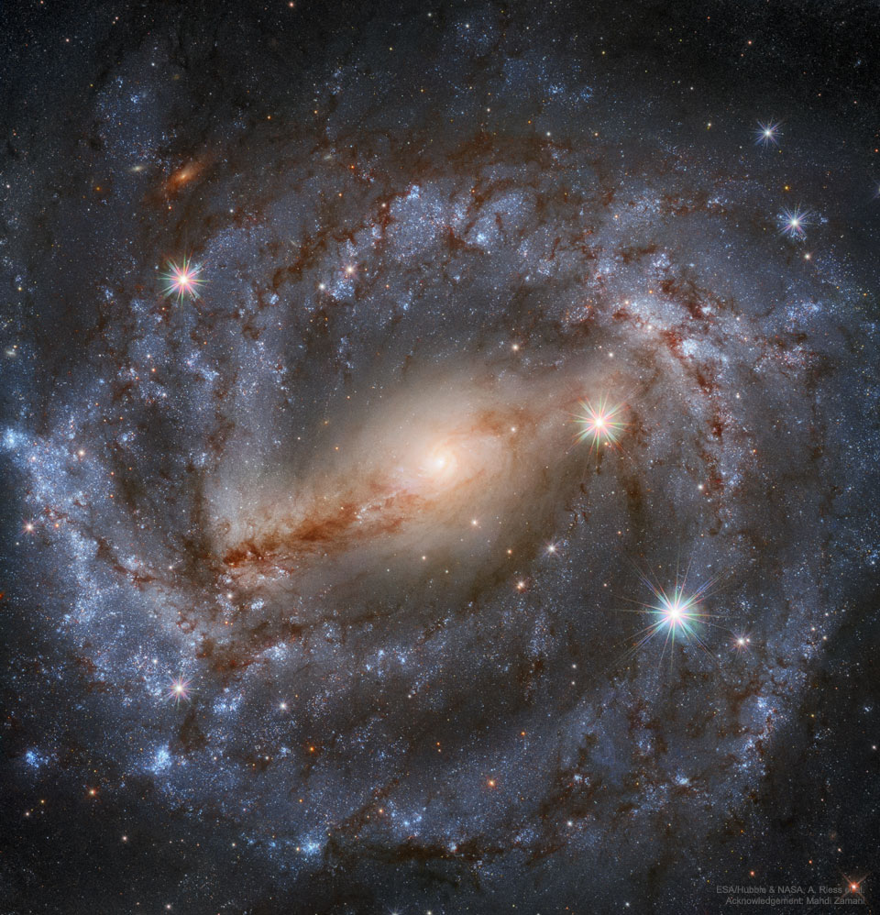
NGC 5643
Image: Hubble

Slide 11
M106
Image: Hubble

Slide 12
Radio Astronomy
Karl Jansky detected noise from Space
Grote Reber began observing
home-built equipment
self funded
Mapped the sky in low resolution
Found three significant sources
Sgr A, Cas A (Galactic)
Cyg A (Exragalactic—750 Mly)

Slide 13
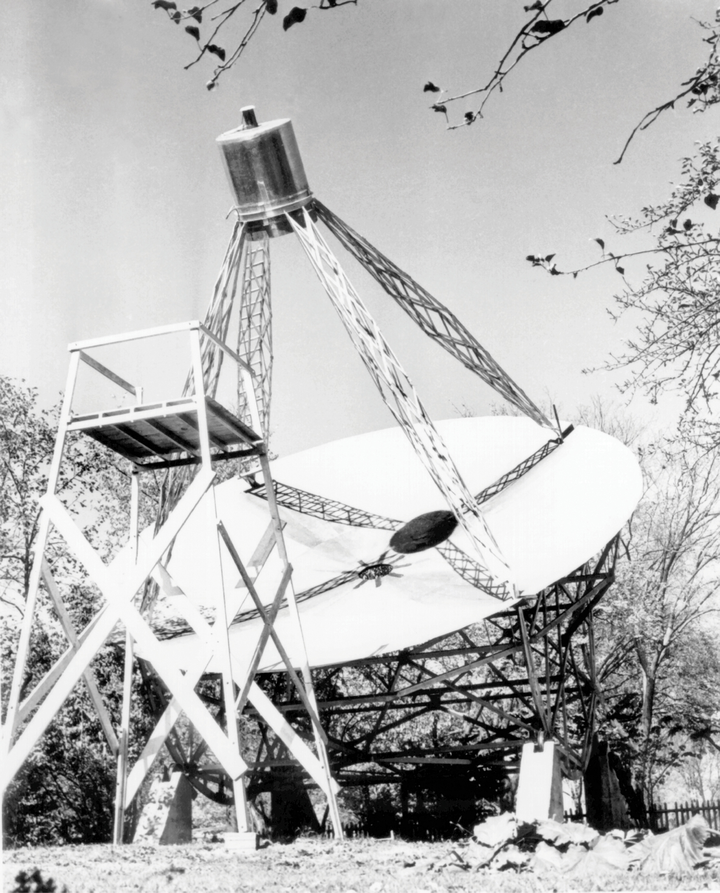
Reber’s Dish
Wheaton, IL
Image: NRAO/AUI/NSF

Slide 14
Radio Galaxies

Slide 15
Radio Galaxies
Elliptical galaxies
Radio sources cover enormous spans
Jets emanating from galactic nucleus
Synchrotron radiation: from ions circling in magnetic field

Slide 16
Hercules A
Image: HST (Visible), VLA (Radio)

Slide 17
Hercules A
HST (Visible), CXC (X-ray), NRAO (fadio); Comins, Chapter opener

Slide 18
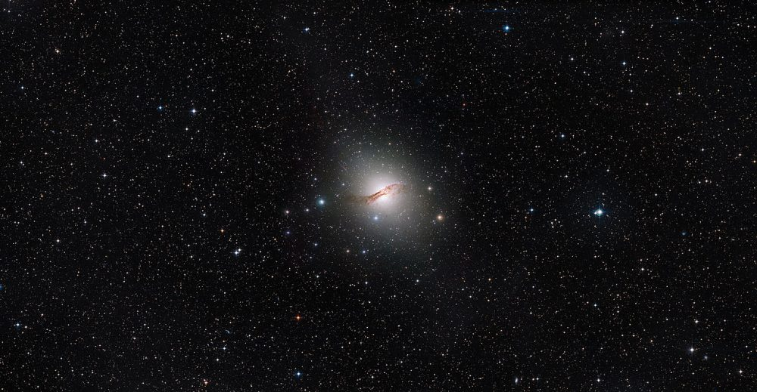
Centaurus A
Image: ESA/Hubble

Slide 19
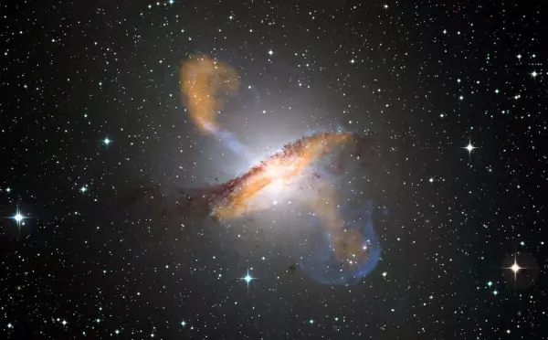
Centaurus A
Image: Chandra, Hubble, APEX

Slide 20
BL Lacertae Objects
Ultra distant, ultra bright
Weak spectral lines
Polarized radiation
High variability on short time scales
Appear associated with elliptical galaxies

Slide 21
Accretion and Jet
Comins, Fig 18-18

Slide 22
What are We Seeing?
Comins, Fig 18-19

Slide 23
Interpretation
All AGNs are powered by material falling into a supermassive black hole
accretion disk and radiation jet
What we see depends on whether the jet points at us
Most AGN have devoured most available matter by now
Galactic collisions allow new activity

Slide 24
Interpretation
Seyferts are dimmer than quasars because their accretion supply is depleted
Most galaxies probably went through a quasar phase

Slide 25
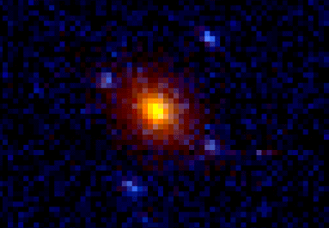
Gravitational Lensing
Galaxy in the light path of a quasar
The four blue dots are images of the same quasar
Image: HST

Slide 26
Fast Radio Bursts
Milliseconds to seconds
May be AGN related
May relate to neutron stars
One class (perytons) attributed to opening a microwave oven door before the magnetron shuts off

