Slide 1
Hubble Classification
Comins, Fig. 17.15

Slide 2
Three Primary Categories
Elliptical
Spiral
Irregular

Slide 3
Spiral Galaxies
Spiral Galaxy M81
Image: NASA/ESA, Hubble

Slide 4
Spiral Galaxies
Contain disk, bulge, halo
Halo stars Population II
Spiral arms in disk
Spiral arm stars Population I
Winding of spiral arms correlates to bulge size
10⁹–10¹² M⊙
Milky Way ~10¹¹

Slide 5
Spiral Arms
If lines of stars, arms would wind tightly
they don’t
Instead, spiral density waves initiate star formation
Waves travel more slowly than the galactic matter
Animation
Mechanism maintaining waves TBD

Slide 6
Spiral Galaxy Classification
Sa: Large bulge, tight spiral,
2% gas and dust
Sb: Moderate bulge, moderate spiral
Sc: Small bulge, loose spiral
15% gas and dust
SB’s: same, but with central bars

Slide 7
Andromeda Galaxy
Closest large spiral
About as large as Milky Way
UV Tour (Swift)
No bar, no ring, moderate winding SA(s)b

Slide 8
NGC 891, Sb
Image: Adam Block, Mt. Lemmon Sky Center

Slide 9
Flocculent Spirals
Self propagating star formation

Slide 10
Flocculent Spiral NGC 4414
Poorly-defined spiral arms
Image: NASA/ESA/ Hubble

Slide 11
Barred Spiral Galaxies
Bar contains stars in highly elliptical orbits
Bars increasing in frequency
70% of nearby spirals are barred
20% of distant spirals are barred

Slide 12
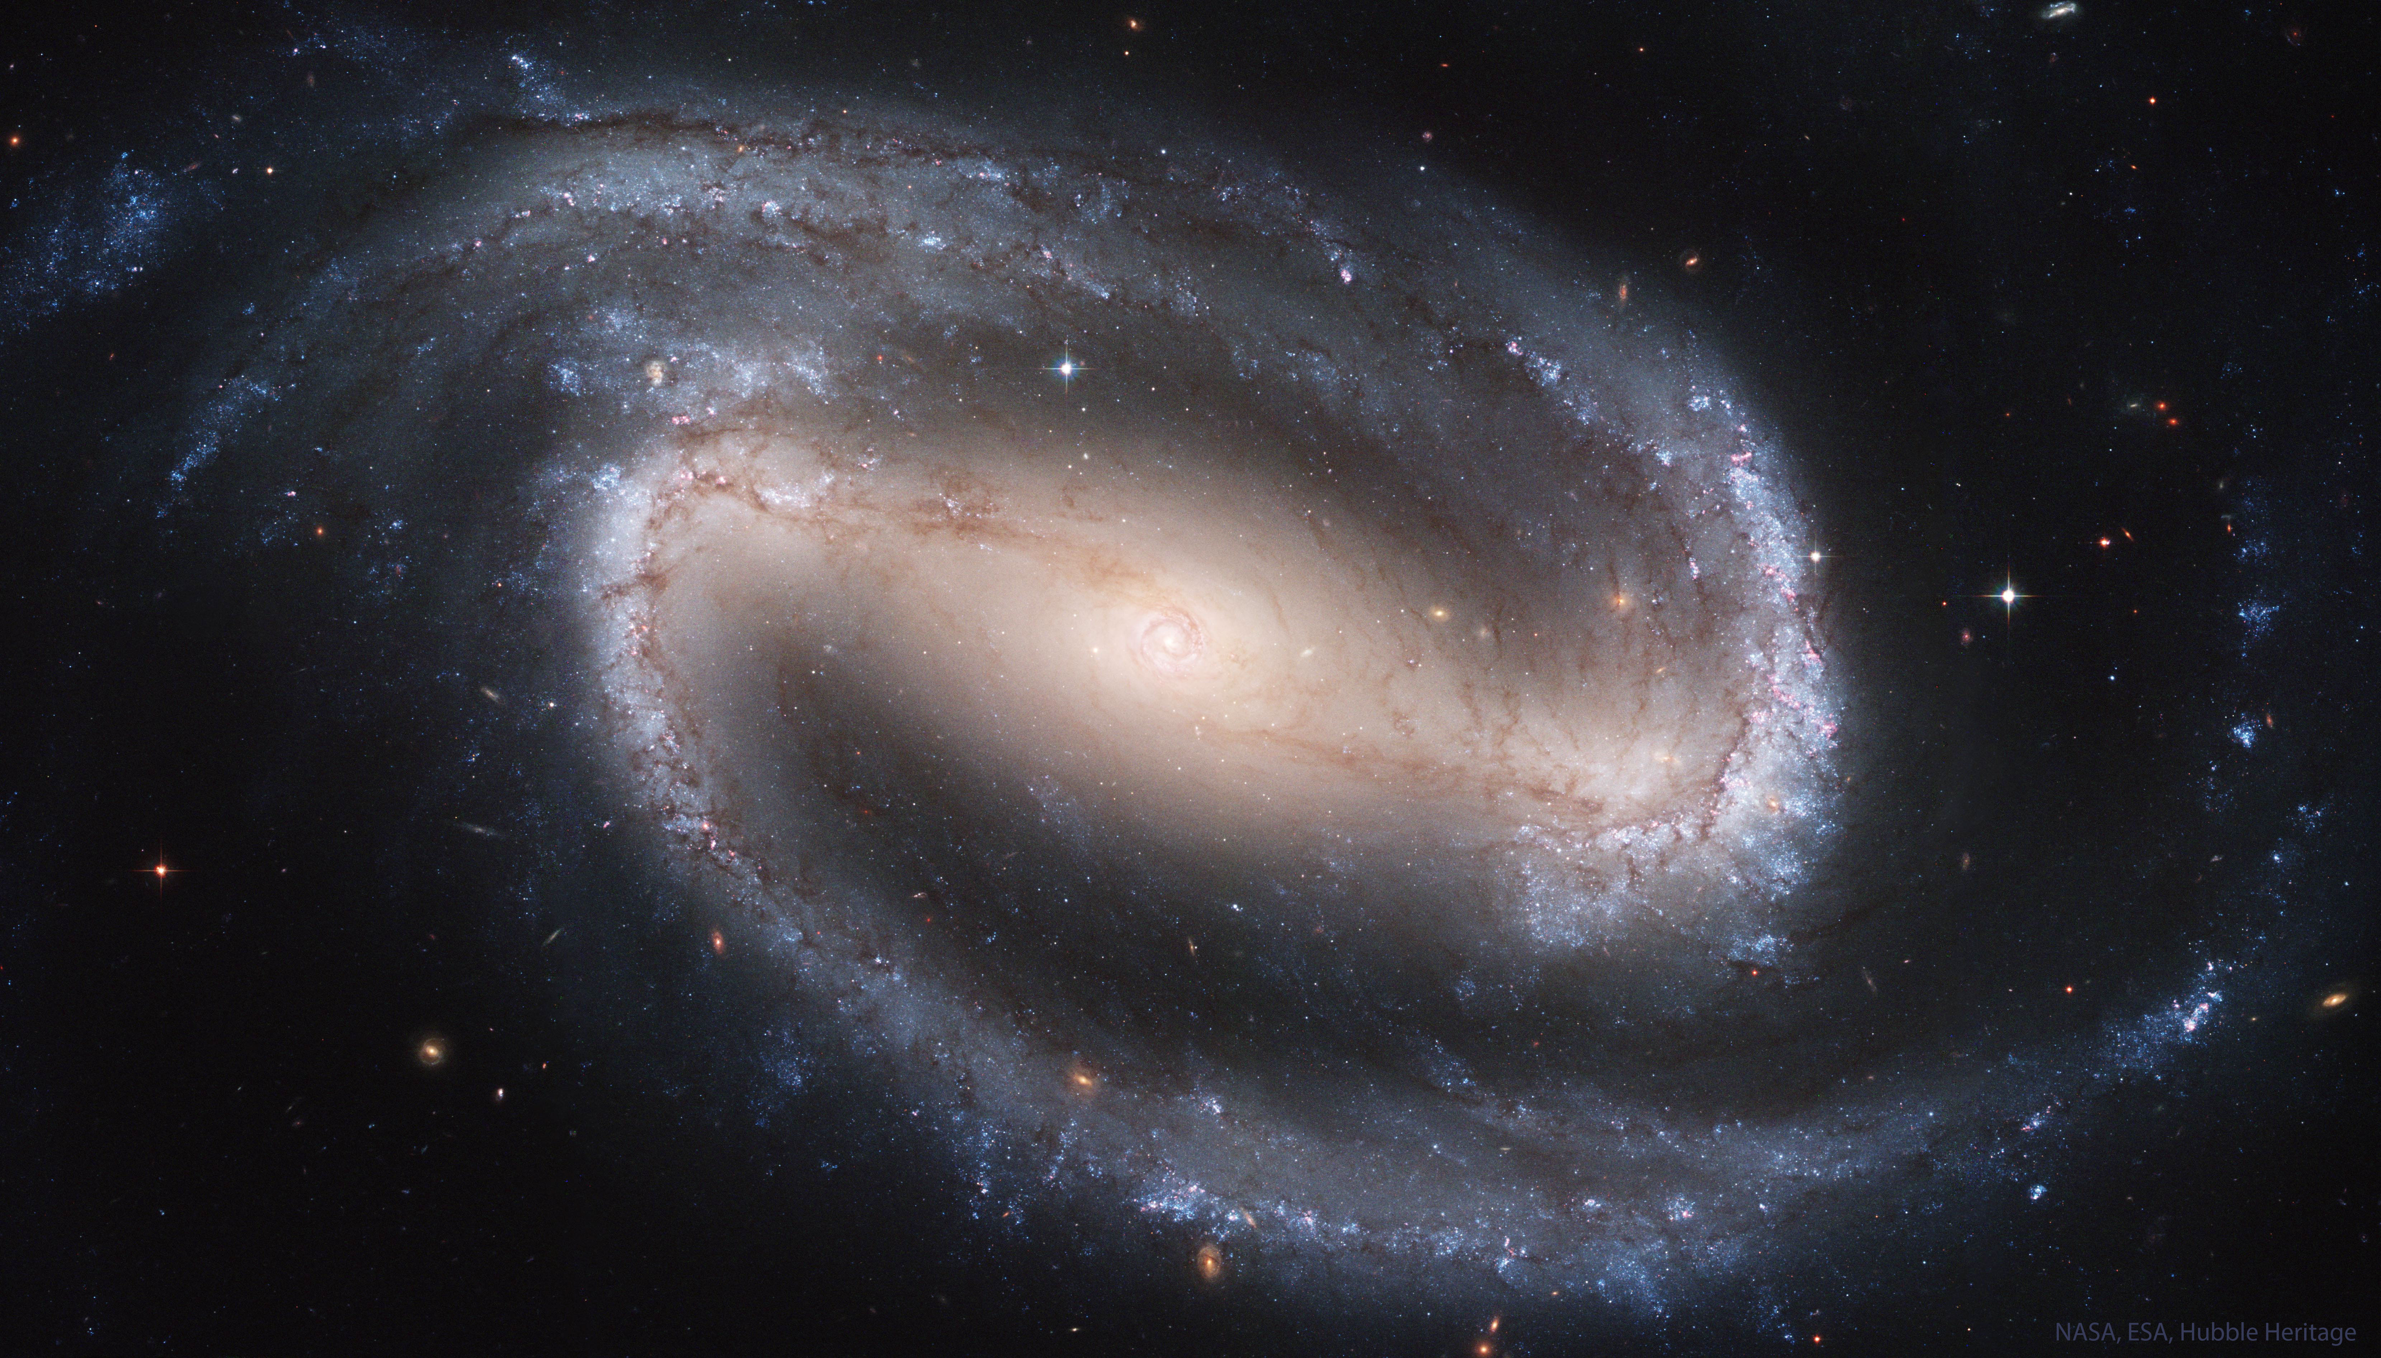
Barred Spiral NGC 1300
Image: Hubble

Slide 13
Grand Design Spiral NGC 1232
Image: European Southern Observatory

Slide 14
Grand Design Spirals
Multiple symmetrical arms
Often accompanied by a nearby satellite

Slide 15
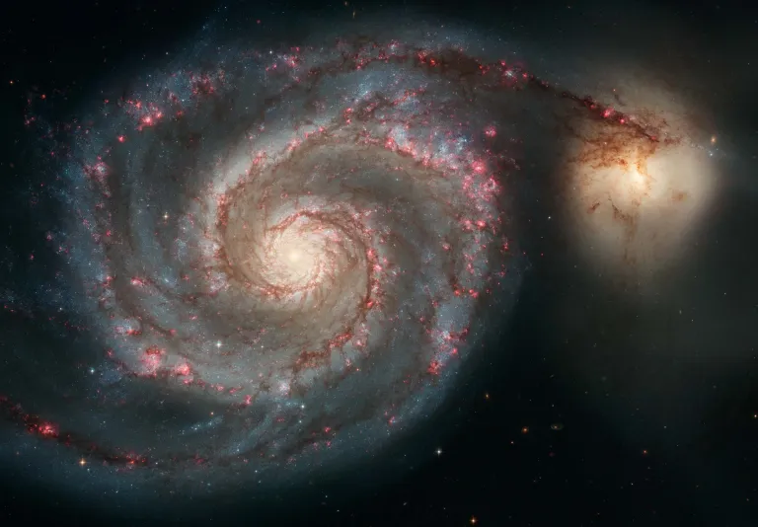
Whirlpool Galaxy
Image: Hubble

Slide 16
Lenticulars
Disk galaxies without spiral arms
Usually lacking in gas and dust
May be barred

Slide 17
Lenticular Galaxy NGC 5866

Slide 18
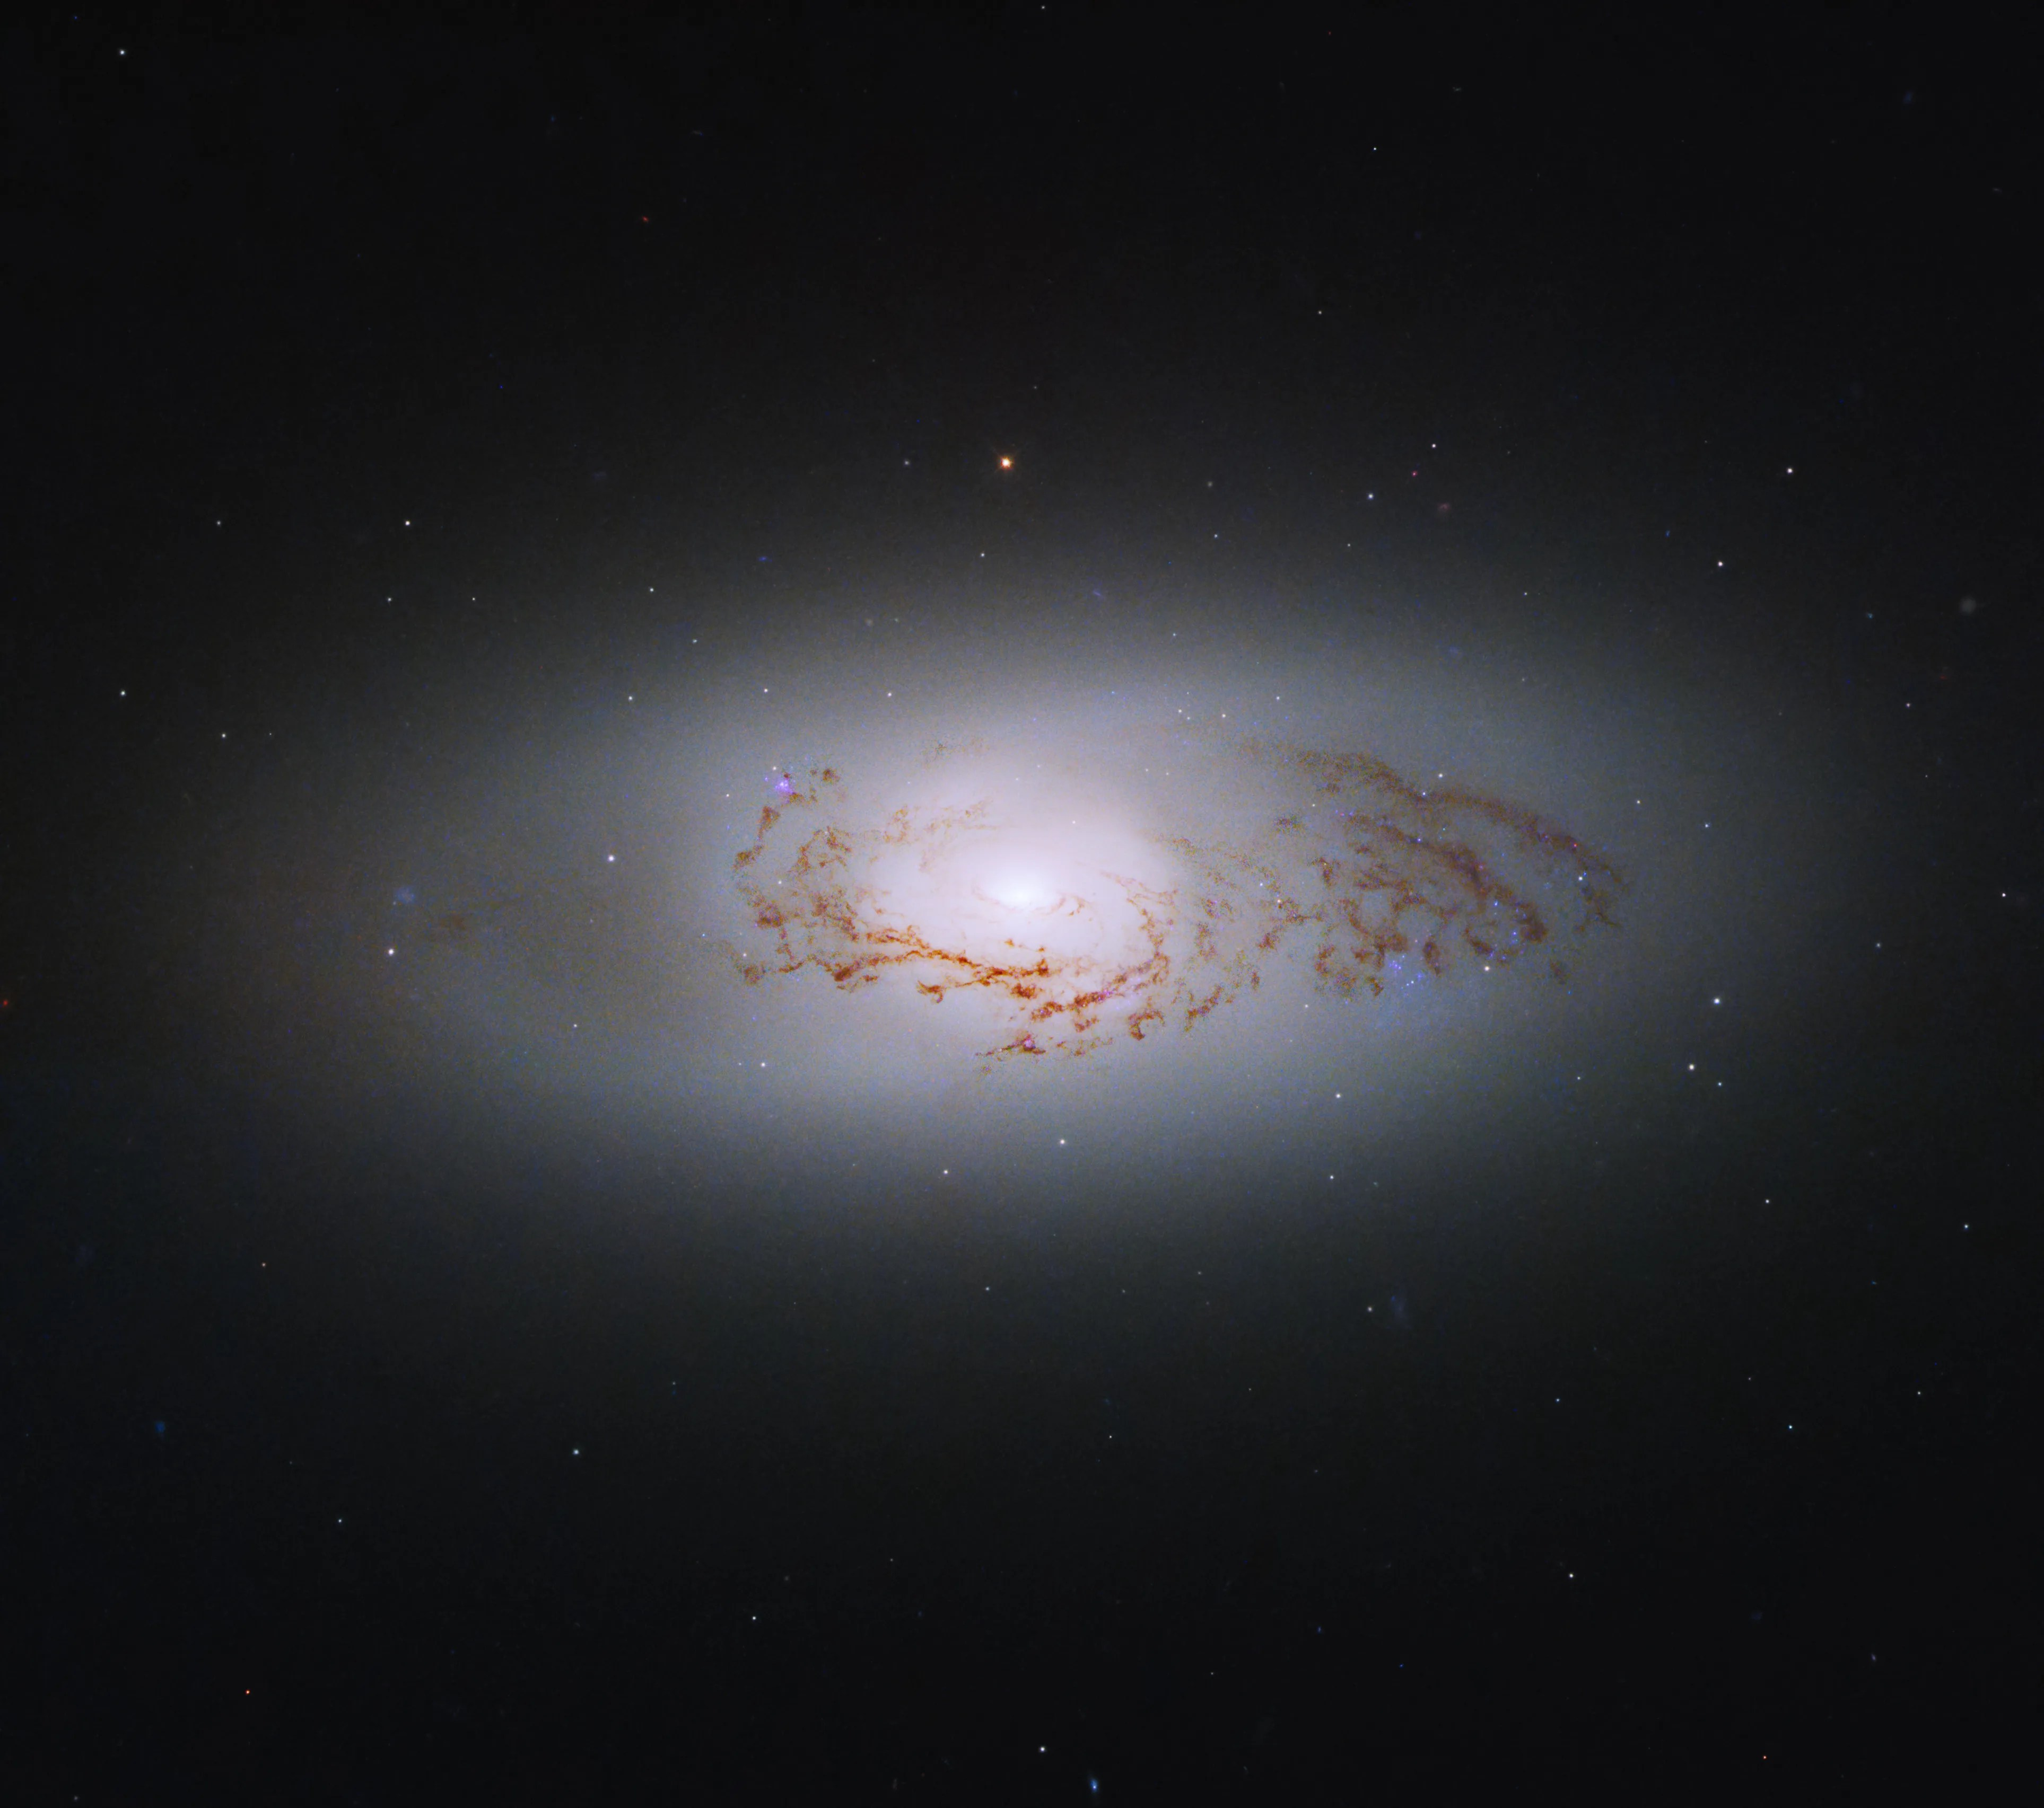
Lenticular Galaxy NGC 3489
Image: NASA, ESA

Slide 19
Spiral Galaxy Rotation Curves
Mass distribution not all visible
Dark matter must be present

Slide 20
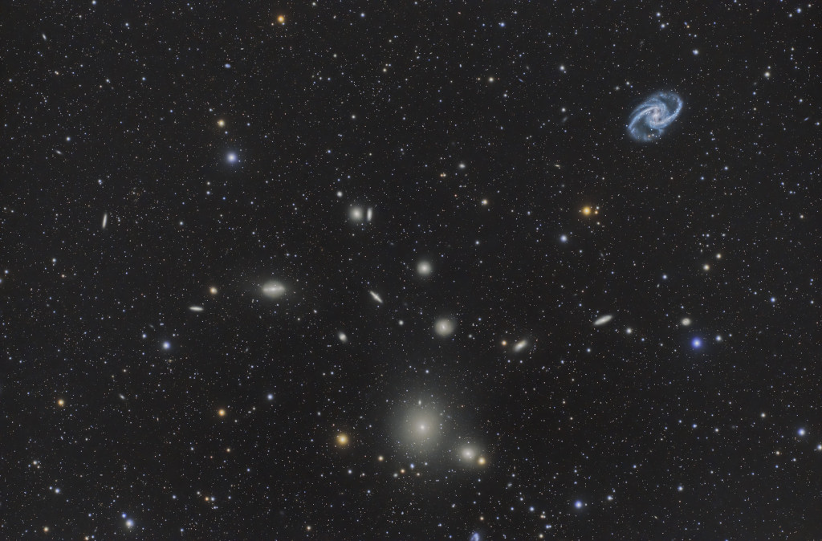
Elliptical Galaxies
Fornax Cluster. Marcelo Rivera, via APOD

Slide 21
Elliptical Galaxies
Smallest and largest of the galaxies
Range from dwarf to giant
May form from collisions of galaxies
Tend to contain Population Il stars

Slide 22
Irregular Galaxies
No clear symmetry or organized structure
Often small, or interacting galaxies
Irr-I contain dust and young Pop I stars
O,B
Irr-II contain Pop II stars
SMC and LMC are Irr-I

Slide 23
Irregular Galaxy M55
Image: Martin Pugh

Slide 24
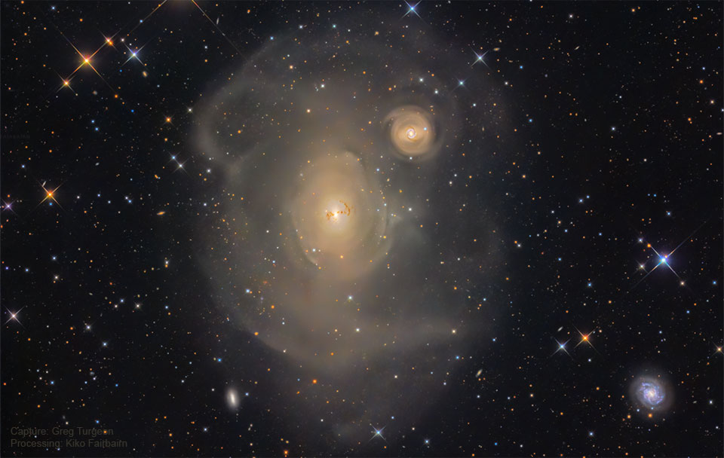
Galactic Cannibalism
Image: Greg Turgeon, via APOD

Slide 25
ARP 142: two views

Slide 26
NGC 6240
Contains at least two supermassive black holes
Image: Hubble

Slide 27
Antenna Galaxies
Image: Kent E. Biggs, via APOD

Slide 28
Mice Galaxies
Image: Hubble

Slide 29
Will We Collide with M31?
Simulation
Also

Slide 30
Hoag’s Object
Image: NASA/ESA/Hubble

Slide 31
Galaxy Clusters
Many galaxies are in close-packed clusters
Most cluster galaxies are elliptical
Most galaxies outside clusters are spiral
ISM in clusters often emits X rays
Bound clusters often shouldn’t be by velocity and observable mass
Dark matter must be present

Slide 32
Types of Galaxy Clusters
Rich and poor
Rich > 1000 galaxies
Regular and irregular
Regular are spherical, centrally concentrated
Closest rich cluster: Virgo cluster
Closest regular cluster: Coma Cluster
Clusters are all redshifted

Slide 33
Virgo Cluster
Image: Abdullah Alharbi, via APOD

Slide 34
Coma Cluster
Image: Joe Hua, via APOD

Slide 35
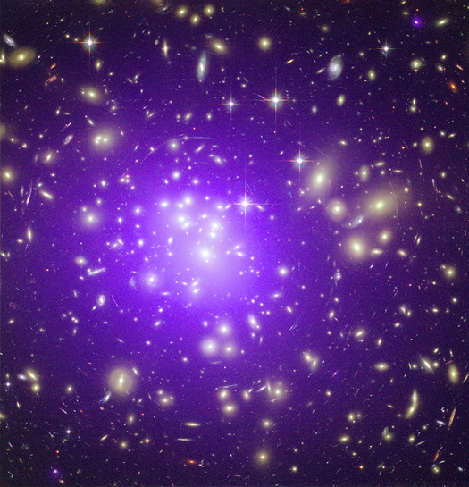
Abell 1689
X ray source
Gravita-tional lens
Image: Chandra/HST Composite

Slide 36
Galaxy Groups
Smaller than clusters
A few large galaxies and more satellites
Our group is the local group
Milky Way, Andromeda. Triangulum, many dwarfs

Slide 37
Local Group
Comins, Fig. 17.20

Slide 38
Stephan’s Quintet
Image: Hubble

Slide 39
Galaxy Superclusters
Not gravitationally bound

Slide 40
Hubble-Lemaitre law
H₀ = Hubble constant
Comins, Fig. 17.345

Slide 41
Hubble-Lemaitre law
If it held in the past, then we can run the dynamic equation backward in time to find what the universe was once like
All the visible universe expanded from a point in the past
It’s still going

Slide 42
The Universe is Expanding
Everywhere
Space itself is stretching

