Slide 1
Galaxies
Including The Galaxy

Slide 2
Our Milky Way
Latin via lactea, “Milk Road”
Greek galaxias kyklos, “milk circle”
same word origin as lactic and galactose
Origin of word “galaxy”
Galileo recognized that the band of the Milky Way comprised many stars

Slide 3
Observing the Milky Way
We see
Uniformly-distributed stars
A band encircling the sky
Globular and open clusters
Nebulae of various types
including obscuring dust

Slide 5
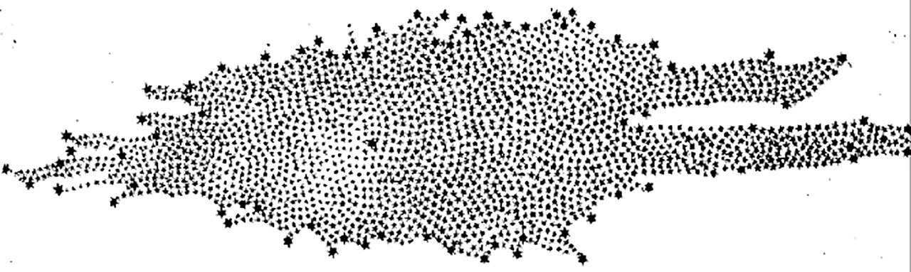
Hershel’s study
Looked for region of greatest star density
Other than obvious disk, no region seemed denser than any other
Are we at the center?
Image: Caroline Herschel

Slide 6
Shapley’s study
Located globular clusters using Cepheid variable stars
Found a spherical distribution centered in Sagittarius

Slide 9
Non-Visible Observations
Radio, IR, X-ray
Shows unique structure near center
SMBH
SNRs
X-ray emitters
Sgr A*

Slide 10
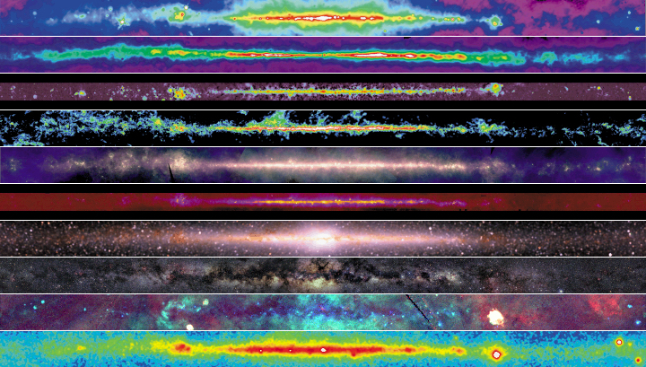
Multi-wavelength Images
408 MHz
21 cm
2.4 GHz
CO
Far IR
Mid IR
Near IR
Visible
X-ray
Gamma

Slide 11
Structure of the Milky Way
in-plane view
axial view
Comins, Fig 16-1

Slide 12
Structure of the Milky Way
Bar
Two main arms
Several minor arms
What is the coordinate system?
Image: NASA/Caltech-JPL, Spitzer data

Slide 13
Different Stars’ Paths
Comins, Fig 16-17

Slide 14
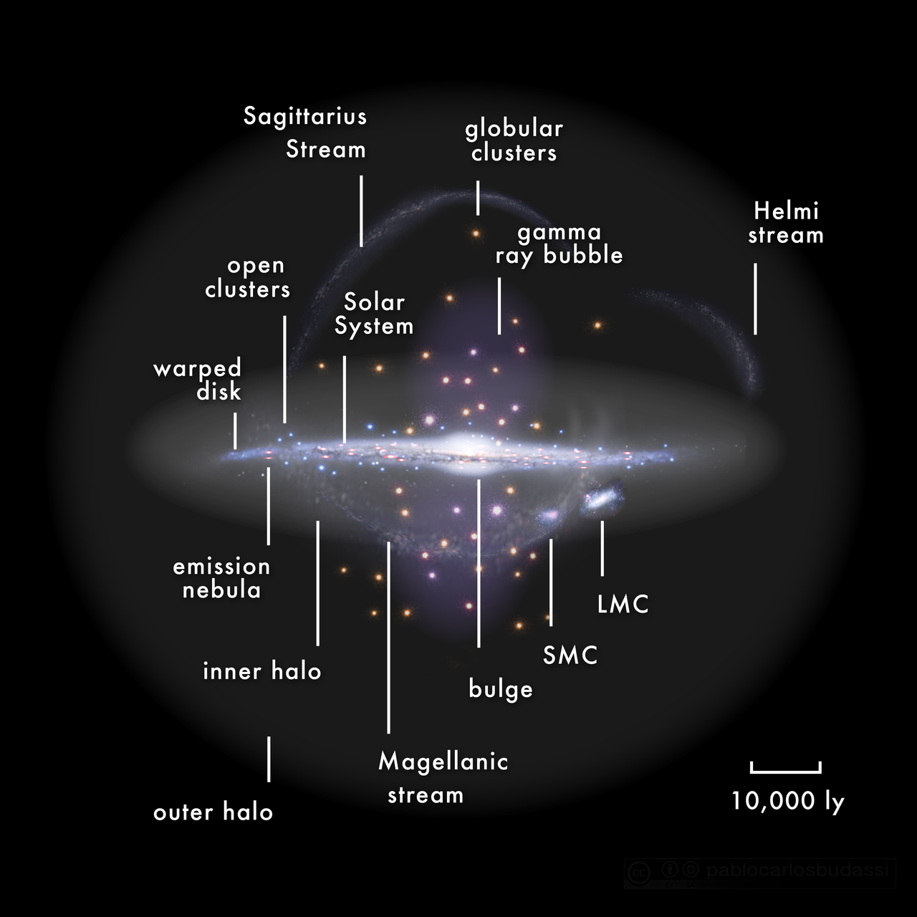
Large-Scale Structure
Image: Pablo Carlos Budassi

Slide 15
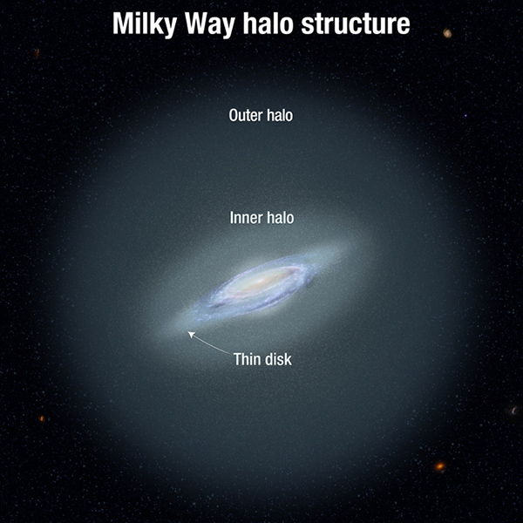
Galactic Halo
Image: NASA, ESA, and A. Feild [STScI]

Slide 16
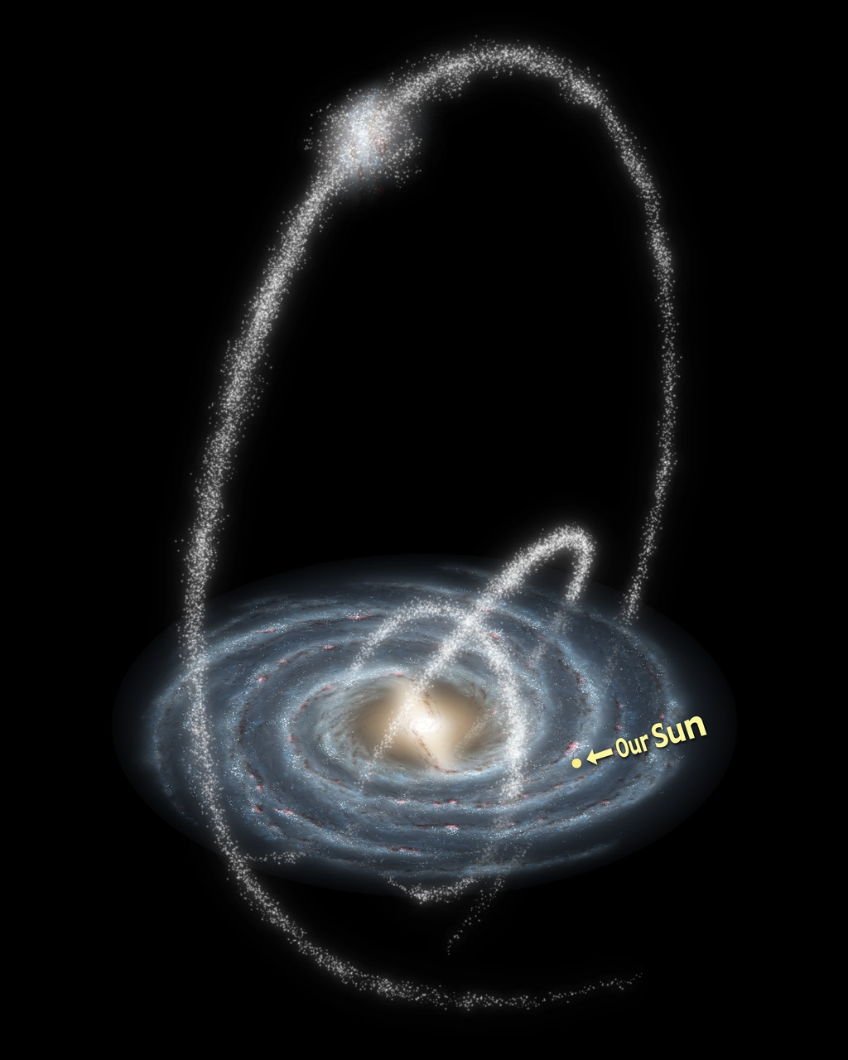
Streams
Cannibalized dwarf galaxies and globular clusters disrupted by tidal forces
Image: NASA/JPL-Caltech/R. Hurt (SSC/Caltech)

Slide 17
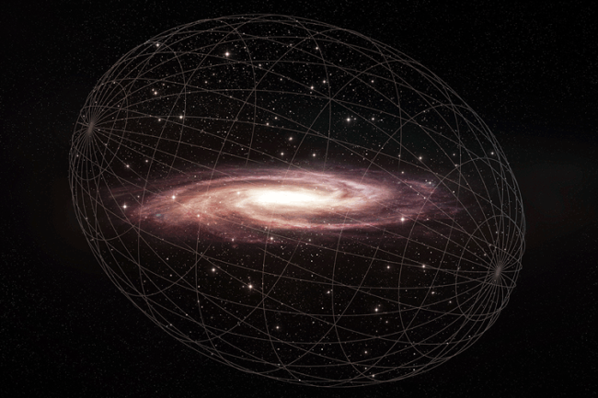
What is the Halo like?
Image: Harvard & Smithsonian Center for Astrophysics |Melissa Weiss

Slide 18
There’s too much Gravity
Galaxy shouldn’t be gravitationally bound
Stars move too fast to stay
How are halo stars bound?
orbital velocities should decrease with distance
But they don’t

Slide 19
Galactic Rotation Curve
Comins, Fig 16-20

Slide 20
Galaxies
We are not alone
Image: Abdulla Al-Harbi, via APOD

Slide 21
Shapley-Curtis Debate
26 April 1920
Harlow Shapley, Heber Curtis
On whether “spiral nebulae” were
dust and gas in the Milky Way
independent ”island universes”
Debate was inconclusive

Slide 22
Later Data
By 1924 Edwin Hubble discovered 12 Cepheids in M31
Measurements showed they were 900 kly distant

Slide 23
“Here is the letter that destroyed my universe.”
–Shapley

