Slide 1
Black Holes
theory
Image: Artist’s conception, NASA/JPL

Slide 2
How did the idea arise?
Black holes allowed by general relativity
(Generalization of special relativity to include acceleration)
Postulate of relativity:
The laws of physics are the same in all inertial frames of reference
This requires the speed of light to be the same for all observers

Slide 3
What about Gravity?
Einstein’s Galilean gedanken experiment:
In a sealed room, could you distinguish between gravity and a constant upward acceleration?

Slide 4
Gravity Can Bend Light
Because acceleration can bend light
a

Slide 5
Matter Bends Space
Light travels the straightest possible path in curved space
That curvature is gravity

Slide 6
Predictions of General Relativity
Gravity bends the path of light
Gravity slows time
Gravity reddens light
All of these have been verified experimentally!

Slide 7
Eddington’s Eclipse Observation
Comins, Fig 15.5

Slide 8
Pound’s and Rebka’s Shift
detector
γ source
red shift
Shifts very small
but real
accord with GR
blue shift
γ source
detector

Slide 9
Gravitational Redshift
Comins, Fig. 15-6

Slide 10
Black Holes
If enough mass is stuffed into a small enough space, its gravitational field will not allow even light to escape
How can matter become this compact?
Comins, Fig 15-8

Slide 11
Collapse
If a neutron star has a mass above 3 M⊙, degeneracy pressure cannot support it against gravity

Slide 12
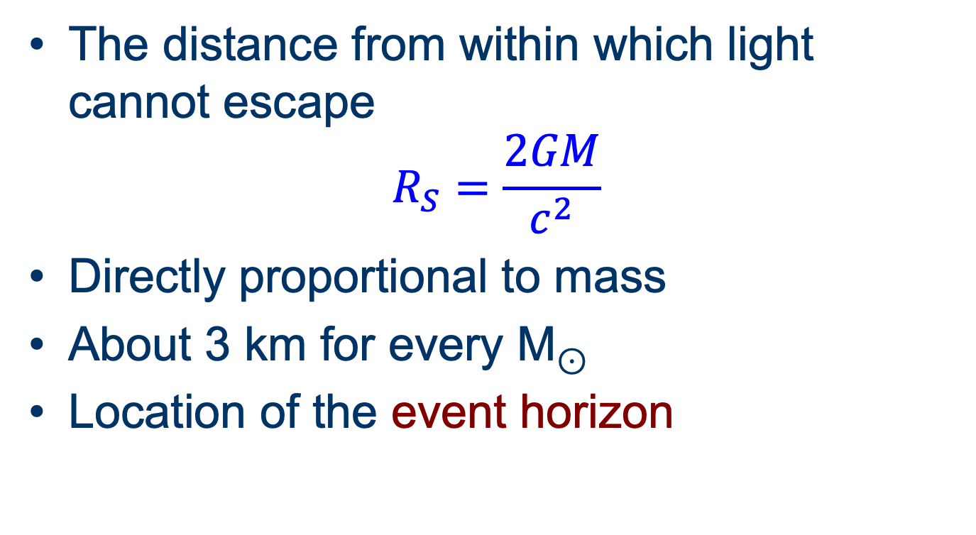
Schwarzschild Radius
The distance from within which light cannot escape
$$R_{S}=\frac{2GM}{c^{2}}$$
Directly proportional to mass
About 3 km for every M⊙
Location of the event horizon

Slide 13
Preserved Properties of Matter
Mass
Electric charge
Angular momentum

Slide 14
Angular Momentum
No spin: Schwarzschild black hole
Spin: Kerr black hole
Causes spacetime to rotate around it

Slide 15
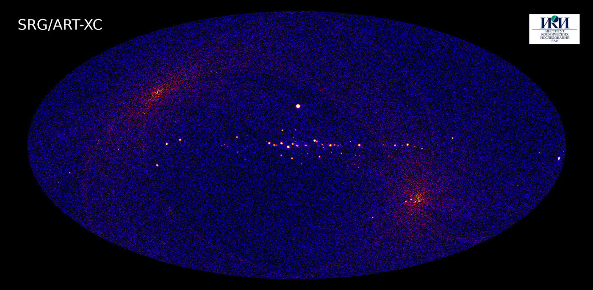
Observing Black Holes
Image: SRG, 4–12 keV band

Slide 16
Observing a Black Hole
How?
They don’t emit light
They don’t emit anything
Options:
Gravitational lensing
Accretion
Hawking radiation

Slide 17
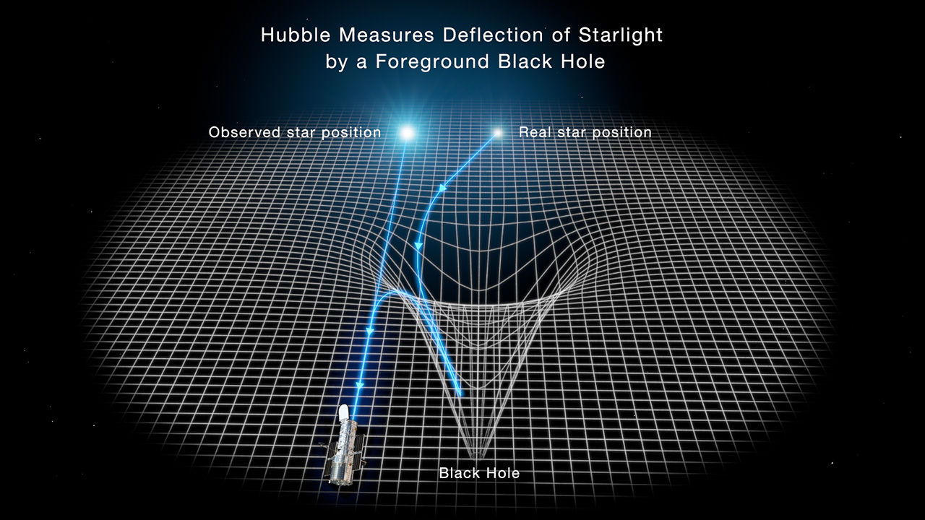
Hubble Hunt: Lensing
Image: Joseph Olmstead, NASA

Slide 18
Cygnus X-1
Image: Visible wavelengths, NASA?ESA

Slide 19
Cygnus X-1
Brightest X-ray source in the sky
Bunary companion to blue supergiant HDE226868 (30 M⊙)
Compact object 9–20 M⊙
Orbit ~0.2 AU; T ~ 5.6 days

Slide 21
X-Ray Source
X-rays emitted by accretion disk
Infalling material heated to fantastic temperatures
Emit X-rays
Variability suggests small object
Spin may be very fast
“Stellar mass black hole”

Slide 22
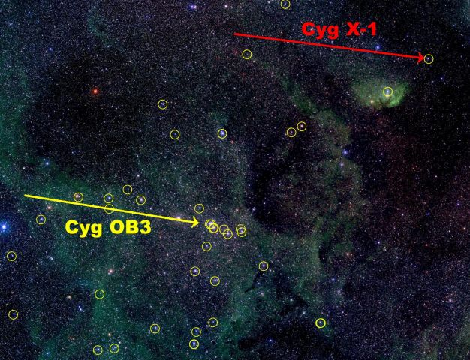
Cygnus OB Association
Image: IAFE, via APOD

Slide 23
Progenitor Star
Probably > 60 M⊙
Collapsed without explosion

Slide 24
M87
jet
Image: Mt Lemmon Sky Center

Slide 25
M87
Large elliptical galaxy in Virgo cluster
Supermassive galaxy
Lacks substantial gas or dust
Bright radio source
enigmatic jet near nucleus

Slide 26
M87 Jet
Image: NASA/Hubble

Slide 27
M87 Jet
Ions accelerated along axis of accretion disk
NASA video

Slide 28
M87 Nucleus
Image: Event Horizon Telescope

Slide 29
M87’S supermassive black hole
~6.5 billion M⊙
R_{S} ~ 120 AU

Slide 30
Milky Way Galaxy
Center in Sagittarius, near Scorpius
Star video
Strong radio and X-ray source

Slide 31
Sgr A*
Main image: IR,/VIS, HST; inset x-ray, Chandra

Slide 32
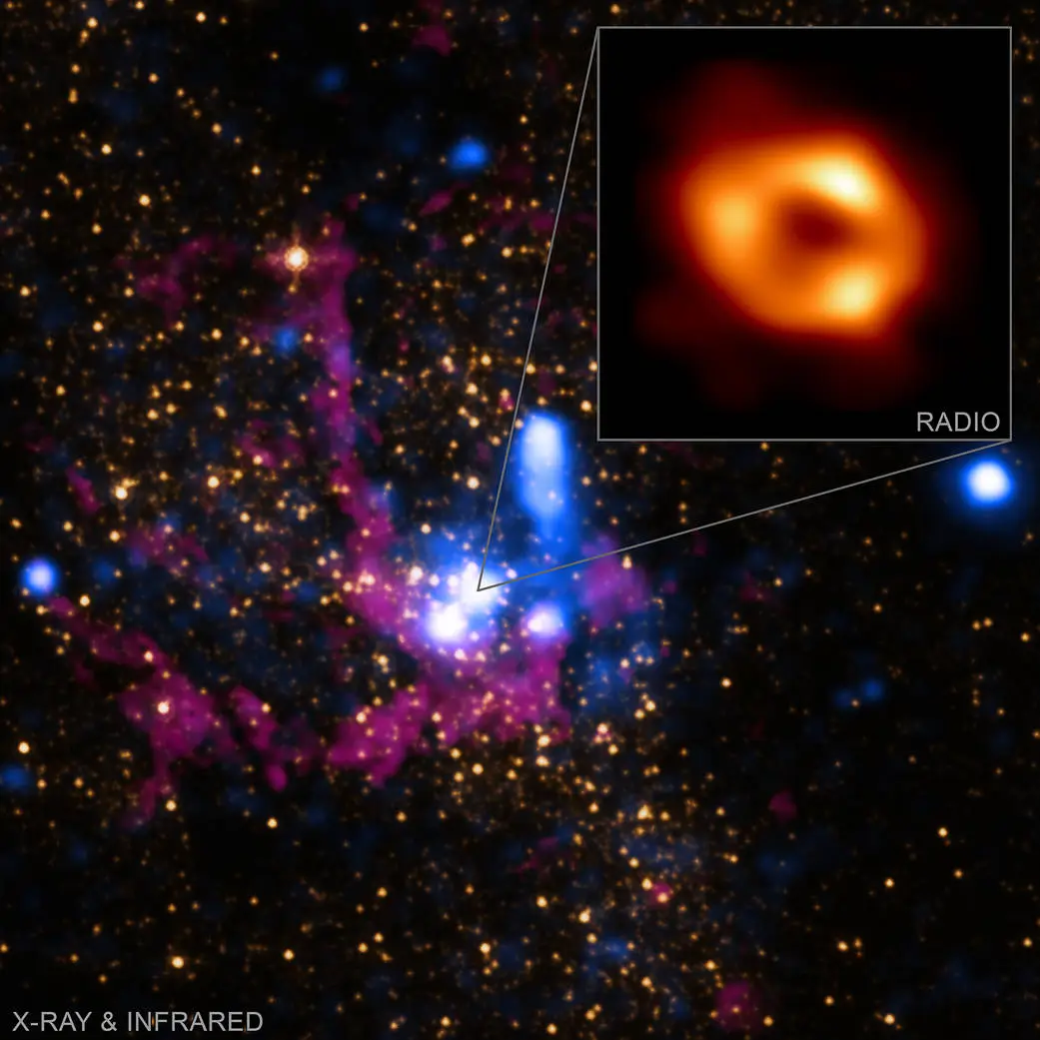
Insert: EHT
Multiple wavelength image

Slide 33
Milky Way’s black hole
4.31 million M⊙
R_{S} ~ 0.08 AU

Slide 34
Intermediate-mass black holes?
They probably exist
Centers of globular clusters
Ultra-luminous x-ray sources
Candidate near Sgr A*

Slide 35
Hawking Radiation
Virtual particle pairs can be created just outside event horizon
One returns, one escapes
Black hole loses mass over time
Process gets faster as black hole becomes lighter

