Slide 1
Stellar Remnants
After fusion ceases
Crab nebula, multi-wavelength composite. NASA/ESA via APOD

Slide 2
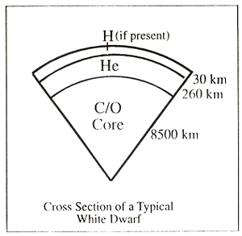
White dwarfs
Layered structure
H/He mesosphere
Degenerate core
Density increases toward center
Maximum mass 1.4 M⊙
Image: Guy Worthey, WA State

Slide 3
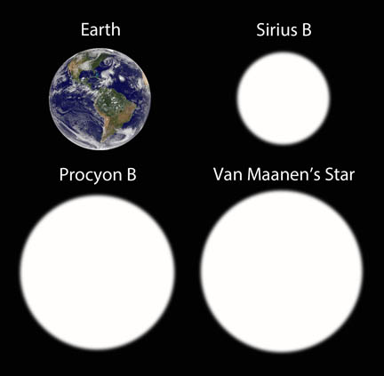
White dwarfs
Greater mass gives smaller radius
Theoretical smallest size ~ Moon
Image: Bob King, Sky and Telescope

Slide 4
Accreting from a companion
Image: NASA/JPL, via space.com. Artist’s conception,

Slide 5
Cataclysmic Variables (Novae)
H builds in shell
shell H flash when hot, dense enough
Explodes and fades
Comins, Fig. 14.8

Slide 6
T Cor Bor
Recurrent Nova
Period ~ 80y
Last seen 1946
Normally m = 10, bursts to m = 2
Duration ~½ day
Predicted for Summer 2024
Could go any minute

Slide 7
Chandrasekhar Limit
Electron degeneracy can only withstand pressure from mass up to 1.4 M⊙

Slide 8
Supernova Type Ia
White dwarf accretes enough mass to exceed Chandrasekhar limit
Core compresses, runaway fusion ensues
Entire star explodes

Slide 9
Will this happen to Sirius?
Sirius B is the heaviest wd measured
close to Chandrasekhar limit
When Sirius A goes giant, will B accrete its envelope?
Probably not
Least separation 8 AU

Slide 10
Supernova Type Ia
Comins, Fig, 14.9

Slide 11
Supernova Type Ia
Used as “standard candle” for extreme distances
fusion initiates at a consistent mass
Luminosity 5×10⁹ M⊙
Recent evidence suggests origin in white dwarf mergers
e.g. dearth of H, He in spectrum

Slide 12
White dwarf mergers
tight wd binaries lose orbital energy by gravity wave emission and magnetic braking
Merge to form
heavier wd
neutron star
supernova

Slide 13
Neutron Stars

Slide 14
Neutron Stars
First proposed in 1933 by Fritz Zwicky and Walter Baade
along with supernovae as a cosmic ray source
Collapsed material, degenerate neutrons
Nuclear density, 10¹⁷ kg/m³
Not taken seriously until pulsar discovery

Slide 15
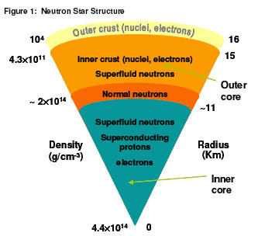
Purported structure
Behvior of neutrons under these conditions not known experimentally
Image: Guy Worthey, WA State

Slide 16
Pulsars
Discovery by then- graduate student Jocelyn Bell
Pulsating radio sources
Short period
Slight slowing implicated single object
Period required small diameter
Conclusion: neutron star

Slide 17
Pulssar
Extremely regular period
Sometimes variable intensity
Comins, Fig, 14-17

Slide 18
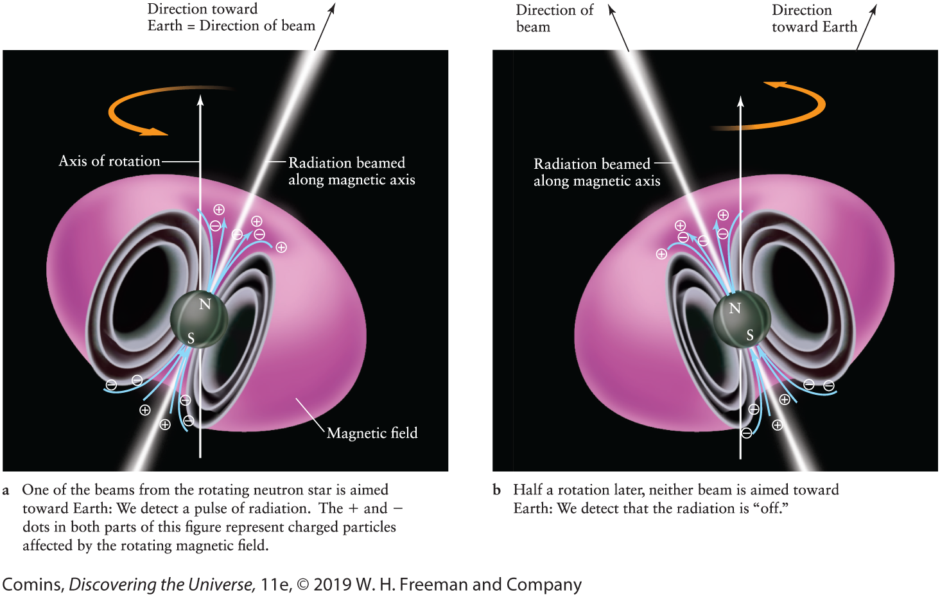
Pulsar model

Slide 19
Pulsar “glitch”
Temporary sudden frequency increase
Not fully understood
diameter decrease
recrystallization?
Comins, Fig, 14-22

Slide 20
Neutron star theory
Created with high angular momentum
High magnetic field
Particles funneled into axial beams
Acceleration creates EM radiation
Rotation causes “light house” effect

Slide 21
Magnetars
Neutron stars with extra magnetic field
high spin rate, convection of conducting material
Credited as soft gamma ray repeaters

Slide 22
Pulsars in binaries
Accretion can cause spin to speed up
millisecond pulsars
Can change companion’s evolution
strip matter

Slide 23
X-ray burster
Comins, Fig, 14-29

Slide 24
Really big Core Collapse
Star > 25 M⊙
Remnant too massive for neutron degeneracy pressure to support
Black hole?

Slide 25
Hypernovae
Thought to be core-collapse of > 30 M⊙ stars

Slide 26
Supernova Impostors
Most famously η-Car
Supernova-bright outburst, but star endures

Slide 27
Homonculus Nebula
Image: multi-wavelength composite, NASA (J. Morse) via APOD

