Slide 1
How Large Stars Die
Some with a bang
some with a whimper
SN1987A remnant, false color Near IR, Webb telescope

Slide 2
Stars’ Ends
< 0.4 M⊙: fade away
0.4–8 M⊙: white dwarf
> 8 M⊙: core collapse

Slide 3
Stars over 8 M⊙
Core He fusion to C, O
C fusion to Ne, Mg
O fusion to S, Si, P
Si fusion to Fe
Each step takes less time

Slide 4
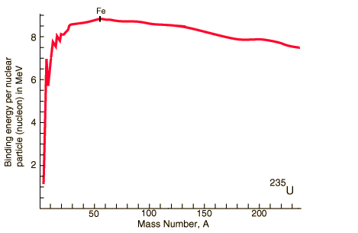
Binding Energy
fission
fusion
Source: Georgia State U., Hyperphysics
http://hyperphysics.phy-astr.gsu.edu/hbase/nucene/nucbin.html

Slide 5
End-stage Supergiant
Comins, Fig. 14.10

Slide 6
Then what?
Iron does not yield energy by fusion
Cannot maintain hydrostatic pressure
Core collapses

Slide 7
Core Collapse
Rising temperature causes photodisintegration
p⁺ + e– → n + ν_{e}
Core reaches nuclear density, bounces
Envelope falls in at ~0.15c
Core and ν collide with envelope
Type II Supernova
r-process nucleosynthesis

Slide 8
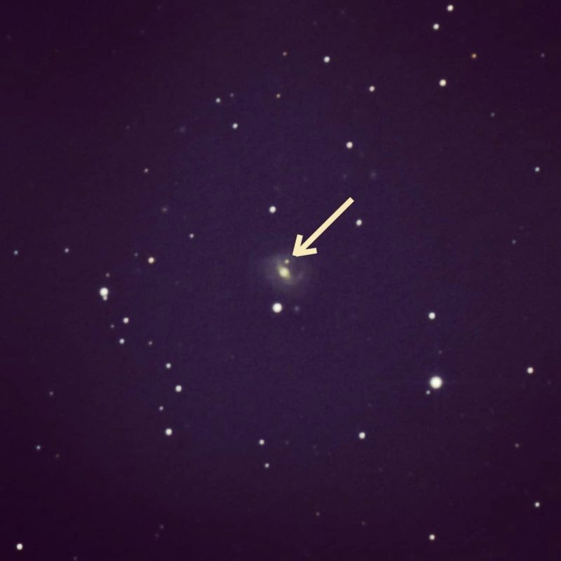
Extragalactic Supernova
SN2018iq
Image: Brian Ottum, via earthsky

Slide 9
Supernova frequency
Estimated ~ 1 per 100y in a galaxy
We haven’t seen one in the Milky Way since 1604
  Kepler’s Supernova
Why so long ago?

Slide 10
Supernova 1987A
In Large Magellanic Cloud
Feb 24, 1987
peak m = 2.9
progenitor star B supergiant
13-second neutrino burst
  12 events at Kamiokande II
  5 at Baksan
  8 at IMB

Slide 11
Collapse without Supernova?
If a star is massive enough, can it overcome a rebound?

Slide 12
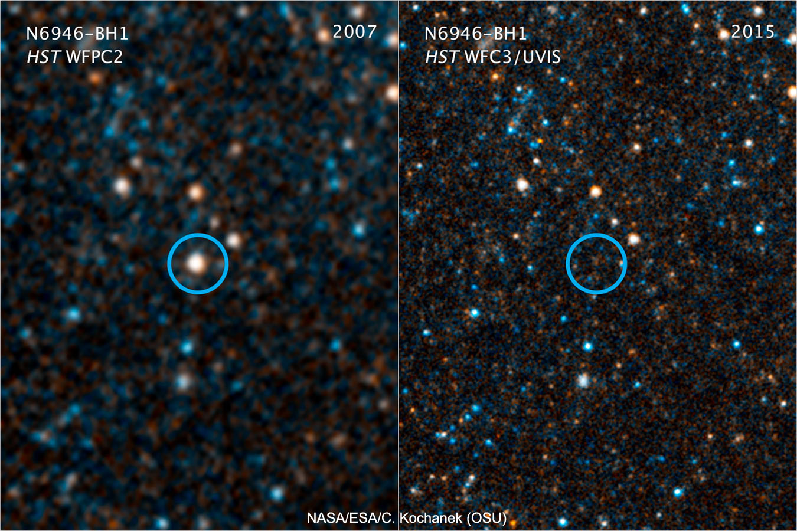
Missing Star
N6946-BH1
disappeared between 2009 2015
Image: NASA, ESA, Hubble

Slide 13
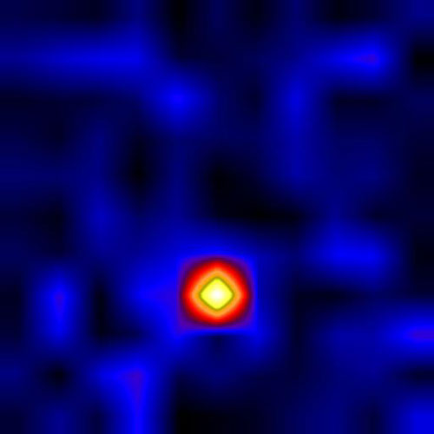
Cygnus X-1
Bright X-ray source
Luminous supergiant (20 M⊕) orbits unseen companion (10 M⊕)
Would they stay together after a supernova?
Image: Cygnus X-1 in X-ray. NASA ,High Energy Replicated Objects project

