Slide 1
A Star is Born
§13.1
Image: NASA/HST

Slide 2
Stars change over time
Temperature
Size
Luminosity
Composition
Structure
Even mass!

Slide 3
Stellar nurseries
Stars begin in clouds of gas and dust

Slide 4
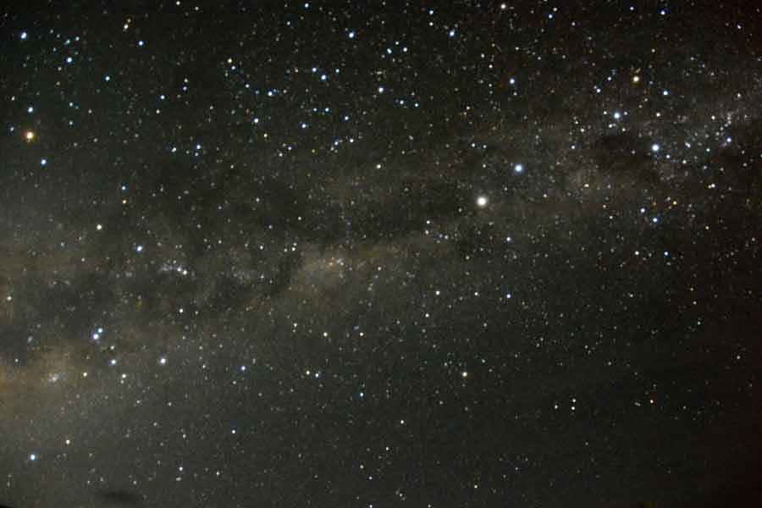

Slide 5
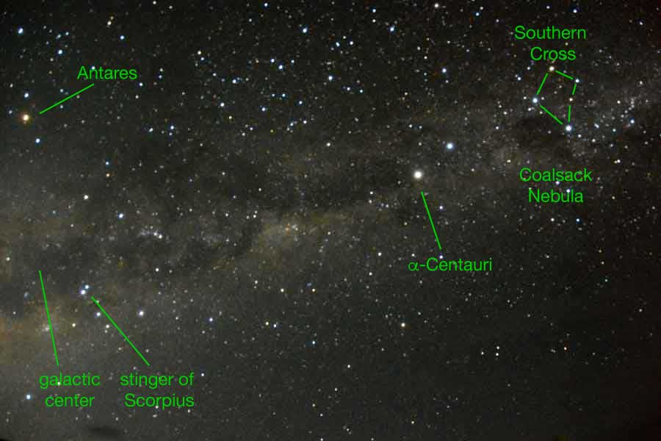

Slide 6
Interstellar Medium
≥ 10% of galactic mass
Low T, visible in IR wavelengths
Composition 74% H₂, 25% He, 1% metals
  by mass
Dust contains C, Si, O, PAH

Slide 7
Observing dust
Dust blocks starlight by interstellar extinction
Dust scatters short-wavelength light in interstellar reddening
  red and IR wavelengths are transmitted
Comins, Fig. 13.5

Slide 8
Molecular Clouds
Composed mostly of H₂
Detected by CO
Evidence that H₂/CO ≈ 10,000
Density 10²–10⁵/cm³
  dense compared to space
  sparse compared to atmosphere
Chamaleon I Molecular Cloud Complex
Image: ESA/Herschel/Planck; J. D. Soler, MPIA

Slide 9
Jeans Instability
How are they triggered?
“Young stars” mean O and B
Energetic radiation ionizes H and He
  “H2” (ionized H) region
  clears the area

Slide 10
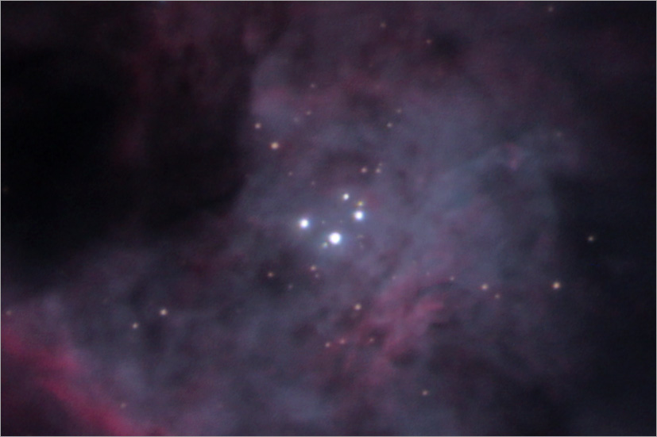
O and B Stars of the Trapezium
Image: Jerry Lodriguss, Astropix

Slide 11
Steps of Star Formation
Jeans unstable cloud contracts
Dark overdense regions ≡ Bok globules
  IR shows dense cores
Spin determines if one large or several smaller stars form
Protostars are large (5 AU), bright in IR
Pre-MS when it stops accreting

Slide 12
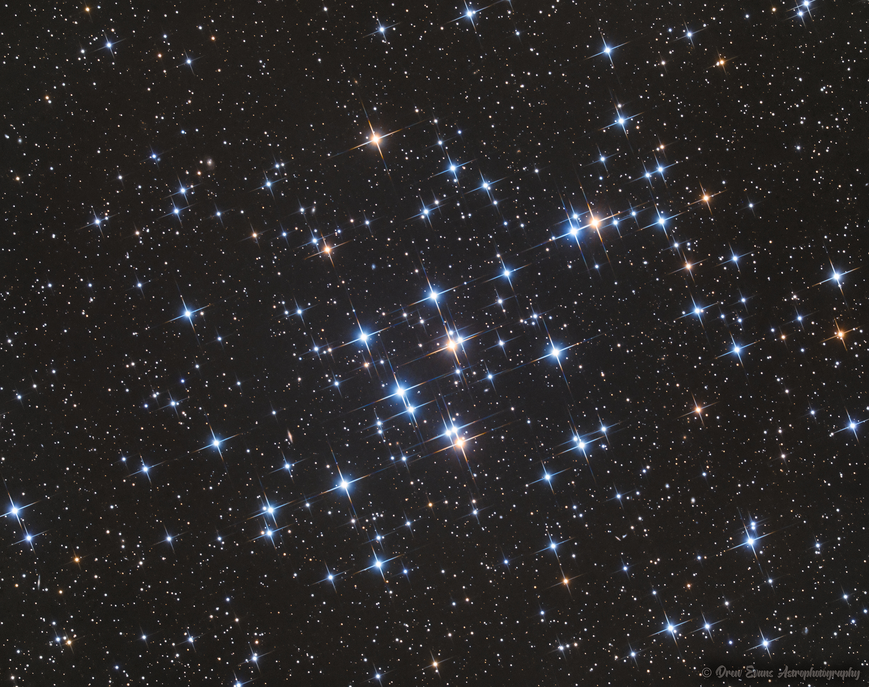
Joining the Main Sequence
Beehive Cluster in Cancer
Image: Drew Evans

Slide 13
Main Sequence
H fuses in the core, hydrostatic equilibrium
Fusion ignites at sufficient core temperature and density
Luminosity is greater at higher mass
  why?
High temperature ⇔ high mass
More massive stars ignite sooner

Slide 14
Path Depends on Mass
Comins, Fig. 13.13

Slide 15
Minimum Mass
≥ 0.08 M⊙ required (95 Jupiters)
Brown dwarf
At > 13 Jupiters, D can fuse
At > 60 Jupiters, Li can fuse
Not of great consequence

Slide 16
Maximum Mass
To be determined
Evidence exists of stars up to 300 M⊙

Slide 17
Leaving the Main Sequence
How stars age

Slide 18
Star Lifetimes
Massive stars live fast and die young
Fusion rate increases with mass faster than direct proportion

Slide 19
Star Lifetimes
Mass (M_{ʘ}) | Surface temperature (K) | Luminosity (L_{ʘ}) | Time on main sequence (10⁶ years) | Spectral class
25 | 35,000 | 80,000 | 3 | O
15 | 30,000 | 10,000 | 15 | B
3 | 11,000 | 60 | 500 | A
1.5 | 7000 | 5 | 3000 | F
1.0 (Sun) | 6000 | 1 | 10,000 | G
0.75 | 5000 | 0.5 | 15,000 | K
0.50 | 4000 | 0.03 | 200,000 | M
Comins, Table 13.2
Older than age of universe

Slide 20
Dwarf Stars 0.08–0.4 M⊙
Keep fusing H until it runs out
Fully convective: complete mixing
Will end as cooling balls of He
(Far in the future)

Slide 21
Above 0.4 M⊙
Stars not convective near core
  radiative zone
When core H diminishes, core is crushed
H shell fusion initiates around core
Outer layers expand, cool
“Red Giant” star phase
Cooler, larger, more luminous than MS

Slide 22
Giant Star stage
Comins, Fig 13-22

Slide 23
H Shell Fusion
Creates He
He settles to core
Core becomes hot and dense enough to fuse He
  100 million K

Slide 24
Helium Fusion
“Triple alpha process”
⁴He + ⁴He → ⁸Be
¹²C + γ
⁴He
Then
¹²C + ⁴He → ¹⁶O + γ

Slide 25
0.4–2 M⊙: Helium Flash
Core compression halted by electron degeneracy pressure
Volume does not increase with temperature
He fusion rapidly ignites
Comins, Fig. 13-25a

Slide 26
0.4–2 M⊙: Helium Flash
Temperature rises to 3.5 MK in a few hours
Degeneracy breaks, core expands and cools
H-fusing layer expands and cools
Star shrinks
Comins, Fig. 13-25a

Slide 27
Above 2 M⊙: He fusion, no flash
Cores do not become degenerate
Feedback between p, T, V, and fusion rate
Some cycling in size and luminosity, not as abrupt as with He flash

Slide 28
After Core He Fusion
Double shell fusion
  Inert C/O core
  Inner He fusing shell
  Outer H fusing shell
  Asymptotic Giant Branch
No further fusion steps
  Not hot or massive enough to overcome C/O degeneracy pressure

Slide 29
Asymptotic Giant Branch
Comins, Fig. 14-2

Slide 30
Mass Loss
Sheds ~30% first time as a giant
Sheds ~50% as AGB

Slide 31
Low-Mass AGB Stars
Core and shell degenerate
Shell can He flash several times
Envelope expands and cools, cooling core
Shell plasma recombines, radiates
Temperature jump expels envelope
Planetary nebula expands from star

Slide 32
Helix Nebula
Image: Patrick Winkler, via APOD

Slide 33
HFG1 and Abell 6
Image: Julian Cadena, via APOD

Slide 34
Little Ghost Nebula
Image: Hubble Heritage, via APOD

Slide 35
M2-9
Image: B. Balick, via APOD

Slide 36
NGC 2392
Image: NASA/Hubble

Slide 37
Planetary Nebulae
Named for disk appearance
Complex shapes not fully understood
Account for 85% of material expelled by stars
Material source for Population I stars

Slide 38
The Core
Becomes a Wolf-Rayet-type star [WR]
  High surface temperature 20–200 kK
  spectral lines of ionized He, C, N
  weak or absent H lines
Cools to a white dwarf
  6 kK in about 5 billion years
Eventually becomes black dwarf
  many billions of years

Slide 39
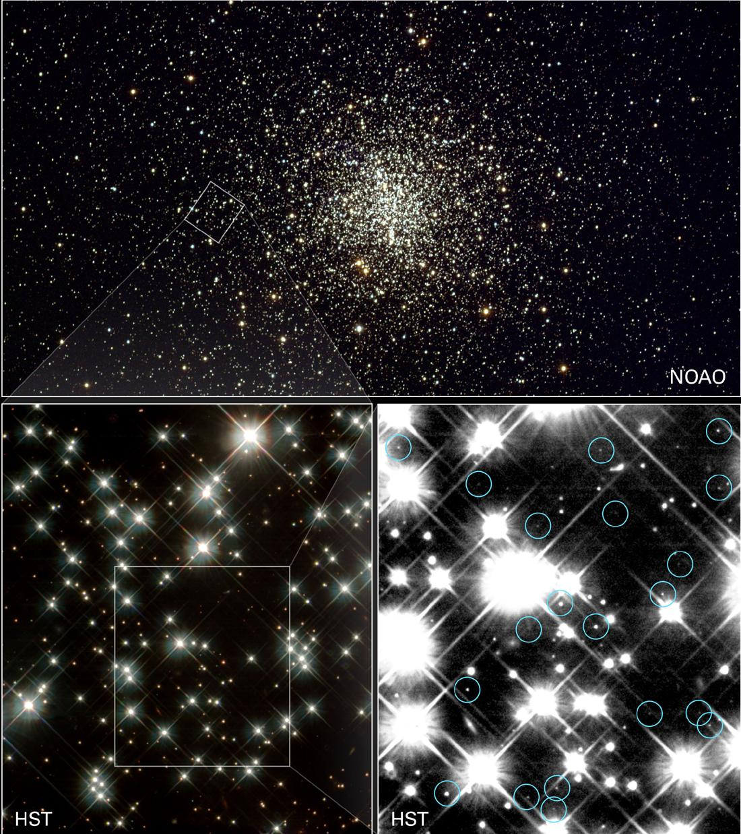
Cluster M4
Circled objects are white dwarfs
Images:
upper: Kitt Peak
Lower: HST

