Slide 1
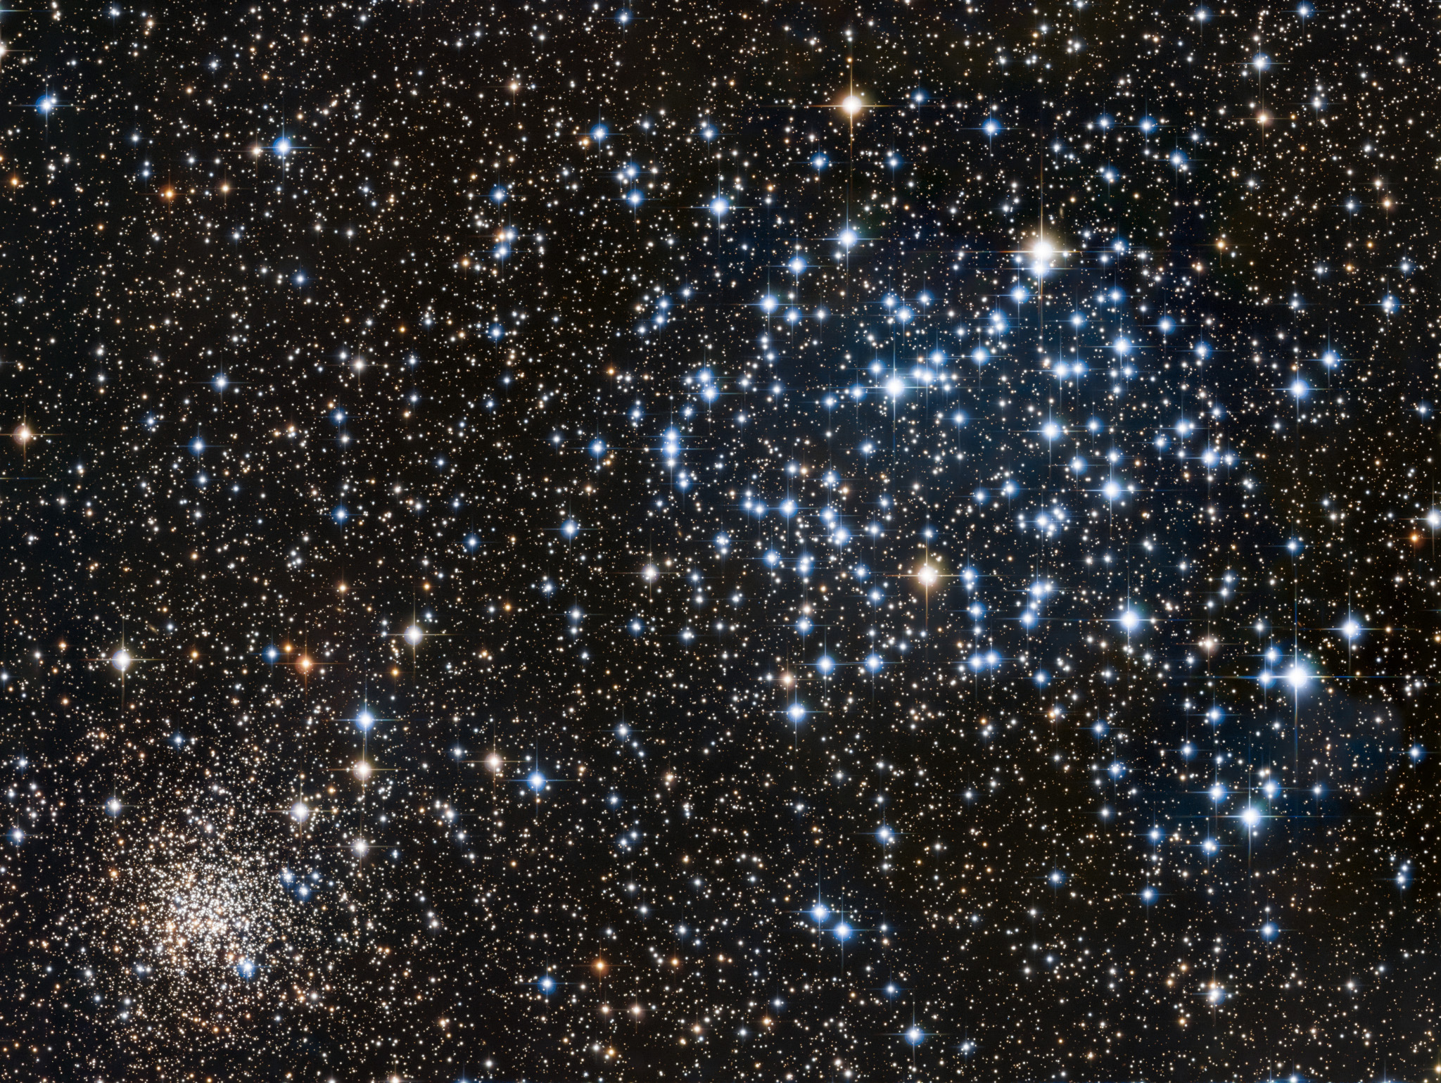
Types of Stars
distinctions and commonalities
Image: Evan Tsasi, LATTE, via APOD

Slide 2
Learning about Stars
What features are critical? What can we learn? Are there categories?

Slide 3
Temperature
Stars are close to black body emitters
Spectrum depends on temperature

Slide 4
Color Temperature
Measure starlight through different color filters
conventionally blue and yellow
Color index is the difference in relative intensity
Plot B–V directly or match to B–V of theoretical black body

Slide 5
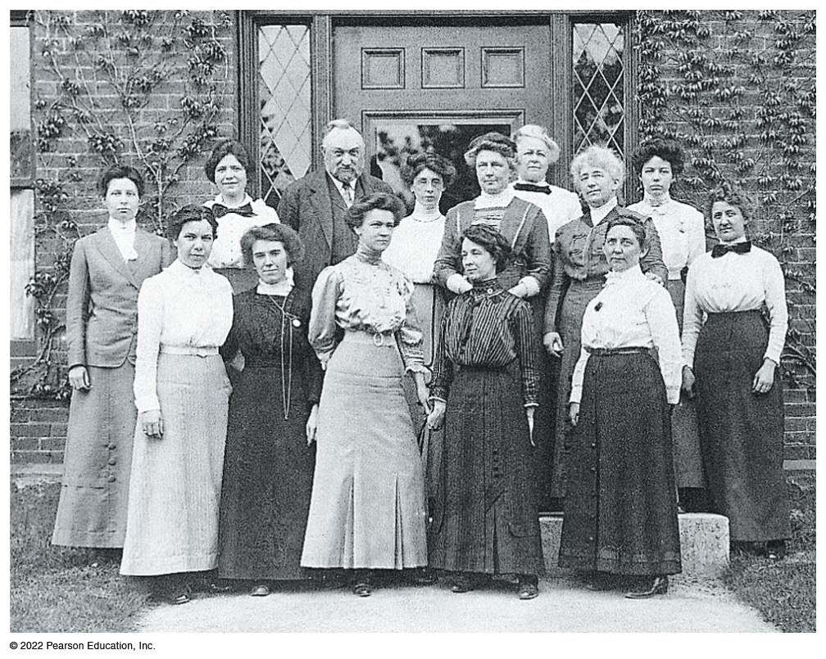
Spectral Class
“Computers” at Harvard College Observatory continued the Henry Draper catalogue of stars to m = 9
Bennett Fig. 12.5

Slide 6
Spectral Class
Williamina Fleming classified stars by the strength of their Balmer absorption lines
classes A–P in descending intensity
Annie Jump Cannon found the correct order was OBAFGKM
Cecelia Payne-Gaposchkin discovered that classes correlate with temperature
descending

Slide 7
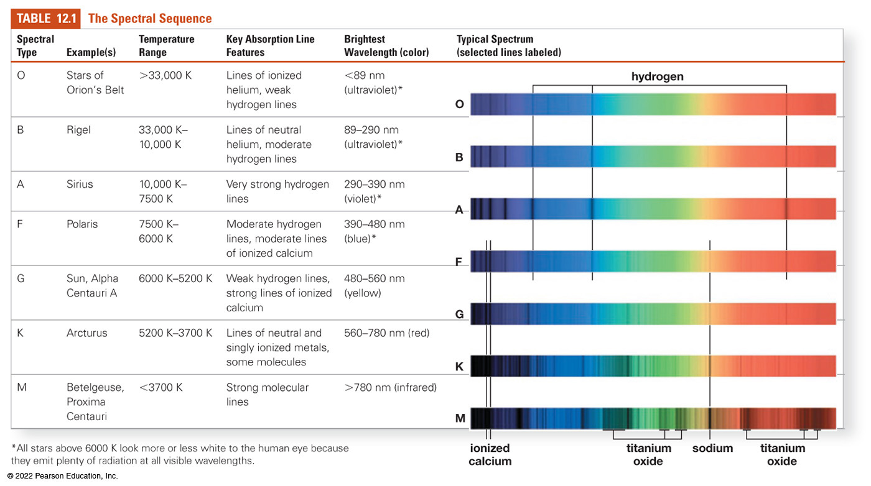
Spectral Classes

Slide 8
Subclasses
Large temperature variations between classes
Divided further into subclasses 0–9
0 is hottest, 9 is coolest
So an A9 is close in temperature to a F0
The Sun is a G2 star

Slide 9
Temperature and Luminosity
Separate of correlated?

Slide 10
Hertzsprung-Russell Diagram
Plot absolute luminosity (M) vs temperature
Bright
Luminosity
Dim
Hot
Cool
Temperature

Slide 11
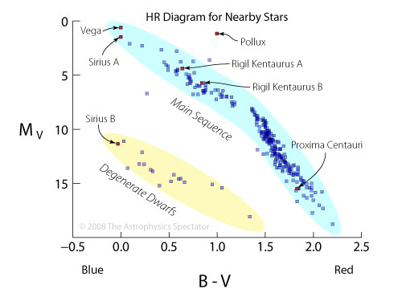
Stars within 10 pc
Image: The Astrophysics Spectator

Slide 12
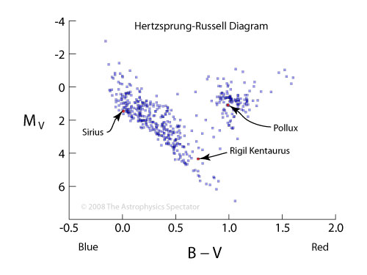
Visible Stars within 50 pc
Image: The Astrophysics Spectator

Slide 13
H-R Groupings
Most stars are main sequence
top left–bottom right diagonal
Some are bright giants and supergiants
large for their temperature
Some are very hot and dim “white dwarfs”
must be very small

Slide 14
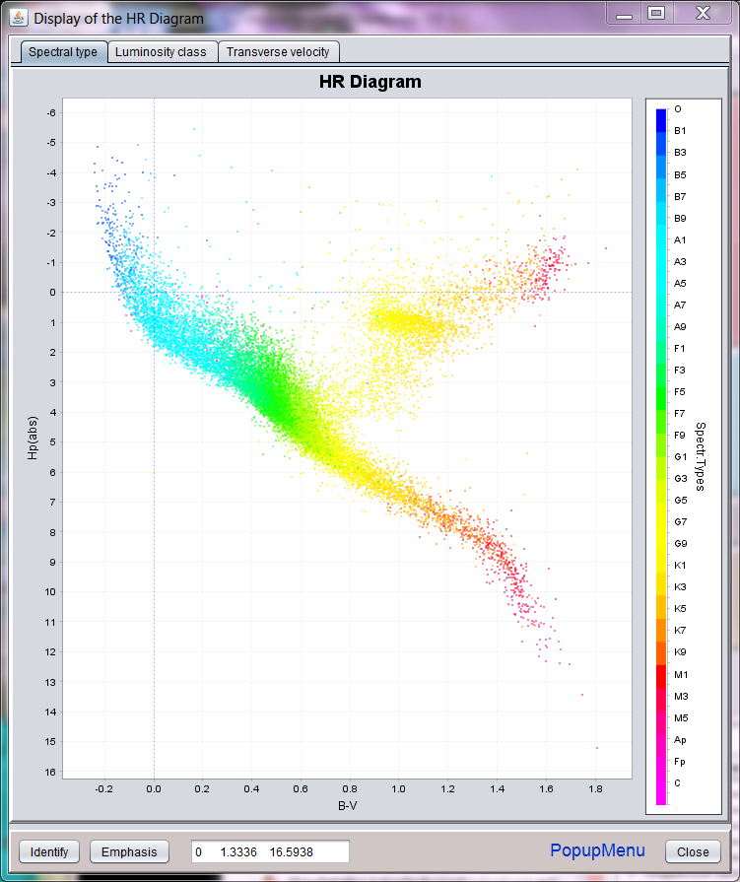
More stars
Image: HipparcosInteractive

Slide 15
Luminosity Classes
Some stars are much brighter than others at the same temperature
they must have much more surface area
A larger star will have a less dense atmosphere
Can measure pressure broadening of spectra
Sharper spectra from larger stars

Slide 16
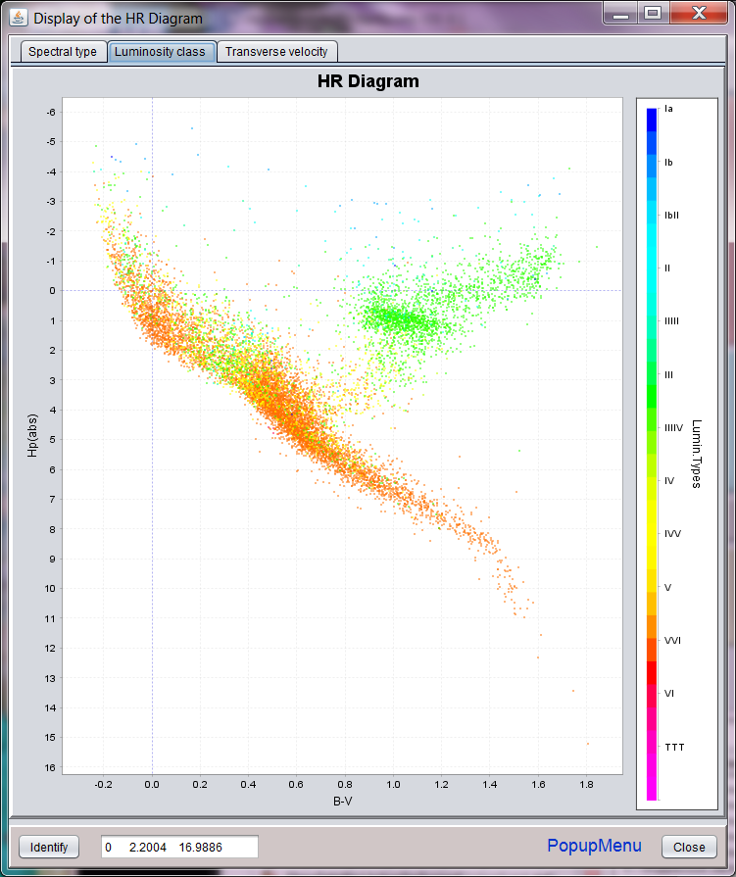
Coded by Luminosity Class
Image: HipparcosInteractive

Slide 17
Luminosity Classes
Classes I–V
Sun is a G2V star

Slide 18
Distance from Spectrum
If we know a star’s spectral class and luminosity class, we can estimate its absolute magnitude
(Approximately)
We can find its distance from its apparent magnitude
(Approximately)
This is called “spectroscopic parallax”

