Slide 1
The Stars
How big and bright?
§12.1

Slide 2
Brightness
The more light a star emits, the brighter it appears.
The more distant a star is, the dimmer it appears.

Slide 3
Quantify Brightness
Energy per time per incident area
Decreases with the square of distance
incident area is proportional to the square of distance
Comins, Fig 12.3

Slide 4
Motivation
We want to know
How intrinsically bright a star is
How large a star is
Mass would be nice to know, too
How distant a star is
These are difficult to find!

Slide 5
Black body formula
A star’s color tells its temperature
Temperature tells its luminosity per area
If we know its temperature and total luminosity, we can calculate its surface area
Then we know its size

Slide 6
Distance
How distant is a star?
We can accurately measure positions on the celestial sphere
two angles, no distance
How can we measure distances?
direct comparison
travel time
triangulation

Slide 7
Parallax
Comins, Fig. 12.1
Nearby star
Even closer star
The smaller the parallax angle, the more distant the object.

Slide 8
Annual Parallax
If θ = 1”, d = 206265 AU
206265 AU = 1 parsec
Distance in parsecs = 1/(parallax in arcseconds)
AU
θ
d

Slide 9
Distances by Parallax
An arcsecond is a very small angle
A parsec is a very long distance
1 parsec = 3.26 light·years
No stars are within 1 parsec of the Sun
closest is 1.3 pc
Very best measurements go out to 10 kpc

Slide 10
Brightness
The magnitude scale

Slide 11
Qualitative scale
In 129 B.C., Hipparchus catalogued stars by brightness
brightest were first magnitude
second, third, etc. progressively dimmer
Naked-eye visible stars range about a factor of 100 in visual brightness

Slide 12
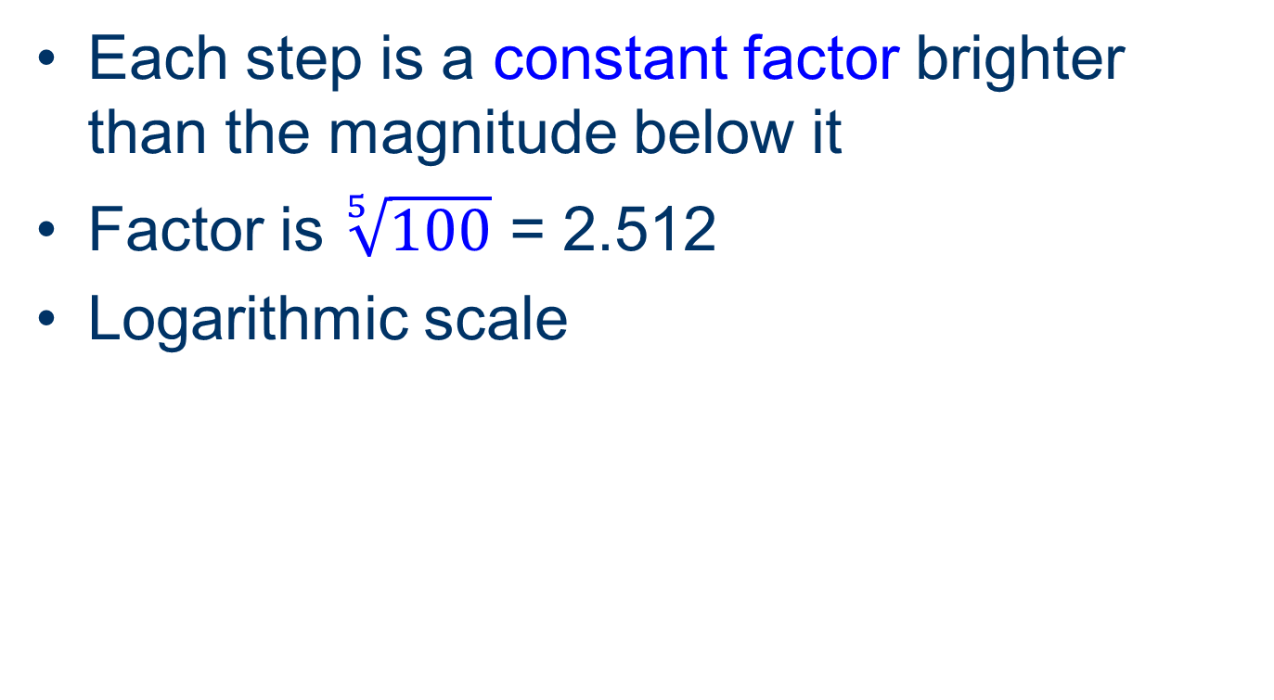
Quantitative scale
Each step is a constant factor brighter than the magnitude below it
Factor is $\sqrt[5]{100}$ = 2.512
Logarithmic scale

Slide 13
Logarithmic scales
decibels
even-tempered scale
pH
stellar magnitudes

Slide 14
Apparent Magnitudes
Sun –26.74
Sirius –1.46
Vega +0.03
Polaris +1.97
Betelgeuse 0.6
Rigil Kentaurus –0.27
Deneb 1.25
Arcturus –0.04

Slide 15
Absolute magnitude
How bright a star would appear from a distance of 10 pc
Can calculate from apparent magnitude and distance
M = m – 5 log₁₀(d/10 pc)
M = absolute magnitude
m = apparent magnitude
d = distance

Slide 16
Absolute Magnitudes
Sun +4.83
Sirius +1.43
Vega +0.582
Polaris –3.64
Betelgeuse –6
Rigil Kentaurus +4.34
Deneb –8.73
Arcturus +0.2

Slide 17
Stellar Masses

Slide 18
Stellar Mass
Physics knows two phenomena involving mass
inertia
gravity
We can’t push a star to see how it reacts
But we can watch it interact with other bodies

Slide 19
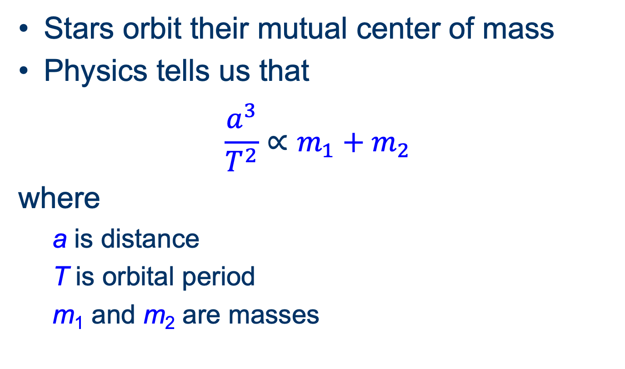
Binary stars
Stars orbit their mutual center of mass
Physics tells us that
$$\frac{a^{3}}{T^{2}}∝m_{1}+m_{2}$$
where
a is distance
T is orbital period
m₁ and m₂ are masses

Slide 20
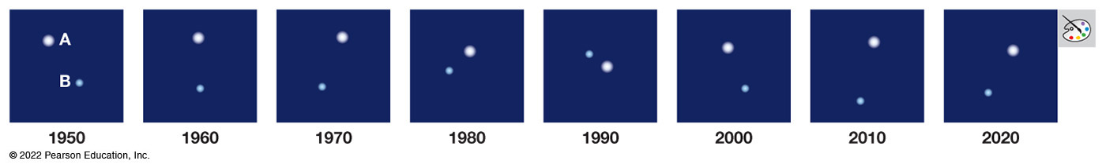
Determining Mass
Orbital parameters of binary stars
semi-major axis
Often practically from period and speed (Doppler)
period
Sirius A and B
Bennett, Fig. 12.6

Slide 21
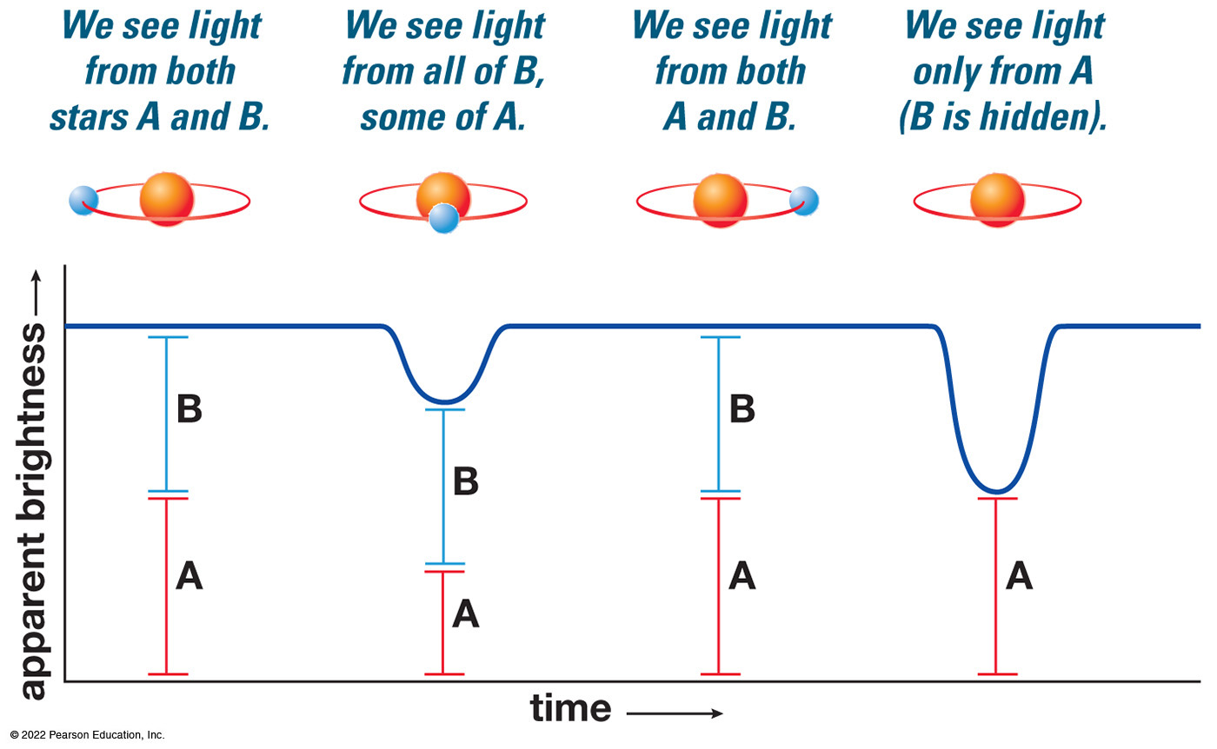
Spectroscopic Binaries
If the binaries eclipse each other:
Can detect orbital periods and approach and recessional velocities by Doppler shift
Can learn relative sizes
Bennett, Fig. 12.8

Slide 22
Stellar Masses
Range 0.08–150 M⊕
Relate to brightness and temperature

