Slide 1
Inside the Sun
The source of it all
§11.8–11.11

Slide 2
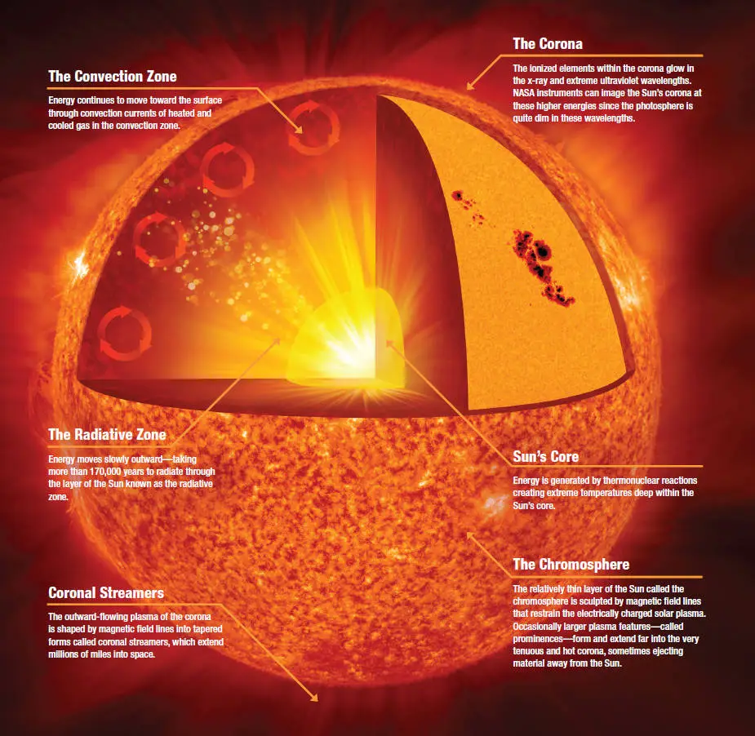
Image: NASA/Jenny Mottar

Slide 3
Why does the Sun shine?
Gravitational collapse causes temperature increase
  Collapse converts gravitational potential energy to kinetic energy
  Temperature is proportional to average molecular kinetic energy
  Hot things glow

Slide 4
Hydrostatic equilibrium
Pressure = weight per area
Pressure increases with density and temperature
Comins, Fig. 11.22

Slide 5
Can it last?
Release of radiant energy lowers temperature
Further collapse raises pressure and temperature
Eventually shrinks and snuffs out

Slide 6
Why does it still shine?
An energy source maintains its size and luminosity

Slide 7
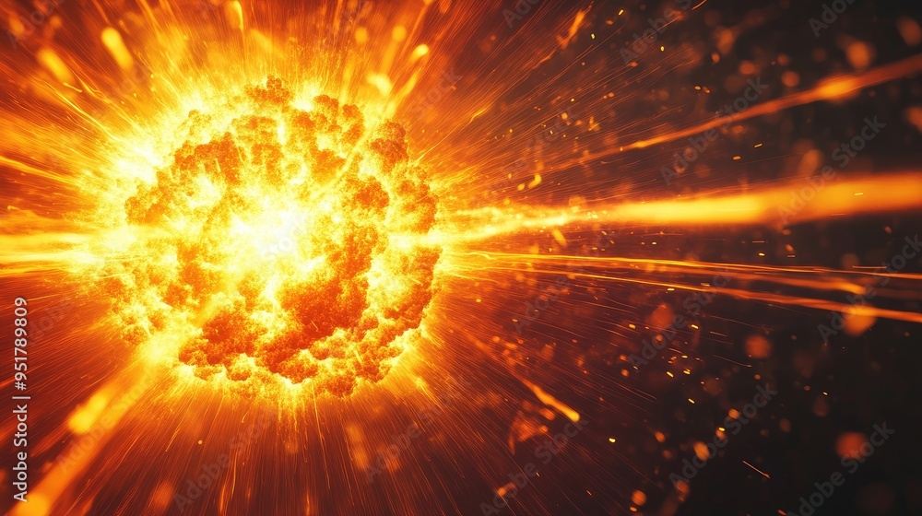
Nuclear Fusion
Image: Adobe Stock/ Generated with AI

Slide 8
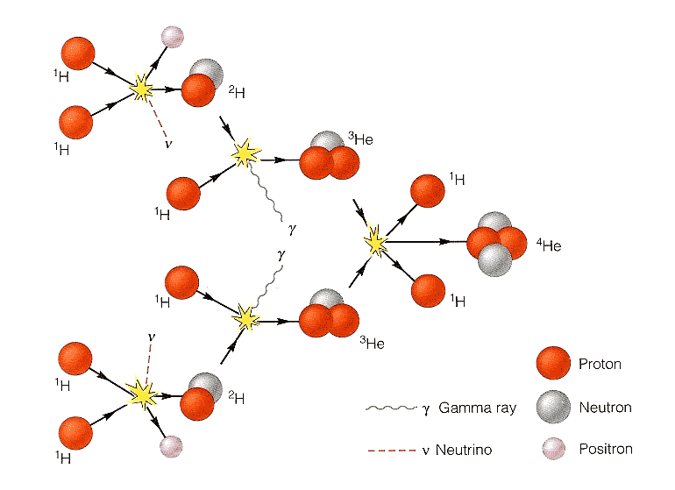
Fusion in the Sun
Source: Seeds, Horizons: Exploring the Universe
Net reaction: 4 p⁺ → ⁴He + 2 e⁺ + 2 ν + 2 γ

Slide 9
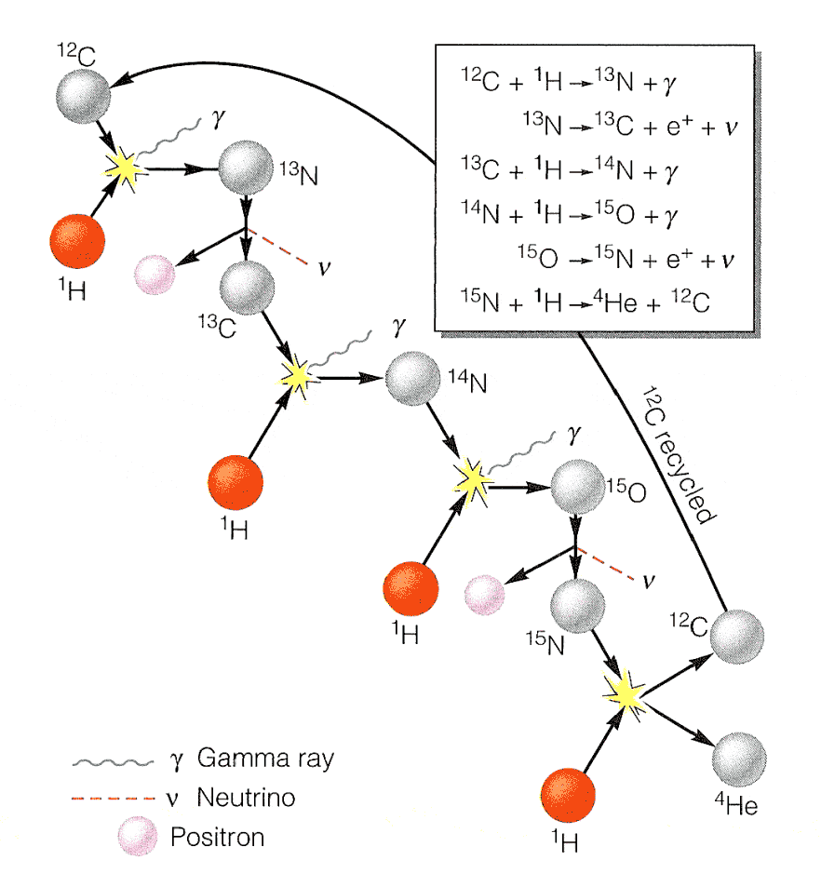
Fusion in Hotter Stars
Source: Seeds, Horizons: Exploring the Universe
Net reaction: 4 p⁺ → ⁴He + 2 e⁺ + 2 ν + 3 γ

Slide 10
Solar Model
Temperature, energy production, density from center to surface
Comins, Fig. 11.23b

Slide 11
The Solar Neutrino Problem
a mystery of nuclear physics

Slide 12
Solar Neutrino Problem
We know the Sun’s power output
We know how much energy is released in
4p⁺ → ⁴He + 2e⁺ + 2ν +2γ
We expect two neutrinos (2ν)
We only detected about 1/3 of the expected yield
Where are all the neutrinos?

Slide 13
Possibilities
We’re assuming the wrong probability of detecting neutrinos
We misunderstand some aspect of solar structure
The Sun only produces 1/3 as many neutrinos as expected
Neutrinos are oscillating

Slide 14
Neutrino “Oscillation”
There are three “generations” of fundamental particles
  lepton, neutrino, two quarks
Everything we see is 1st gen
Higher generations are more massive
Swiftly decay to 1st gen + energy

Slide 15
What are neutrinos?
Intrinsically uncharged
  don’t interact with light or electric fields
Participate in some nuclear reactions
  electron capture, beta decay
Seldom interact with normal matter
  Solar neutrino flux: 10¹¹/cm/s
Mass unknown
  very light, maybe zero

Slide 16
Massless particles
According to Special Relativity:
Travel at the speed of light
Frozen in time
  time stops as v →c
Neutrinos seem to travel at light speed

Slide 17
Particle generations
1st generation
  electron, e neutrino, up, down
2nd generation
  muon, μ neutrino, charm, strange
3rd generation
  tau, τ neutrino, top, bottom

Slide 18
Neutrino oscillation
Could neutrinos cycle between generations?
If they do, they must have time to do it
If they have time, they must be slower than c
If they are slower than c, they must have mass

Slide 19
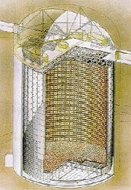
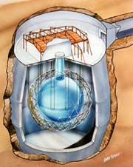
Oscillation verified
Solar Neutrino Observatory (SNO) in Sudbury, Ontario
Super-Kamiokande in Hida, Japan
© Garth Tietien 1991
© Kamioka Observatory

Slide 20
Conclusion
The Sun makes neutrinos according to expectation
The neutrinos subsequently behave unexpectedly

