Slide 1
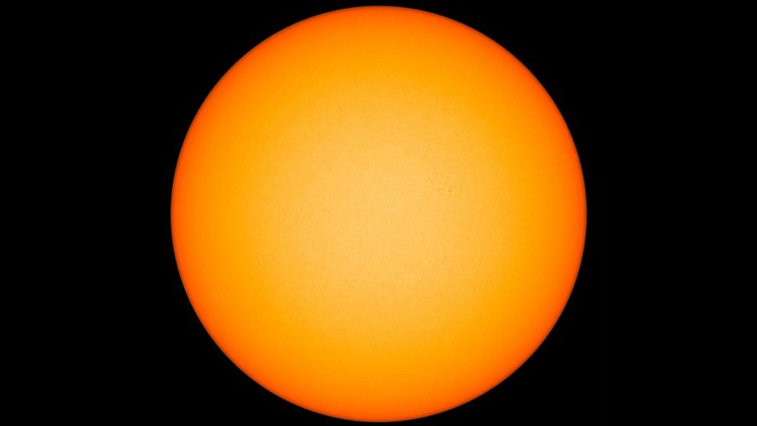
The Sun
in the eye of the beholder
§11.1–11.7
Image: NASA/SDO

Slide 2
Sun
Mass 1.988×10³⁰ kg
3.33×10⁵ m_{E}
99.86% of Solar system
Diameter 1.39×10⁶ km
oblateness 5×10^{–5}
Density 1408 kg/m³
Obliquity 7.25°
Composition 90.965% H, 8.889% He

Slide 3
Sun’s Rotation
Rotational period
25 days at equator
34 days at poles
Rotation rate = (14.37 – 2.33 sin² L – 1.56 sin⁴ L) deg/day

Slide 4
Photosphere
The surface we see
Pressure 125 mb–0.868 mb
Temperature 6600 K (base)–4400 K (top)
Thickness 500 km

Slide 5
Coarse Features
Limb darkening
Sunspots (variable)

Slide 6
Fine Surface Features
Granules
Bright centers, darker edges
~1000 km diameter
Rising core, sinking edges
Lifetime ~20 min
Interpreted as convection cells

Slide 7
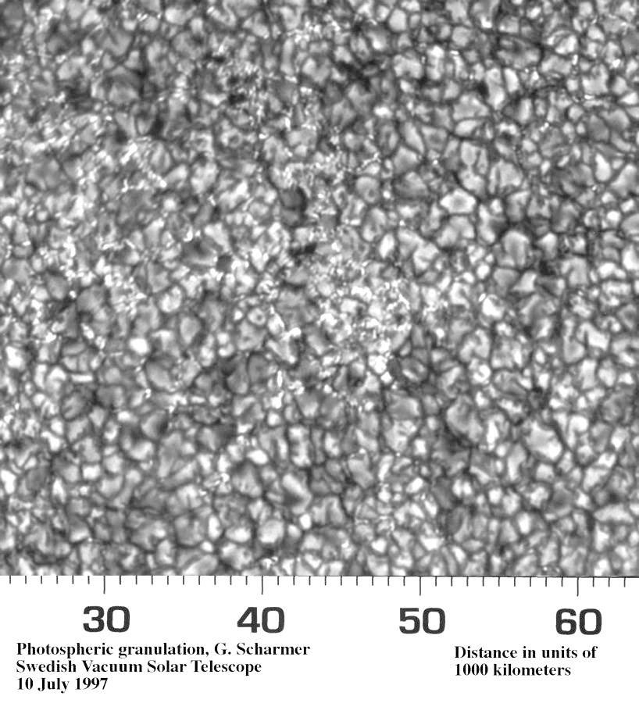
Granules
Image: Swedish Vacuum Solar Telescope

Slide 8
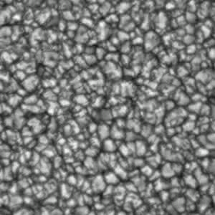
Granules

Slide 9
Fine Features
Supergranules
30×30 granules
3×10⁴ km diameter
lifetime ~5 days

Slide 10
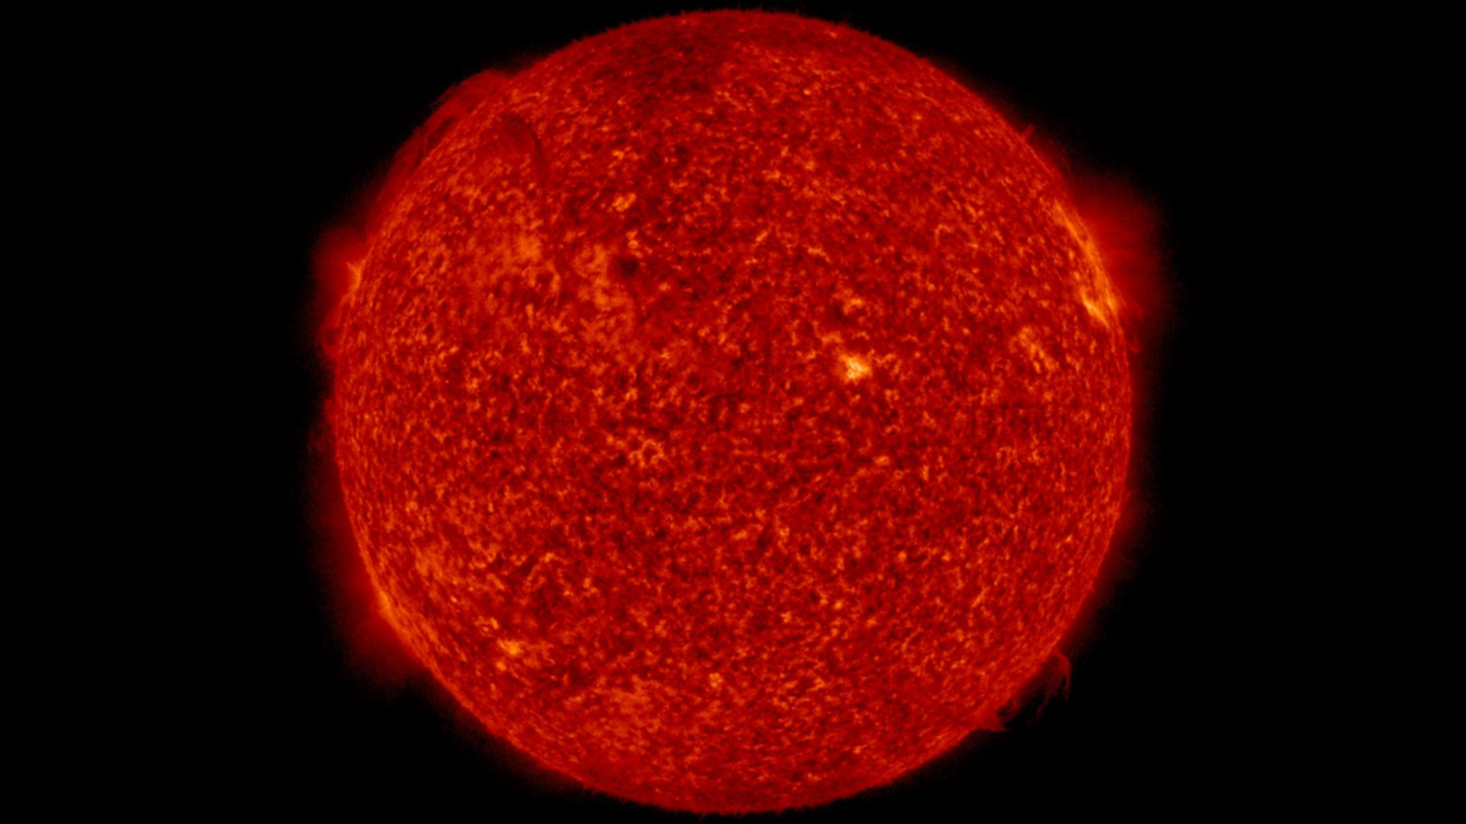
Chromosphere
Image: NASA/SDO

Slide 11
Chromosphere
Above photosphere
2000 km thick
4,000 K at base, 10,000 K at top
Brighter at Hα than photosphere
Hα is red 656 nm line in H Balmer series
Imaged/observed in Hα

Slide 12
Fine Features
Spicules
spikes fencing supergranules
fast-rising, short-lived spikes
magnetic component
NASA video
Image: JAXA/NASA, Comins Fig. 11.4

Slide 13
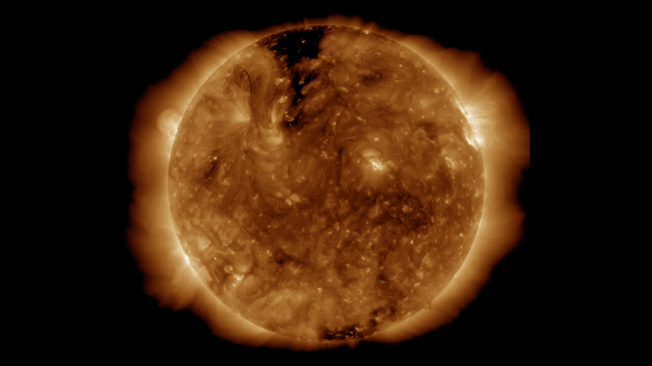
Corona
Image: NASA/SDO

Slide 14
Corona
Very low density, 10^{–10} sea level atm
Temperature several million K
emits UV and X radiation as well as visible
About as bright as full moon
But visible on Earth only during total eclipse
Studied from satellite
Temperature from magnetic heating

Slide 15
Solar Wind
Electrons, H, He ions
Propelled by magnetic field
~3.9×10⁵ m/s = 0.0013 c
Density ~ 9/cm³ at 1 AU
Dominates Space out to ~115 AU
Interstellar medium (ISM) beyond
Boundary is heliopause

Slide 16
Solar Magnetic Field
Polar Field: 1 - 2 Gauss
Sunspots: 3000 Gauss
Prominences: 10 - 100 Gauss
Chromospheric plages: 200 Gauss
Bright chromospheric network: 25 Gauss
Ephemeral (unipolar) active regions: 20 Gauss

Slide 17
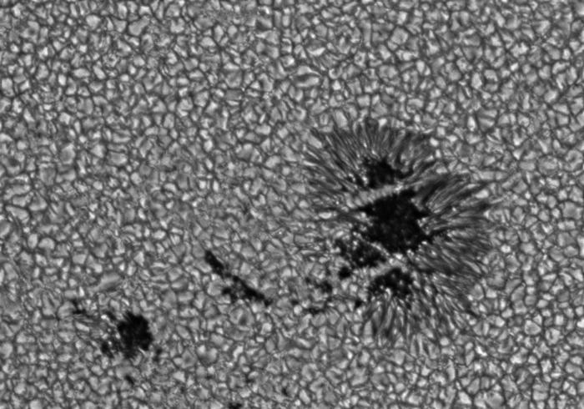
Sunspots
Image: NASA

Slide 18
Sunspots
Size ~Earth diameter
Duration hours – months
Reveal differential solar rotation
Dark interior: umbra
4300 K
Lighter edge: penumbra
5000 K

Slide 19
Sunspot Magnetism
Spots appear in N-S pairs
Dynamo: churning conductive ionic plasma beneath surface via differential rotation

Slide 20
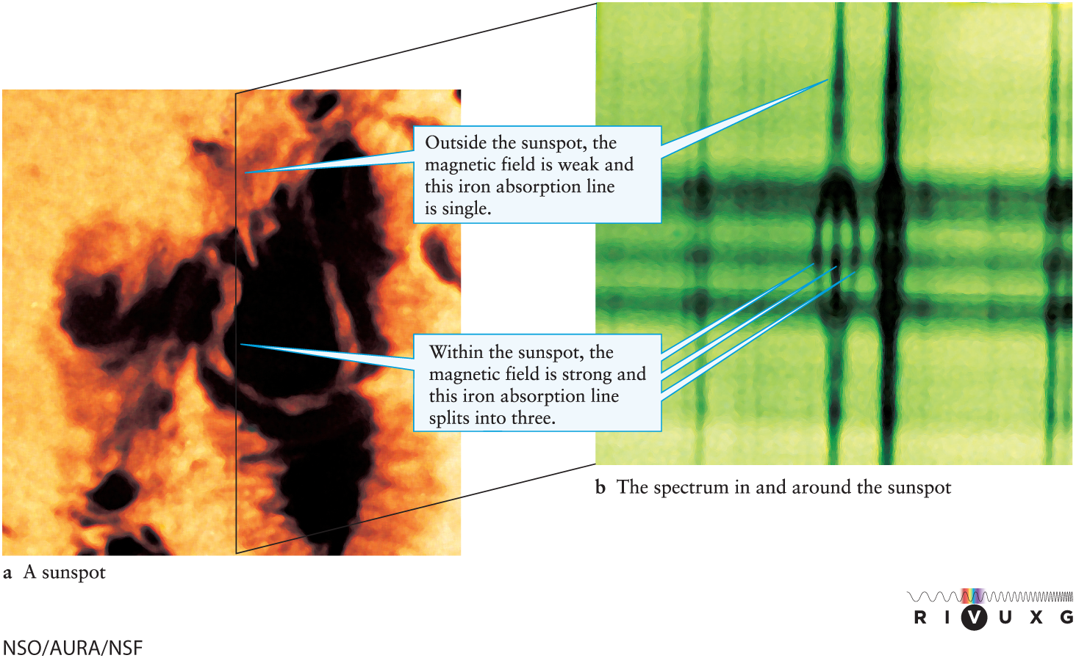
Magnetic Field

Slide 21
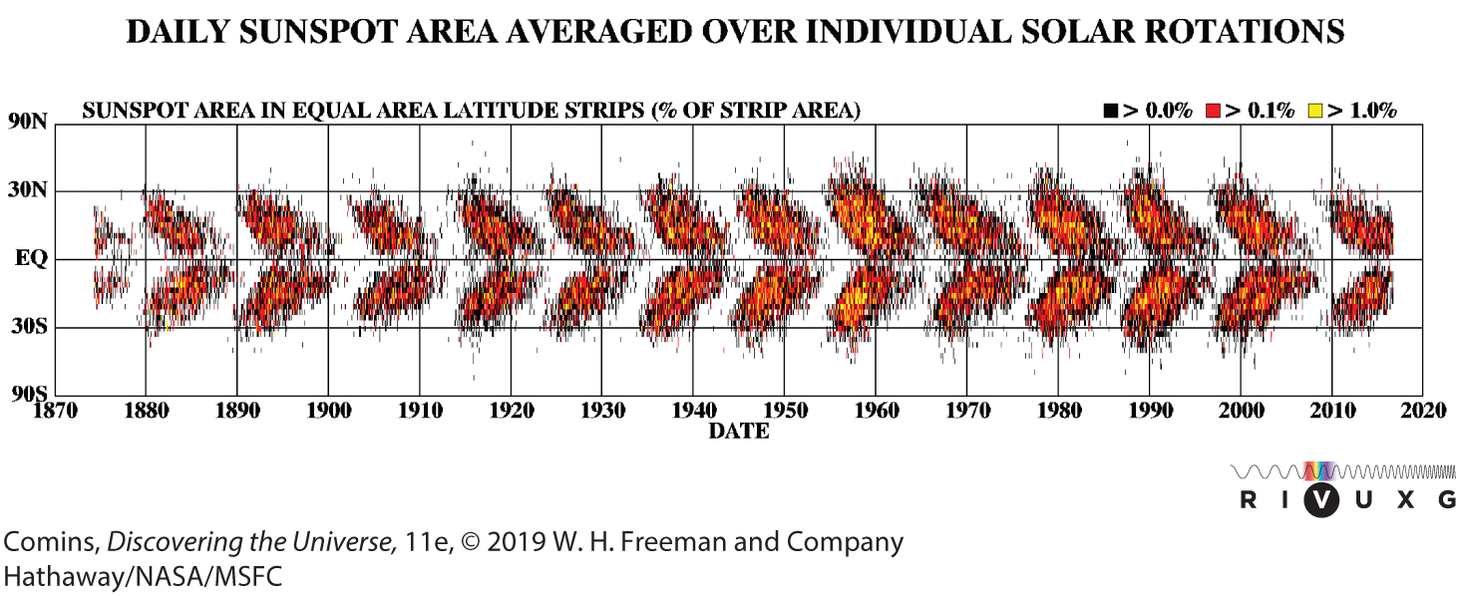
Solar Cycle
~11 year cycle of sunspot activity
Solar output higher during sunspot maxima

Slide 22
Solar Cycle
Polarity flips between cycles
full period is 22 y
Maunder minimum 1645–1715
little recorded sunspot activity
contemporaneous with Little Ice Age

Slide 23
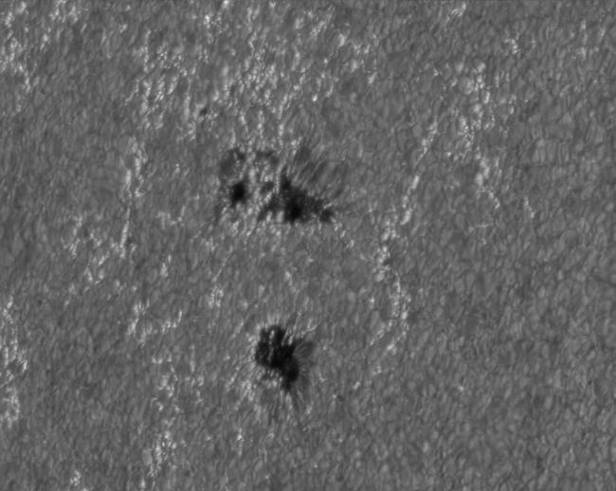
Faculae
Bright spots between granules
Correlate with sunspots
Image: NASA

Slide 24
Other Magnetic Effects
Photospheric observations (Hα) show
Plages
photospheric faculae
Filaments
narrow, sinuous, dark lines
Prominences
at the rim

Slide 25
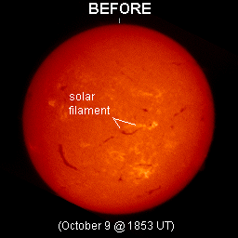
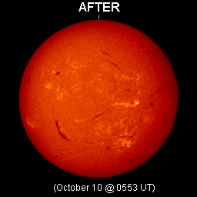
Filament collapse
Image: NOAA/SEC, Hα

Slide 26
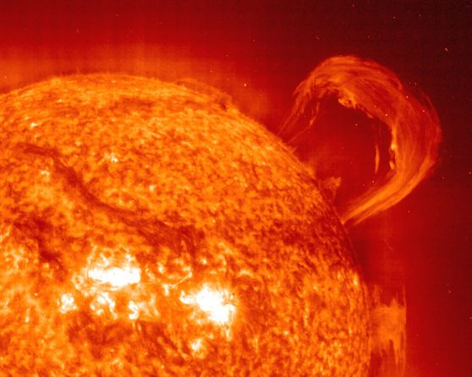
Prominence
Image: SOHO/EIT Consortium, ESA, NASA

Slide 27
Solar Flares
Ejection from interacting sunspots
Image: JAXA/NASA; Comins Fig. 11-18

Slide 28
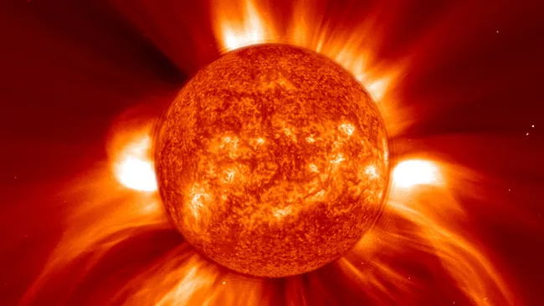
Coronal Mass Ejections (CME)
Image: ESA/NASA/SOHO

Slide 29
Coronal Mass Ejections
From corona
Attributed to magnetic field line recombination
Can damage satellites, injure astronauts

